Slide 1
Seattle IT 2020 Learning Conference
Teaching our kids to be Cyber Smart
*kids also invited to join this session

Slide 2

Topics
Meet the presenters for this session:
Seattle IT’s
Denise Mendoza Ginger Armbruster Sr. Compliance & Policy Manager Chief Privacy
Digital Security & Risk Officer
SPD
Jon Engstrom
Cyber Security Investigator for the Seattle Police Department
Internet Safety
Cyber Bullying
Your information & Privacy
Cyber Security & Risks
Safety Tips for Parents
Parent/Caregiver Resources
Q&A
Notes:
Denise
Introduce Ginger, Jon and Myself
Go through topics
If you have kids at home with you, they’re welcome to join us for this session.
If you have questions – chat
Moderators will monitor & collect questions for Q&A portion
This Photo by Unknown Author is licensed under CC BY-SA
This Photo by Unknown Author is licensed under CC BY-NC

Slide 3

Online Activities
Remote Learning
YouTube
Facebook
Twitter
TikTok
Roblox
Instagram
Snapchat
Xbox/Playstation
Twitch
Discord
All of these games, sites, apps
have messaging that can allow all users to interact.
Don’t accept Friend Requests
from people you don’t know.
Above all be cautious.
Notes:
Denise
Online use – time spent
Kids Remote Learning
Gaming
Social media
Interactions
This Photo by Unknown Author is licensed under CC BY-NC-ND

Slide 4

Cyberbullying – What is it?
CYBERSTALKING
Repeatedly posting or sending unwanted or intimidating messages and threats.
HARASSMENT
Posting or sending offensive, mean, rude and insulting messages. Trying to embarrass someone.
FRAPING/FAKE PROFILES
Someone creates a fake profile, hides their identity, and is impersonating someone and shares embarrassing or inappropriate content. Or logging into your account.
OUTING
Act of tricking someone into revealing personal or embarrassing information that they want to use to share publicly to humiliate someone.
GOSSIP
Posting or sending cruel gossip to damage someone reputation and relationships and spreading rumors.
Notes:
Denise
Bullying
electronic devices, such as cell phones, computers, and tablets
communication tools including social media sites, text messaging, chats, and websites.
The different types of bullying
This Photo by Unknown Author is licensed under CC BY-SA

Slide 5

Being bullied is never your fault.
BLOCK THEM – Lots of these games will allow you to
Block people from interacting with you.
REPORT IT – You don’t need to respond to mean messages. You can report it on the website or app.
SAVE THE MESSAGES – Take screenshots for evidence so you can show an adult that will help you.
TELL SOMEONE – You should talk to an adult, a grown up you trust like your parents or teachers. They can help you find ways to make the bullying stop.
Notes:
Making cyber bullying easier to talk about
Communicating that this is topic is something they can always come to you about.

Slide 6



Value your Privacy
Personal Information
What’s the big deal?
What type of personal
information should not
share & why?
Privacy matters. Knowing what personal information is being collected and how it is being used is important to making informed decisions online.
Privacy Settings
Take charge of the information
that others can see about you.
This Photo by Unknown Author is licensed under CC BY-SA-NC
Notes:
Ginger
Personal Information
Device/Application privacy settings
Dangers sharing public location
This Photo by Unknown Author is licensed under CC BY-SA
This Photo by Unknown Author is licensed under CC BY-NC-ND

Slide 7

False Information
Fake News
News stories or hoaxes created to deliberately misinform readers.
Just because you see it online, doesn’t mean it’s a fact.
Being able to identify fake news on social
media feed is crucial to being responsible and
informed.
Social media
Gamified challenges that supposedly target children and adolescents to commit acts of violent or self-harm.
How can you
spot fake news?
Notes:
Ginger

Slide 8


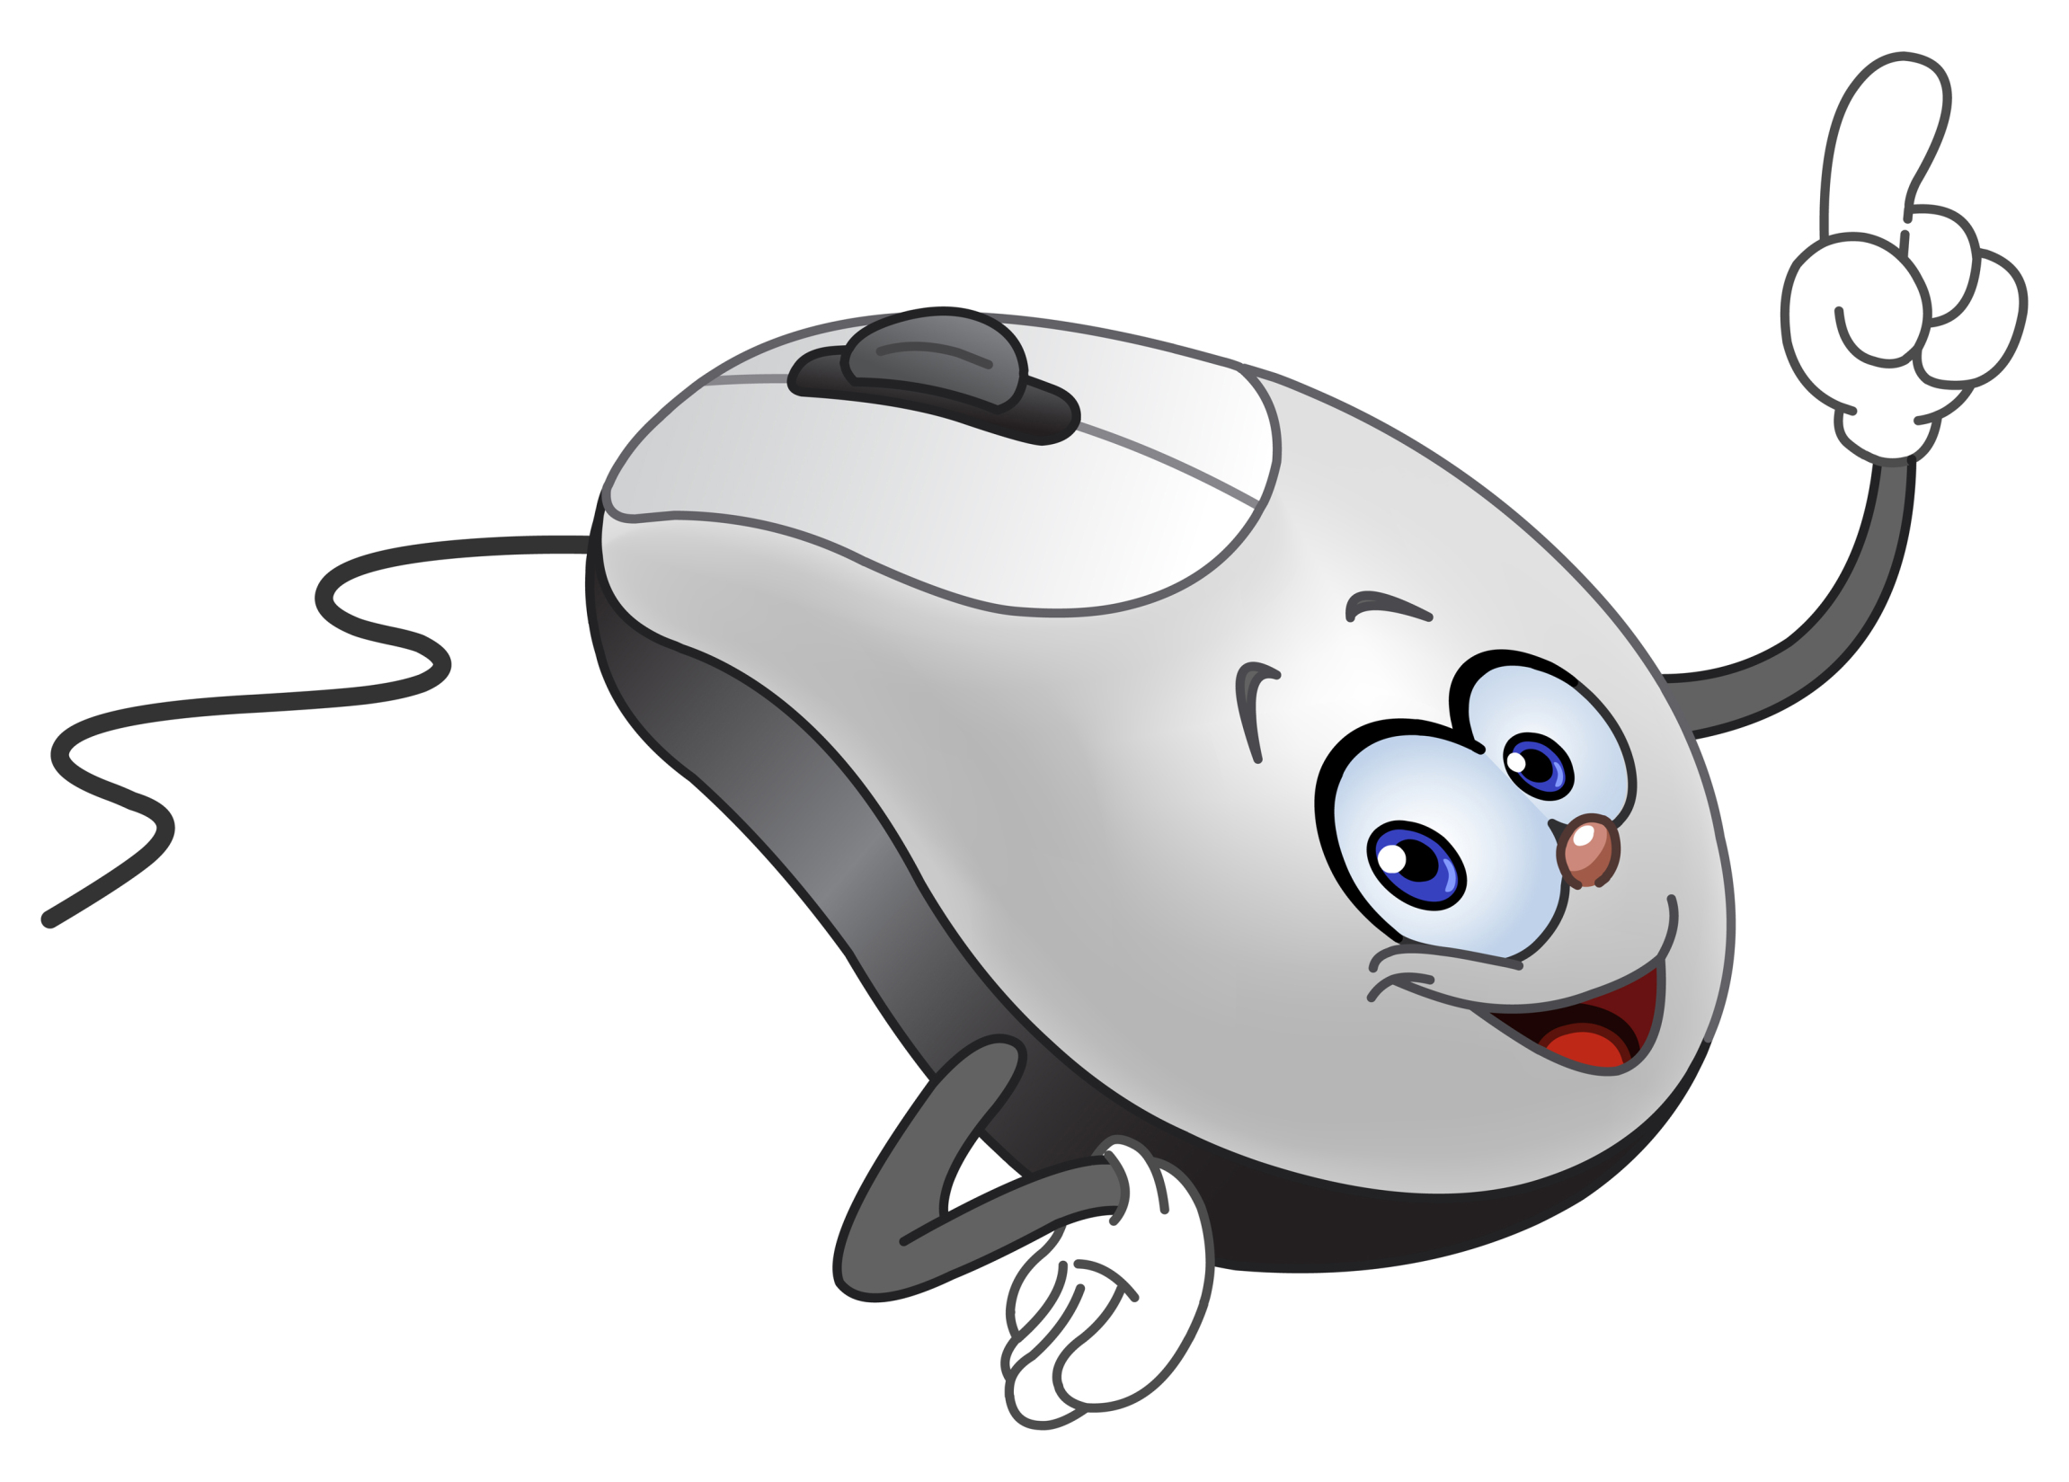
Cyber Security
Protect Your Circle
Trend in Cyber-Crimes
Basic Data Hygiene
Device & Account Settings
Passphrase Management
Expect Fraudulent Calls & Emails – Listen to Your Gut
Think Before You Click
Digital
Residence
Notes:
Jon
This Photo by Unknown Author is licensed under CC BY-SA-NC
This Photo by Unknown Author is licensed under CC BY-SA

Slide 9

Know Your Risks
Remote Learning
Best practices for online learning
tools such as Zoom & Google Classroom
Mitigations
How can you help everyone in your circle to significantly reduce their risk of a security/privacy catastrophe?
Trends
Overview of the most likely schemes and tactics to be used against you and yours.
Exposures
Typical exposures that could
lead victimization.
Notes:
Jon
This Photo by Unknown Author is licensed under CC BY-NC

Slide 10

Security Safety Tips in 10 Actionable Steps Effective Security Habits
Choose long, unique, passphrases
Change your passphrases regularly
Lock your session every time you go away from your computer
Clear your desk or working area
Regularly back up your sensitive data
6. Encrypt your confidential emails and files
7. Beware of social engineering
8. Beware of links in emails and texts
9. Periodically check for software updates
10. Report suspicious emails and incidents
Notes:
Jon
This Photo by Unknown Author is licensed under CC BY-SA-NC

Slide 11
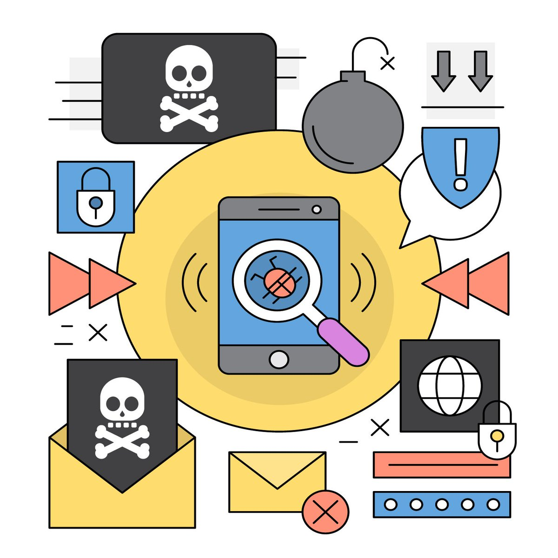
Parent or Care giver Resources
Sites for Children and Parents
https://staysafeonline.org/stay-safe-online/managing-your-privacy/tips-parents-raising-privacy-savvy-kids/
https://beinternetawesome.withgoogle.com/
https://www.cyberwise.org/online-security-hub
https://niccs.us-cert.gov/formal-education/integrating-cybersecurity-classroom
https://joincyberdiscovery.com/
https://www.nist.gov/itl/applied-cybersecurity/nice/resources/online-learning-content
http://www.cultureofcybersecurity.com/kids/kids-activities/
https://www.pbs.org/wgbh/nova/labs/lab/cyber/
Notes:
Jon & Ginger
Ginger
Fliers

Slide 12

Digital Security Resources
General Security Guides & Resources
https://snubsie.com/30-day-security-challenge
https://blog.doist.com/security-checklist-remote-workers/
https://inteltechniques.com/links.html
https://protonmail.com/blog/work-from-home-security-guide/
https://digitalguardian.com/blog/best-information-security-podcasts
Slides and Fliers below will be available on the Privacy Teams Site
Online Gaming Privacy
What LGBTQ communities should know about online safety
STOP . THINK . CONNECT Privacy Tips for Teens
Notes:
Jon & Ginger
Ginger
Fliers

Slide 13
Q & A
And REMEMBER!
THINK BEFORE YOU CLICK!
Denise Mendoza
Ginger Armbruster
Jon Engstrom
Thank you all and stay safe.
This Photo by Unknown Author is licensed under CC BY-NC
Notes:
Denise Ginger Jon

