Slide 1

Surveillance Technology Public Comment Meeting
Seattle Police Department

Slide 2
Welcome to Public Engagement Session: SPD Technologies

Slide 3
City of Seattle’s Definition of Surveillance
Surveillance is defined as technologies that "observe or analyze the movements, behavior, or actions of identifiable individuals in a manner that is reasonably likely to raise concerns about civil liberties, freedom of speech or association, racial equity or social justice."
Certain technologies, such as police body cameras and technologies for everyday office use, are excluded from the law.

Slide 4
Rundown of Events
SPD will present on technologies currently in use
Break into smaller conversational groups
Each group will feature a facilitator and a notetaker

Slide 5
How to Comment on Technologies
Comment card
Comment online at seattle.gov/privacy
Mail a comment to Surveillance & Privacy Program: Seattle IT, PO Box 94709, Seattle, WA 98124

Slide 6
Ground Rules
Be polite and allow others to have time to speak
Keep it civil and respectful

Slide 7
Automated License Plate Readers
Parking Enforcement and Patrol
Seattle Police Department

Slide 8
Seattle Police Department Mission
Prevent crime;
Enforce the law, and
Support quality public safety by delivering respectful, professional and dependable police services.

Slide 9
Automated License Plate Readers (ALPR)
Keep traffic flowing by enforcing parking laws;
Enforce Seattle’s Scofflaw Ordinance
Recover stolen vehicles;
Locate endangered individuals; and
Identify vehicles in criminal investigations.

Slide 10
SPD’s ALPR-Equipped Vehicles
19 ALPR -Equipped Vehicles
8 Parking Enforcement
  5 ALPR-equipped sedans (AutoVu)
  3 ALPR-equipped boot vehicles (Neology PIPS)
11 Patrol
  9 Precinct Vehicles (Neology PIPS)
  Major Crimes & Canine Unit vehicles (Neology PIPS)

Slide 11
How It Works
Vehicle-mounted cameras photograph license plates
Software
  Optical character recognition (OCR) interprets characters on plate photos
  Photos, computer-interpreted license plate characters, date, time, and GPS location loaded in database (“reads”)
  Captures no personally-identifying information

Slide 12
HotList
All 19 vehicles upload the HotList
  National stolen vehicle plate database
  Vehicles sought by SPD
    Criminal investigations
    Endangered individuals
    Warrants

Slide 13
“Hits”
  System checks “reads” against HotList
  Signals “hit” when image of plate from vehicle on HotList is captured
  Officer must verify “hit” is accurate before taking action.

Slide 14
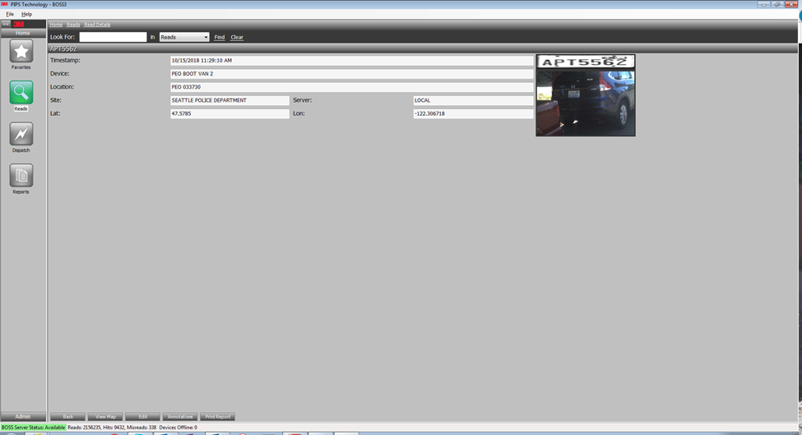
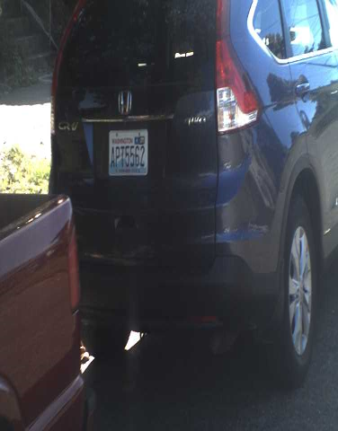
HotList “Hit”

Slide 15
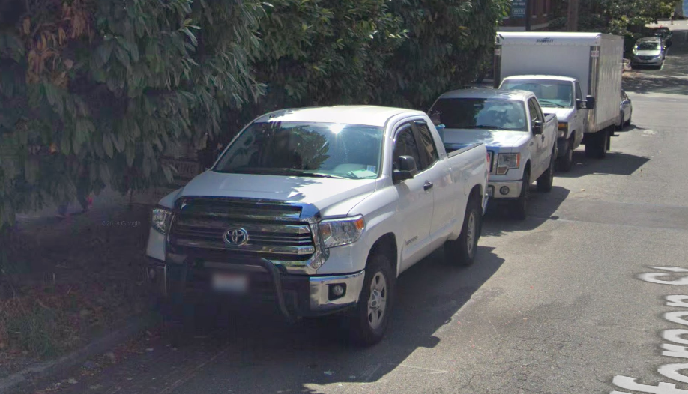
Google Street View

Slide 16
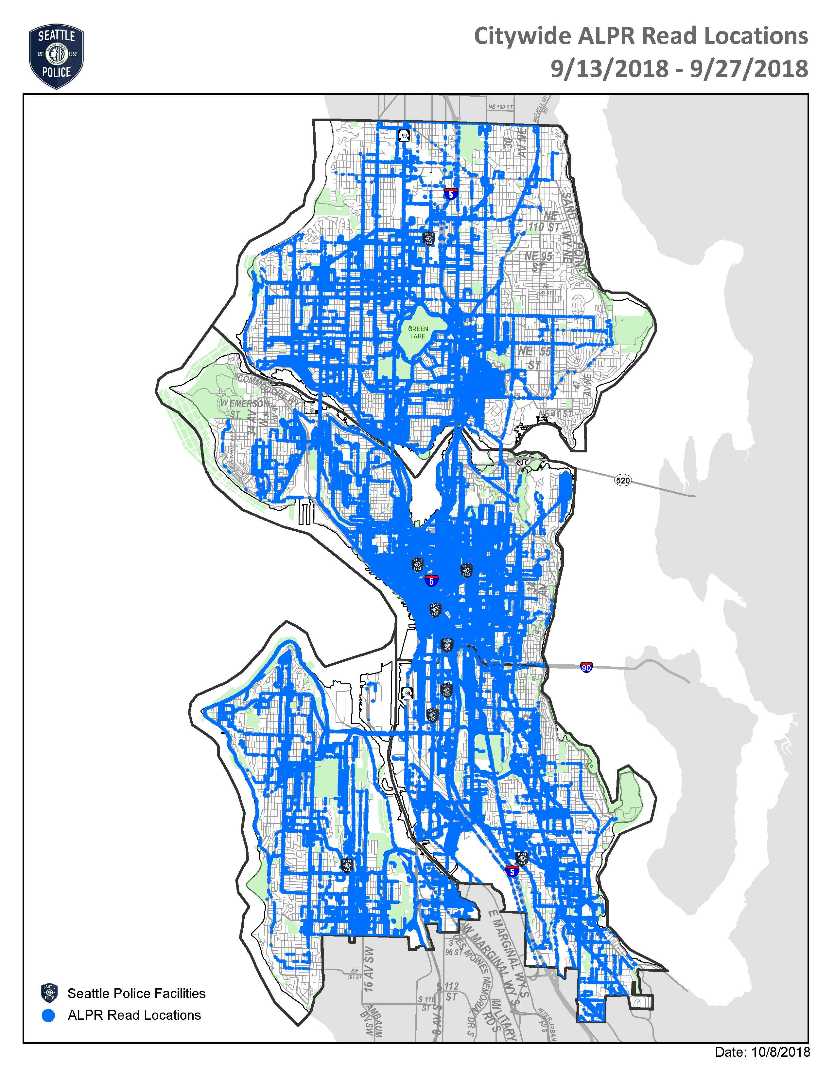

Slide 17
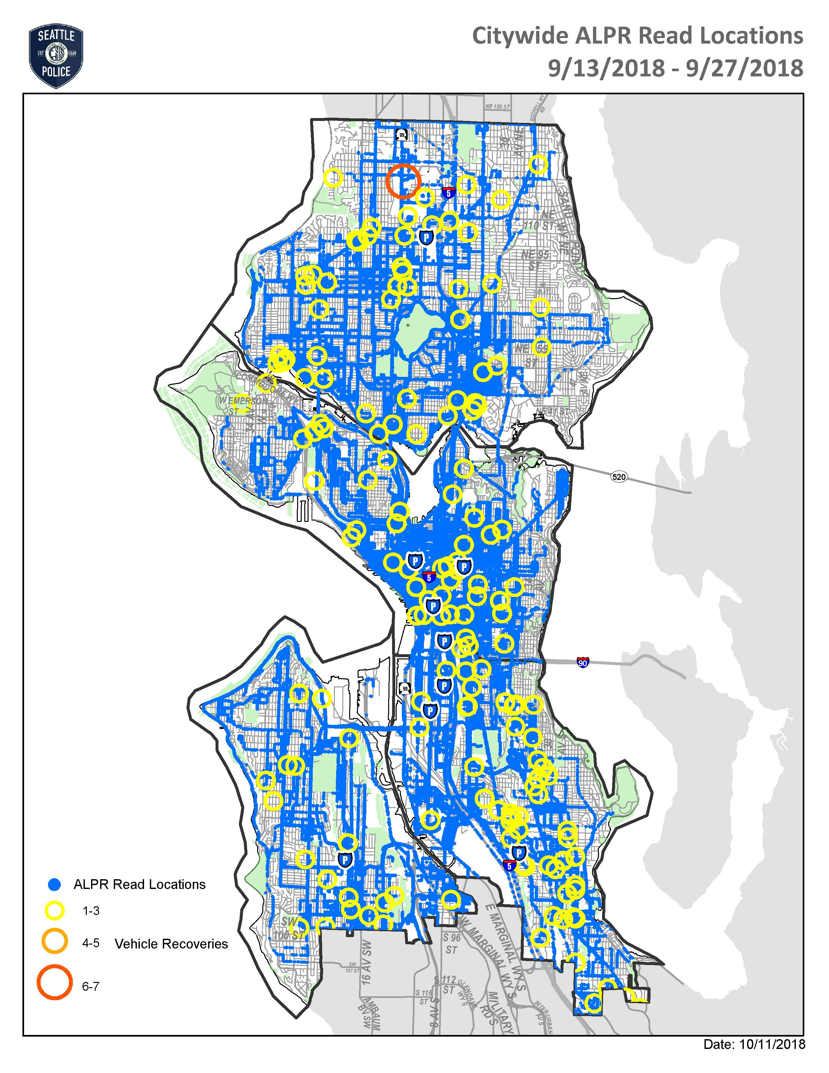

Slide 18
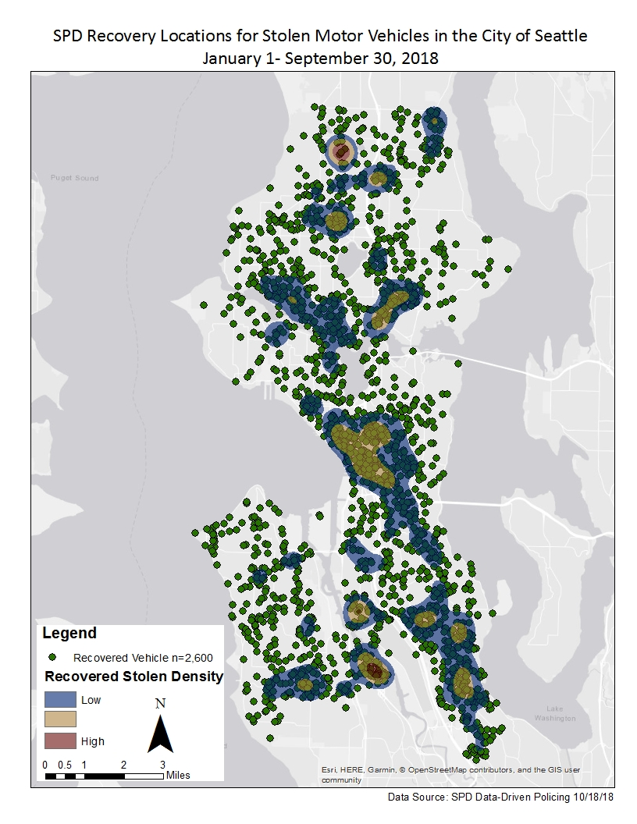

Slide 19
Parking Enforcement ALPR
  Time-Limited, No Pay Zones
  Digital Chalking and related license image (Autovu)
  Restricted Parking Zone (RPZ) Verifies plates against permit list

Slide 20
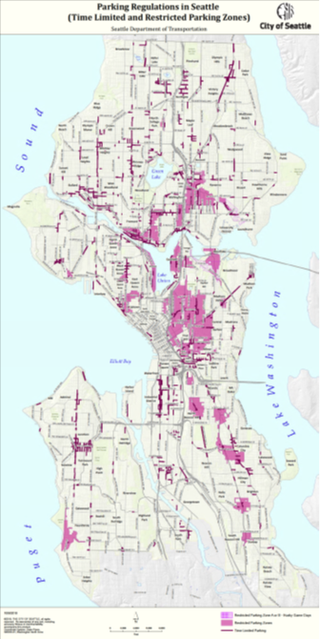

Slide 21
Parking Enforcement ALPR
  Scofflaw Enforcement (SMC 11.35)
  Boots vehicles with four or more overdue, unpaid parking tickets
  Scofflaw Mitigation Program
  Lived-in vehicles

Slide 22
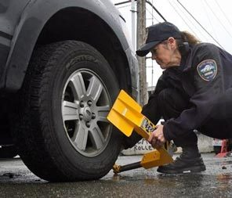

Slide 23
“Hits” Data Storage
  Verified “hits” are downloaded from system and retained with case file or in Municipal Court citation records

Slide 24
“Reads” Data Storage
  5 Parking Enforcement Sedans (Autovu)
  “Reads” data not retained or accessed for investigations

Slide 25
“Reads” Data Storage
  14 PIPS-Equipped Vehicles
    “Reads” data is stored in secure on-site SPD server
    Not pooled with other agencies’ ALPR data
    Automatically purged after 90 days

Slide 26
“Reads” Data Access & Use
  Accessed for criminal investigations
  SPD access only
  Authorized SPD users must enter incident number/reason for access
  Access audit trail by user, incident number/reason, date, time
  Data used in investigations is downloaded and retained in case file

Slide 27
Policies Governing Use
  ALPR (SPD Policy16.170) .
  Use of department-owned devices/software (SPD Policy 12.040)
  Access to criminal justice information and records (SPD policies 12.050 and 12.080)
  Use of department email and internet (SPD Policy 12.110)
  Use of cloud storage services (SPD policy 12.111)

Slide 28
Public Comment
Marc GarthGreen
Deputy Chief
Adrian Diaz
Assistant Chief – Collaborative Policing
Eric Sano
Captain – Traffic Unit
Kevin Grossman
Captain – South Precinct
Mary Perry
Director of Transparency & Privacy

Slide 29
Small Group Discussion
20 minute discussion: SPD Automated License Plate Readers (ALPR)

Slide 30
Small Group Discussion
20 minute discussion: SPD Parking Enforcement

Slide 31
What’s Next?
Upcoming public meetings through 11/5
Comments collected will be included in the SIR submitted to the Surveillance Advisory Working Group, and then City Council for full Council vote.

Slide 32
Ways to Comment
Public comment period for group 1 technologies is open through 11/5/2018
All comments collected will be included in the SIR submitted to the Surveillance Advisory Working Group, and then City Council for full Council vote.
Provide comments by:
  Seattle.gov/privacy
  Fill out a comment card
  Mail a comment to Surveillance & Privacy Program: Seattle IT, PO Box 94709, Seattle, WA 98124

