Slide 1
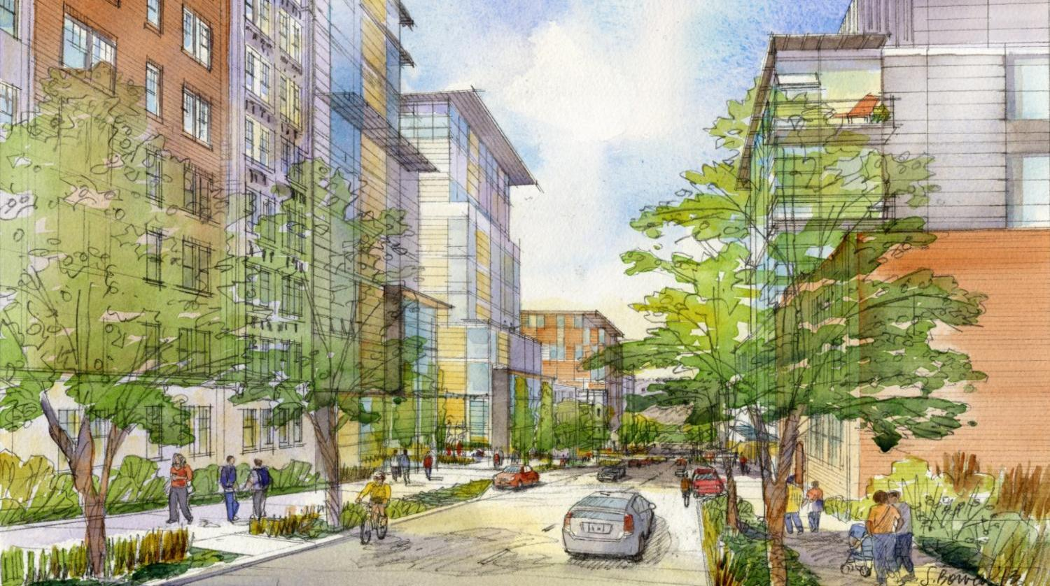



U District urban design
Seattle Dept. of Planning and Development
November 13, 2014

Slide 2
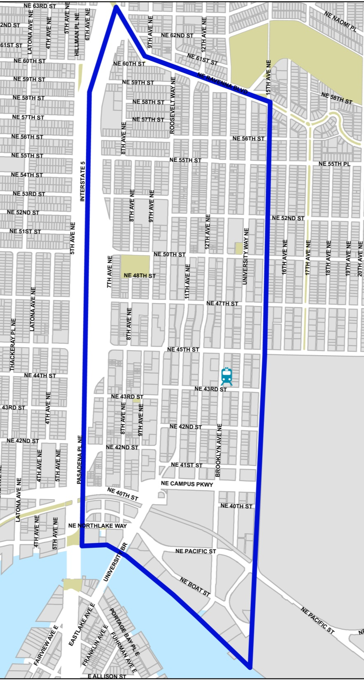
Why plan?
Major residential and job growth in this urban center
Light rail opening in 2021
How to maintain character and improve livability in the midst of growth?

Slide 3
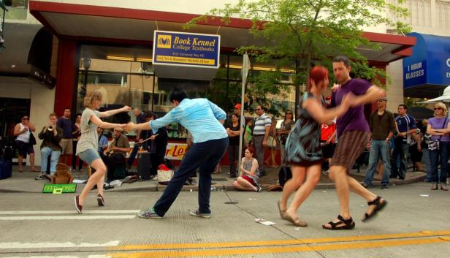
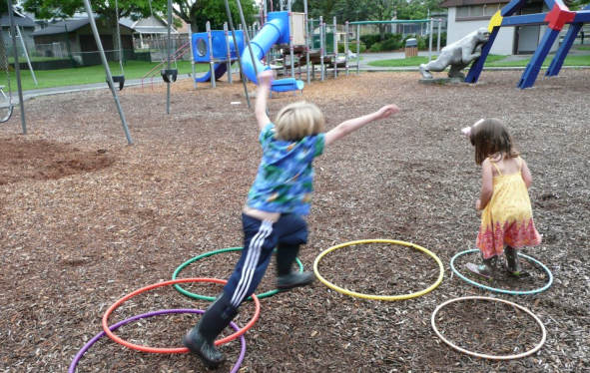
Overview
U District Partnership
New, broad-based organization
Large community events, coordination
Expanding Business Improvement Area
Urban Design Framework (DPD, 2013)
Streetscape designs (2014)
Environmental Impact Statement (2014)
Comp Plan amendments (2015)
Zoning (2015)
Design guidelines (2016?)
Park investments (Seattle Parks)
Ongoing acquisition, planning, improvements

Slide 4
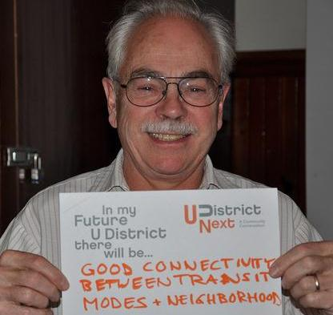
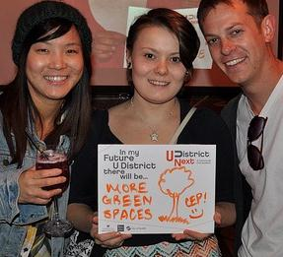
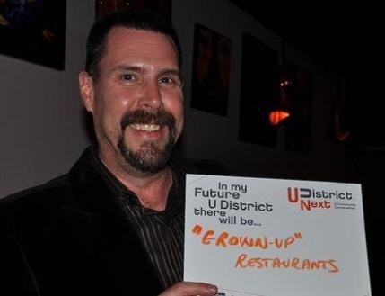
Community Participation
Urban Design Working Group
A year of meetings to develop initial recommendations.
Participants: residents, developers, businesses, UW, social services, City staff
Ongoing work re: streets, zoning, open space
Broader public input
Walking tours
“Community Conversations”
200+ meetings

Slide 5
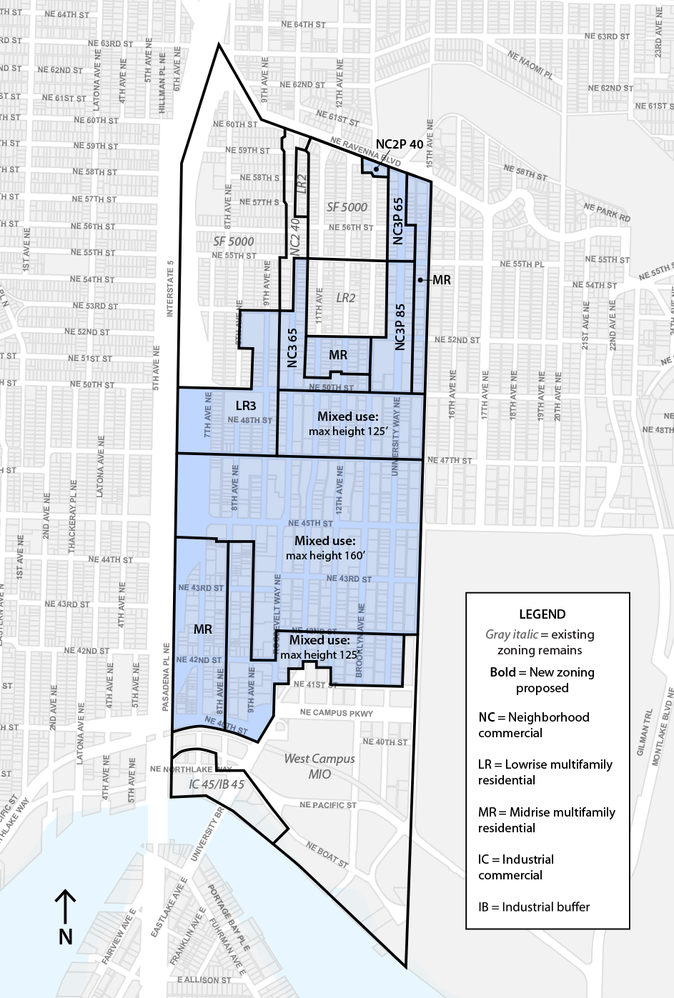
EIS Alternative 1
Lower high-rises in moderately dispersed pattern
More dispersed than Alt 2
More concentrated than Alt 3
Maximum heights 125 to 160 feet (on the Ave too)
Mid-rise development north of 50th
High-rise buildings closer together
Landscaped setbacks + widened sidewalks
Notes:
Key Features
More dispersed than Alt 2
More concentrated than Alt 3
Maximum heights 125 to 160 feet (on the Ave too)
Mid-rise development north of 50th
High-rise buildings closer together
Landscaped setbacks + widened sidewalks

Slide 6
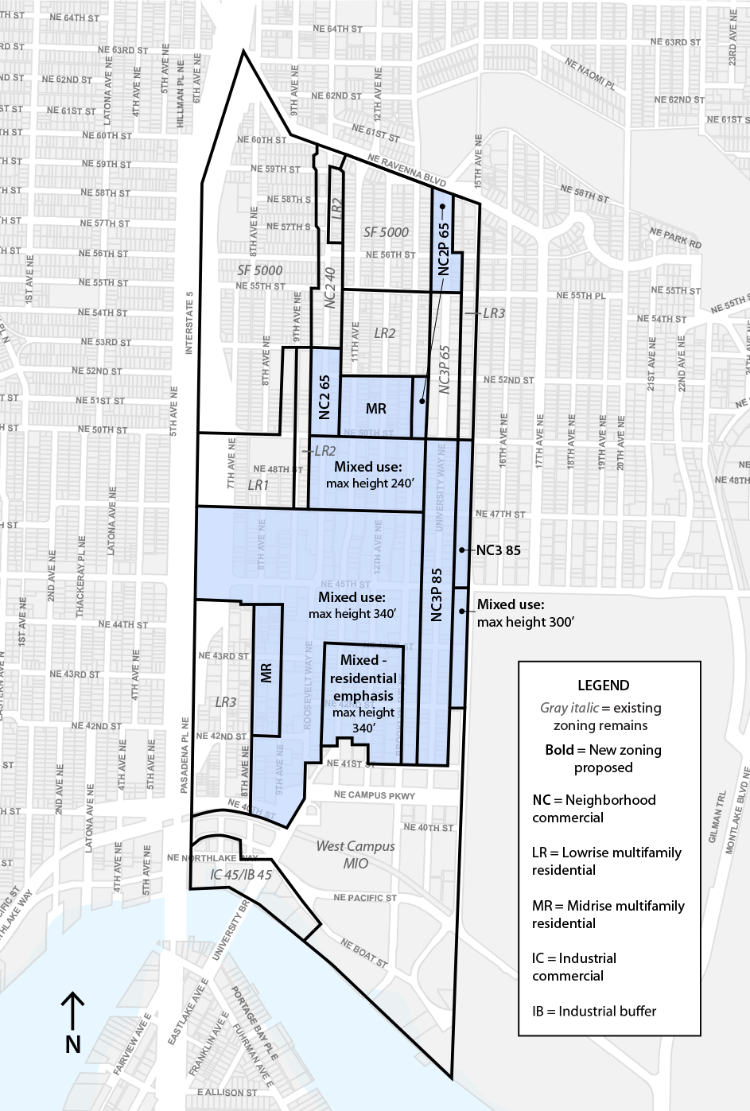
EIS Alternative 2
Taller high-rises concentrated around transit center
Greatest heights & growth in core area
Maximum building heights 240 to 340 feet in core area
Reduced appearance of bulk and more separation, compared to Alt 1
Along the Ave heights 65 to 85 feet — much less than Alt 1
Fewer zoning changes north of 50th, compared to Alt 1
Area-specific and landscaped setbacks + widened sidewalks
Notes:
Greatest heights and growth in core area
Maximum building heights 240 to 340 feet in core area
Reduced appearance of bulk and increased separation, compared to Alt 1
Along the Ave heights 65 to 85 feet — much less than Alt 1
Fewer zoning changes north of 50th, compared to Alt 1
Area-specific and landscaped setbacks + widened sidewalks

Slide 7
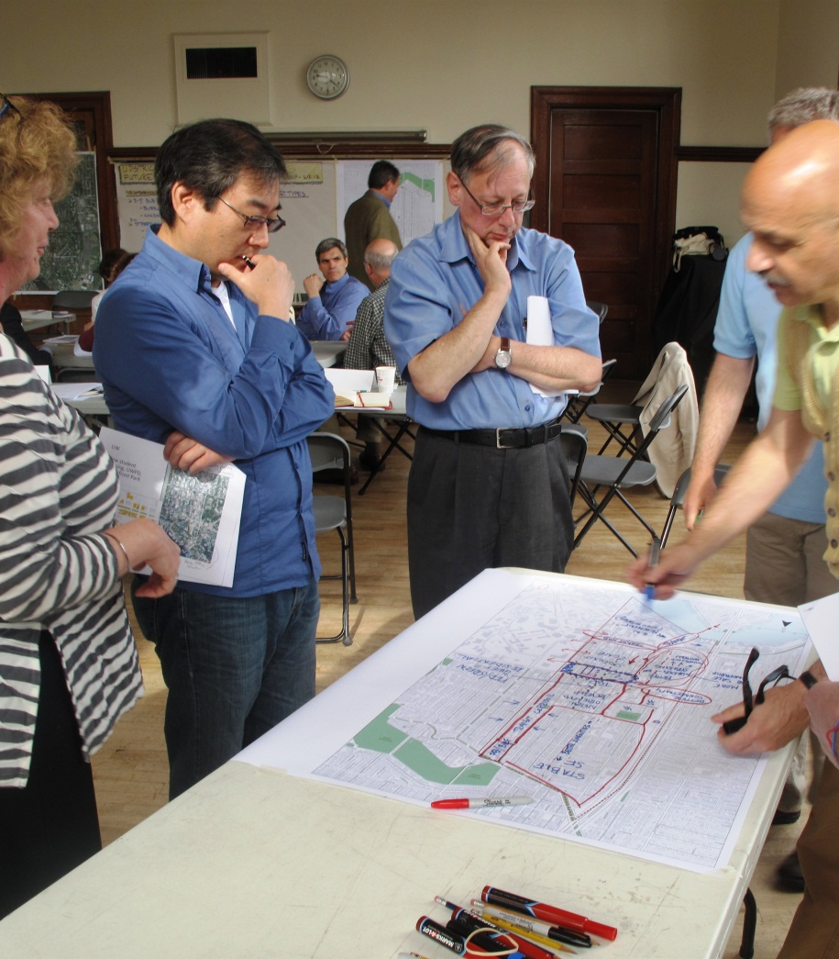
2015 Comp Plan amendments
Future Land Use Map amendments to align with Urban Design Framework, allow zoning changes
Language edits to update and clarify – shift emphasis and language where needed, remove specific height references
Remove outdated figures
Core concepts remain – not intending a complete overhaul
Notes:
Greatest heights and growth in core area
Maximum building heights 240 to 340 feet in core area
Reduced appearance of bulk and increased separation, compared to Alt 1
Along the Ave heights 65 to 85 feet — much less than Alt 1
Fewer zoning changes north of 50th, compared to Alt 1
Area-specific and landscaped setbacks + widened sidewalks

Slide 8
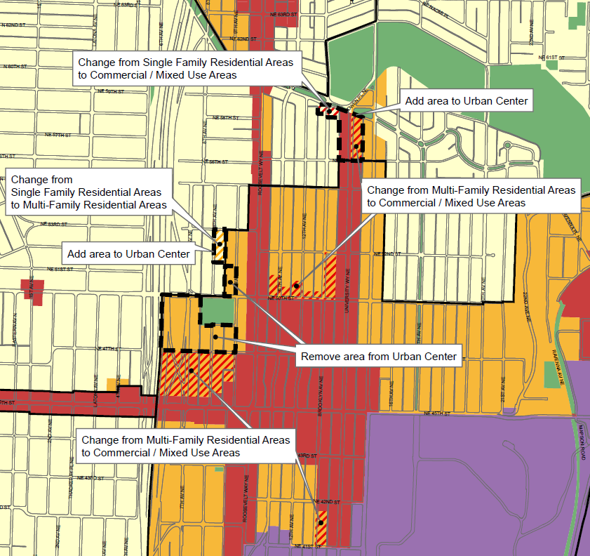

Slide 9
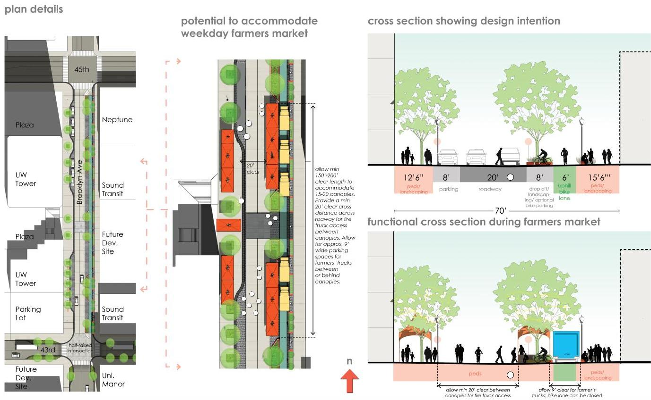
Green street design: Brooklyn Ave NE

Slide 10
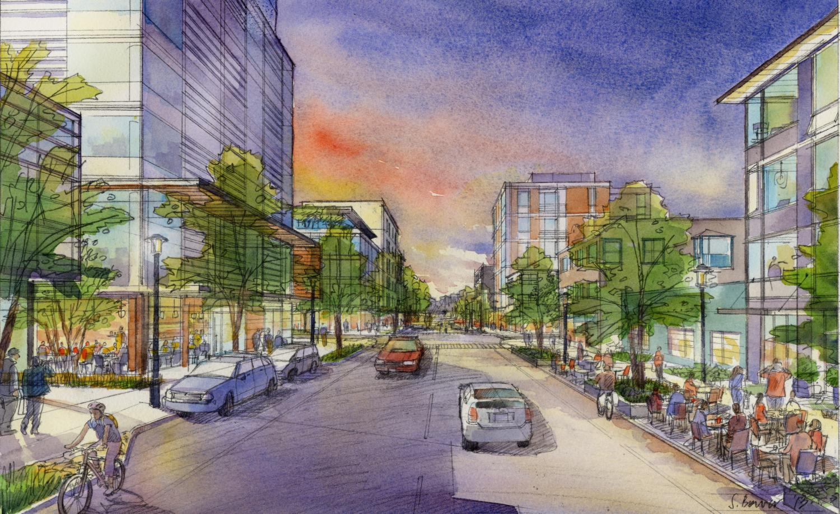
Dave LaClergue dave.laclergue@seattle.gov (206) 733-9668
www.seattle.gov/dpd/udistrict

