Slide 1
Equity Analysis: Elements
Transportation
Land Use
Urban Villages
Environment
Housing
Economy
Human Development
Cultural Resources
Utilities
Capital Facilities
Parks

Slide 2

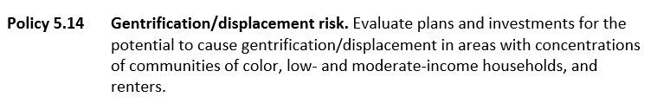
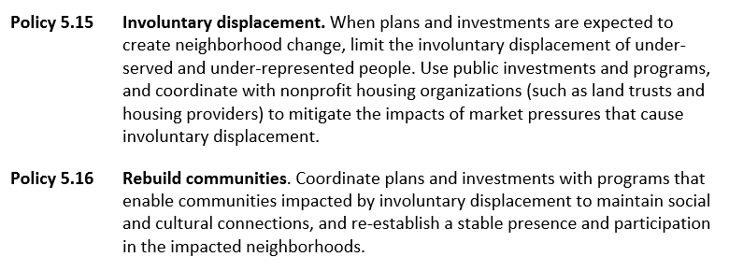
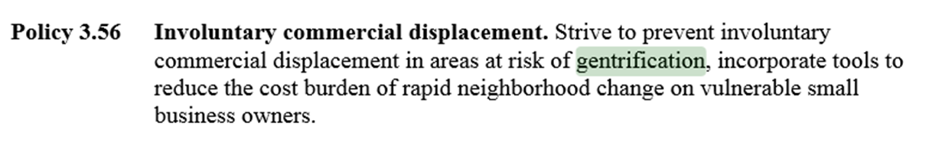
Portland Equity Definition and Example Policies

Slide 3
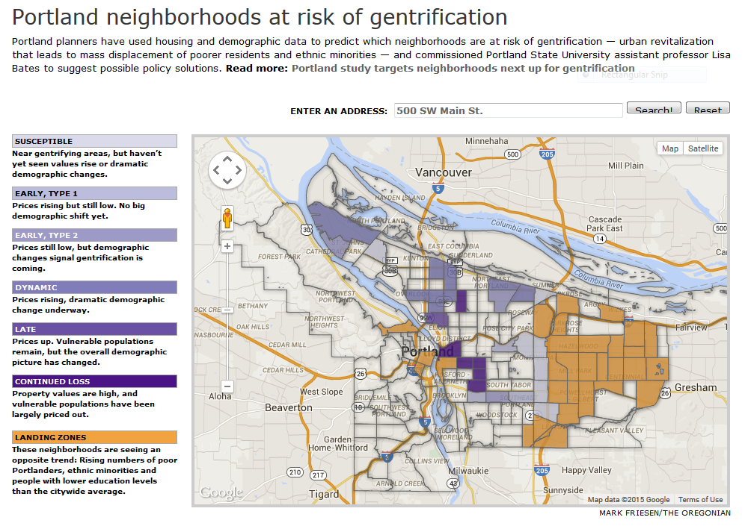
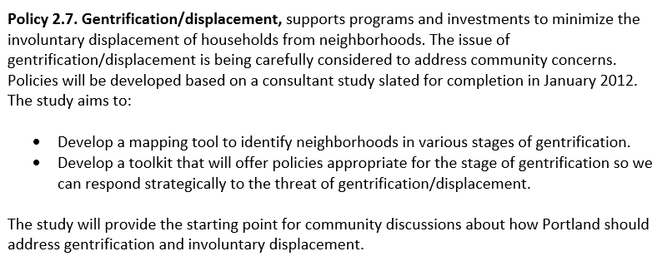
Equity Analysis: Growth Strategy

Slide 4
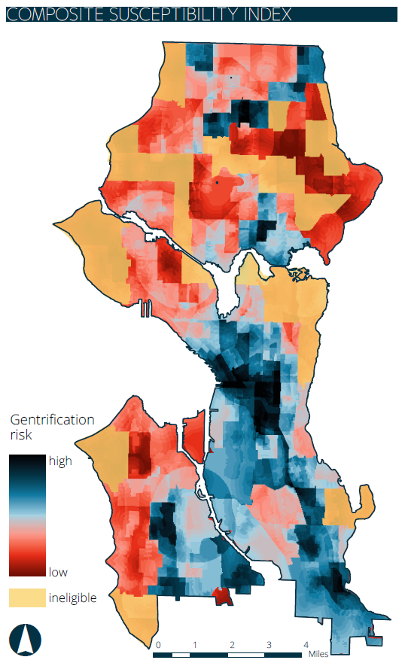
Gentrification Susceptibility Mapping of Seattle by Tufts University in 2013

