Slide 1


Transportation Planning Overview
Planning Commission
Tracy Krawczyk
December 8, 2016

Slide 2
Our mission, vision, and core values
Mission: deliver a high-quality
transportation system for Seattle
Vision: connected people, places, and products
Committed to 5 core values to create a city that is:
  Safe
  Interconnected
  Affordable
  Vibrant
  Innovative
For all

Slide 3
Policy & Planning division role
Develop policies to guide mobility, access and placemaking uses with city street rights of way
Deliver plans to make it easier to walk, bike, take transit and move goods
Transform streets into inviting public places
Inform local and regional transportation investments decisions

Slide 4
2016 work plan highlights
Planning
Comprehensive Plan update ROW allocation policies Level-of-service policies Pedestrian Master Plan Update Freight Master Plan Transit Master Plan update One Center City Move Ballard Impact Fees (on hold) Community mobility studies
Revenue & Capital Development
Capital project prioritization Regional planning Grant applications Federal legislation review/ comment
Urban Design
Complete Streets Program Streetscape concept plans Tactical urbanism Pavement to Parks Program Right-of-Way Improvements Manual Update

Slide 5
From plan to implementation
Comprehensive Plan
citywide growth vision
Modal, Subarea & Operational Plans
articulate solutions and priorities
Move Seattle
10-year Strategic Vision
Capital Investment Program (CIP)
6-year funding priorities
Implementation/Work Plans
3-5 year priorities
Project/Program Implementation
aligned with annual budgets

Slide 6
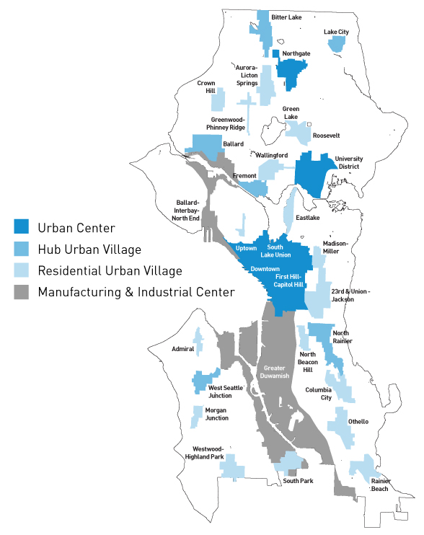
Comp Plan growth strategy
Focus growth to more efficiently serve it
  Urban centers
  Manufacturing & industrial centers
  Urban villages
80% of city growth in centers/villages since 1994
Future growth targets 2015-2035
  70,000 additional households
  115,000 additional jobs

Slide 7
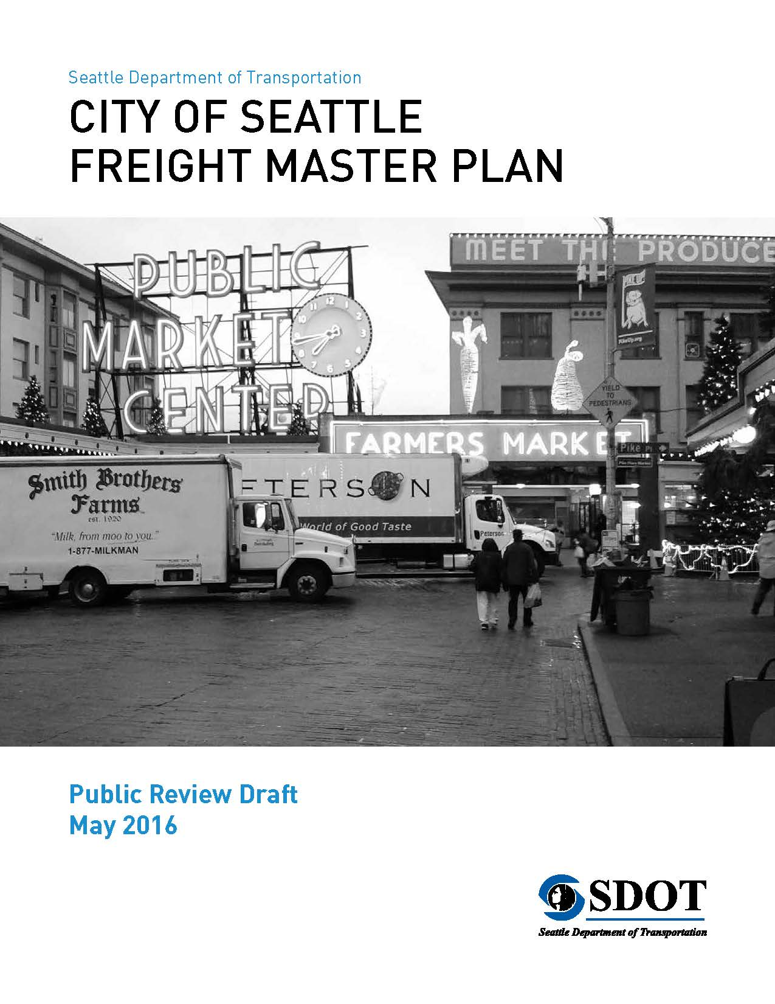
Citywide modal plan purposes
20-year blueprint to:
Support growth
Achieve desired outcomes
  Safety
  Affordability
  Connectivity
  Vibrancy
Increase travel options
Improve travel conditions
Guide investments

Slide 8
Modal master plan contents
Seven “P”s
Policy framework
Priority investment network
Projects
Programs
Prioritization framework
Performance measures
“Pfunding” strategy
Other Elements
Best practices review
Existing conditions
Future conditions
Design guidelines
Project detail sheets
Implementation strategy
Outreach summary

Slide 9
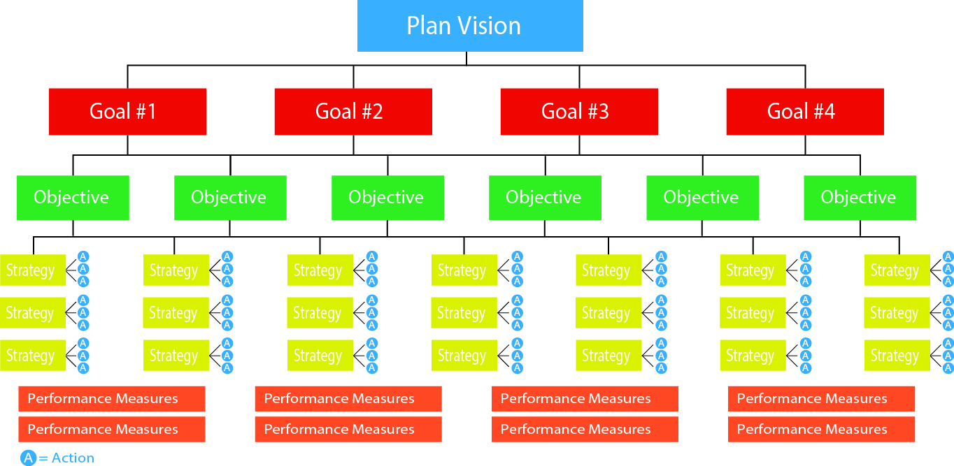
Policy framework
Notes:
Vision:
Articulates the desired future outcome of the Plan.
Goals:
Desired outcomes (what we hope to accomplish).
Objectives:
How we plan to accomplish the Plan goals.
Strategies:
Key actions for implementing each objective.
Performance Measures:
How we track progress in achieving Plan goals.

Slide 10
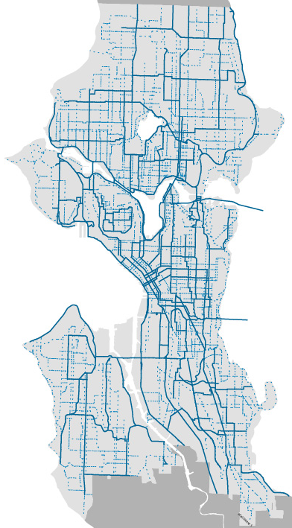
Bicycle Master Plan (2014)
Vision: Riding a bicycle is a comfortable and integral part of daily life in Seattle for people of all ages and abilities
Goals: Increase ridership and safety and enhance connectivity, equity and livability
Identifies an all ages and abilities network:
  Protected bike lanes
  Off-street trails
  Neighborhood greenways

Slide 11
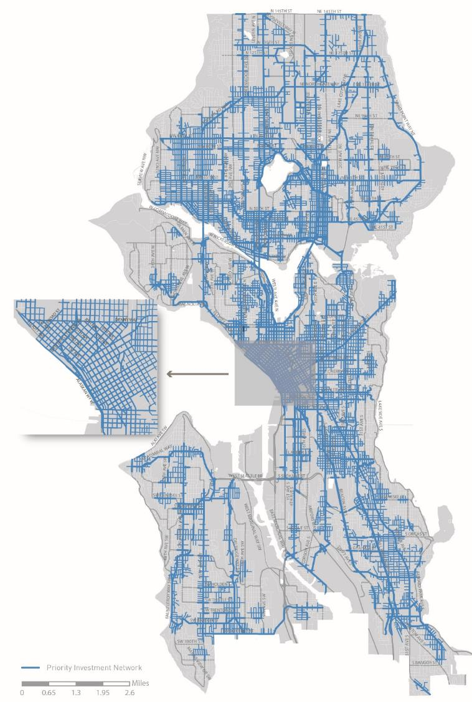
Pedestrian Master Plan Update (2016)
Vision: Seattle is the most walkable city in the Nation
Goals:
Safety: Reduce the number and severity of crashes involving pedestrians.
Equity: Make Seattle a more walkable city for all through equity in public engagement, service delivery, accessibility, and capital investments.
Vibrancy: Develop a connected pedestrian environment that sustains healthy communities and supports a vibrant economy.
Health: Get more people walking to improve mobility, health, and prevent disease.

Slide 12
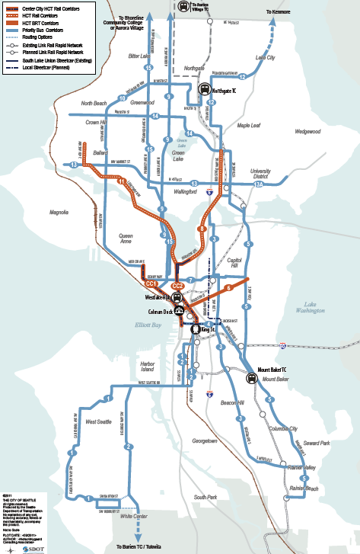
Transit Master Plan
(2012/2016)
Goal: Make riding transit easier and more desirable for more types of trips
2016 update focused on RapidRide BRT network expansion
Guides city purchase of Metro bus service

Slide 13
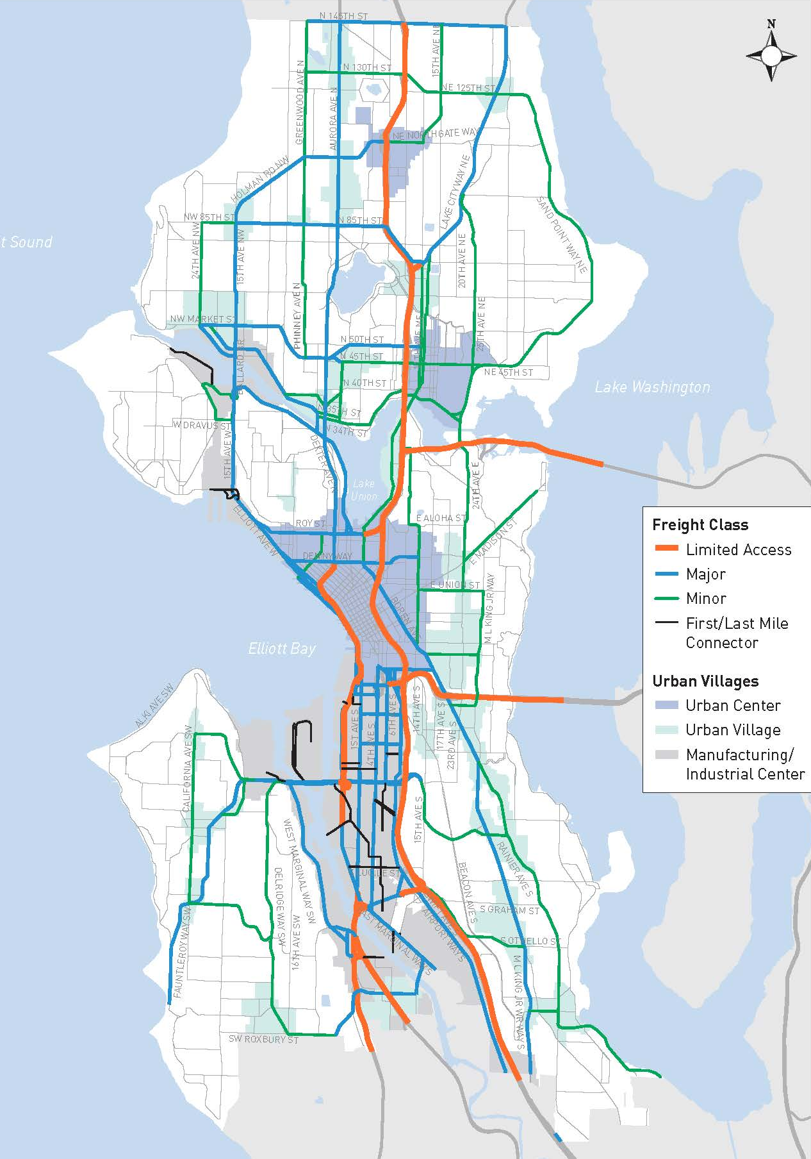
Freight Master Plan (2016)
Vision: A vibrant city and thriving economy connecting people, and products within Seattle, and to regional and international markets
Goals address:
  Economy
  Safety
  Mobility
  State of good repair
  Equity
  Environment

Slide 14
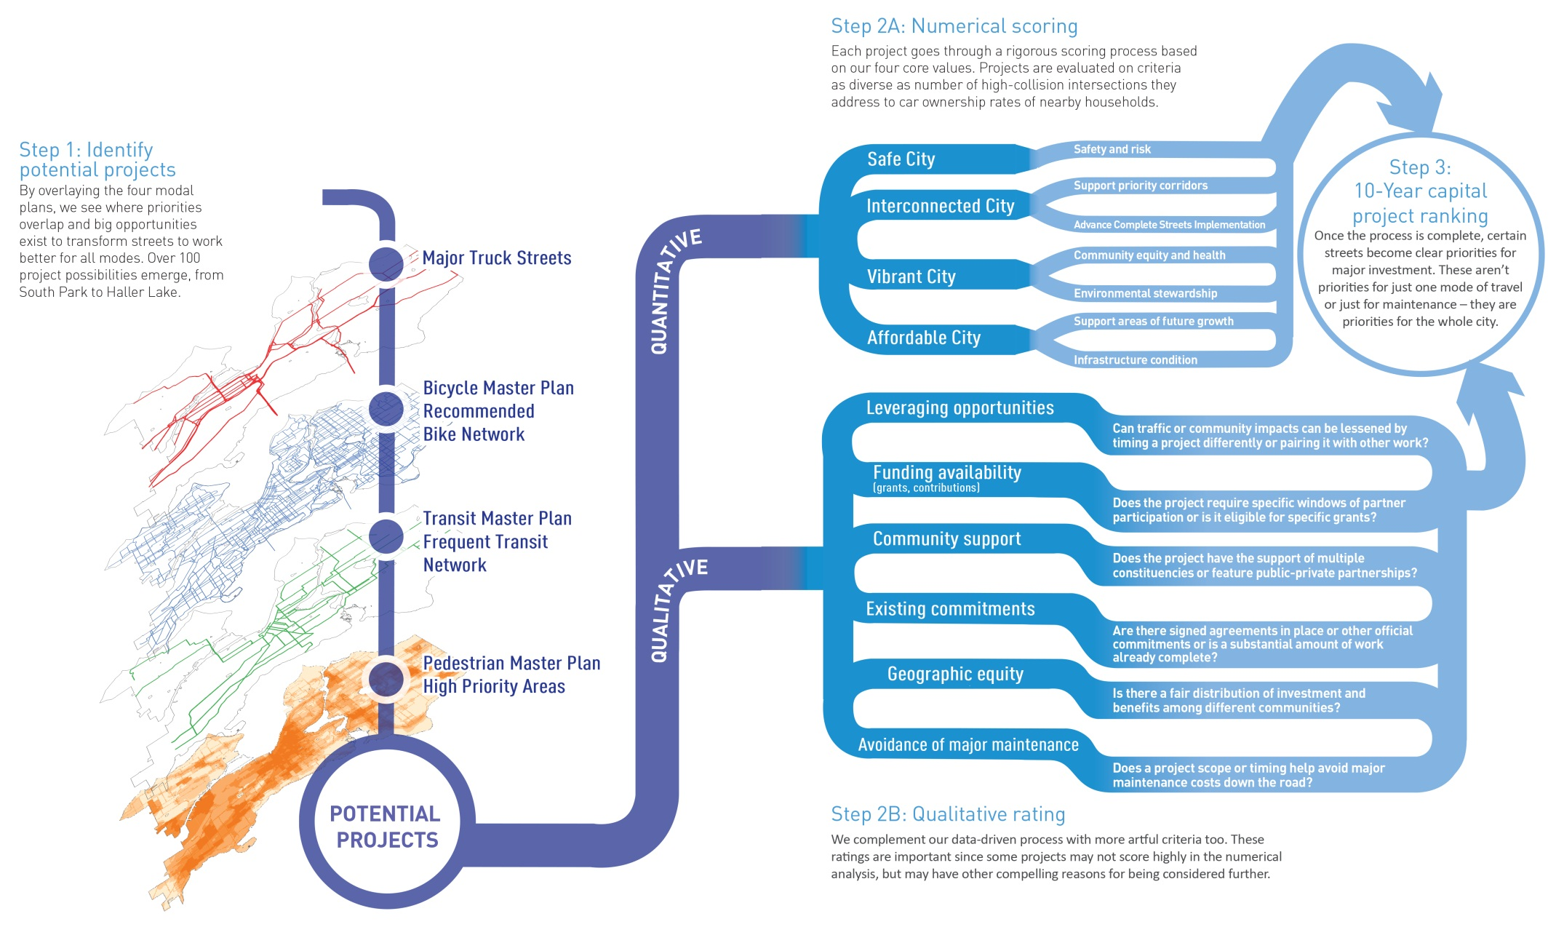
Prioritizing large capital projects
14

Slide 15
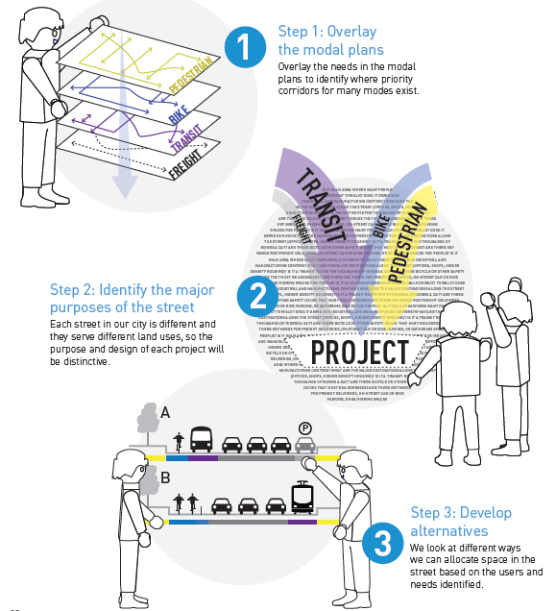
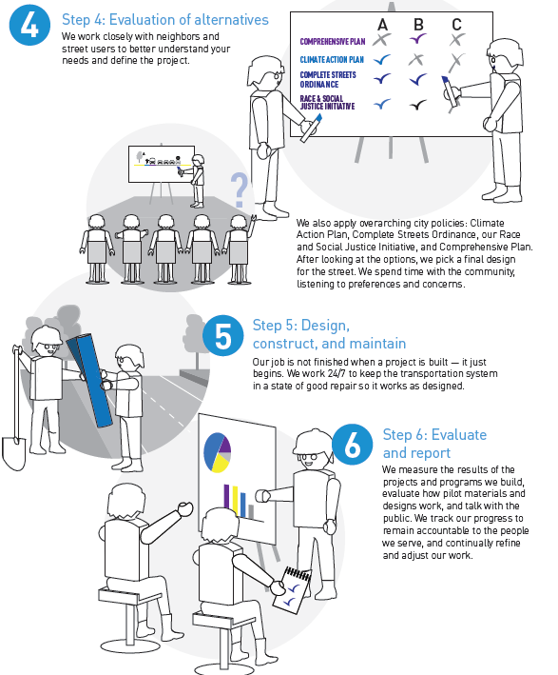
From plan to project

Slide 16

16

Slide 17
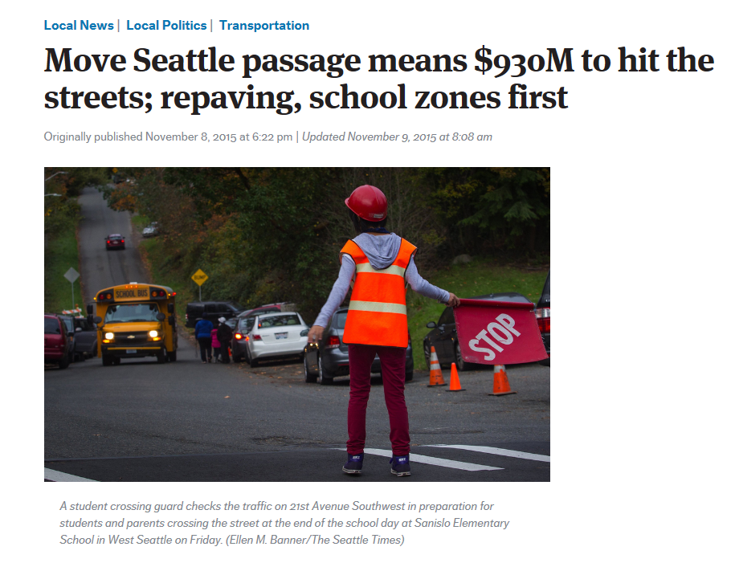
17

Slide 18
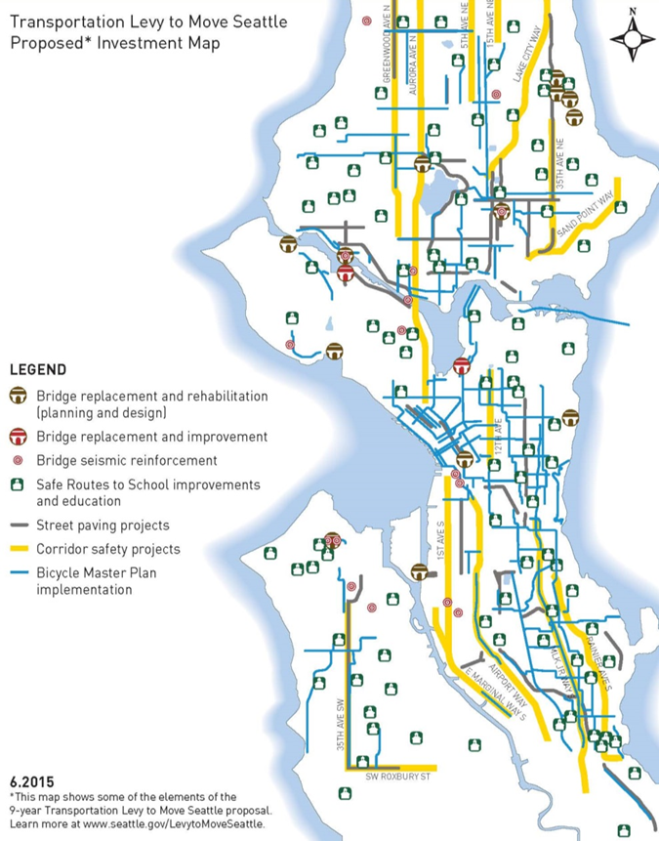
Voter-approved levy package
Safe Routes $207 M
Congestion Relief $303 M
Maintenance and Preservation $420 M
9-year total $930 M
18

Slide 19

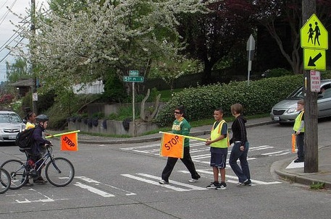
Safe Routes
Provide safe and accessible routes connecting schools, transit hubs, and other destinations
Move Seattle Levy Commitments:
Complete 12 – 15 corridor safety projects
Build Safe Routes to School at every public school
Repaint crosswalks so they are clearly marked
Improve the City’s system of traffic signals, signs, and markings
Repair up to 225 blocks of damaged sidewalks
Crossing improvements at 750 intersections
Complete 20-35 neighborhood priority projects to improve safety
19

Slide 20
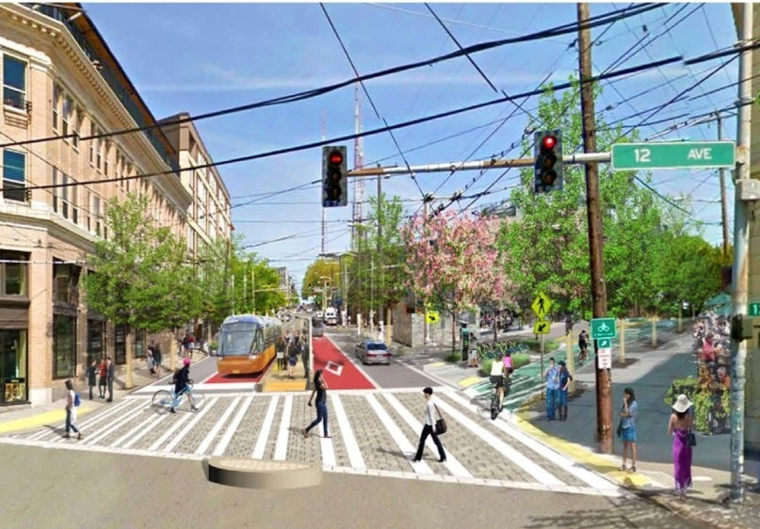
Congestion Relief
Enhance transportation choices throughout the network
  Move Seattle Levy Commitments:
  Complete 7 transit plus multimodal corridor projects
  Traffic signal timing improvements on 5 corridors each year
  Increasing access to Light Rail
  Build 250 blocks of new sidewalk
  Freight Mobility Improvements
  Advanced Signal Infrastructure Improvements
20

Slide 21
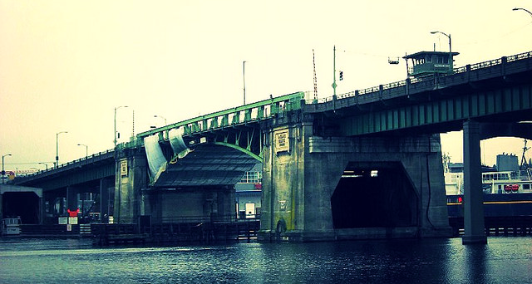
Maintenance & Repair
Continue maintenance and repair work along Seattle’s busiest streets and bridges
  Move Seattle Levy Commitments:
  Repave up to 180 lane-miles of arterial streets
  Paving spot improvements at 65 targeted locations each year
  Seismic improvements to 16 vulnerable bridges
  Replace the Fairview Ave. Bridge
  Replace every tree removed with two new trees
  Addressing flood prone neighborhoods
21

Slide 22
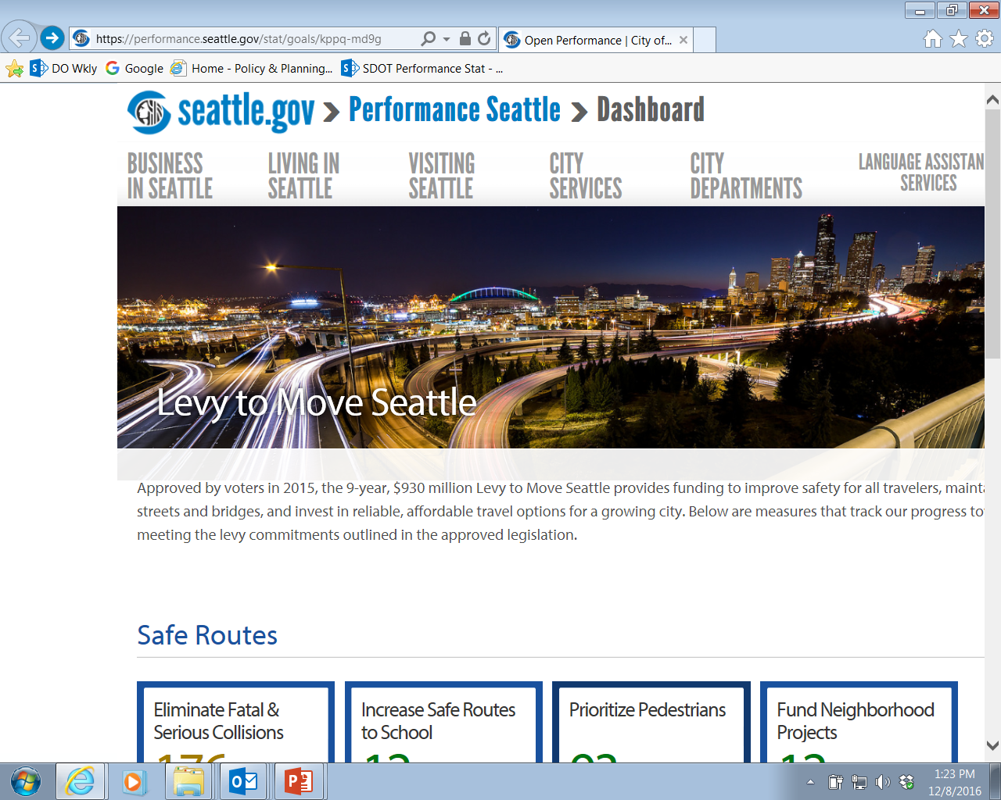
Performance Seattle dashboard
http://www.seattle.gov/move-seattle-dashboard
22

Slide 23
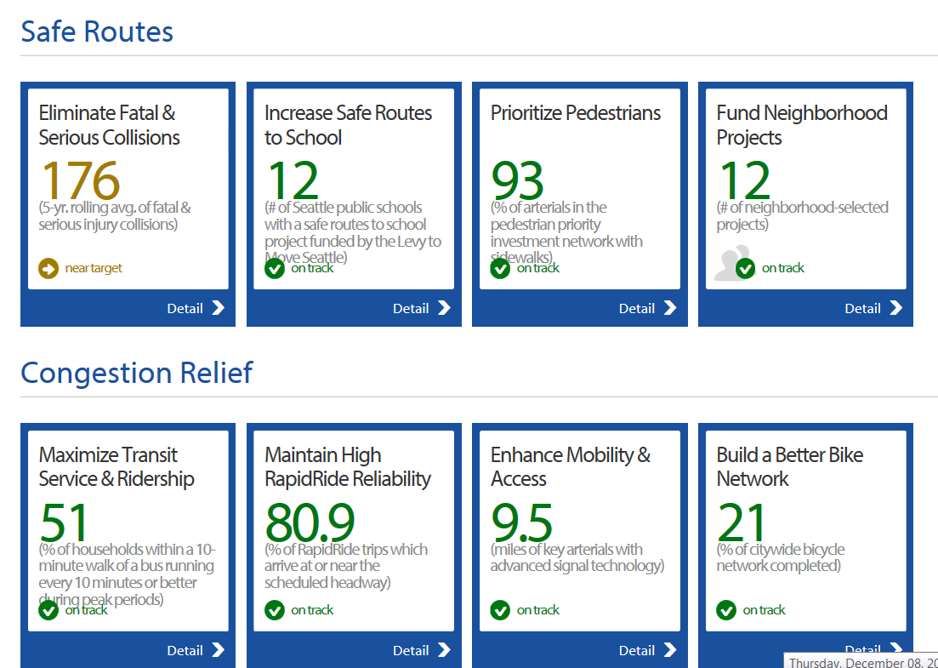
Performance data
23

Slide 24
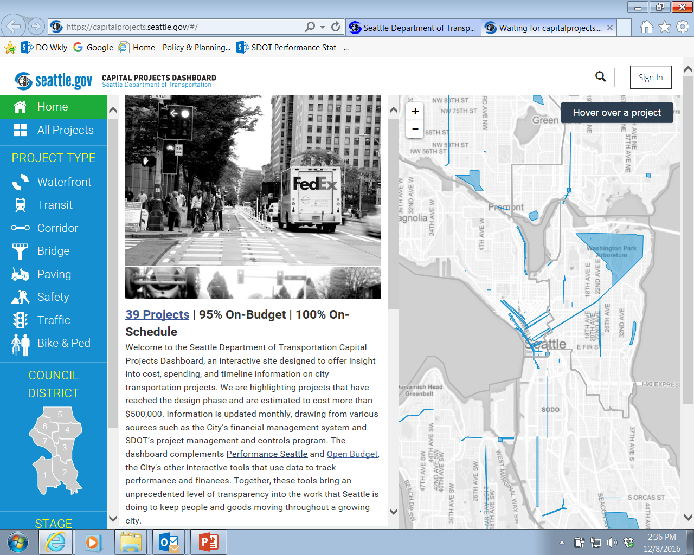
SDOT Capital Projects Dashboard
24

Slide 25





Questions?
tracy.krawczyk@seattle.gov | (206) 733-9329
http://www.seattle.gov/transportation/freight.htm
http://www.seattle.gov/transportation

