Slide 1
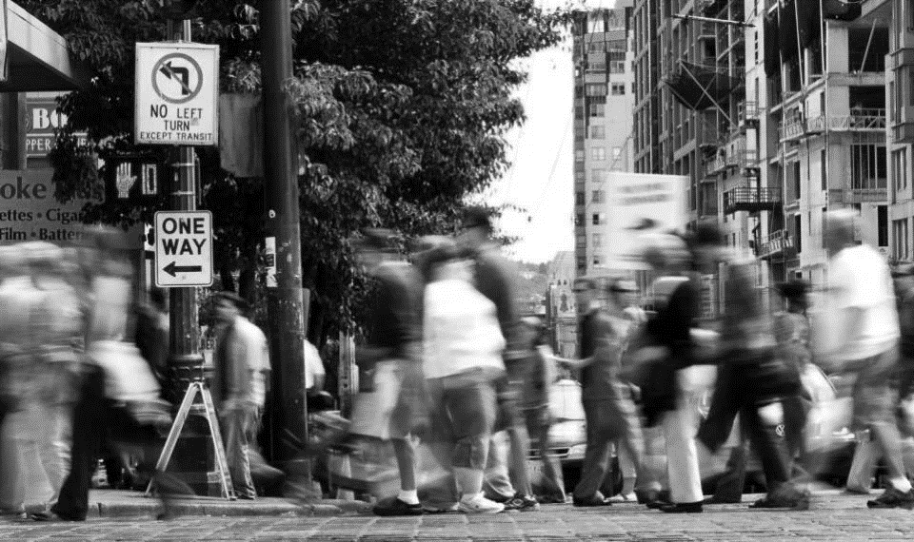

Pedestrian Master Plan Update
Seattle Planning Commission
Tracy Krawczyk, Ian Macek
December 8, 2016

Slide 2
Our mission, vision, and core values
Mission: deliver a high-quality
transportation system for Seattle
Vision: connected people, places, and products
Committed to 5 core values to create a city that is:
Safe
Interconnected
Affordable
Vibrant
Innovative
for all

Slide 3
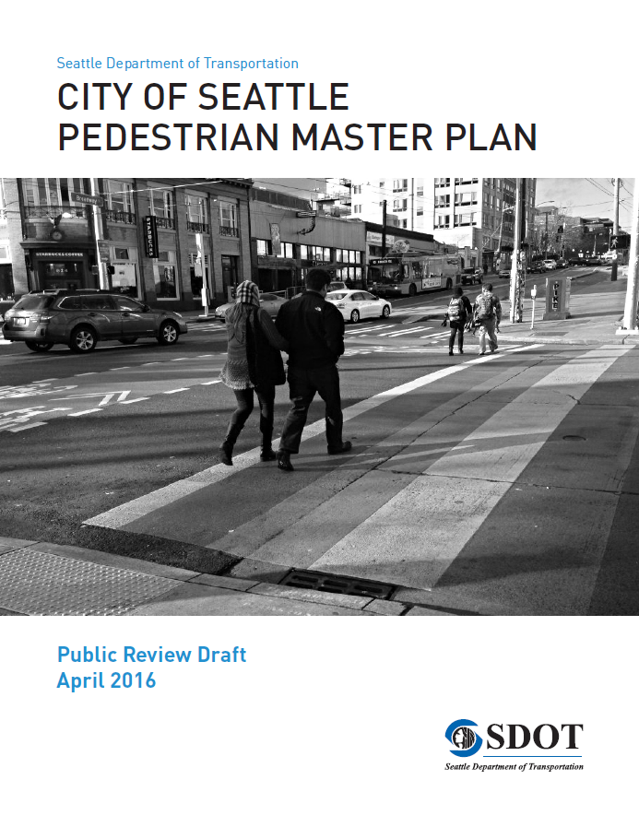
Plan purpose
Blueprint to provide walking improvements
Data-driven prioritization of funding
Designed to focus resources to improve access to transit and schools

Slide 4
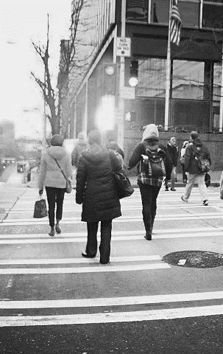
Policy framework
Vision: Seattle is the most walkable city in the Nation
Goals:
Safety: Reduce the number and severity of crashes involving pedestrians
Equity: Make Seattle a more walkable and accessible city for all through equity in public engagement, service delivery, accessibility, and capital investments
Vibrancy: Develop a connected pedestrian environment that sustains healthy communities and supports a vibrant economy
Health: Get more people moving to improve health and increase mobility

Slide 5
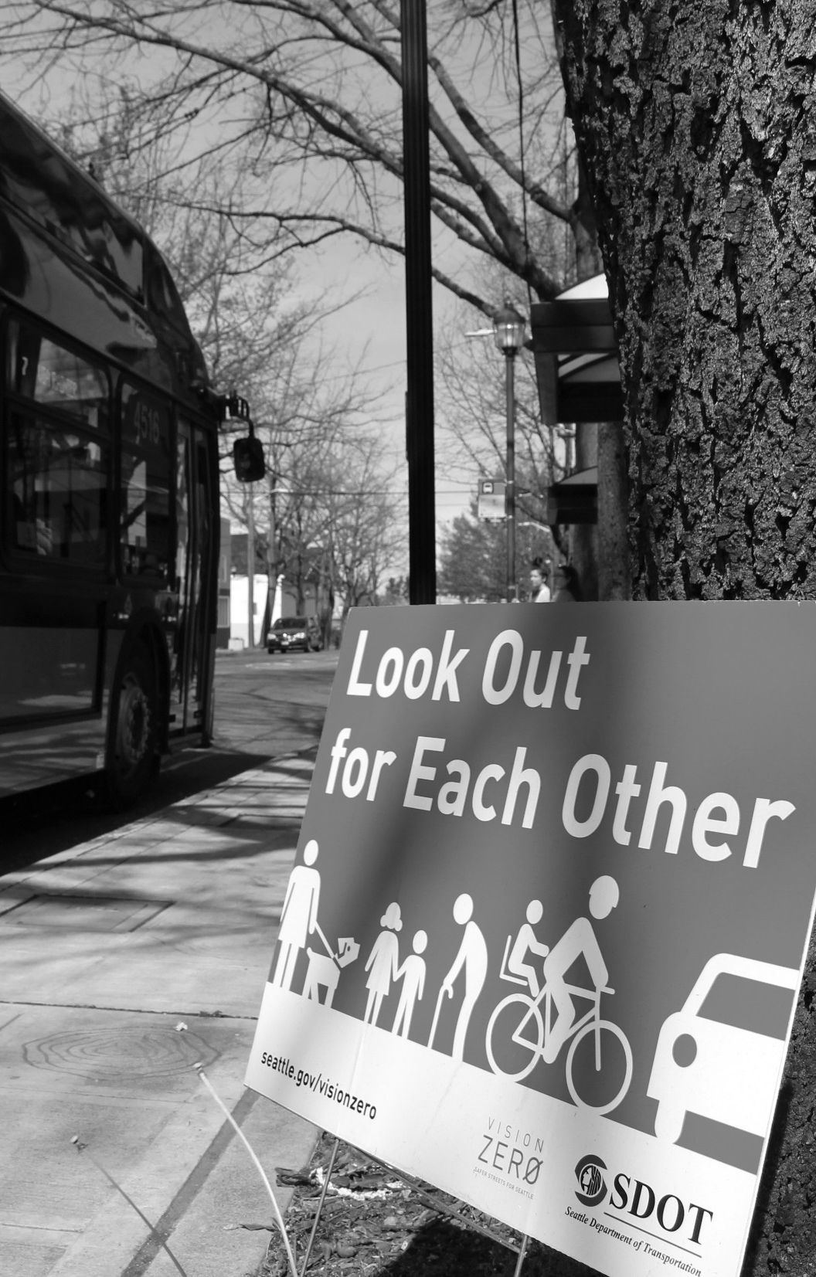
Update focus
Assessment of progress since 2009
Priority Investment Network (PIN)
Performance measures
Updated strategies and actions

Slide 6
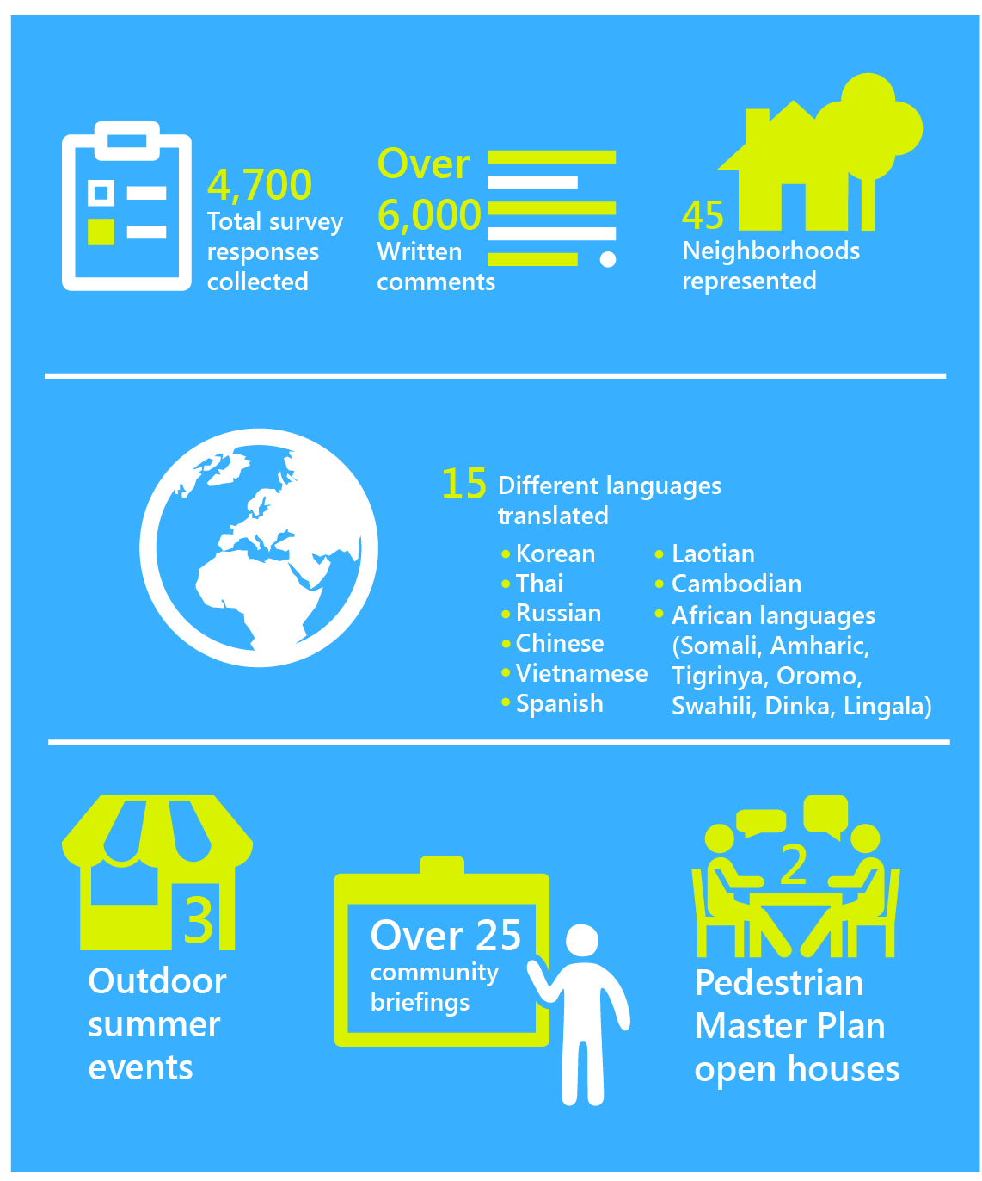
Early public engagement
Focus investments on:
Streets connecting families and children to schools
Streets connecting people to transit stops
Sidewalks and crossings on busy arterial streets
Residential streets where sidewalks are missing
Locations where pedestrians are injured

Slide 7
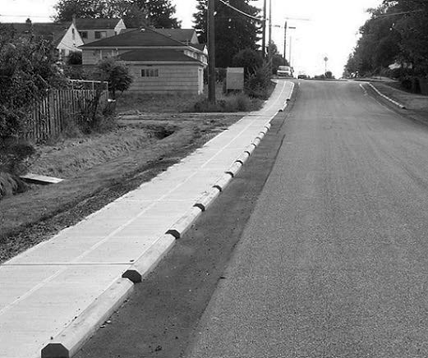
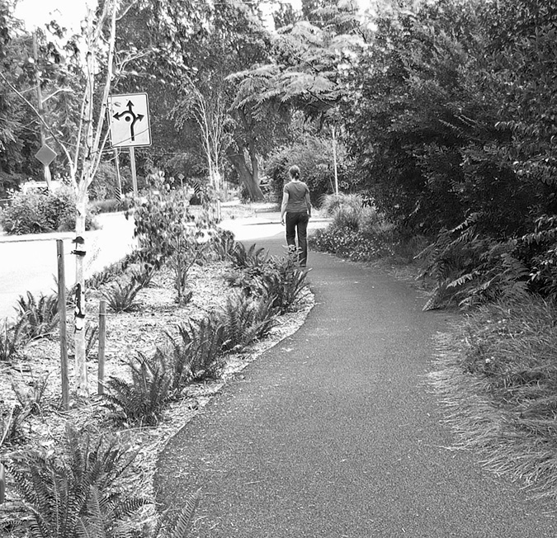
Early public engagement (cont.)
Support for low-cost walking treatments
Received favorable reception, except shared streets

Slide 8
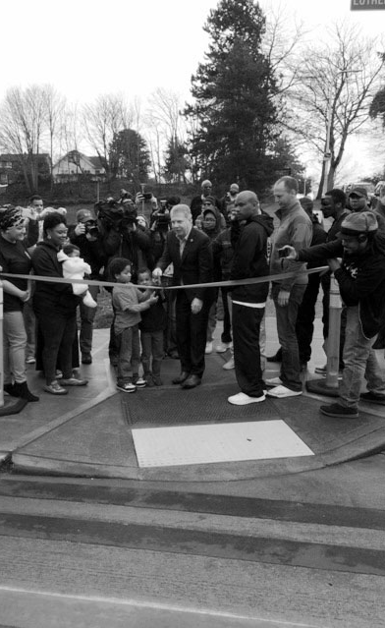
Draft plan public comments
Support for:
Sidewalk and crossing improvements
Connections to schools and transit
Increased pedestrian funding
Expanded data collection
Proactive safety approach
Change requests:
Expand Priority Investment Network
Further discuss maintenance needs
Be realistic about funding outlook

Slide 9
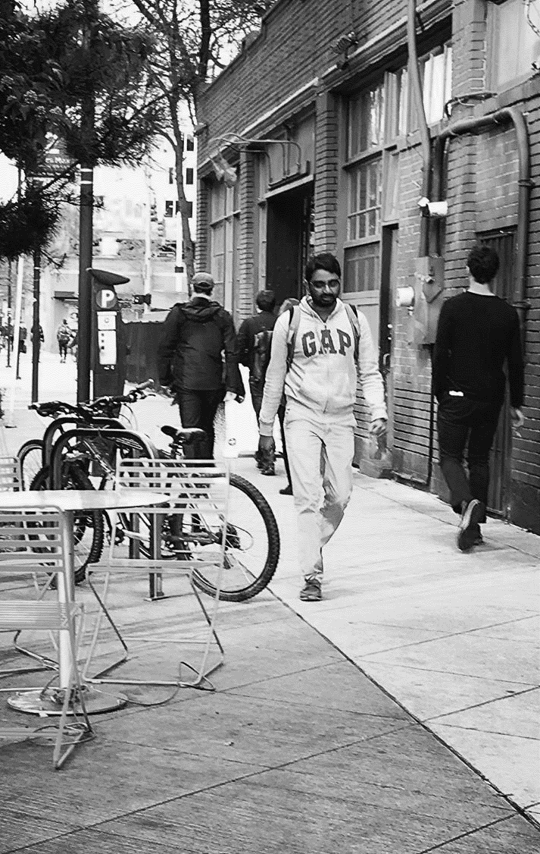
Recommended plan changes:
No Priority Investment Network expansion
Additional discussion of maintenance needs
New actions
Improve ability to track new pedestrian improvements
Explore options to increase maintenance funding
More explicit discussion of pedestrian needs outweighing funding

Slide 10
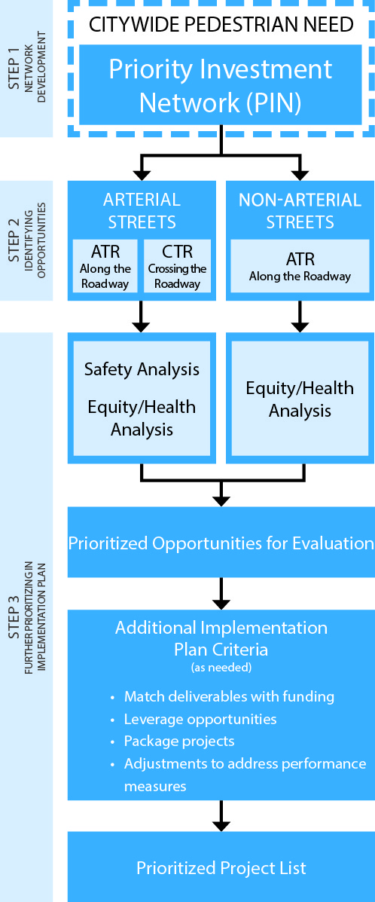
Prioritization framework
Step 1
Develop a citywide Priority Investment Network (PIN) using vibrancy (or demand) factors
Step 2
Identify opportunities to improve walking conditions along and crossing the streets in the PIN
Step 3
Further prioritize investments within an implementation plan, using safety, equity, and health analyses

Slide 11
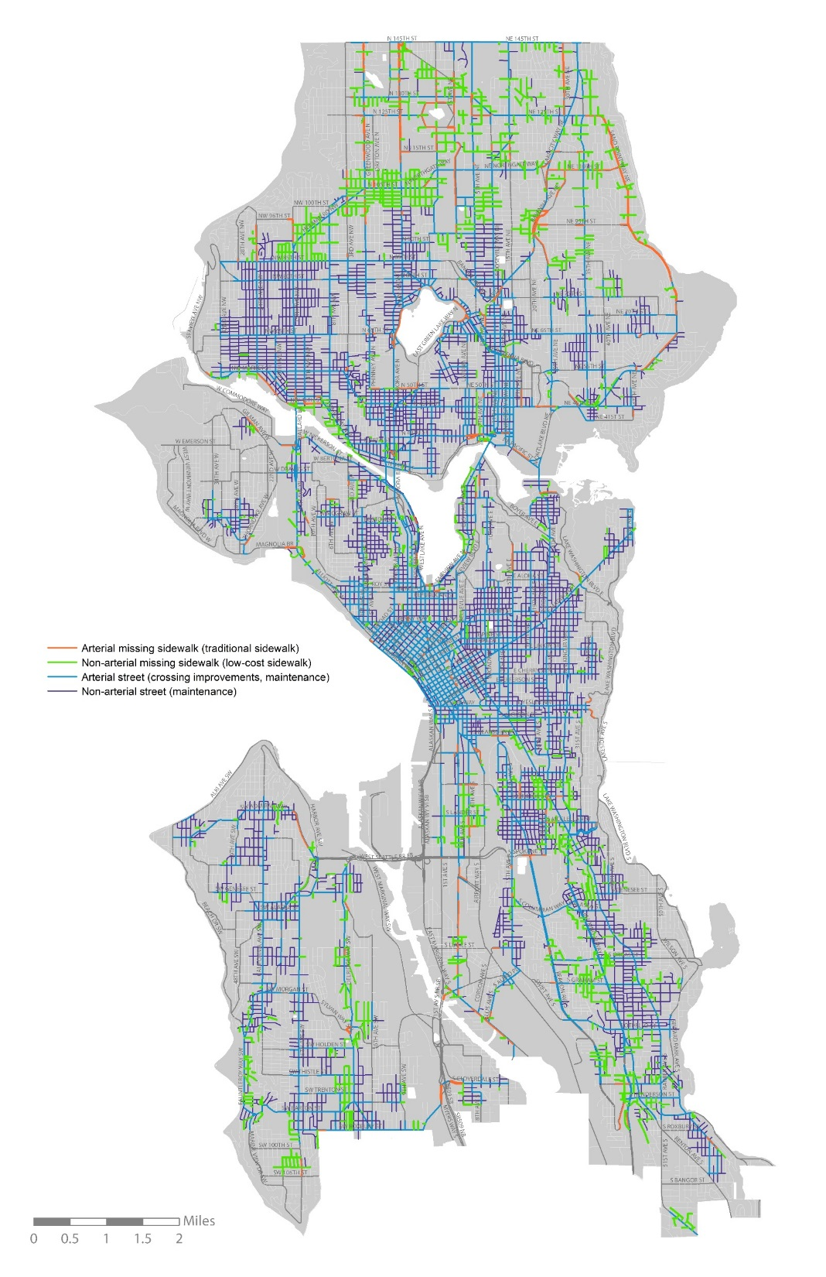
Priority Investment
Network
ARTERIALS | Citywide | PIN
Total # blockfaces | 12,835 | 9,220
Total blockfaces missing sidewalks | 1,804 | 572
NON-ARTERIALS | Citywide | PIN
Total # blockfaces | 32,609 | 14,884
Total blockfaces missing sidewalks | 9,990 | 3,109
PIN street with sidewalk
Arterial
Non-arterial
PIN street missing sidewalk
Arterial
Non-arterial

Slide 12
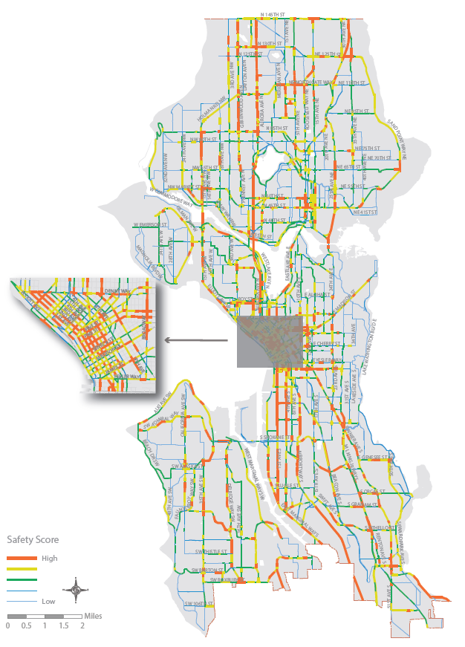
Prioritization: safety
Used to further prioritize arterial streets
Analysis includes:
Pedestrian collisions
Arterial classification
Roadway width
Controlled crossing spacing
Speed

Slide 13
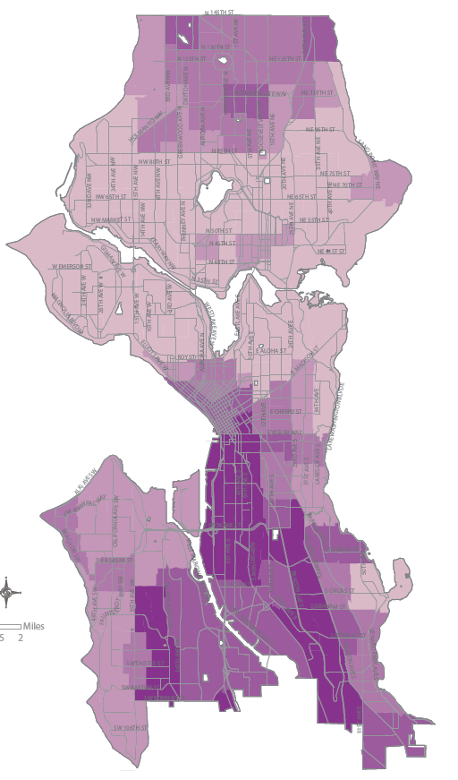
Prioritization: equity and health
Used to further prioritize arterial and non-arterial streets
Analysis includes:
Race
Income
Disabled population
Diabetes, obesity, and physical activity rates

Slide 14
Implementing strategies and actions
Example
Stem from Plan goals and objectives
Outline how we will improve walking conditions within the PIN
20 strategies
Over 60 actions
Strategy 2.2: Shorten pedestrian crossing distances
Action 2.2.1: Provide curb bulbs, pedestrian crossing islands, and/or pedestrian refuge, when possible
Action 2.2.2: Use lane reductions, as appropriate, as part of the engineering toolkit when making pedestrian or other safety improvements

Slide 15
Performance measures
Measure | Desired trend | Performance target
Number of pedestrian fatalities and serious injury collisions | Decreasing rate | Pedestrian fatalities and serious injury collisions reach zero by 2030
Rate of crashes involving pedestrians | Decreasing rate of pedestrian crashes per 100,000 residents | (None recommended)
Percent of sidewalks within the PIN completed | Increasing percentage of Priority Investment Network arterial sidewalks completed | 100% of PIN arterial sidewalks complete by 2035
Mode share | Increasing percentage of walking trips | (None recommended)
Pedestrian activity | Increasing number of pedestrians at count locations over time | (None recommended)
Children walking or biking to or from school | Increasing percentage of trips by children | (None recommended)

Slide 16
Funding outlook
Priority Investment Network (PIN) 20-year need
 | Blockfaces missing sidewalk | Total cost (Arterials: $300K/blockface Non-arterials: $150K/blockface )
Arterial streets within PIN | 572 (42.1 miles) | $172M
Non-arterial streets within PIN | 3,109 (206.4 miles) | Both sides of street: $466M One side of street: $256M
Total PIN sidewalk need | 3,679 | $427M to $637M
Move Seattle funding (9-year)
SDOT Program | Total Levy Amount | Levy Deliverable
PMP Implementation Program (crossings) | $30M | Make curb ramp and crossing improvements at up to 750 intersections citywide
PMP Implementation Program (sidewalks) | $61M | Build 250 new blocks of sidewalk (traditional and “low cost” sidewalks)
Safe Routes to School | $7M | Complete 9-12 Safe Routes to School projects each year
Vision Zero | $23M | Complete 12-15 corridor safety projects, improving safety for all travelers
Neighborhood Greenways | $36M | 60 miles of new greenways
Multimodal improvements | $104M | Complete 7+ multimodal corridor projects (will include pedestrian elements)
Drainage partnership | $10M | Partner with SPU to provide pedestrian infrastructure and address drainage issues

Slide 17
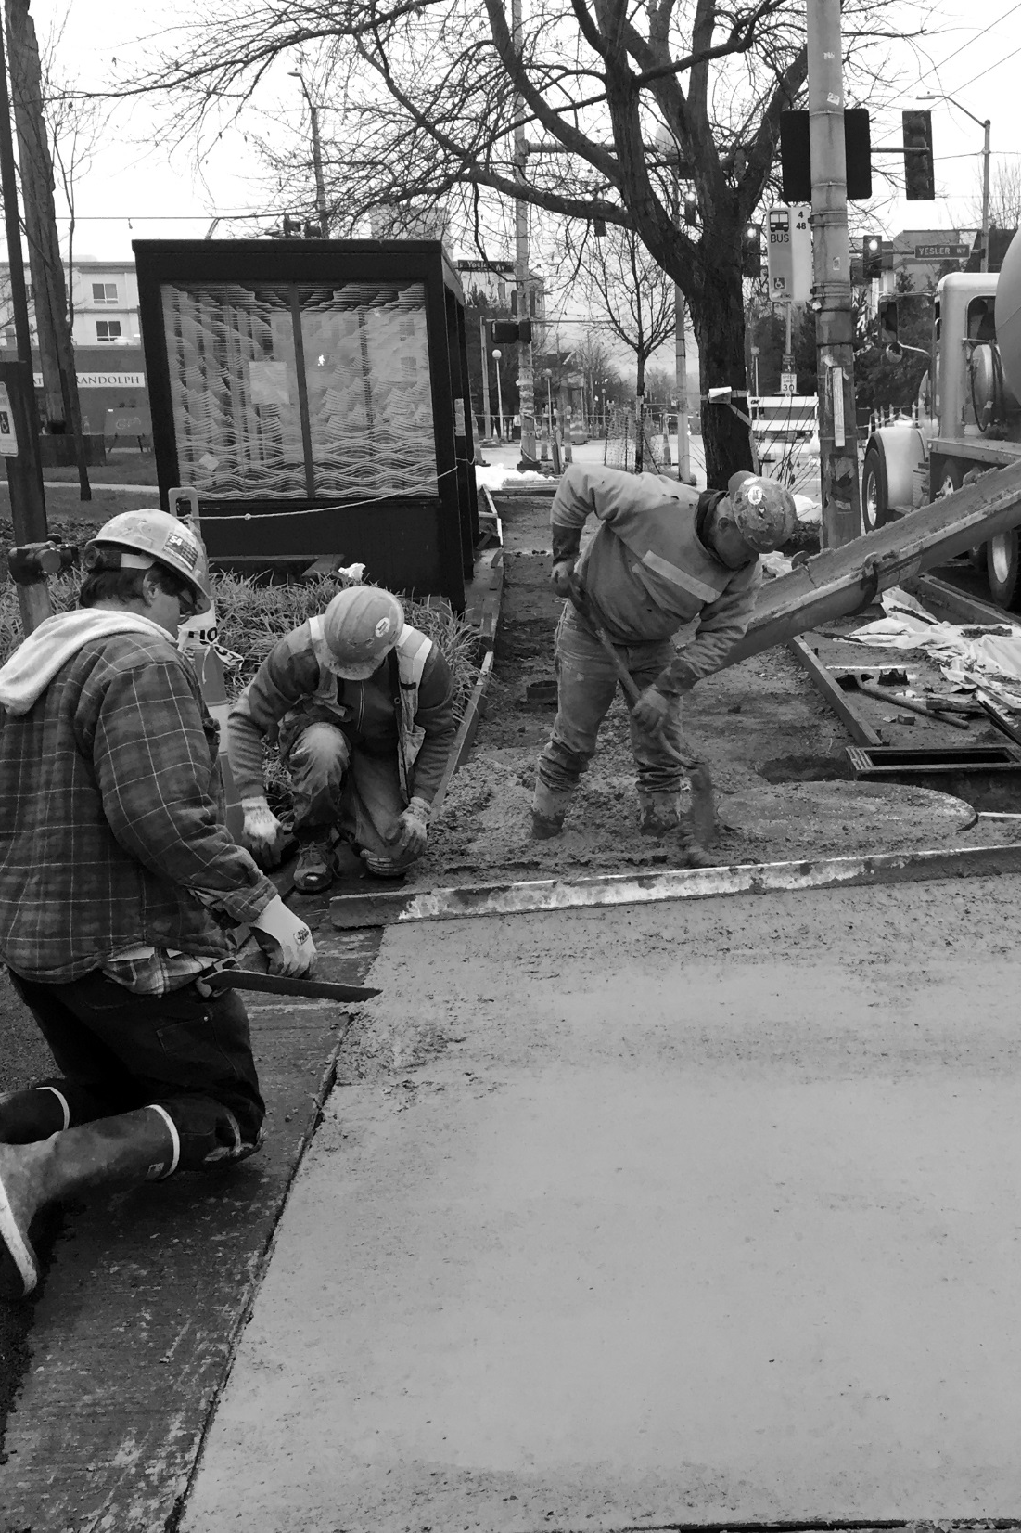
Implementation plan
Developed after PMP adoption
3-5 year priorities
Annual updates
Seattle Pedestrian Advisory Board role
17

Slide 18
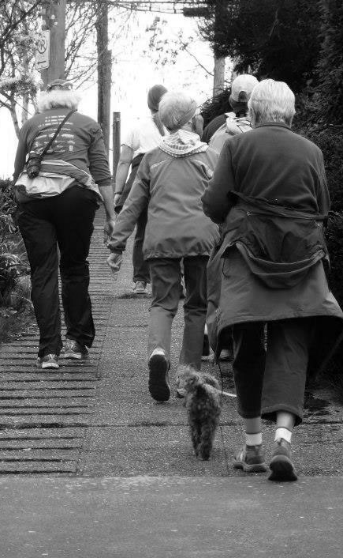
Next steps
Briefings
Seattle Pedestrian Advisory Board December 14
State Environmental Policy Act (SEPA) and Determination of Non-Significance (DNS)
Council adoption early 2017 (anticipated)
Planning Commission provide support for the PMP

Slide 19





Questions?
ian.macek@seattle.gov | (206) 733-7576
tracy.krawczyk@seattle.gov | (206) 733-9329
http://www.seattle.gov/transportation/pedMasterPlan.htm
http://www.seattle.gov/transportation

