Slide 1

Preparing for Climate Change
Presentation to the Planning Commission
Seattle Office of Sustainability & Environment
Tracy Morgenstern

Slide 2
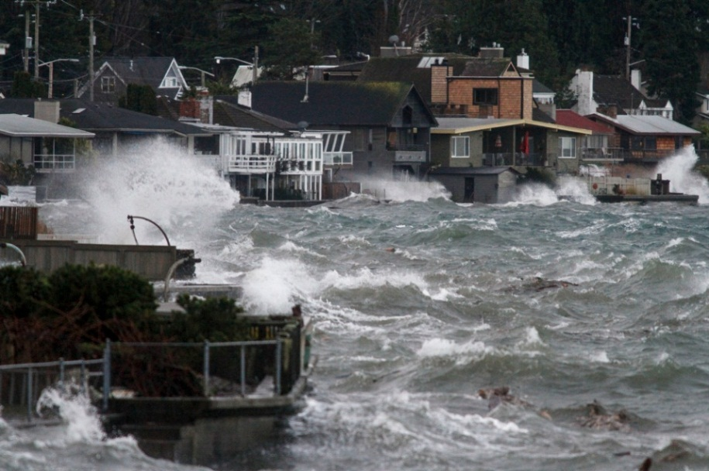
Climate Change in the Pacific Northwest
Temperature
Precipitation
Sea level

Slide 3
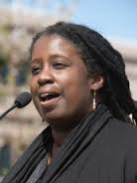
Equitable Climate Preparedness
“The effects of climate change threaten everyone, but they do not threaten all people equally.”
“The voices of frontline communities, the ones most impacted, usually don’t make it to the airwaves.”
Jacqui Patterson, Director
NAACP Climate Justice Initiative

Slide 4
Vulnerability Factors
Racism
Age
Location
Occupation
Health
Income
Living Conditions
Language Barriers

Slide 5
Planning Priorities
EQUITY: Prioritize actions that reduce risk and enhance resilience for communities with disproportionate climate risk.
CO-BENEFITS: Design and implement resilience strategies that advance community goals.
NATURAL SYSTEMS: Use nature-based solutions that leverage ecosystem services and foster natural systems resilience.

Slide 6
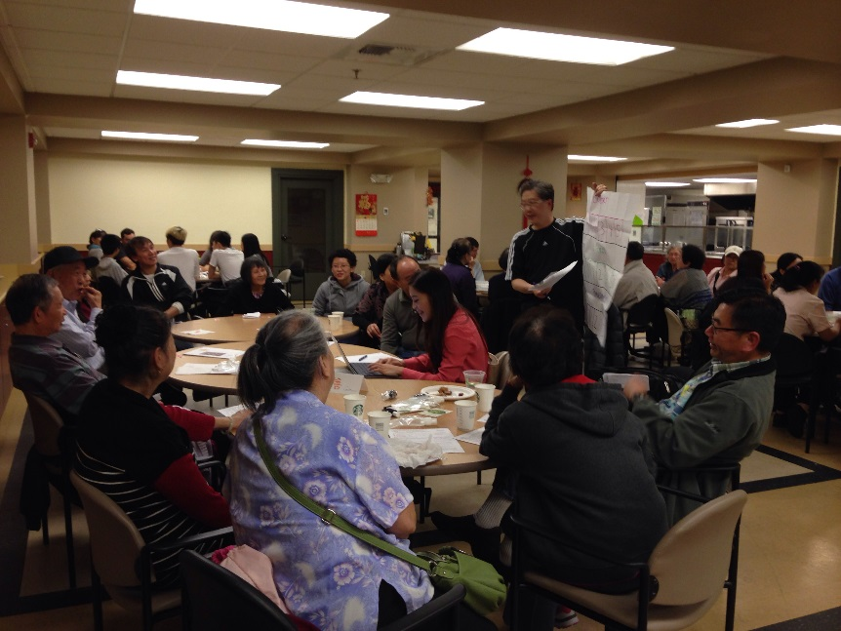
Citywide Actions
Sea level rise capital projects guidance
Equitable climate preparedness planning and evaluation tool
  Strategies
  Community-driven planning

Slide 7

Sectors
Transportation
Land Use & the Built Environment
City Buildings
Parks
Drainage & Water Supply
Electricity
Community Preparedness

Slide 8
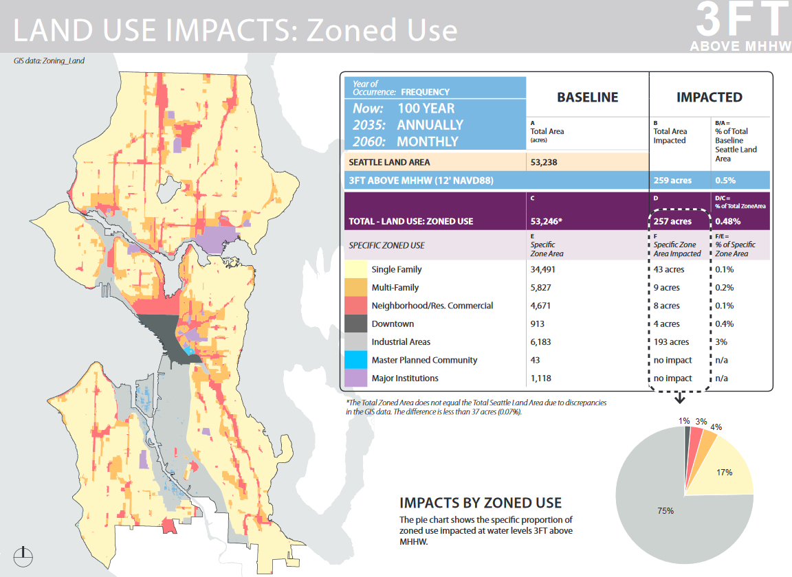
Land Use & Built Environment
Flooding
Landslides

Slide 9
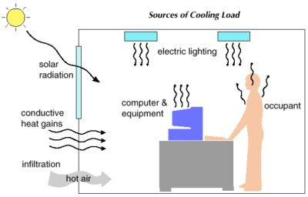
Land Use & Built Environment
Energy Management & Cooling

Slide 10
Land Use Actions - Planning
Mitigate heat islands (trees, GSI, etc)
Incorporate preparedness and passive survivability into planning and dev’t processes
Incent or require building upgrades to improve preparedness (passive cooling, energy storage, daylighting, passive survivability, etc.)
Consider impacts on communities of color and prioritize programs to mitigate those impacts

Slide 11
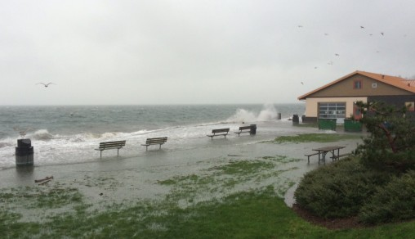
Land Use Actions - Floodplain
Evaluate benefits/costs of participating in CRS
Review Floodplain Ordinance & update maps
Consider rolling easements in next Shoreline Master Plan update

Slide 12
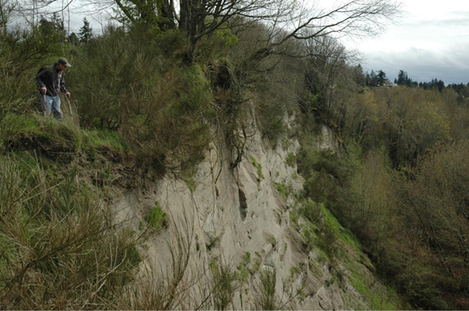
Land Use Actions – Landslide Hazards
Maintain citywide landslide data resource
Update the Landslide study
Evaluate mechanisms to support private drainage improvements

Slide 13
Built Environment Actions
Evaluate code opportunities to minimize energy use, particularly passive envelope strategies
Evaluate ASHRAE cooling temperature design standards
Support efficiency upgrades including use of heat pumps which also provide cooling
Encourage use of shade trees
Support adoption of heat pumps in community gathering places

Slide 14
Equity Goals
Reduce disproportionate climate risk and help ensure that the benefits and burdens of preparedness strategies are equitably shared:
Prioritize actions that help communities of color and lower income communities moderate potential impacts and cope with the consequences of climate change.
Empower frontline communities as leaders in the planning process.

Slide 15
Equity Actions
Develop an equitable climate preparedness planning tool to help:
  Identify who is benefiting/burdened by climate change and adaptation strategies
  Identify equitable adaptation strategies that function at the root causes of disproportionate vulnerability
  Conduct community-driven planning
Prioritize designated EEI Focus Areas and Populations.
Design planning processes to include community as partners, sharing decision-making power.
Foster social cohesion, a key factor in community resilience, through engagement and planning processes

Slide 16

Questions & Comments
Seattle Office of Sustainability & Environment
www.seattle.gov/environment

