Slide 1
City of Seattle Mandatory Housing Affordability Program
A program of Seattle’s
Housing Affordability and Livability Agenda

Slide 2

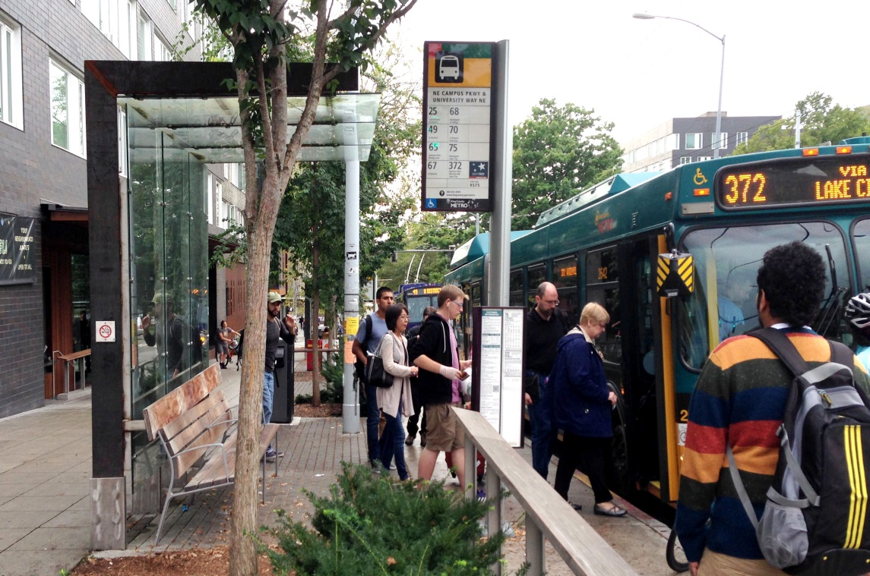

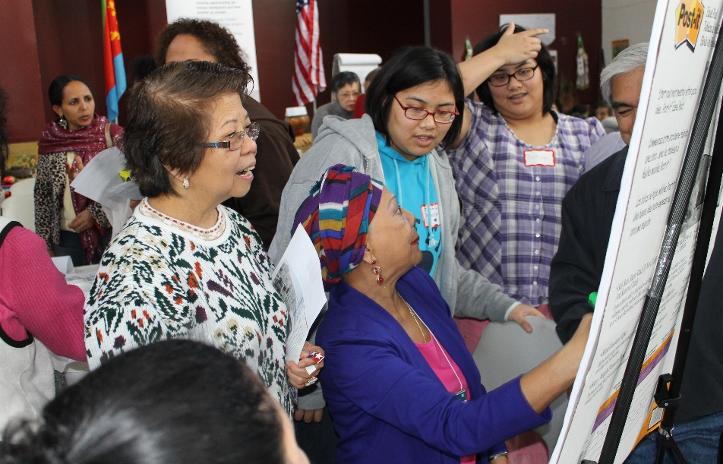
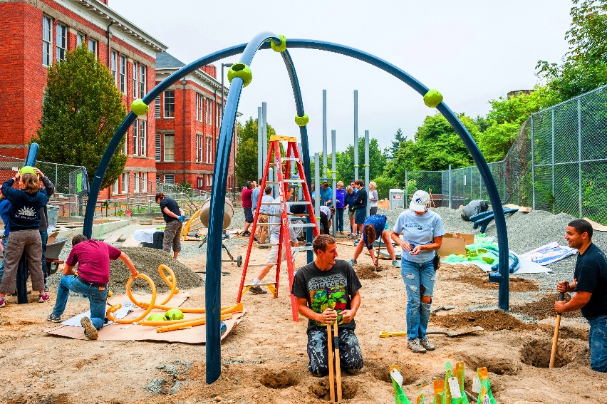
Investing In Our Communities.
Notes:
Investing in Our Communities
Improving Transportation and Mobility –
Investing in Transit 85% increase this year
Prioritizing Safety on our roads for all users
Advancing Race and Social Equity –
Enacting Sick and Safe Leave so everyone can care for themselves or their loved ones
Removing barriers for employment, housing and City services
Improving Access to Preschool
Making way for 2,000 more kids to attend preschool an effective way to close the achievement gap
Improving Parks –
Improving equipment and user experience and prioritizing investments in the areas our city growing most.

Slide 3
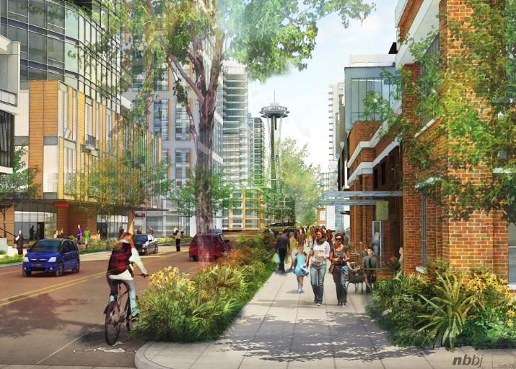
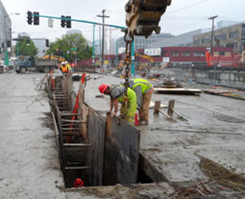
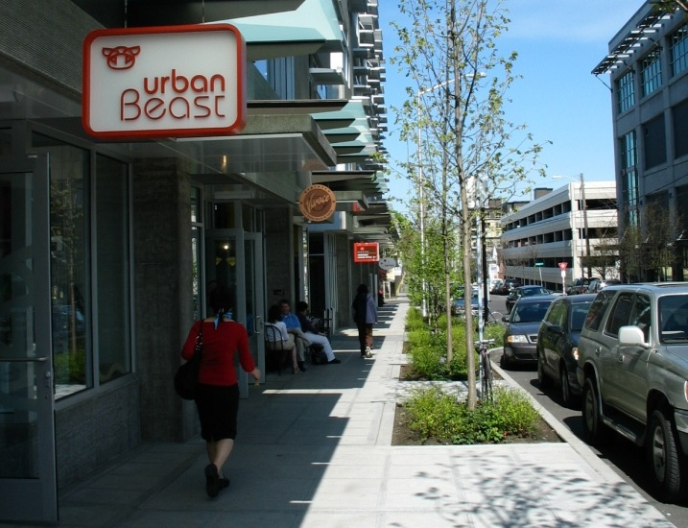
Development Contributions
New development is already required to contribute to:
Transportation
Streetscape Improvements
Utility Improvements
Child care, open space, historic preservation, farm & forest preservation (through Incentive Zoning)
Considering Impact Fees to fund open space and transportation improvements. Draft proposal out for public discussion in Spring 2016.

Slide 4
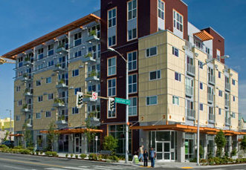
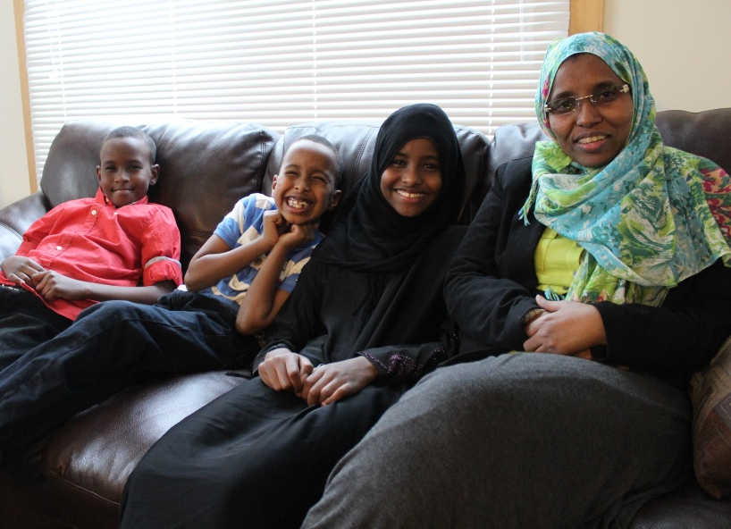
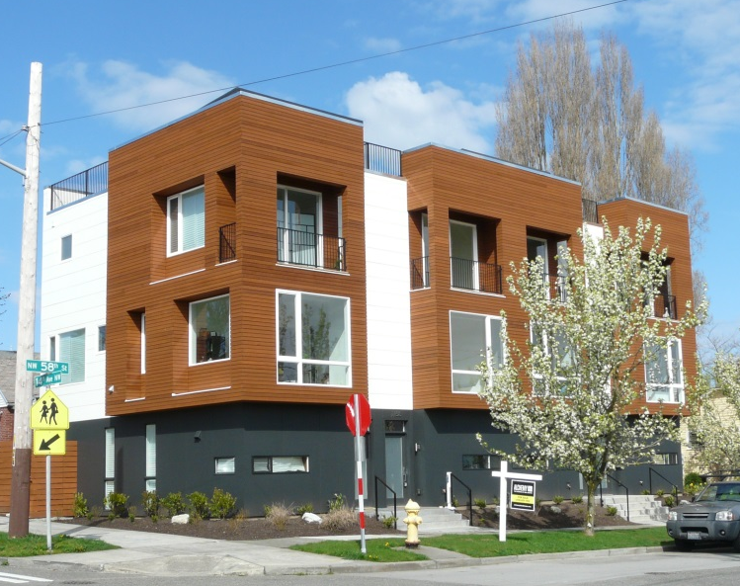
What is the MHA Program?
A new program to create affordable housing units as we grow.
Requiring that all NEW multi-family residential and commercial development contribute to affordable housing
Providing additional development capacity to offset the cost of these requirements
Utilizing a state-approved approach used by other local cities

Slide 5
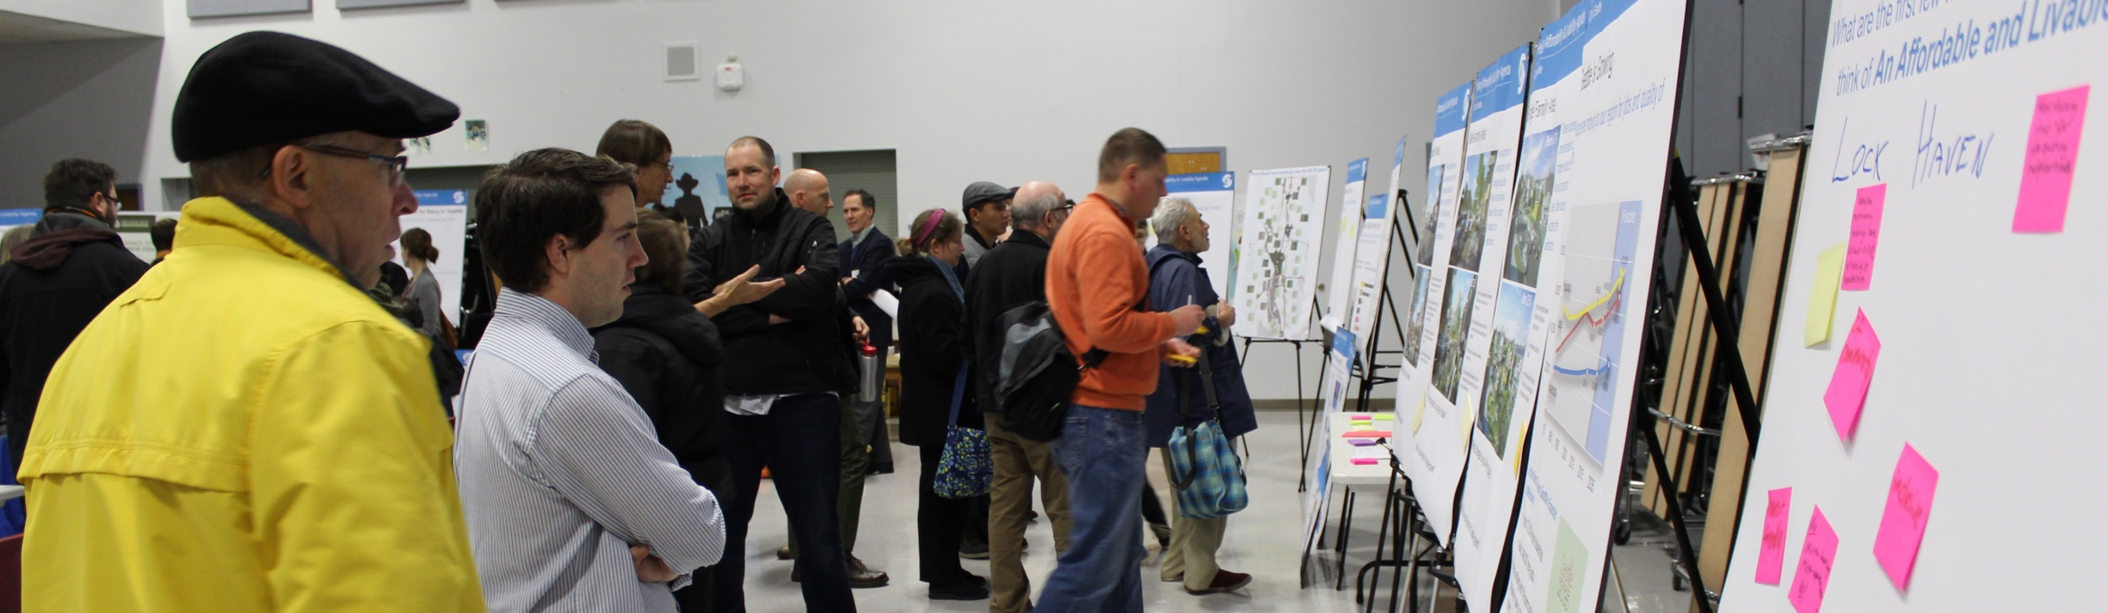
MHA Implementation
Creating a Framework
MHA-Commercial Structure (Complete)
MHA-Residential Structure (Spring/Summer 2016)
Zoning Changes and Implementation
Downtown, SLU, select neighborhoods (Summer 2016)
Remaining Areas (Spring 2017)

Slide 6
Affordable Housing Requirements
Principles
MHA program should:
Aim to generate 6,000 affordable units toward the 20,000 unit goal
Target households making less than 60% of Area Median Income
($38,000 for one person and $54,000 for a family of four)
Build upon existing Incentive Zoning program
Encourage a mix of performance and payment
Apply broadly while considering specific exceptions for historic areas, lakefront blocks, or the shoreline district
Notes:
Give examples of buildings $ and number

Slide 7
Downtown/SLU Implementation

Slide 8
Affordable Housing Requirements
Specific Proposal for Downtown & South Lake Union
Requirements vary by zone:
 | Payment Option (Per Square Foot) | Performance Option (Percentage)
Commercial | $8 to 18 | 5% to 11%
Residential | $5 to 13 | 2% to 5%
Notes:
Give examples of buildings $ and number
Think it is important to comment on the legal frame again, like those that have been successfully implemented in other local cities.

Slide 9
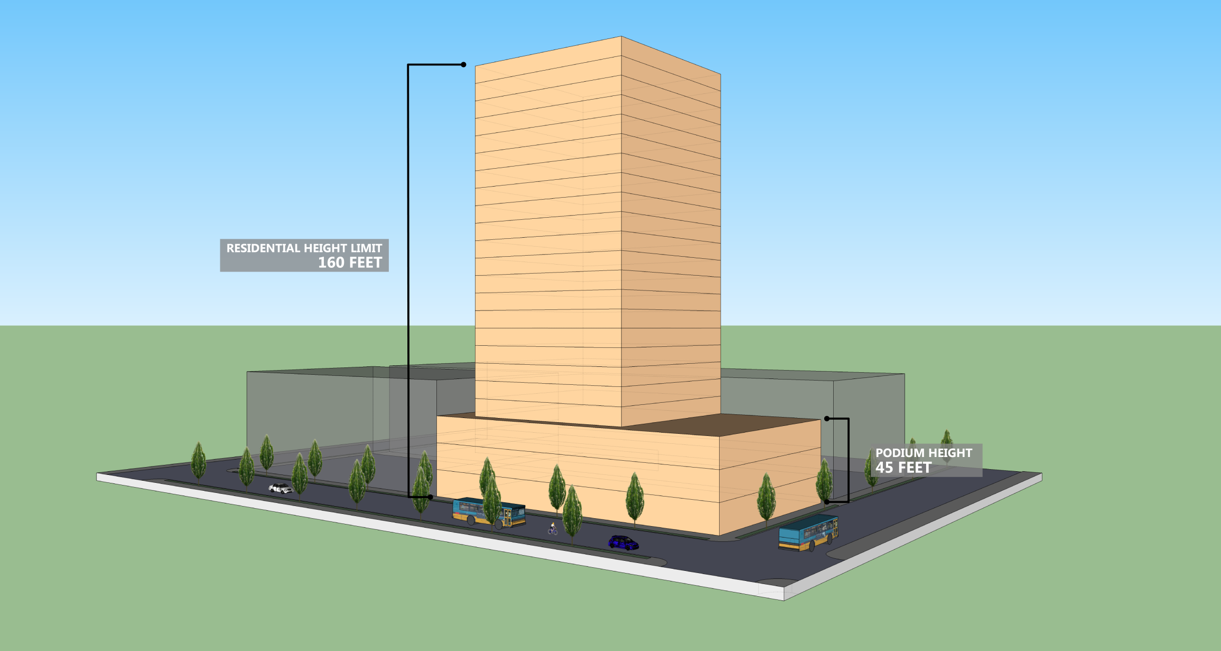
Residential Tower Example
Current

Slide 10
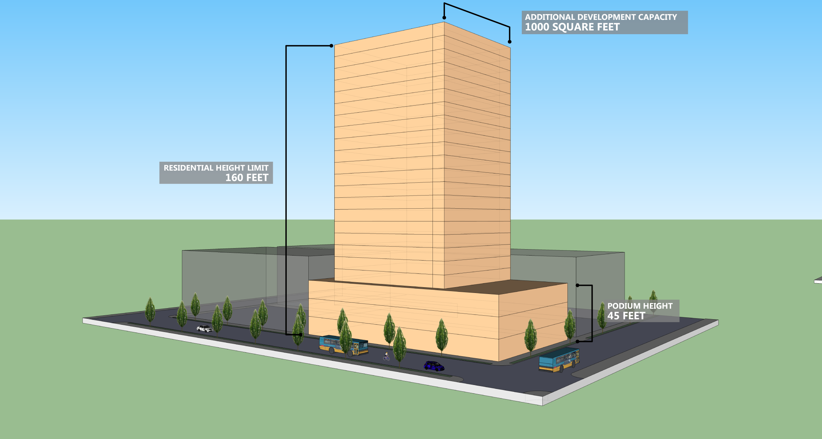
Residential Tower Example
Proposed: Increase maximum floor plate by 1,000 square feet

Slide 11
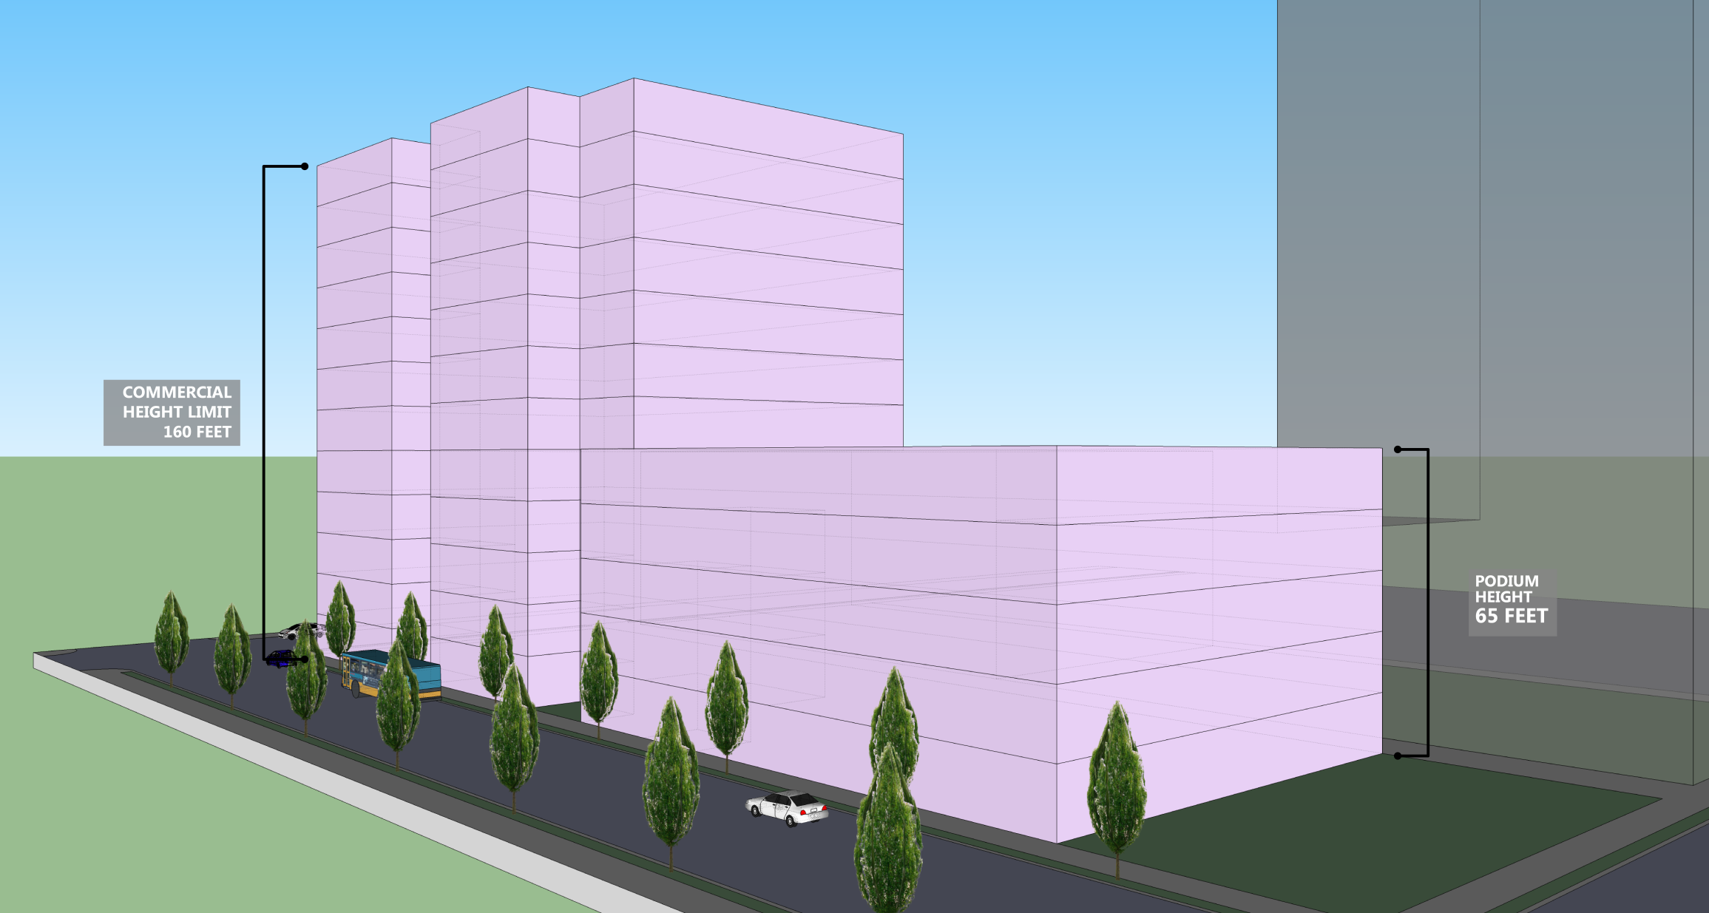
Commercial Tower Example
Current

Slide 12
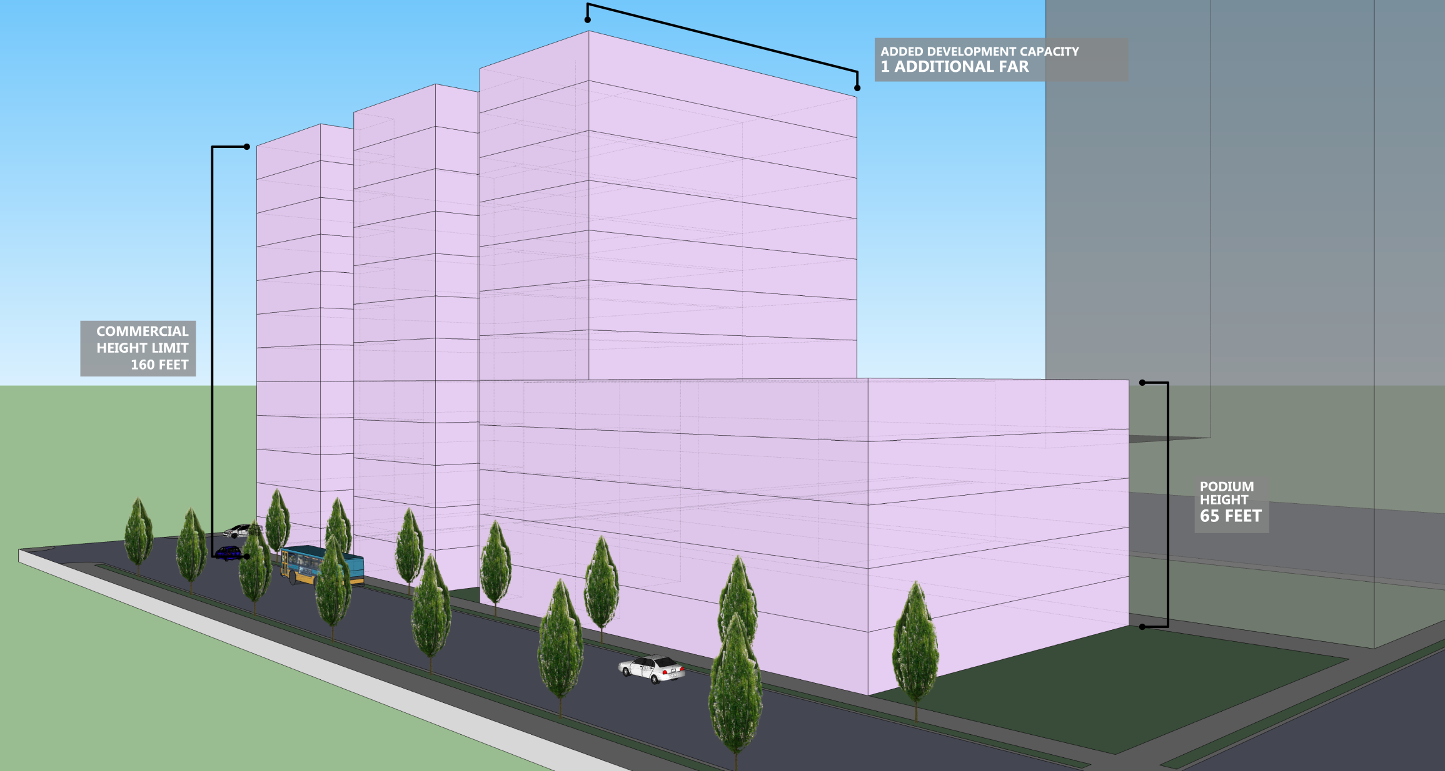
Commercial Tower Example
Proposed: Increase maximum Floor Area Ratio by 0.5 to 1.0

Slide 13
Issues to be studied
The following issues will also be studied as part of the implementation process in 2016:
Tower Spacing in DOC2 zones
Tower Coverage in SLU zones

Slide 14
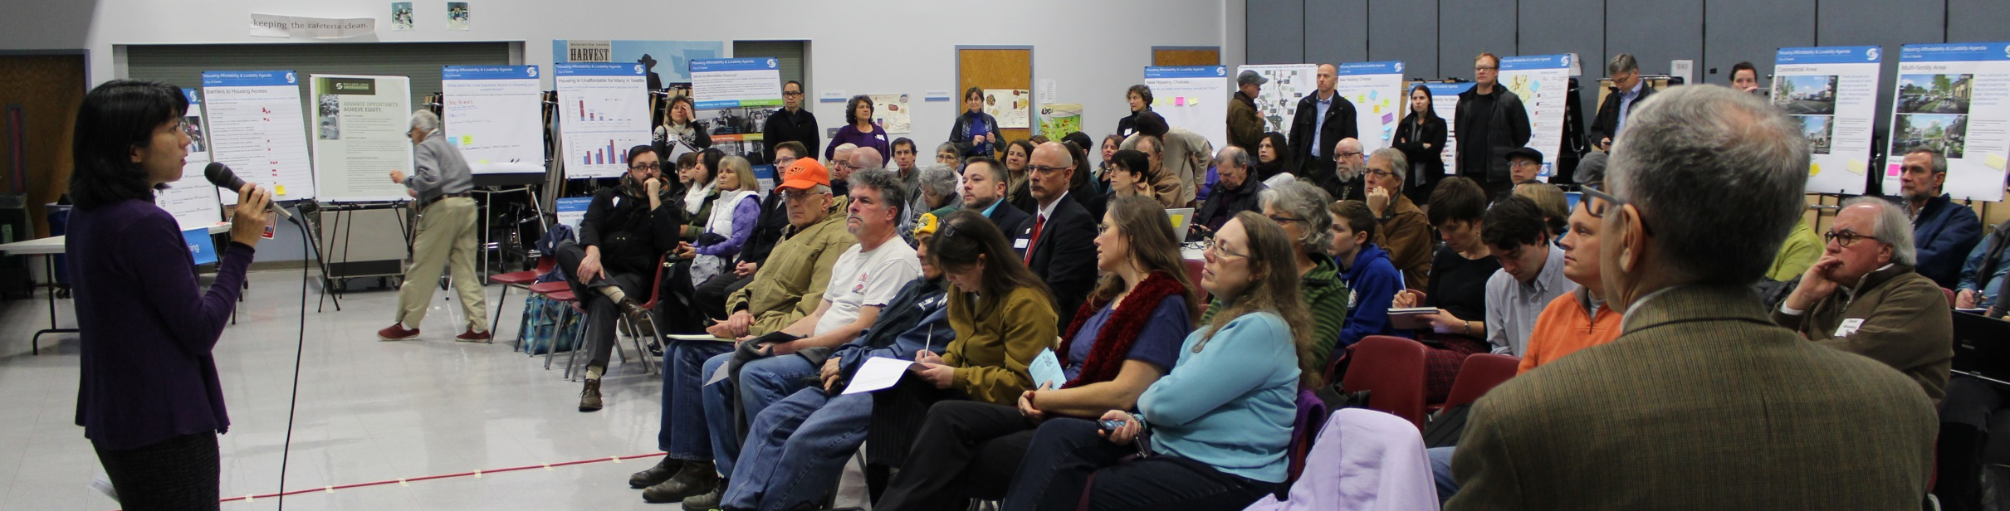
Next Steps
Presentations & Discussion
December 2015 - March 2016
Open House March 2016
Legislation to Council
May/June 2016
Potential Adoption September 2016
Notes:
Reiterate that the proposal will be rolled out in February after the community input. It is important to let them know that this is how we will shape and then report back!

Slide 15
Implementation outside Downtown/SLU

