Slide 1
SEATTLE PLANNING COMMISSION
Thursday, July 10, 2014
3:00 – 5:30 PM
City Hall, Room L280
Draft AGENDA revised 7/8/14
Chair's Report and Minutes Approval 3:00 – 3:15 PM
Update: Nathan Torgelson, Deputy Director DPD 3:15 – 3:35 PM
Report Out: Future Land Use Map 3:35 – 4:05 PM Commissioner Krikawa
Review: 4:05 – 5:05 PM Urban Village Draft Element
Staff Update: 5:05 – 5:25 PM Retreat
Public Comment 5:25 – 5:30 PM
ADJOURN 5:30 PM

Slide 2
Future Land Use Map Discussion
LUT received a briefing from Tom Hauger on the current DPD thinking.
LUT discussion report out today, no decision needed.
July 24th Full Commission to finalize comments on the comp plan review thus far.

Slide 3
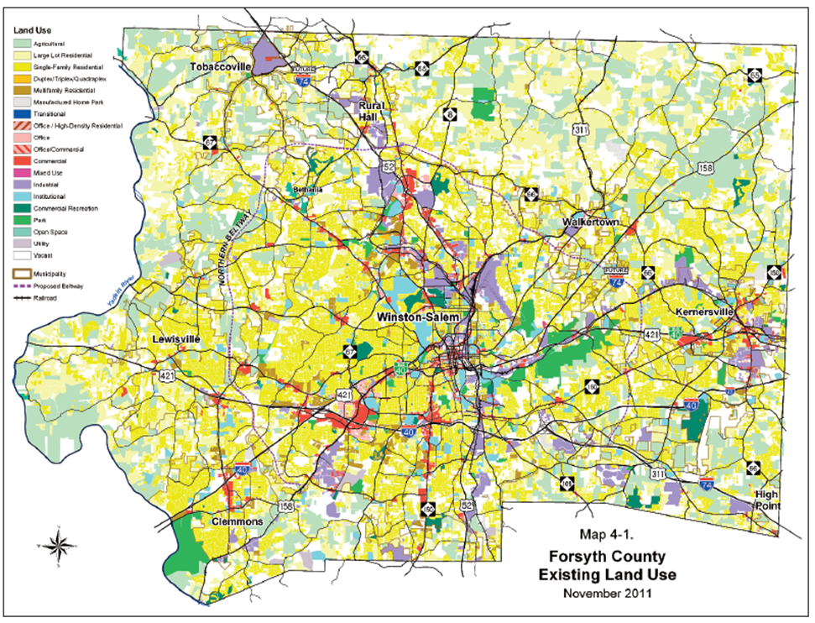
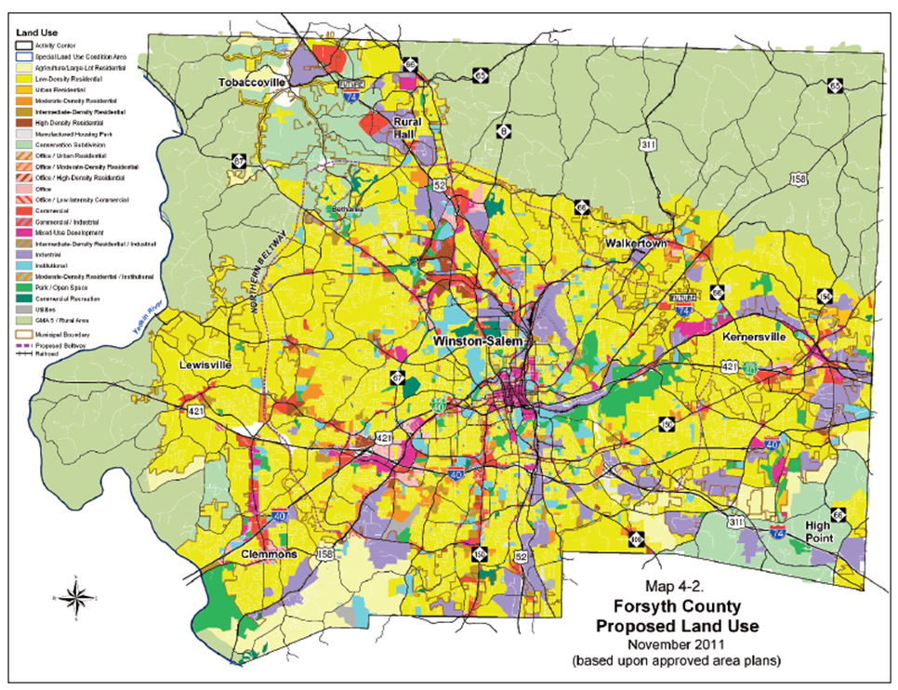
Future Land Use Map
Recommend an existing and a Future Land Use Map to show the vision.

Slide 4
Future Land Use Map
Urban Village is not a land use.
Possible to show as “Mixed Use/Commercial” land use (aka red).
Then ensure that the areas are defined to reflect vision in the Land Use Element –
Mixed Use/Commercial
LUG17 Create strong and successful commercial and mixed-use areas that encourage business creation, expansion and vitality by allowing for a mix of business activities, while maintaining compatibility with the neighborhood-serving character of business districts, and the character of surrounding areas.
LUG18 Support the development and maintenance of areas with a wide range of characters and functions that provide for the employ­ment, service, retail and housing needs of Seattle’s existing and future population.
LUG19 Include housing as part of the mix of activi­ties accommodated in commercial areas in order to provide additional opportunities for residents to live in neighborhoods where they can walk to services and employment.

Slide 5
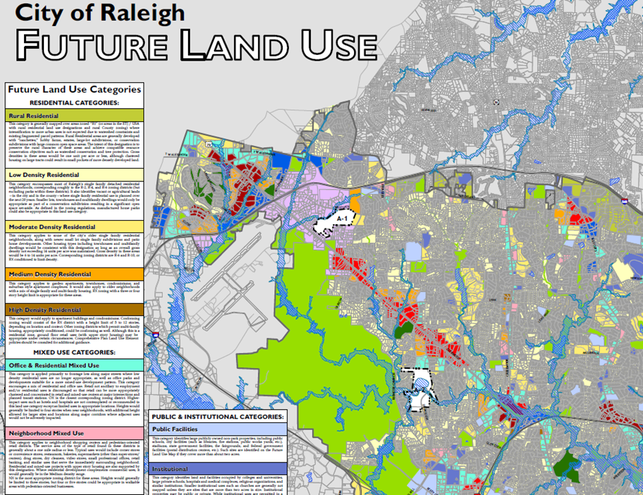
Future Land Use Map
A more defined legend could be helpful for community and developer predictability.

Slide 6
Legend Examples
Urban neighborhood | Predominantly residential area with a range of densities. May include other small-scale uses, including neighborhoods serving commercial, and institutional and semipublic uses (for example, schools, community centers, religious institutions, public safety facilities, etc.) scattered throughout. More intensive non-residential uses may be located in neighborhoods closer to Downtown and around Growth Centers. | Varies, but predominantly low density (8-20 du/acre); not intended to accommodate significant new growth or density Community corridor Primarily residential with intermittent commercial uses clustered at intersections in nodes. Commercial uses, generally small-scale retail sales and services, serving the immediate Medium density.
Neighborhood Centers (30 – 150 units/acre) – Compact mixed use areas that historically developed adjacent to major intersections. They are served by transit and include two, or more, of the following uses: residential, commercial retail, and office, small scale industry, institutional, and open space. Uses may be within a building or buildings with close proximity.

Slide 7
Future Land Use Map
Master Planned Developments should be removed from the FLUM as it is not a land use.
Changing the FLUM for Master Planned Development is part of the Land Use Code. This code should be changed because an MPD should be consistent with the surrounding uses.

Slide 8
Future Land Use Map
Discussion on the Executive Committees Work…

Slide 9
Future Land Use Map
Currently included on the FLUM are only Major Institutions.
Should all institutions big and small be included in FLUM?

Slide 10
Urban Village Discussion
First Draft of Urban Village Element completed June 2nd, currently scheduled for several more drafts.
Staff Review worksheet was prepared and sent as part of this Commission packet.
Transit Communities and Urban Village “type” definitions will be discussed at next weeks Comp Plan Task Force meeting.

Slide 11
Urban Village Discussion
Sample Goal statements to lead into chapter
The Urban Village Model will meet the Overall Core Value of Community by striving to create places, streets, and spaces that in aggregate meet the needs of people at all stages of life are visually attractive, safe, accessible, functional, inclusive, have their own distinctive identity, and maintain or improve local character.
The Urban Village Model will meet the Overall Core Value of Equity by creating spaces that serve the needs and aspirations of all its people, promoting health, resilience, and equity within Urban Villages. New development and public investments within Urban Villages are enduring and inclusive. The Comprehensive Plan should work to reduce disparities by working within the urban Village, Land Use and Housing Element to ensure the Plan meets its equity goals.
The Urban Village Model will meet the Overall Core Value of Environmental Stewardship through more compact land use pattern to support the efficient provision of public services, improve the performance of transportation networks, preserve open space, and reduce the negative impacts of low intensity and non-contiguous development on our natural systems.
The Urban Village Model will meet the Overall Core Value of Economic Resiliency by creating jobs that are appropriate for each Village type. By maintaining community based economies that promote living wage jobs, provide services for neighborhoods and allow for innovation and entrepreneurial growth.
Language drafted by SPC staff

Slide 12
Urban Village Discussion
Urban Village Distinctions:
Urban Center – Defined in draft element
Hub Urban Village – Defined in draft element
Residential Urban Village – Defined in draft element
Manufacturing Industrial Centers – Defined in draft element
Areas Outside of Urban Villages–not defined in draft element . SPC draft below
Areas Outside Urban Villages include: Low Intensity Residential, Medium Intensity Residential and some Mixed Use Land Uses. These areas include major corridors like Aurora Avenue and Rainier as well as many Single Family neighborhoods. It is important when developing Land Use Element, Housing Element and Capital Facilities to ensure that Areas Outside Urban Villages that are currently Low Opportunity are made priority based on measurable equity outcomes . Language drafted by SPC staff
There is not currently a goal for Areas Outside of Urban Villages. Should there be?

Slide 13
Urban Village Goal
(Pg. 3) UVG 1 Promote physical environments of the highest quality and emphasize the special identity of each of the city’s neighborhoods, particularly within urban centers and villages as the city grows and changes.
This is the single goal for this entire Element. Do we want to have something else reflected here?

Slide 14
Urban Village: Urban Design
GOAL: Maintain and enhance Seattle's character and sense of place, including its natural setting, history, human scale, and sense of community identity as the city grows and changes.
Do we want to talk about race/culture here. Do we want to be more explicit?

Slide 15
Urban Village: Urban Design
Natural Environment
Built Environment
Do we want to talk to the role of alleys?
Open Spaces
UD29 Consider the needs of growing demographic and ethnic groups in the design of public space.
Do we want to be specific about gathering spaces/community buildings?

Slide 16
Urban Village: Designate UV
Should the language be more proactive to state where new Urban Village should go?
Natural conditions, the existing development pattern, and current zoning are conducive to supporting denser, mixed-use pedestrian environments where public amenities and services can be efficiently provided.
Access to transportation facilities, including public transit, is good or can be improved
Do we want to say something about based on the adopted Transit Master Plan or the Future Transit Network?;
Public and private facilities, services and amenities, such as parks, schools, and commercial services, are available or can be provided over time; and
Existing public infrastructure has capacity or potential to accommodate growth.
Do we track what is adequate or able to accommodate? Should we?

Slide 17
SPC Annual Retreat recap
Conversation with john powell
Initiatives and efforts:
National APA conference
Participate in Regional Conversations
Economic Development Commission
Walking Tours
Improve working relationships with Elected Officials

