Slide 1



Seattle’s Equitable Development Initiative
Together we can leverage our collective resources to create communities of opportunity for everyone, regardless of race or means.
Notes:
Nora

Slide 2

Why an Equitable Development Initiative?
Can we grow with prosperity and stability?
Seattle is in an enviable position, our city is beautiful and our economy is strong – People continue to move here.
Our people are our most important assets.
We are an international city – a city that welcomes people who are finding their way in our culture after arriving from other countries.
We are a city that is founded by people making and building things – a city of working people.
This is Seattle now.
With citywide equity policies and strategic equitable investments, this can also be our future.
Notes:
Nora

Slide 3
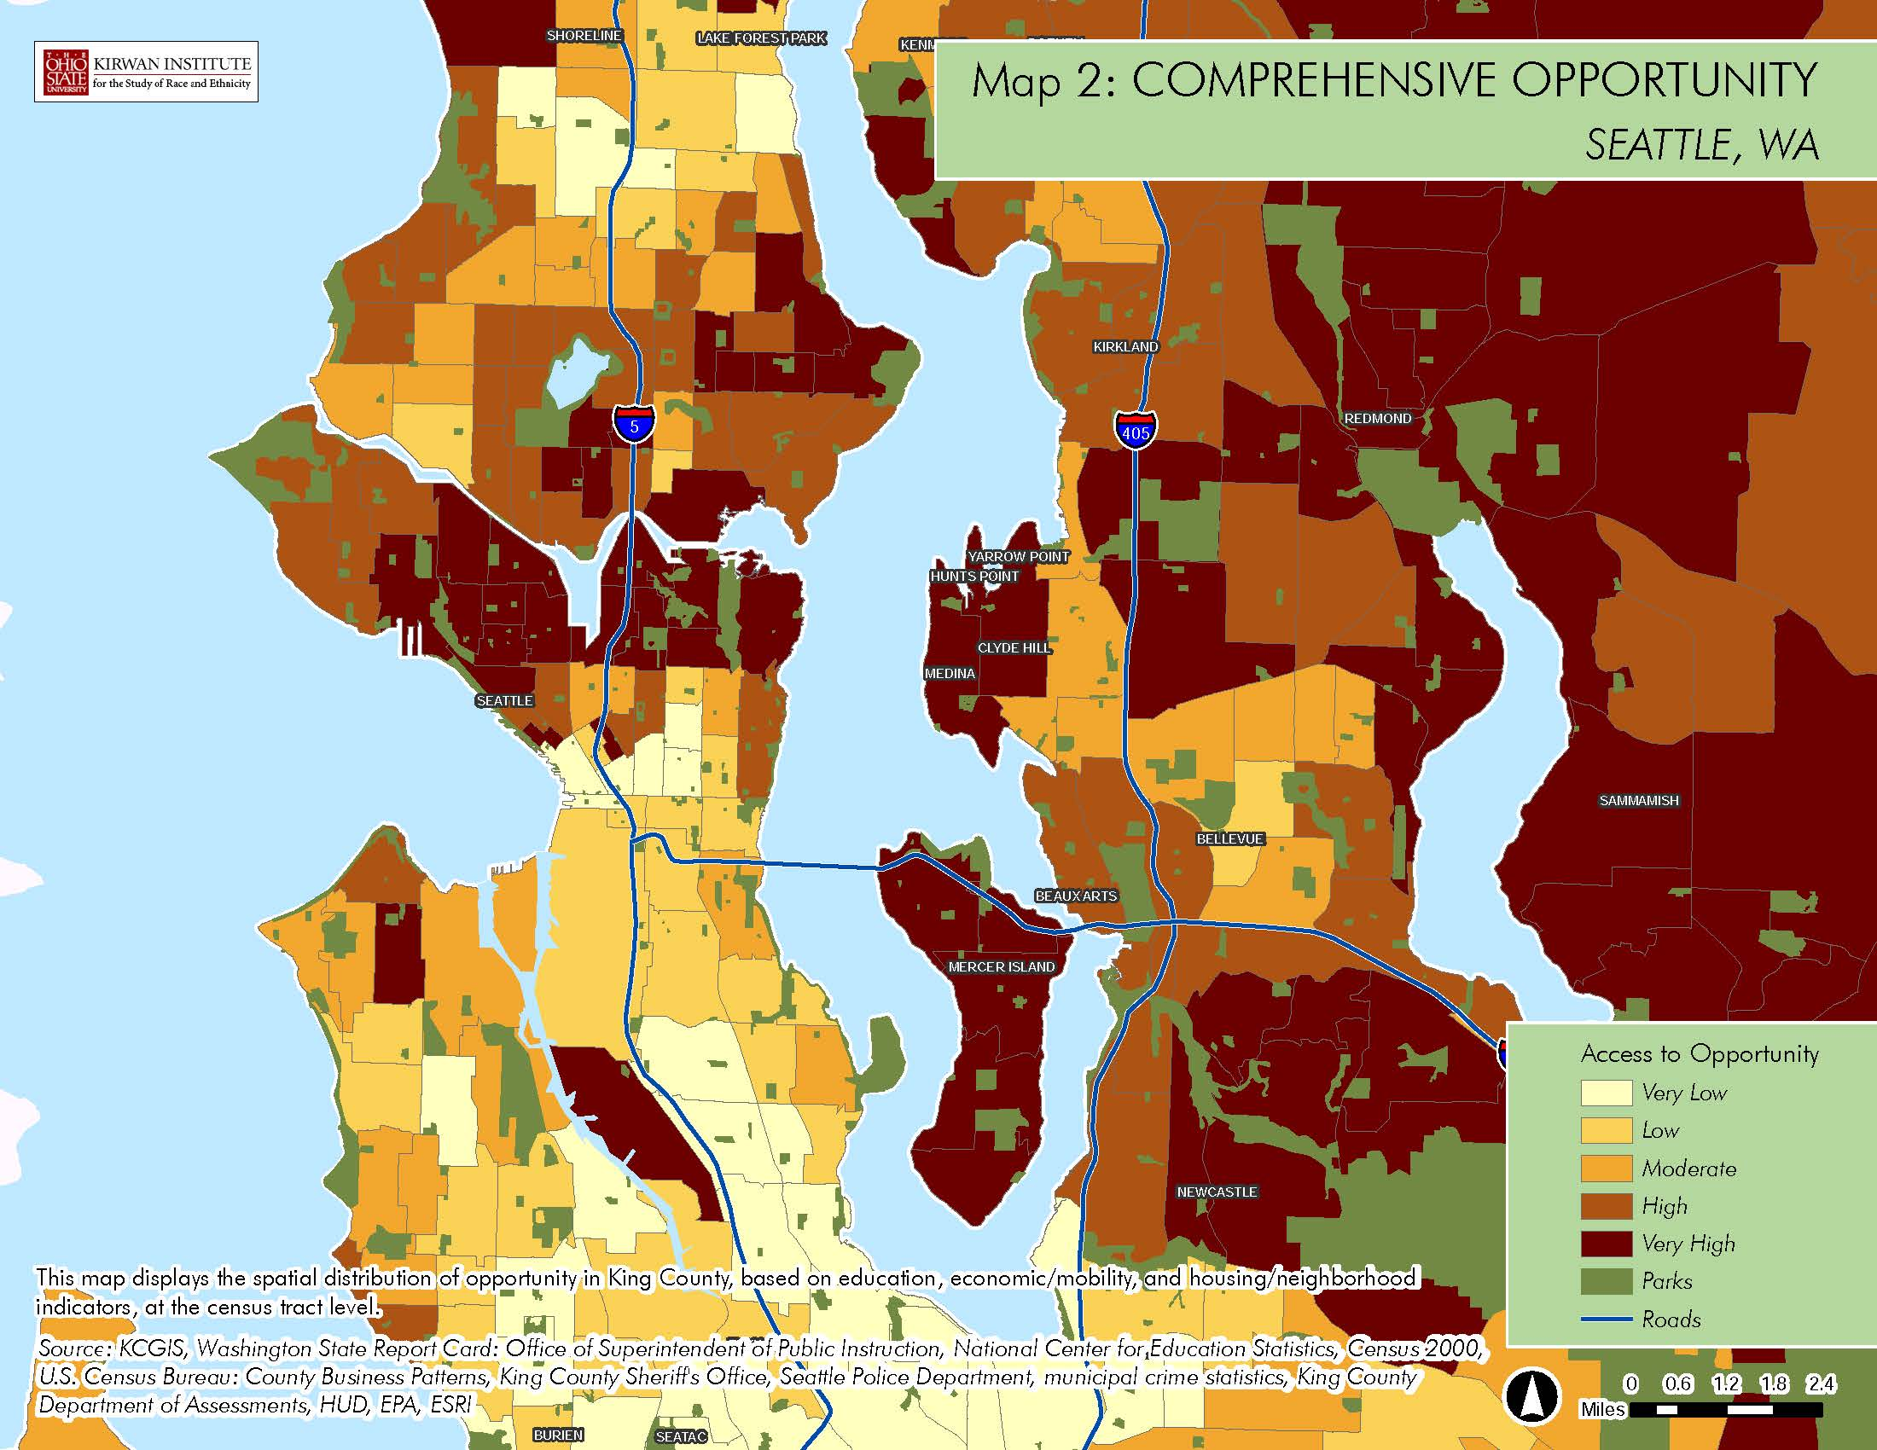
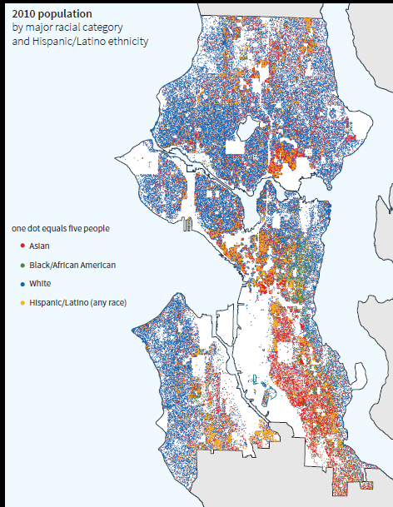
Notes:
Patty

Slide 4
Equitable Development Initiative
Authorizing Legislation RSJI Exec Order Resolution 31492 - Education - Equitable TOD - Criminal Justice - Equitable Development
Components:
Comprehensive Plan updated with clear equitable development goals and policies
Rainier Valley South Implementation to create new jobs and effective pathways to living wage careers for Rainier Valley
Equitable TOD Strategy with equitable development goals and investment priorities
Community Building creating the place and structure to support equitable participation and decision making
Outcomes:
Clear equitable development policies to guide Seattle’s growth citywide
Community stability and economic mobility in Rainier Beach and Othello
New partnerships with agencies and philanthropy
A diverse community working across cultural divides to determine its future
Notes:
Nora

Slide 5
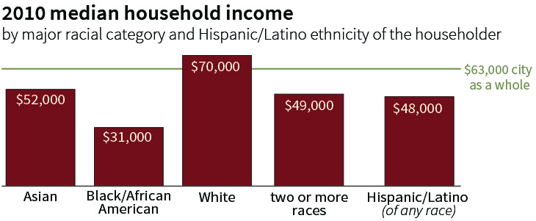
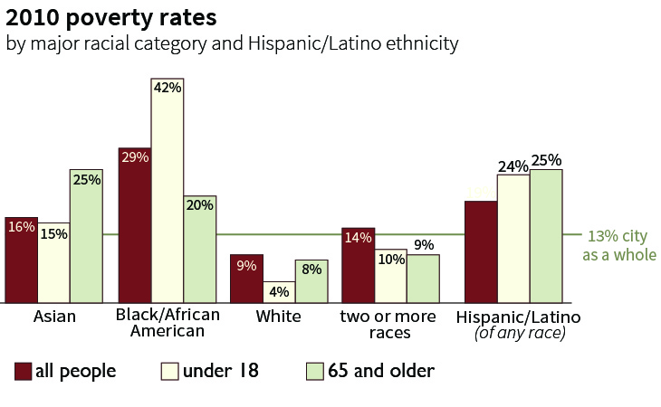
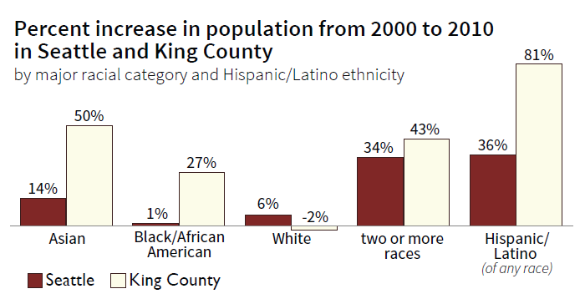
Comprehensive Plan update
Context: 70,000 new households & 115,000 new jobs over the next 20 years
Components
Establish clear context for equitable growth;
Update goals and policies;
Develop measurable goals; and
Prioritize public investments.
Outcomes
Clear policy guidance for equitable development;
Adopted by June 2015; and
Measurable outcomes identified.
Notes:
Ryan

Slide 6
PolicyLink Recommendations
Convey principles and broad expressions of values and policy commitments
Recognize and address cross-cutting issues, with focus on outcomes for people and places more than on administrative ‘silos’
Recognize and resolve internal contradictions in local policy
Build in flexibility for response to demographic, economic and technological change
Enhance and expand community engagement
Value community cultural identity and incorporating strategies to address it
Use plan as guidance for the entire City operation, not just the planning department
Notes:
Ryan

Slide 7
Road Map for Equity in Comp Plan
Clarity of vision for equity in the intro
Equity in the Comp Plan elements
Equity metrics and displacement early warning tool
Equity analysis of the growth scenarios
Community engagement
Notes:
Ryan

