Slide 1
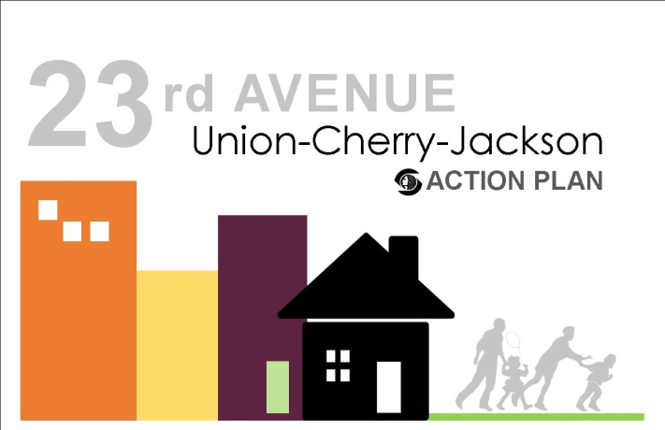
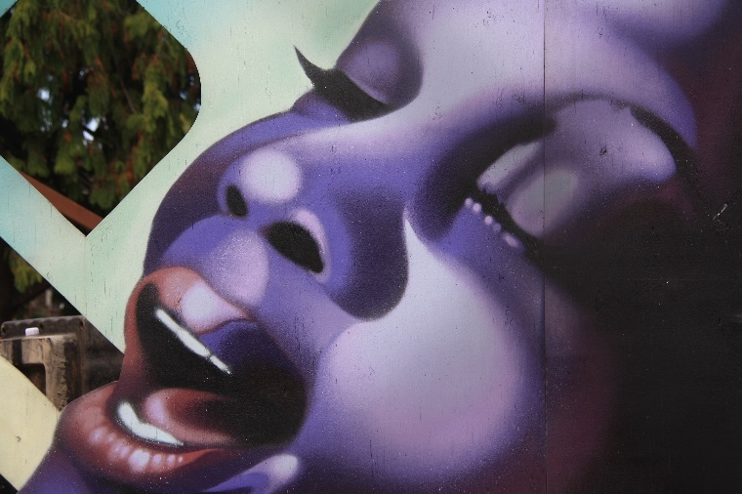
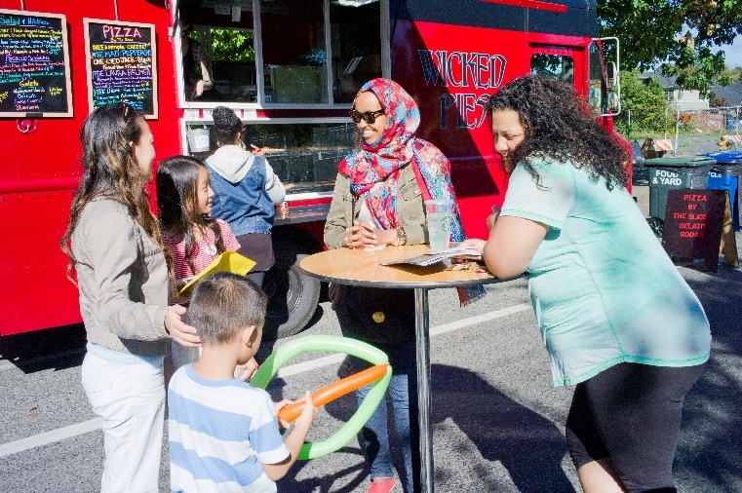
Planning Commission Briefing
August 25, 2016

Slide 2

Passion-Empowerment-Working Together
Today’s topics
  Project background
  Community process
  Deliverables
  Rezone recommendation

Slide 3
Project Background
  Why: leverage investment, generate community energy, foster collaboration
  What : focus on the heart of African American Community
  Challenges: displacement, distrust, no shared vision
Opportunities: shared vision, community building, leverage resources
Notes:
the center of the African American community
Black/African American declined from 64% in 1990 to 28% in 2010, while the White population increased from 16% to 44% in the same time period
Lots of assets, but not working together

Slide 4
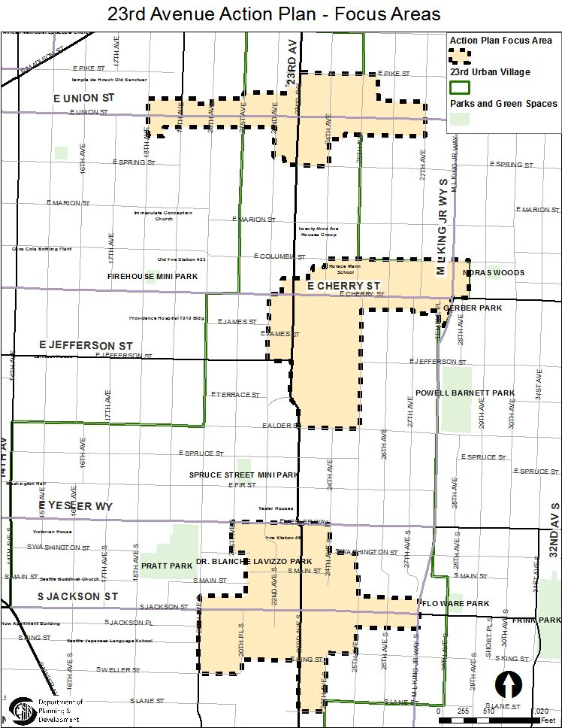
What is this Action Plan?
Create a shared vision and action items
Focus on 23rd Ave Union-Cherry-Jackson
Empower community and work together to make things happen
Leverage Investment
Notes:
Starting early 2013

Slide 5
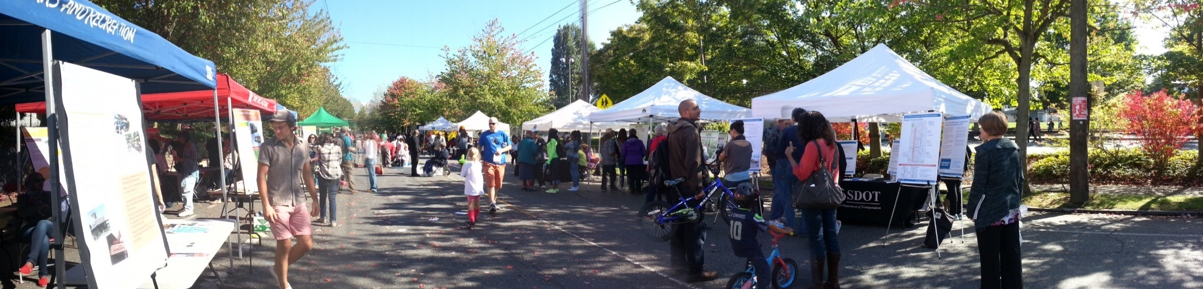
Community Process
23rd Ave Action Community Team (ACT)
  Ensure community voice and balance of interests; take actions
Community meetings
  Over 100 meetings, 2,000 participants, 40 community organizations
Public Outreach & Engagement Liaisons (POEL)
    Under-representative community
Notes:
Over 3 years community process
POEL: east African (Afaan-Oromo, Amharic, Tigrinya), Spanish, African American, Youth, Senior
POELs are expert "bridge-builders" who are bi-cultural and bi-lingual. Their work is conducted in a culturally-specific manner allowing participants some comfort and familiarity while navigating the City's processes.

Slide 6
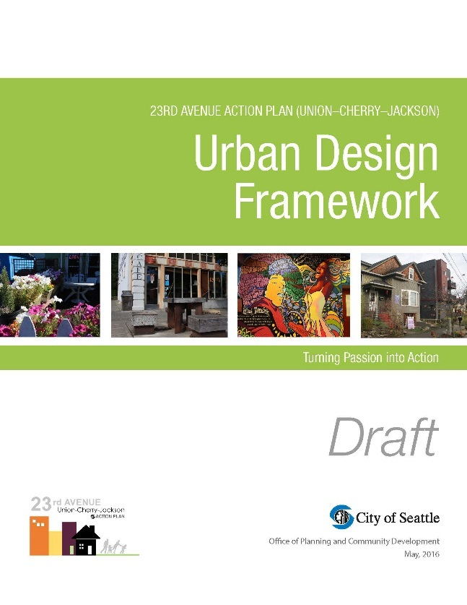
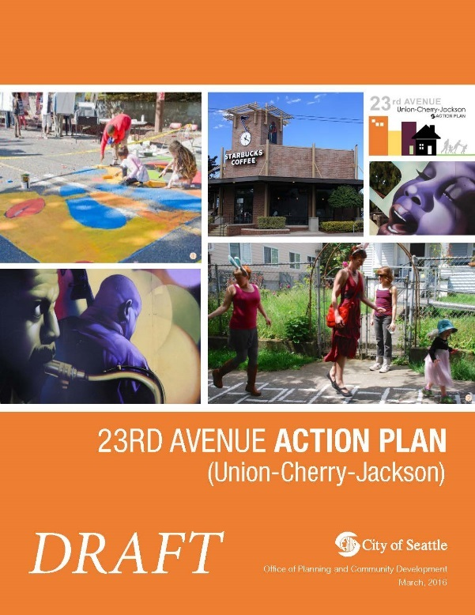
Deliverables
23rd Ave Action Plan (Union-Cherry-Jackson)
Urban Design Framework
Rezone
Central Area Neighborhood design guidelines

Slide 7
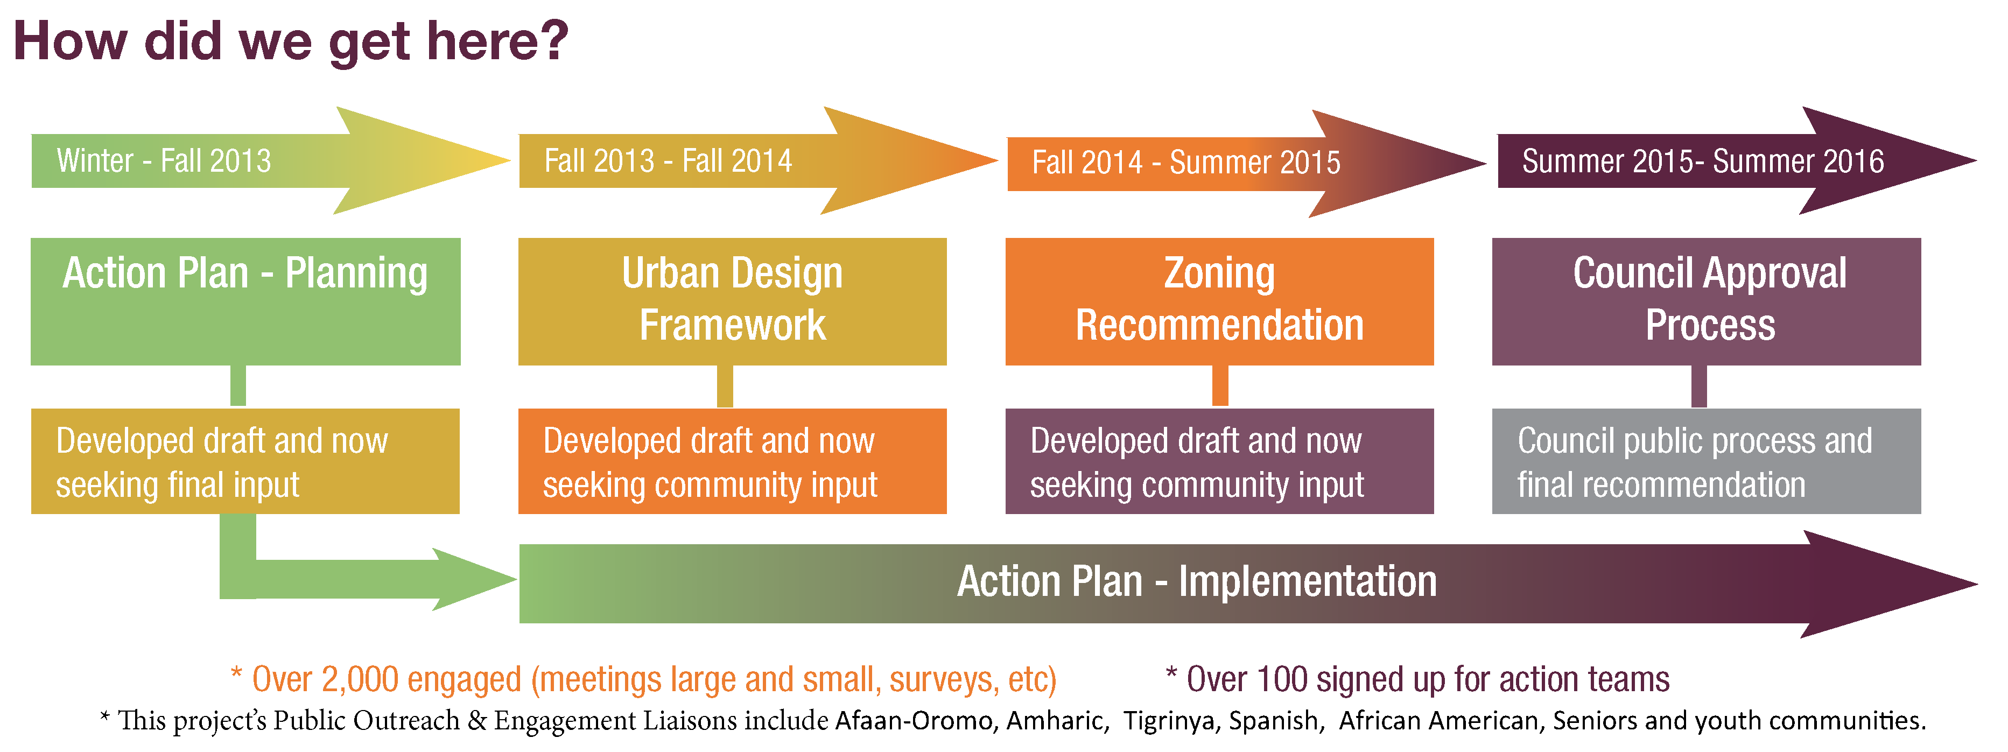
Timeline

Slide 8
Rezone Recommendations
Rezone intent
create vibrant commercial districts that encourage pedestrian friendly mixed use development
provide opportunities for a variety of shops & services
Support existing and new businesses and development
Provide affordable housing
Strengthen the Central Area’s unique identity and community character

Slide 9
Rezone summary
Along 23rd Ave at Union, Cherry and Jackson
a total of 111 parcels on approximately 22 acres of land

Slide 10
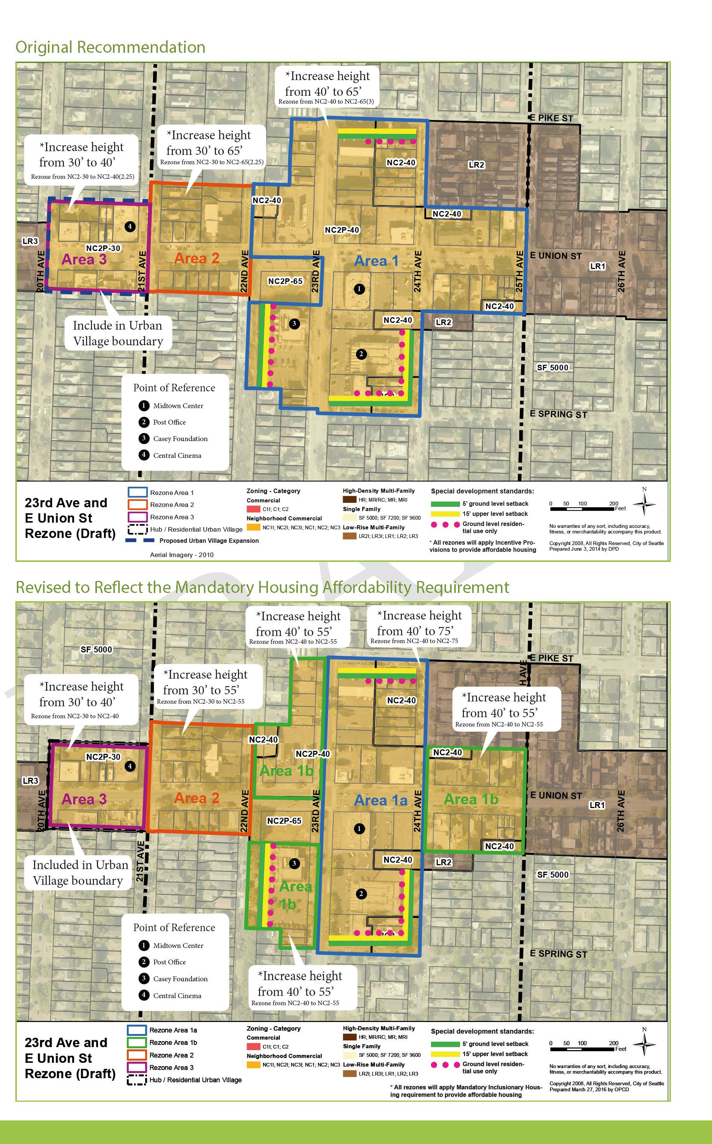
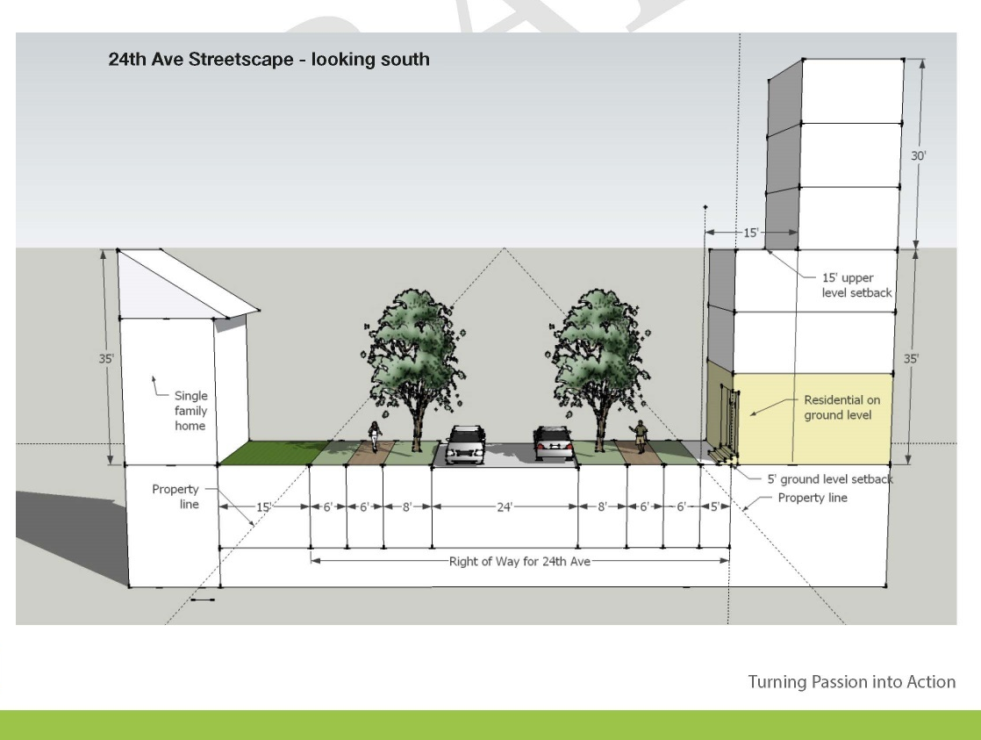
23rd and Union Rezone
total 74 parcels, 11 acres
Increase capacity: 298 units, 54,835 sf of commercial, 183 jobs
Notes:
Central cinema, uncle ike’s

Slide 11
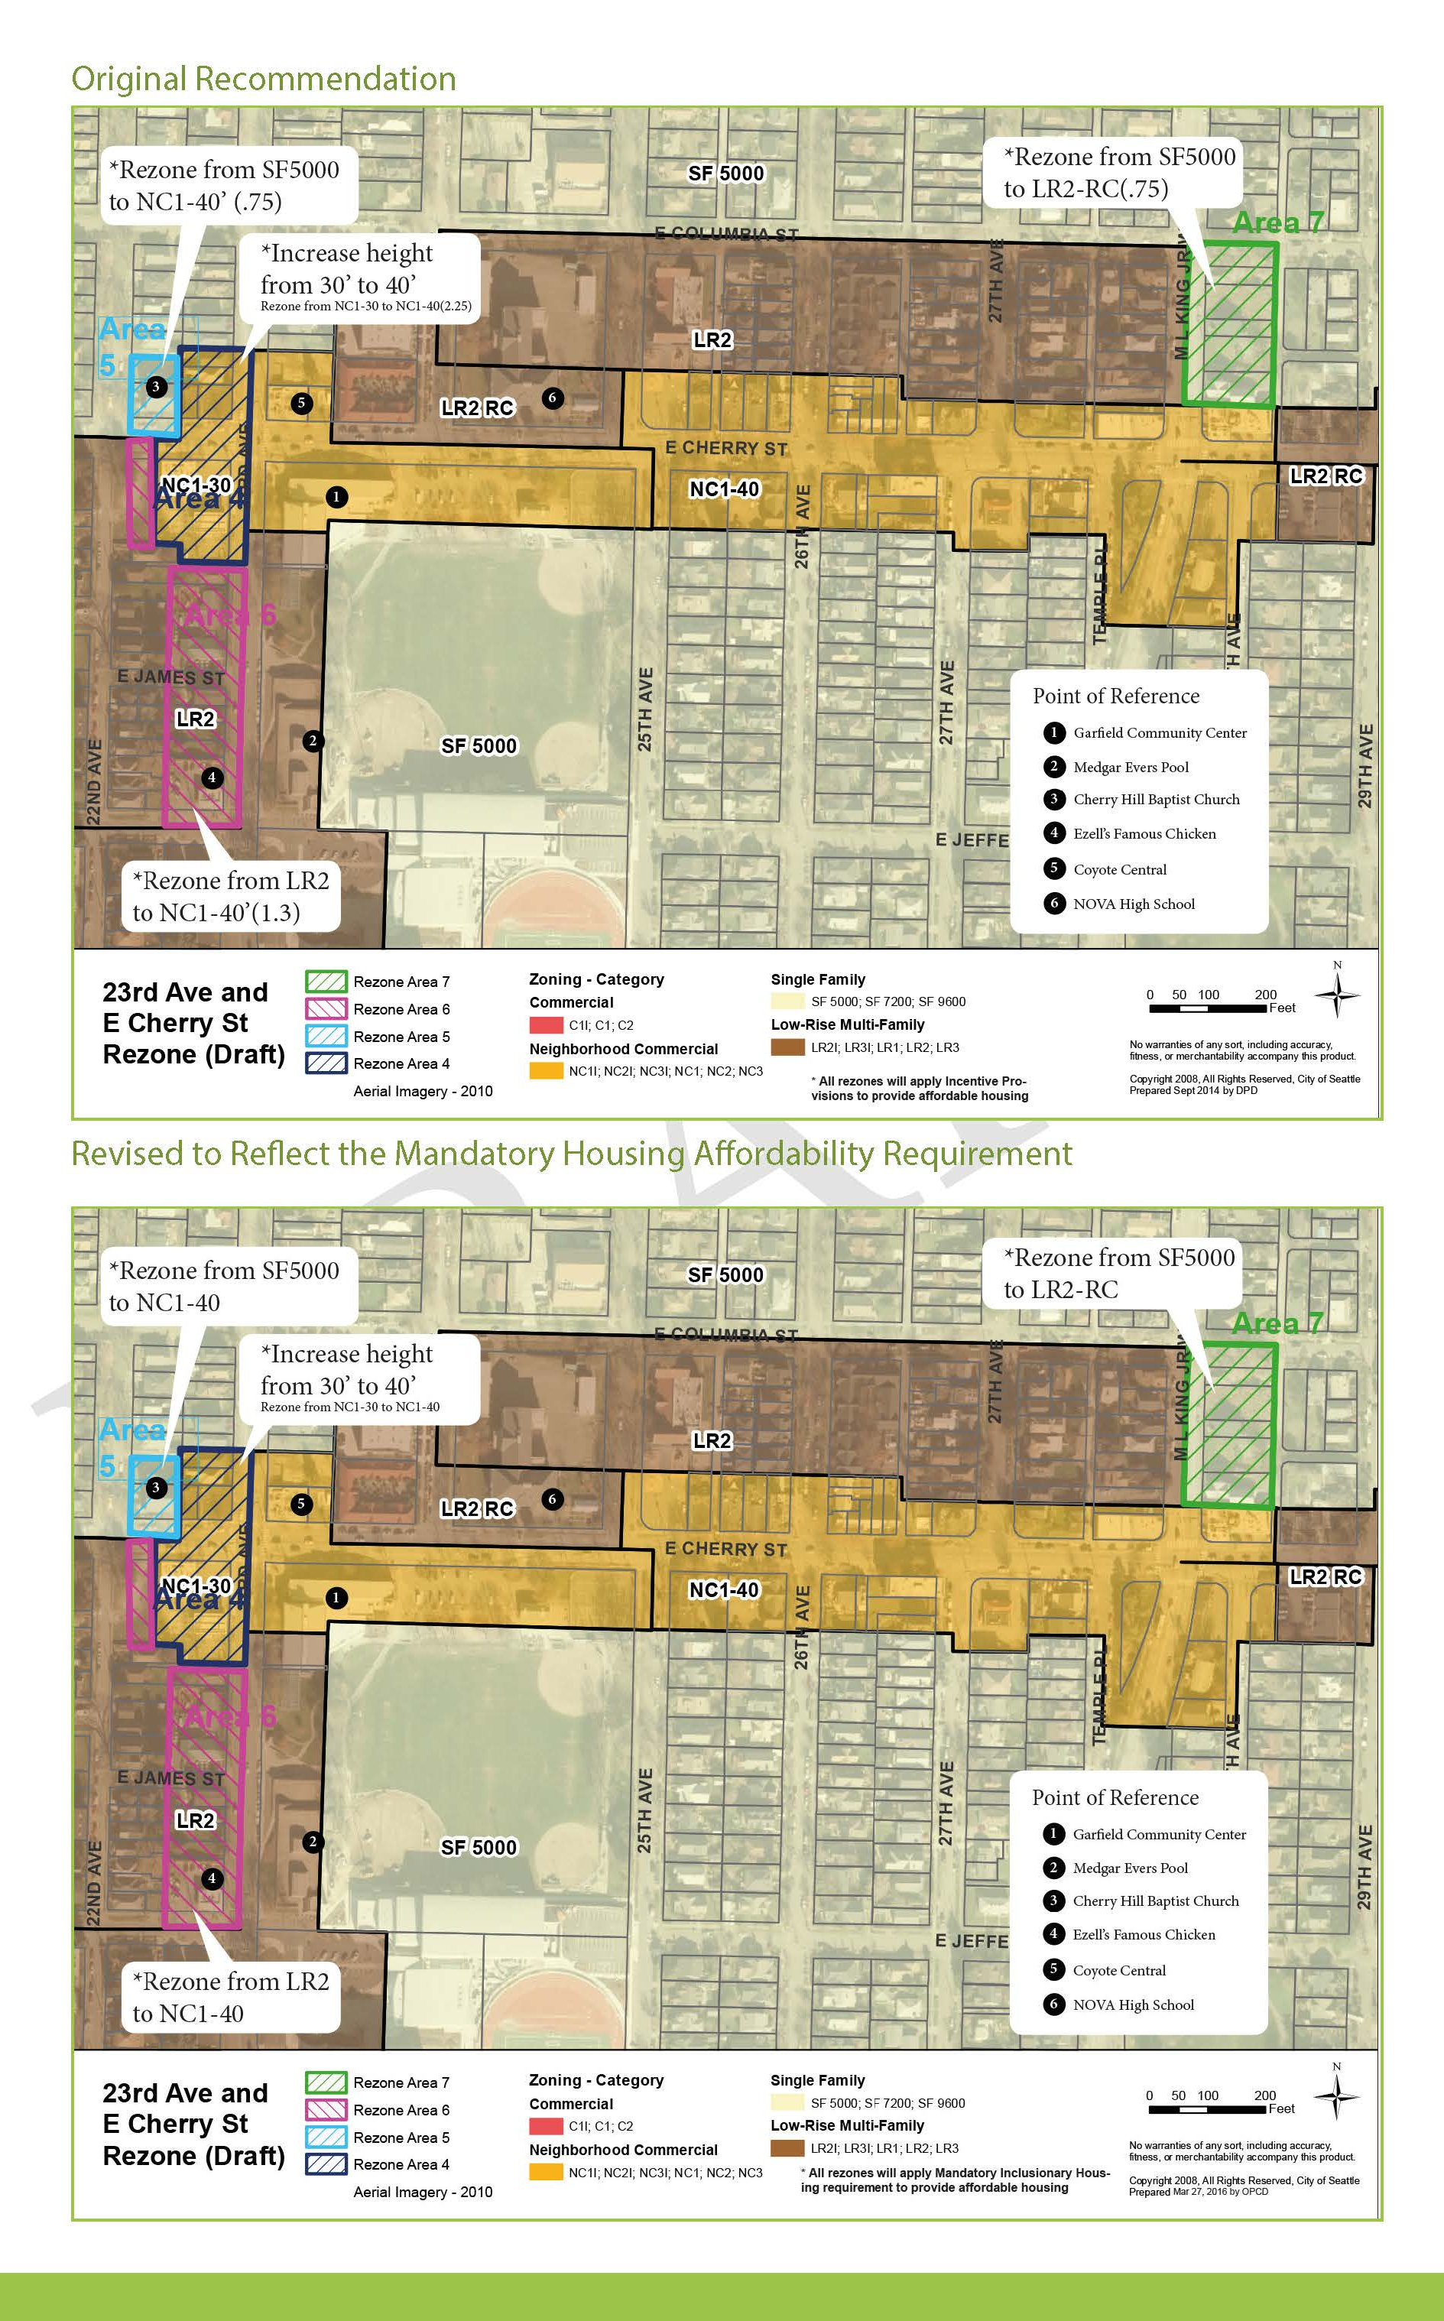
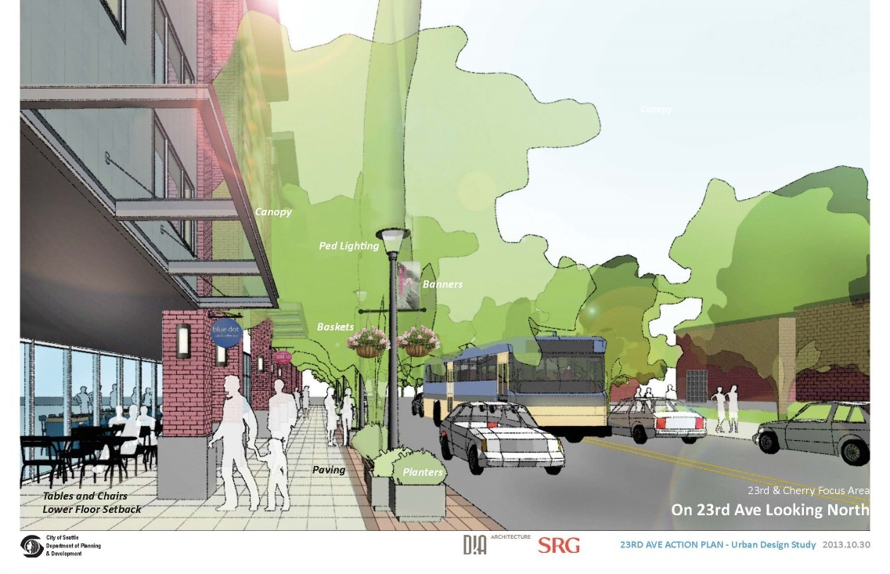
23rd and Cherry Rezone
total 20 parcels, 3 acres
Increase capacity: 98 units, 41,675 sf of commercial, 123 jobs
Notes:
Garfield high school, community center, pool, Ezell’s chicken, Ethiopian restaurant

Slide 12
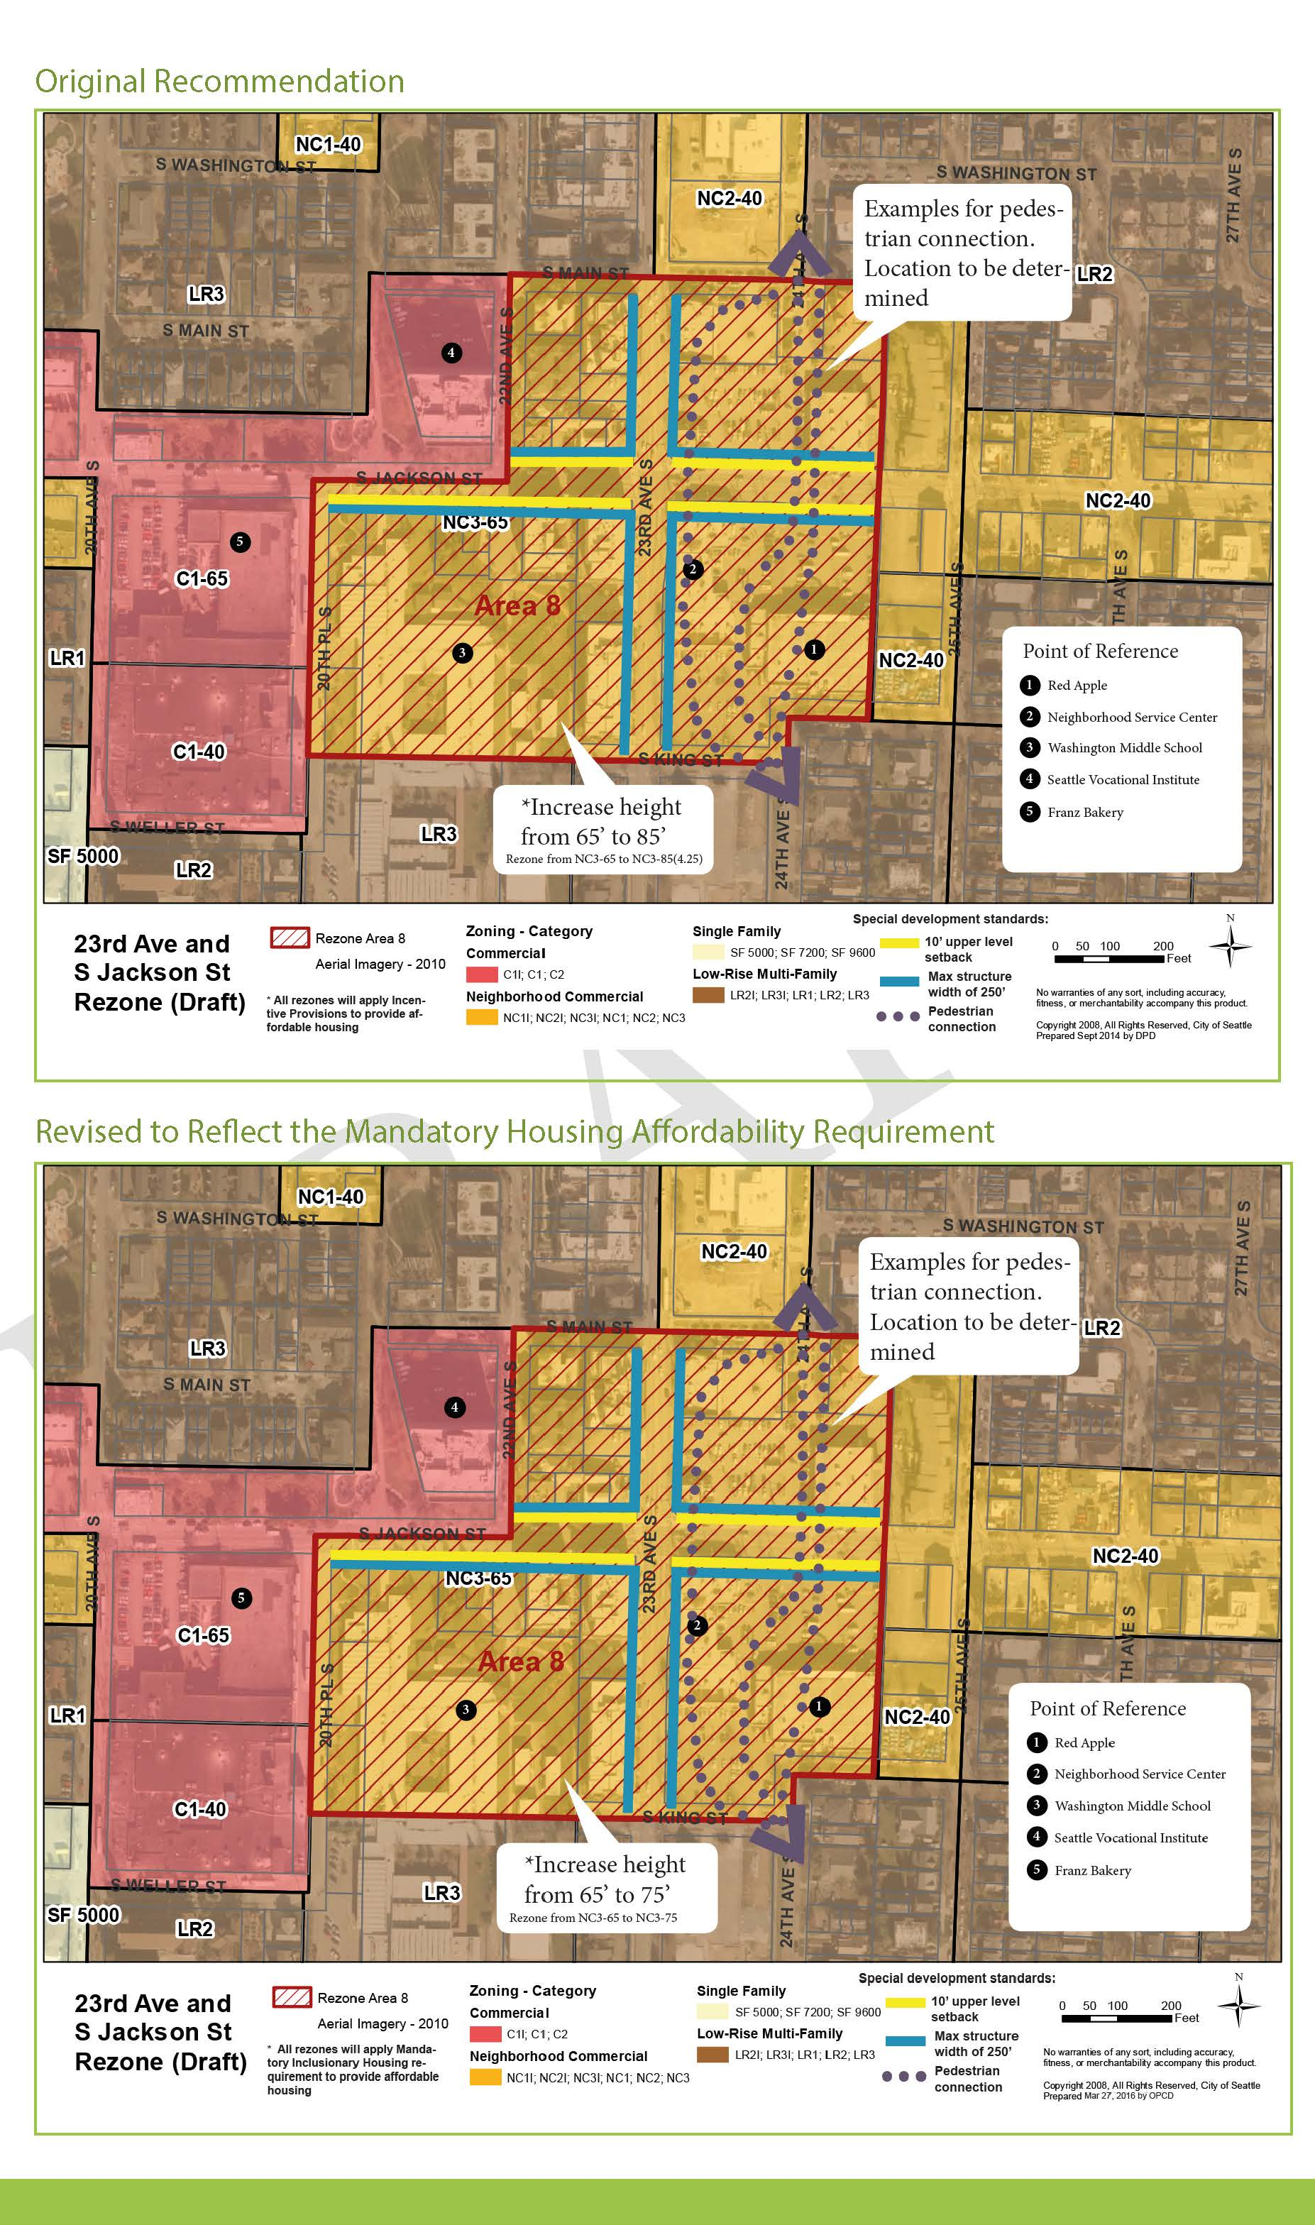
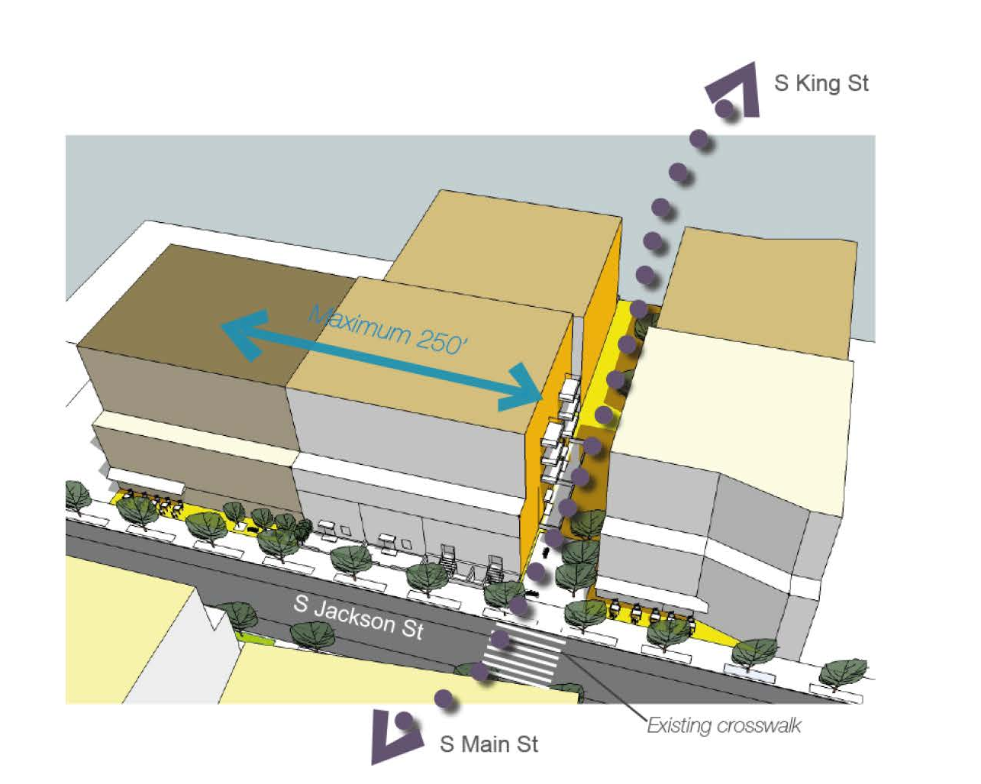
23rd and Jackson Rezone
total 17 parcels, 9 acres
Increase capacity: 187 units, 46,863 sf of commercial, 156 jobs
Notes:
Future Vulcan development, red apple, Starbucks for east African gathering, pratt, Washington middle school

Slide 13
Current challenge and efforts
23rd Ave street construction – displacement concerns
Missed opportunities – Vulcan development, Lake Union Partner
Impact to other property/business owners (Capitol Hill Housing, Bangasser, Ezell’s, church, CAYA etc)

Slide 14
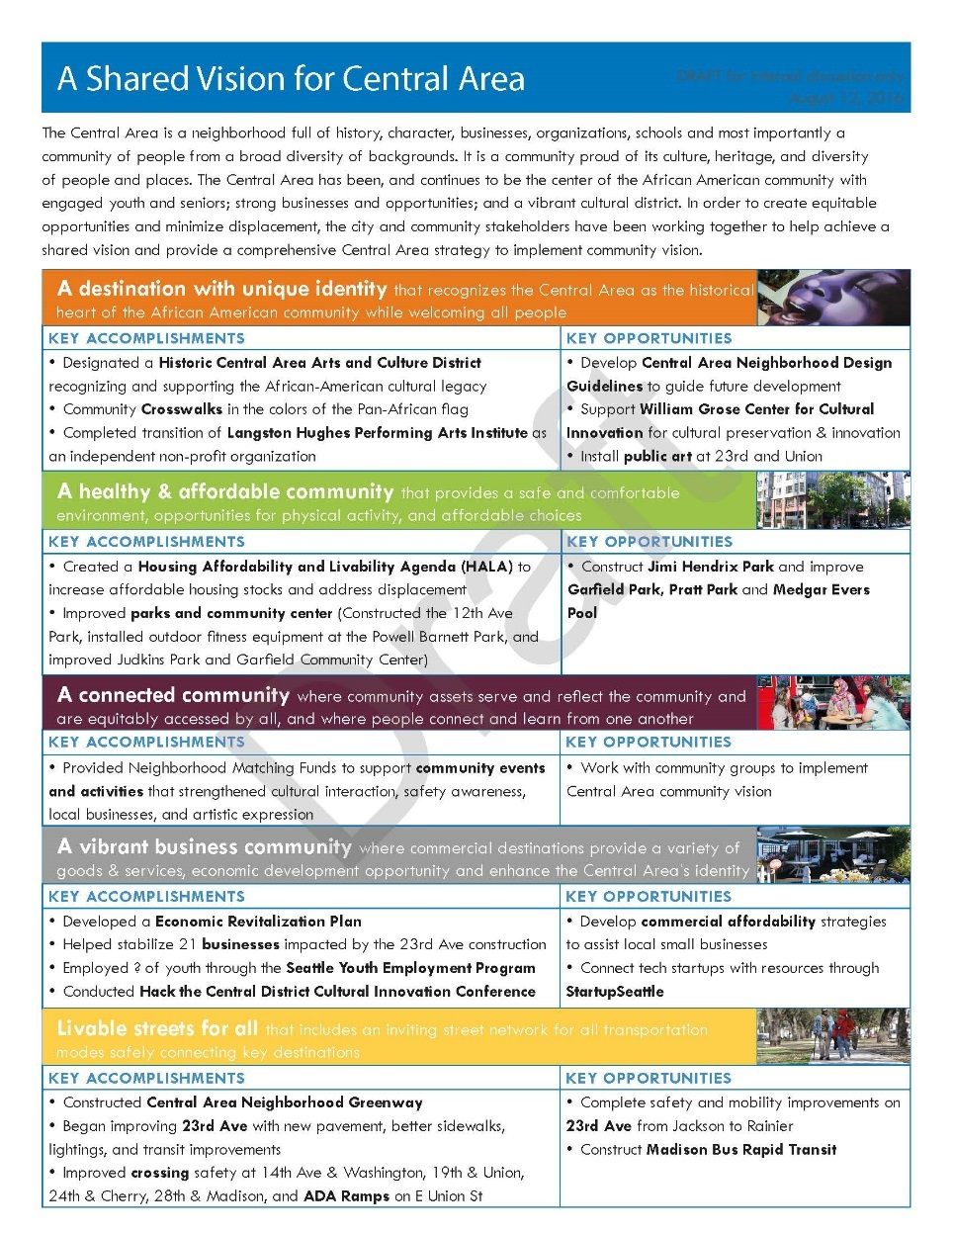
Current challenge and efforts
Coordinate work in the Central Area
  Central Area Integrate Plan document
  Central Area Interdepartmental Team
    23rd Ave street construction
    Historic Central Area Arts and Culture District
    Central Area Economic development plan
    Neighborhood Design Guidelines

Slide 15
Questions?
Quanlin Hu
Office of Planning and Community Development
206.386.1598
quanlin.hu@seattle.gov

