Slide 1



Utilizing GIS and Community Engagement to Promote Bicycle Safety in Seattle: A Profile of Bicycle-Related Collisions and Fatalities from 2010 to 2014
Seattle Bicycle Advisory Board (SBAB) Meeting
December 7th, 2016
Christina Yantsides, MPH Public Health – Seattle & King County Violence and Injury Prevention (VIP)

Slide 2

BACKGROUND
Bicycle Injuries and Deaths ⬆ in US
Bicycling benefits: health, economic, social, environmental
Alignment with Traffic Safety Initiatives
WA State and Seattle Target Zero

Slide 3
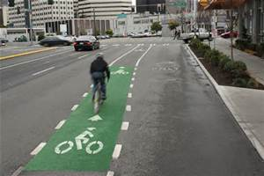
OBJECTIVE
To gain a greater understanding of the causes of bicycle-related injuries and fatalities in Seattle, to develop recommendations to promote bicycle safety and equity.

Slide 4
METHODS: Quantitative
GIS Mapping of Bicycle-Related Collisions
SDOT Bicycle Data: January 2010- December 2014
Descriptive data analysis
Bicycle Fatality Review (BFR)
King County Medical Examiner Office (MEO) → medical examiner reports, death certificates, police reports, autopsy and toxicology results
Field Observations

Slide 5
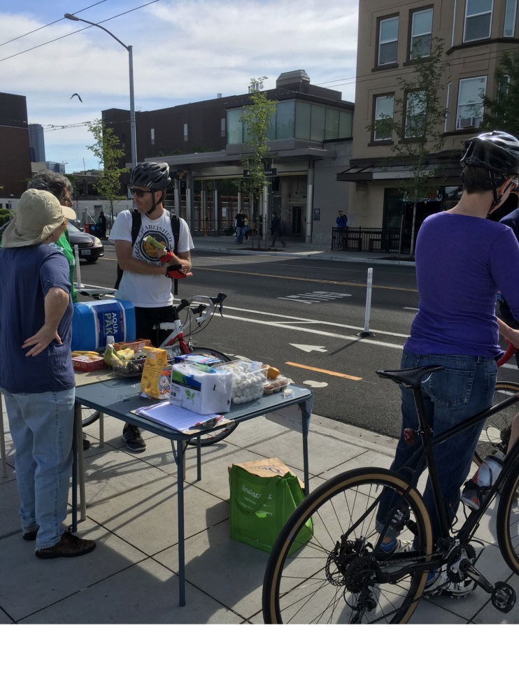
METHODS: Qualitative
Community Engagement:
Traffic and Bicycle Safety meetings
Informal Interviews with experts
Research: Local news, social media, webinars
Notes:
Explain the qualitative approach to your study

Slide 6
RESULTS: Quantitative
2,007 Bicycle-related Collisions over 5 years

Slide 7
WHICH MONTHS/SEASON?
Seattle “Summer” Months
Clear/Partly Cloudy Weather
71% fatalities
69% severe injuries
During Daylight Hours
74% daylight vs. 18% at night

Slide 8
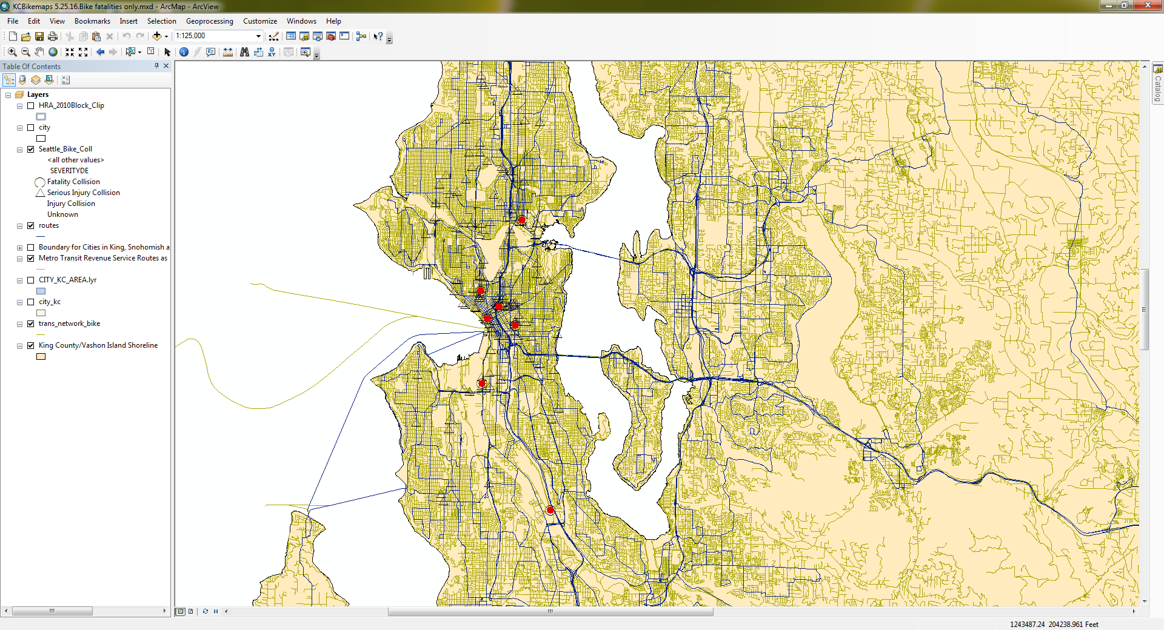
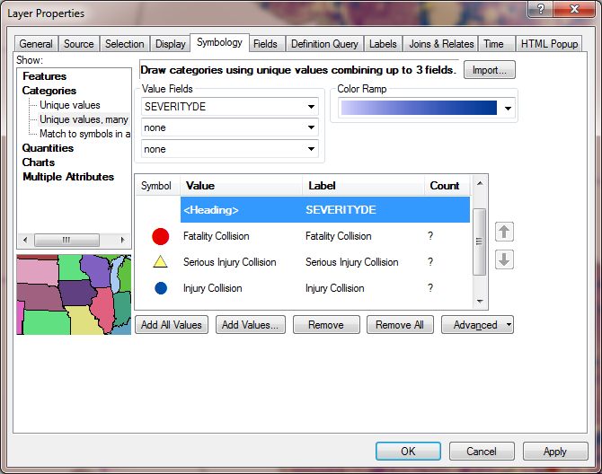
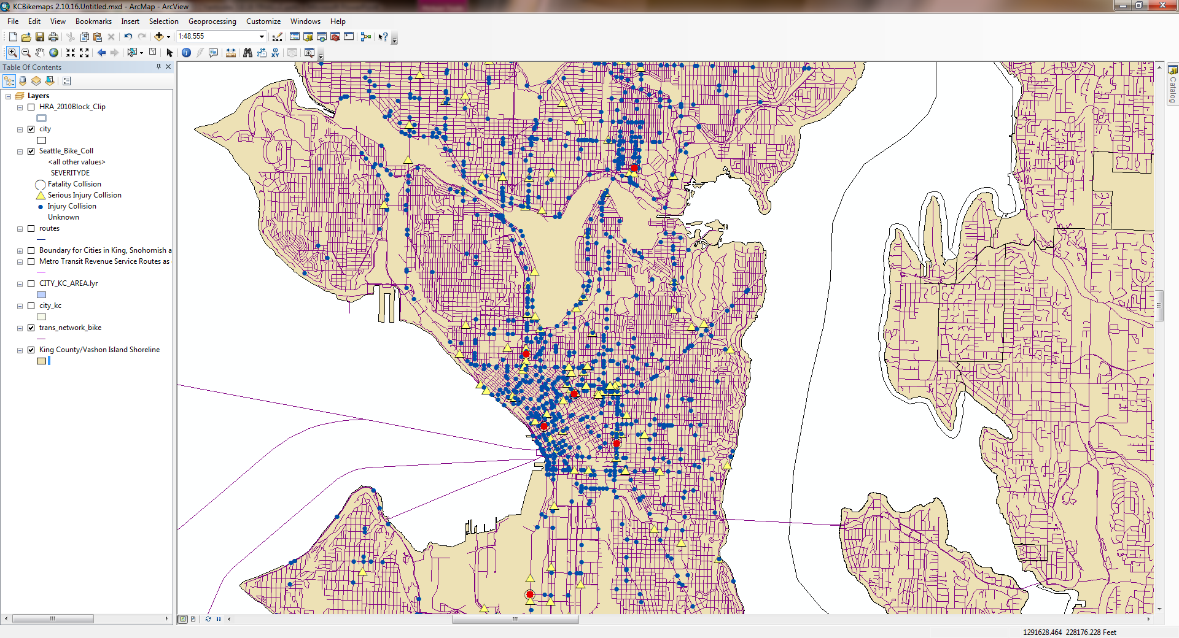
Bicyclist-Related Fatalities 2010 - 2014
7 bicycle related fatalities
2 bicycle related fatalities were not captured
Seattle, Washington

Slide 9
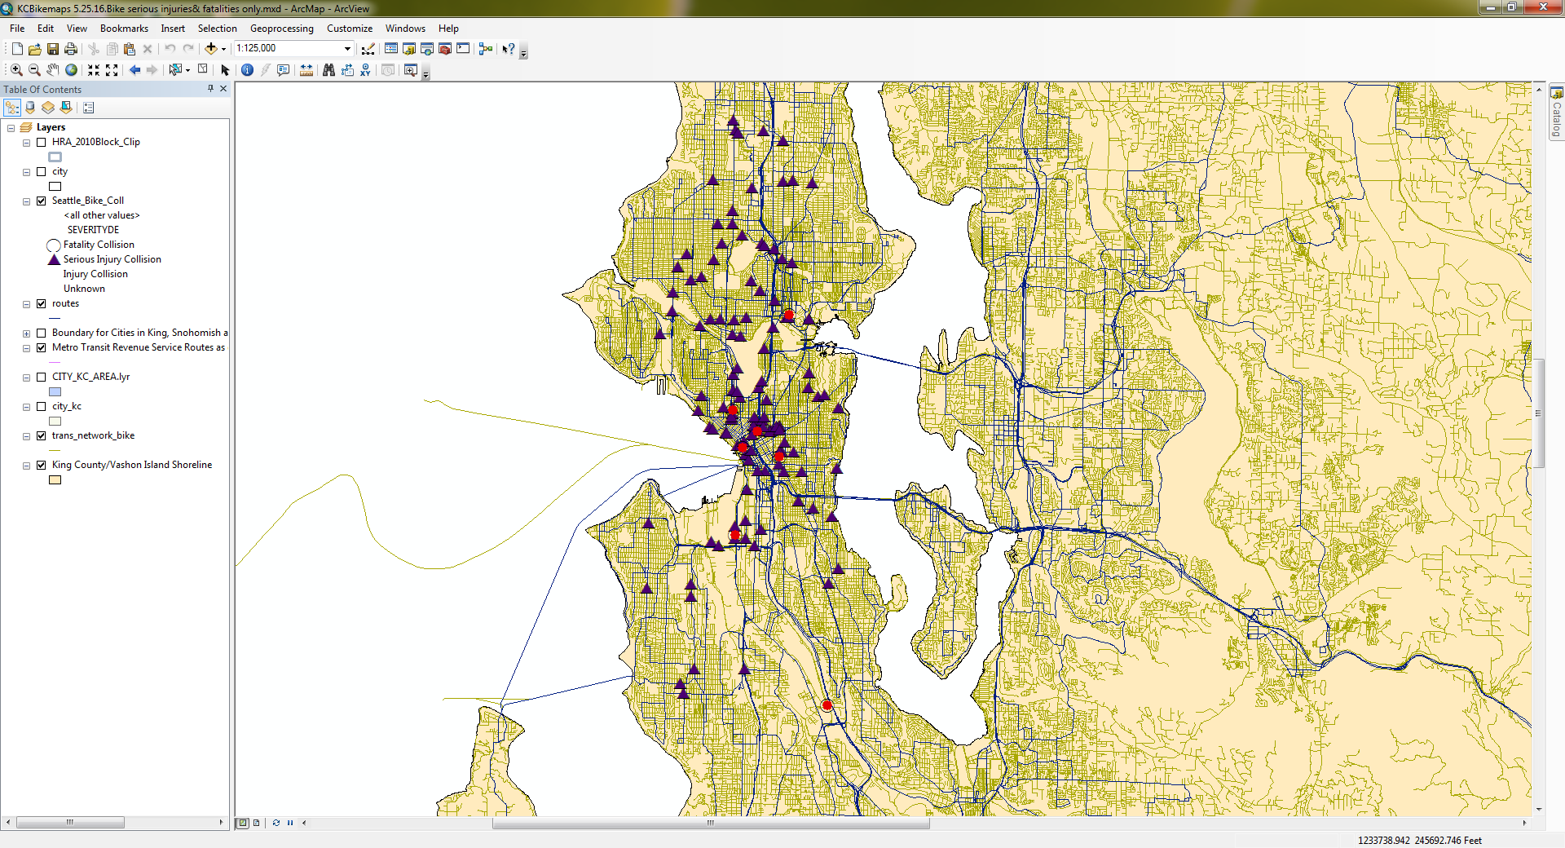
Bicyclist-Related Serious Injuries 2010 - 2014
Many Fatalities & Severe Injuries ≠“hot spots”
Areas with fewer injuries ≠ safer
Seattle, Washington

Slide 10
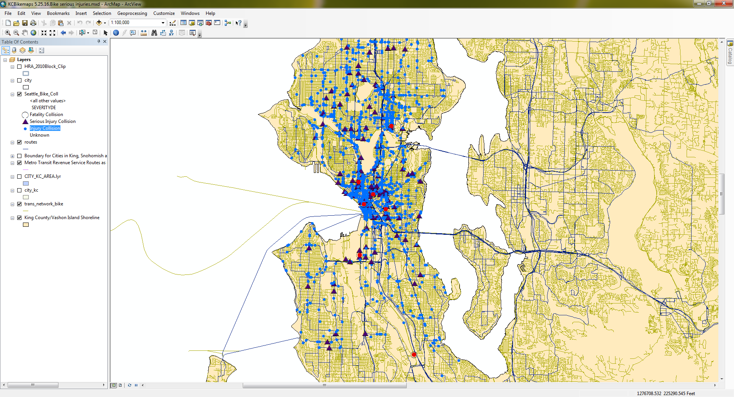
Bicyclist-Related Non-Serious Injuries 2010 - 2014
Many non-serious injuries are not reported
Seattle, Washington

Slide 11
Community Engagement: Bicycle Equity
“After months of fighting for better bike infrastructure in the Rainier Valley, anticipated projects have been cancelled or delayed.”
“The single most important missing link is a connection to downtown. There is no existing plan to make this connection.”
~Rainier Valley residents

Slide 12
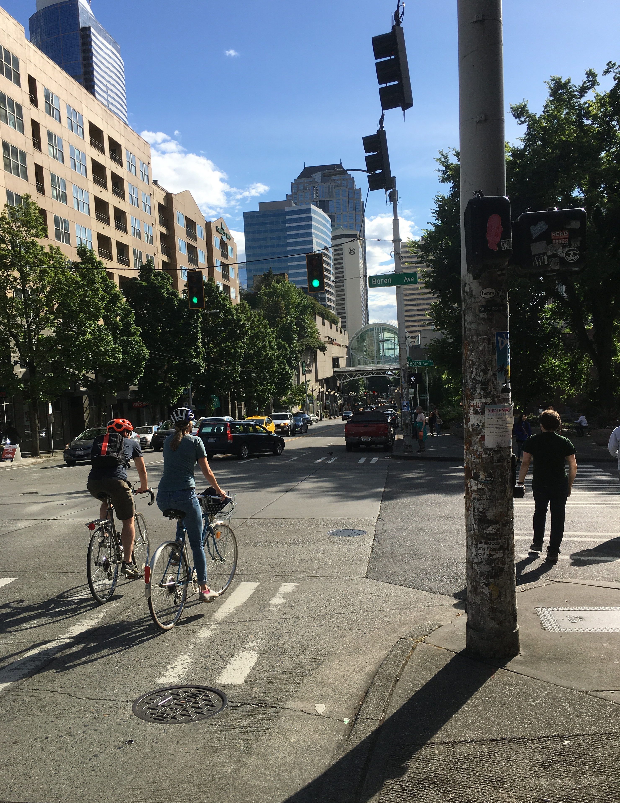
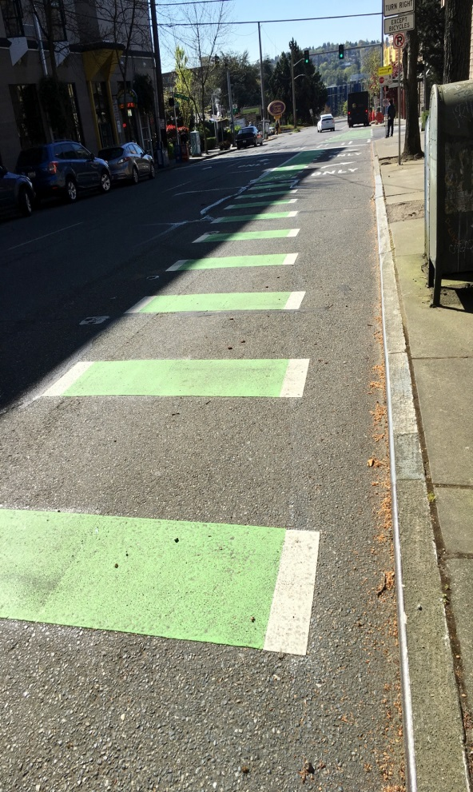
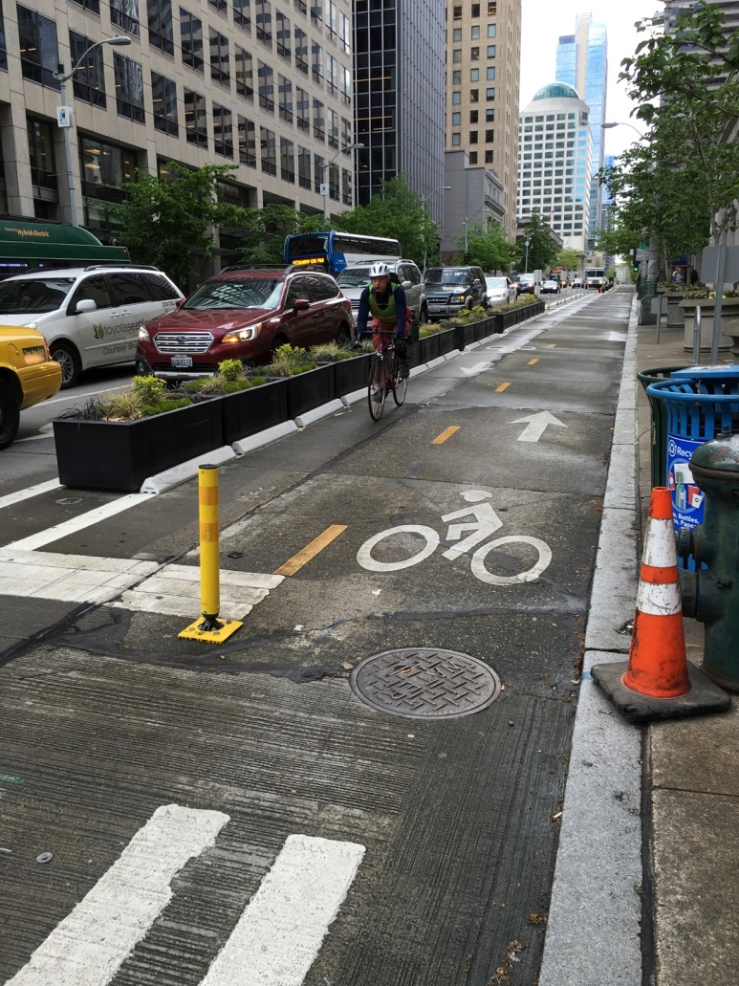
Bicycle Fatality Review (BFR) Field Observations
Protect Bicycle Lanes (PBLs)
No Changes
Colored Conflict Area
Seattle, Washington

Slide 13
LIMITATIONS/CHALLENGES
Data Limitations
Not comprehensive of ALL collisions (‘near misses’)
Injury Severity ‘Misclassification’
No bicycle equivalent for “vehicle miles travelled”
Field Observations don’t capture all risk factors

Slide 14
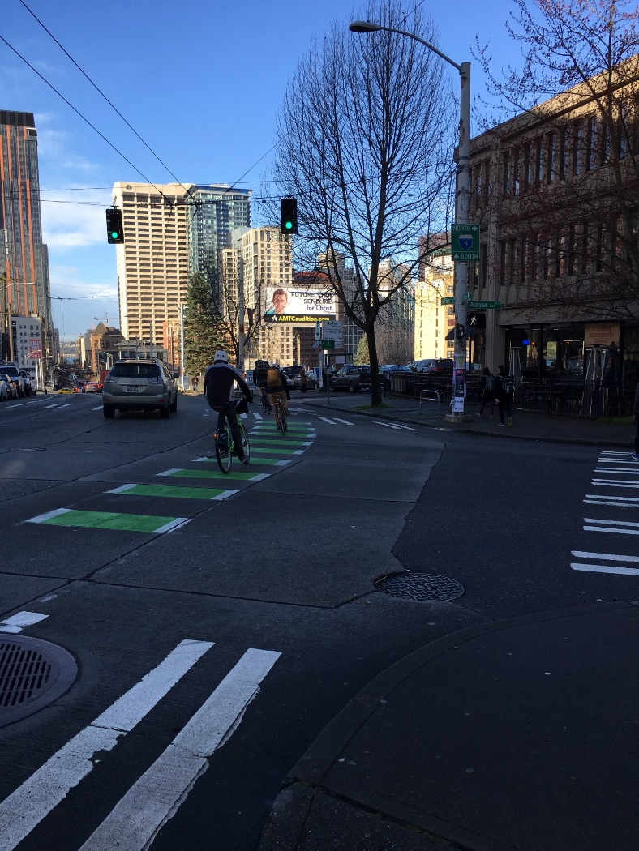
KEY FINDINGS
Collisions ⬆, fatalities remain consistent
Bicycle collisions occur daytime, summer, dry conditions
Many fatalities & severe injuries ≠“hot spots”
Lack of surveillance data
Underserved communities left out of current bicycle safety initiatives

Slide 15
RECOMMENDATIONS
Improve tracking and surveillance
Increase communication, collaboration and information sharing
Continue fostering community education, awareness, and engagement
Promote education and policy legislative initiatives to improve bicycle safety

Slide 16


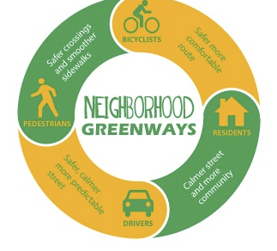



Thank You!
Notes:
These lesson learned are in no way comprehensive nor are they inclusive of all issues pertaining to bicycle safety, rather they should serve to aid future planning of bicycle facilities and infrastructure and serve as a guide for issues revolving bicycle safety in Seattle.

Slide 17
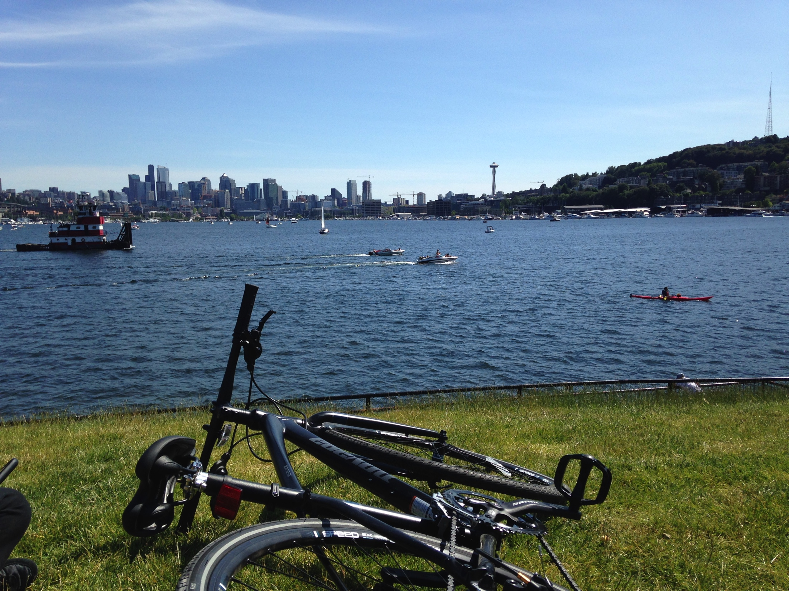
Questions? Comments!
CONTACT INFORMATION:
Christina Yantsides, MPH christina.yantsides@kingcounty.gov

