Slide 1
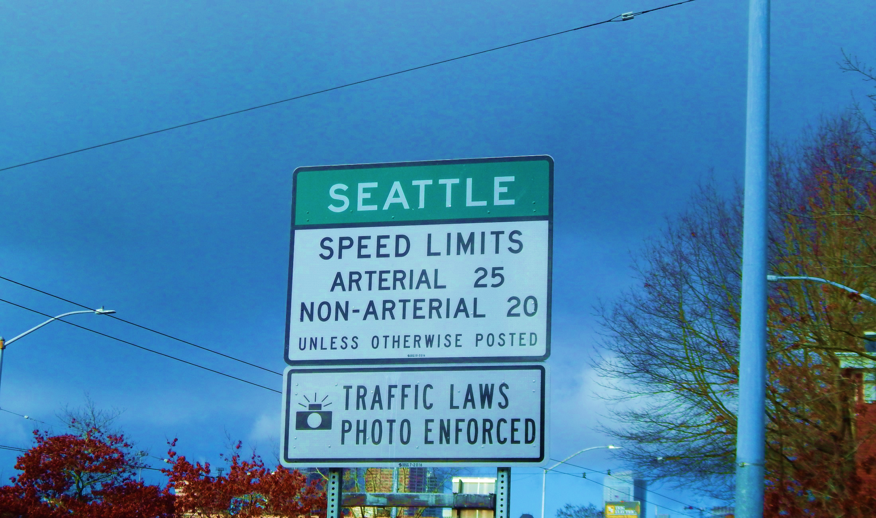

Lowering Speed Limits to Save Lives Vision Zero
Seattle Bicycle Advisory Board
James Le
March 7, 2018

Slide 2
Our mission, vision, and core values
Mission: deliver a high-quality
transportation system for Seattle
Vision: connected people, places, and products
Committed to 5 core values to create a city that is:
Safe
Interconnected
Affordable
Vibrant
Innovative
For all
2
Notes:
Our core values for transportation anchor to the core values that Mayor Murray has laid out in his vision (Move Seattle) for Seattle:
Safe
Interconnected
Affordable
Vibrant
Innovative

Slide 3
Presentation overview
Background
Methodology
Prioritization
Evaluation schedule
3
Notes:
Let the audience know the purpose of your presentation (is it purely informational, are you seeking feedback, etc). Then walk them through what you’ll be covering.

Slide 4
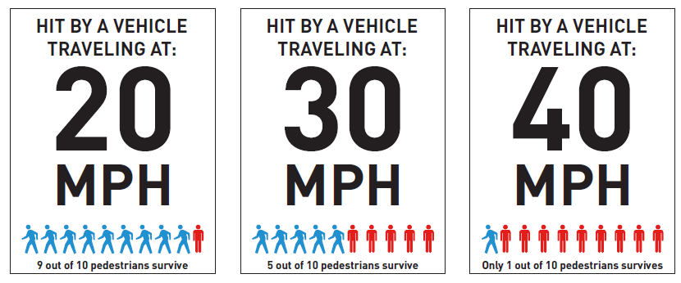
Background
Speed is the critical factor in the frequency and severity of crashes
Key part of Seattle’s Vision Zero efforts to end traffic deaths by 2030
4

Slide 5
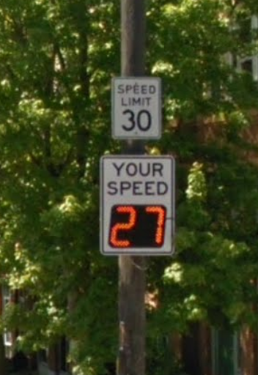
Current methodology
Primarily based on 85th percentile speeds
Speed at which 85% of people are driving at or below
5

Slide 6
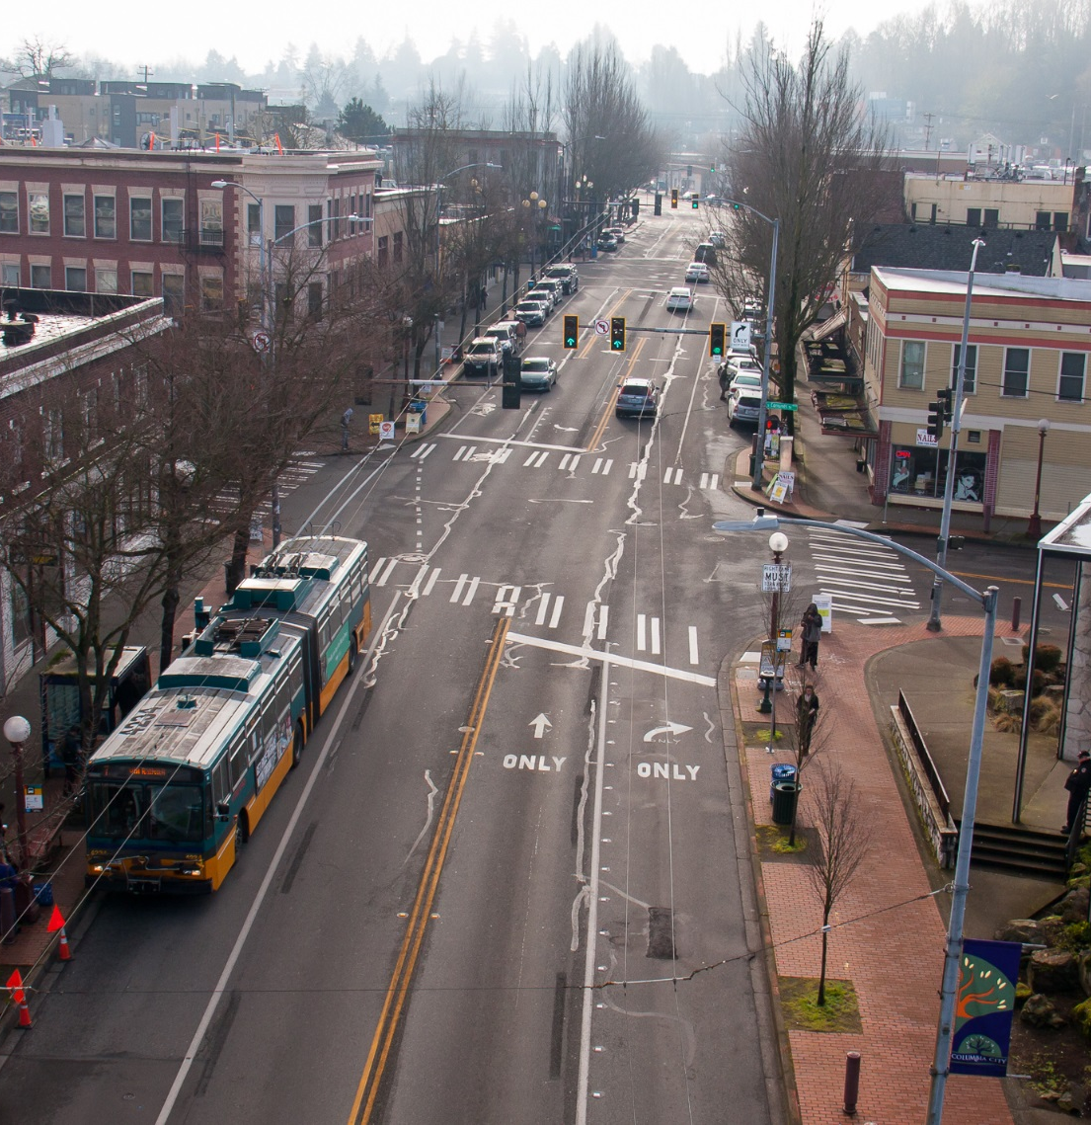
What we’re looking at
Based on USLimits2
Factors being considered:
Traffic signal density
Pedestrian and bicycle activity
Parking activity
Driveway density
6

Slide 7
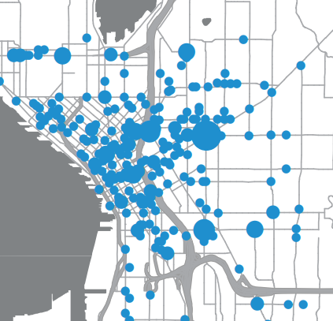
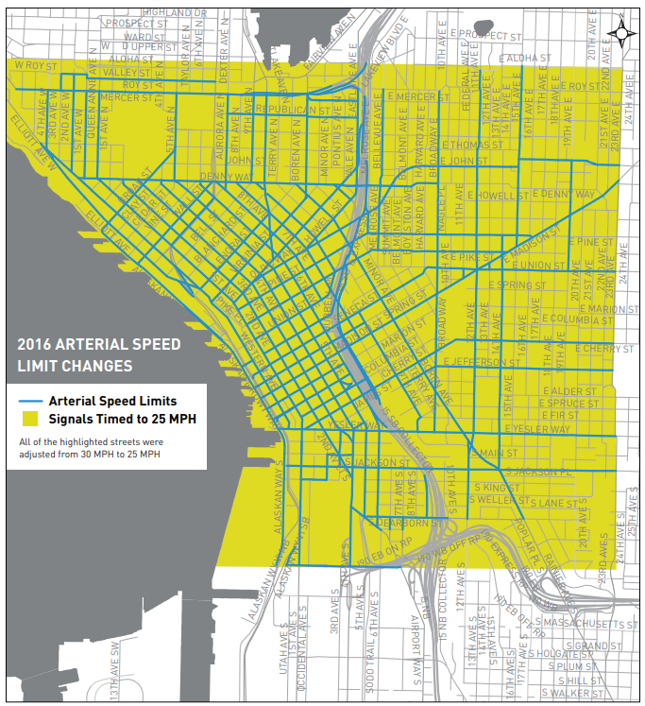
Prioritization
Focused on where pedestrian crashes are happening
2016 Pedestrian Crash locations
2016 CBD speed limit changes
7

Slide 8
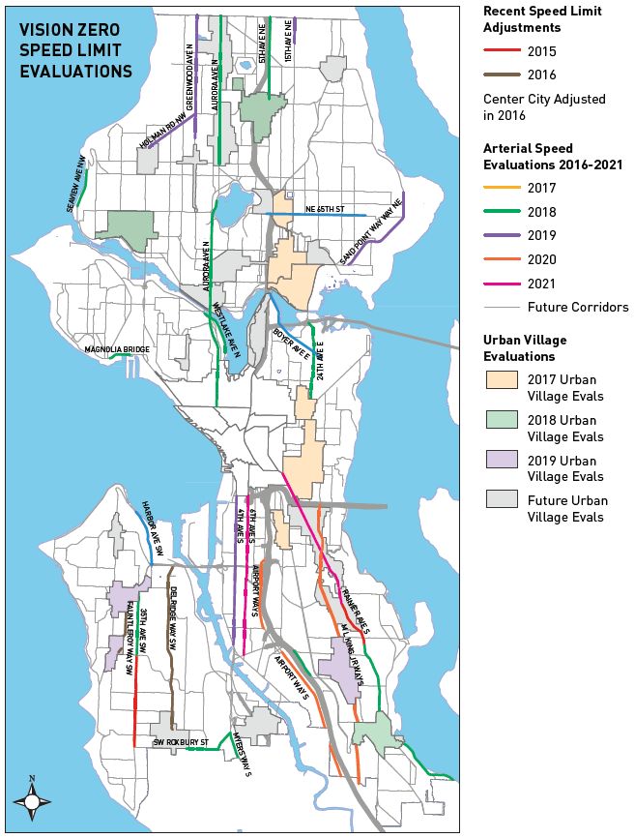
Evaluation schedule
Prioritizing urban villages
Evaluating corridors that have been redesigned
Limited budget for this work
8
2017 Vision Zero Progress Report

Slide 9
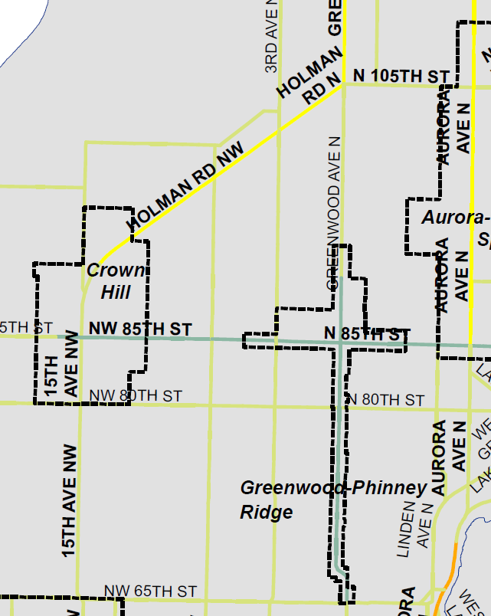
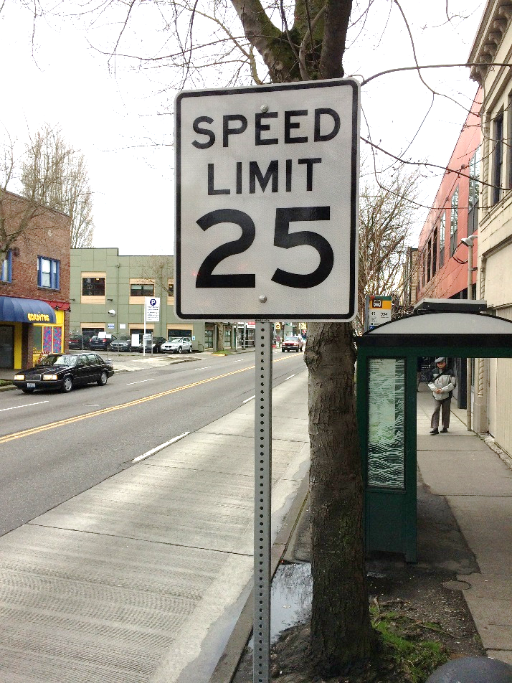
Greenwood/Phinney implementation
30 mph
25 mph
25 mph
Implemented Feb 2018
9

Slide 10
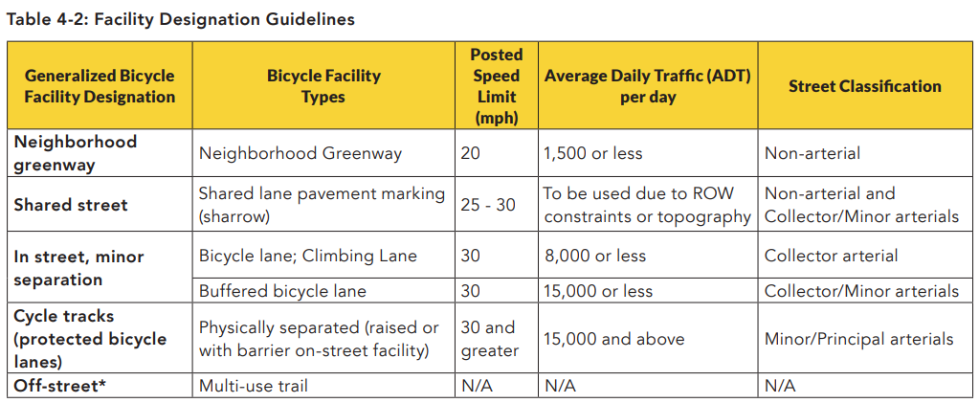
What the BMP recommends
10

Slide 11
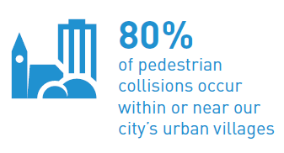
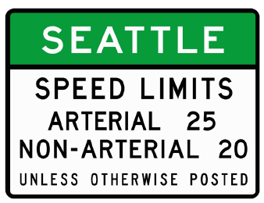
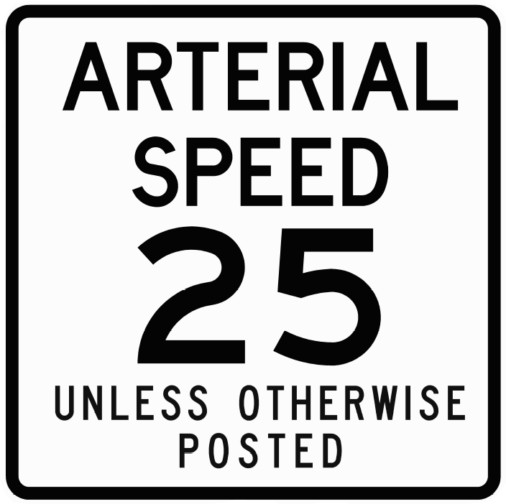
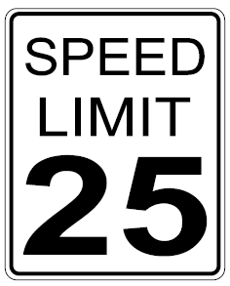
Timeline
Vision Zero launched!
Rainier Ave S (25 mph)
35th Ave SW (30 mph)
Delridge Way SW (30 mph)
Fauntleroy Way SW (30 mph)
Began urban village evaluations
2015
2016
2017
2018
Greenwood/ Phinney urban village
11

Slide 12




Questions?
James Le@seattle.gov
https://www.seattle.gov/visionzero
www.seattle.gov/transportation

