Slide 1
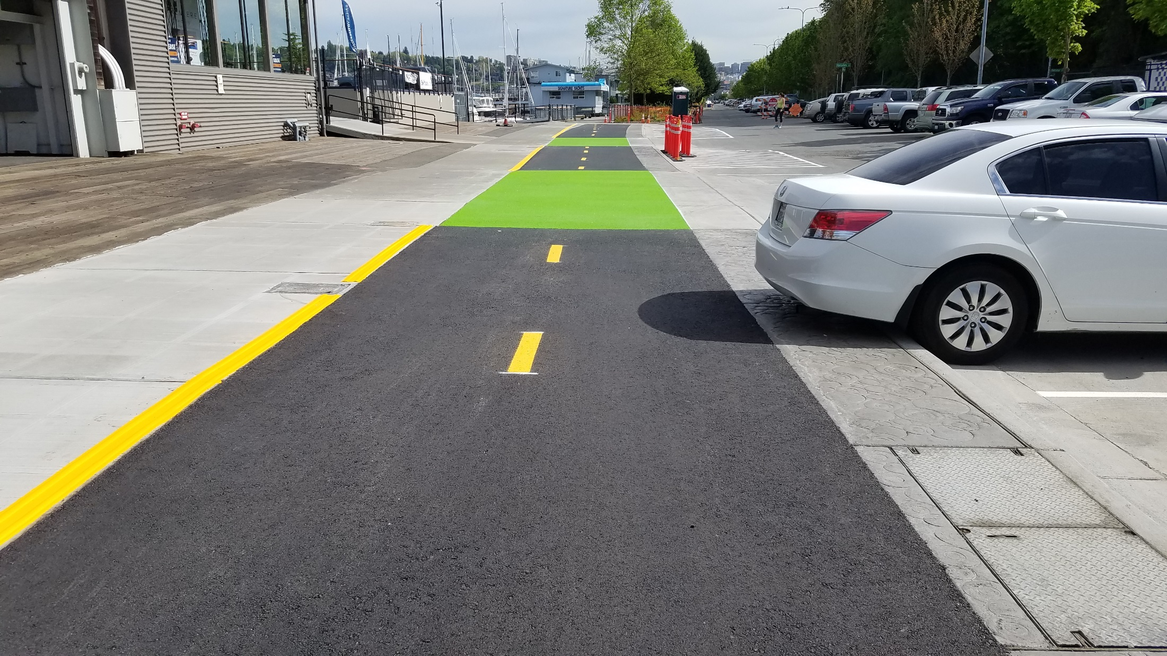

Protected bike lane progress
Seattle Bicycle Advisory Board
Sam Woods
May 4, 2016

Slide 2
Our mission, vision, and core values
Mission: deliver a high-quality
transportation system for Seattle
Vision: connected people, places, and products
Committed to 5 core values to create a city that is:
Safe
Interconnected
Affordable
Vibrant
Innovative
For all
2

Slide 3
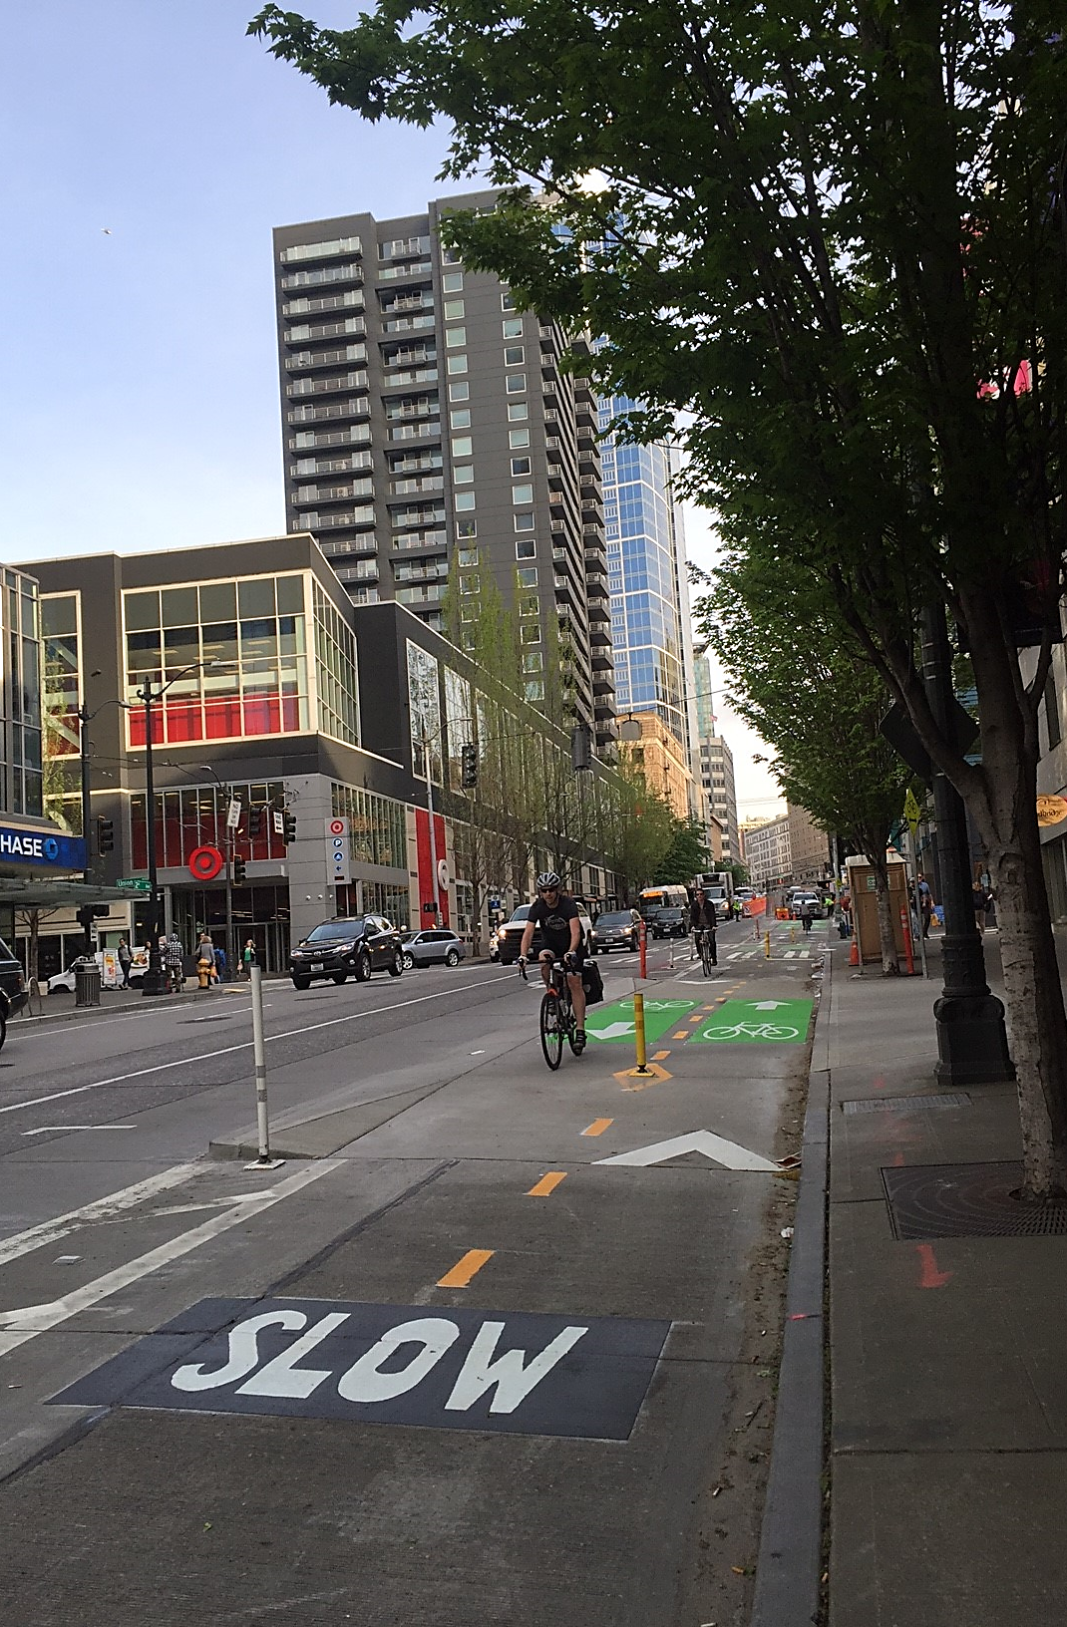
Presentation overview
Westlake Cycle Track construction
9th Ave N
2nd Ave upgrades
2nd Ave Safety Project

Slide 4
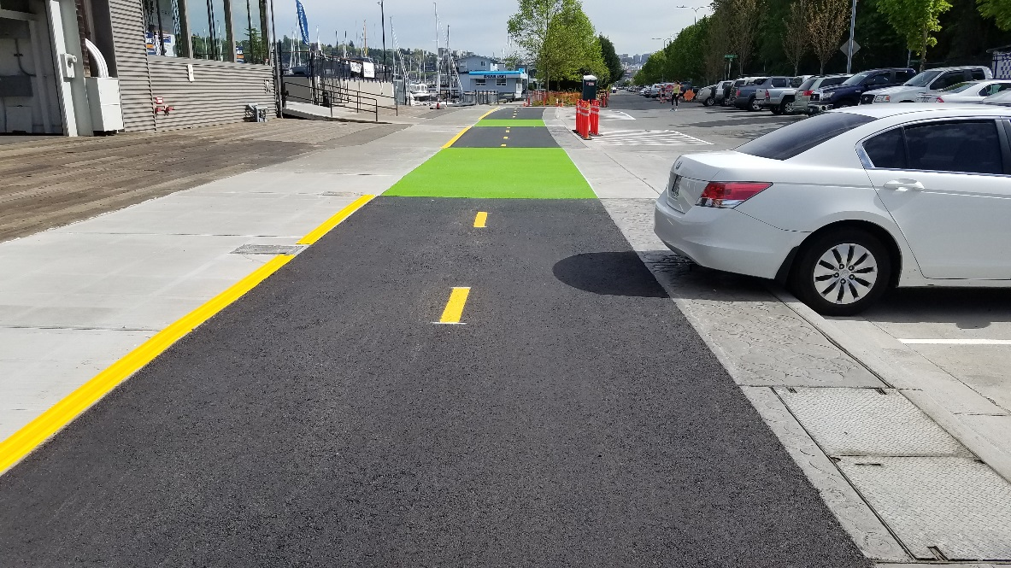
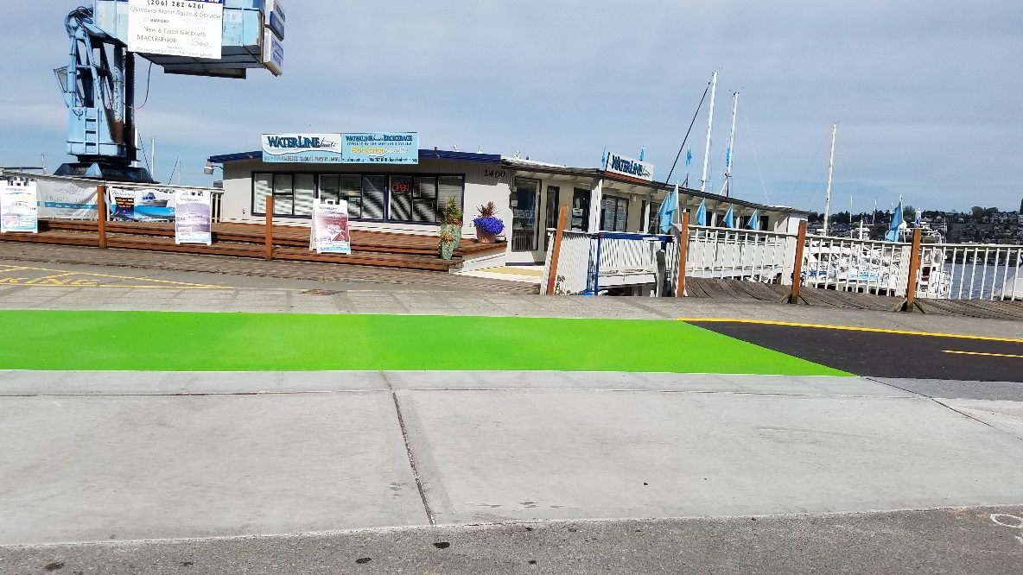
Westlake Cycle Track construction
The north half of the Westlake corridor now has a protected bike lane
Notes:
About half way complete!
Phase 1 is complete
Phase 2 is nearly complete
Phase 3 is in progress

Slide 5
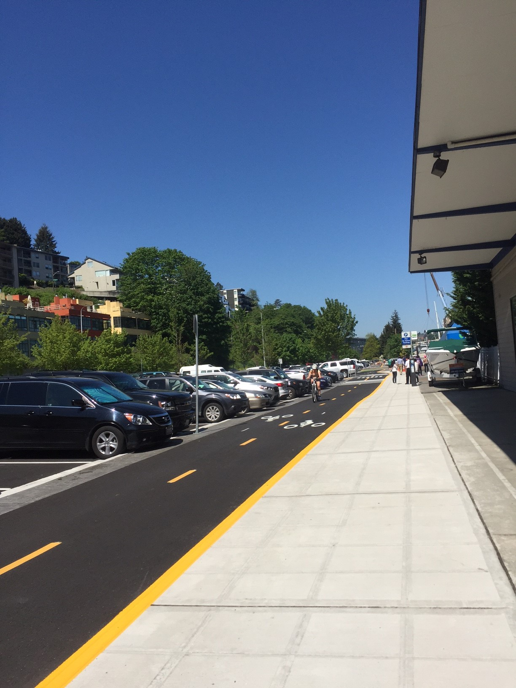
Westlake Cycle Track construction
Rider education:
Please ride on new protected bike lane
Follow posted signs
Be on the look out for corridor ambassadors this Friday
Notes:
To help promote safety for all users, please ride on new protected bike lane rather than in the parking area or on the sidewalk.
Working with Cascade to have ambassadors on the corridor this Friday to welcome people to the protected bike lane and encourage them to ride on it

Slide 6
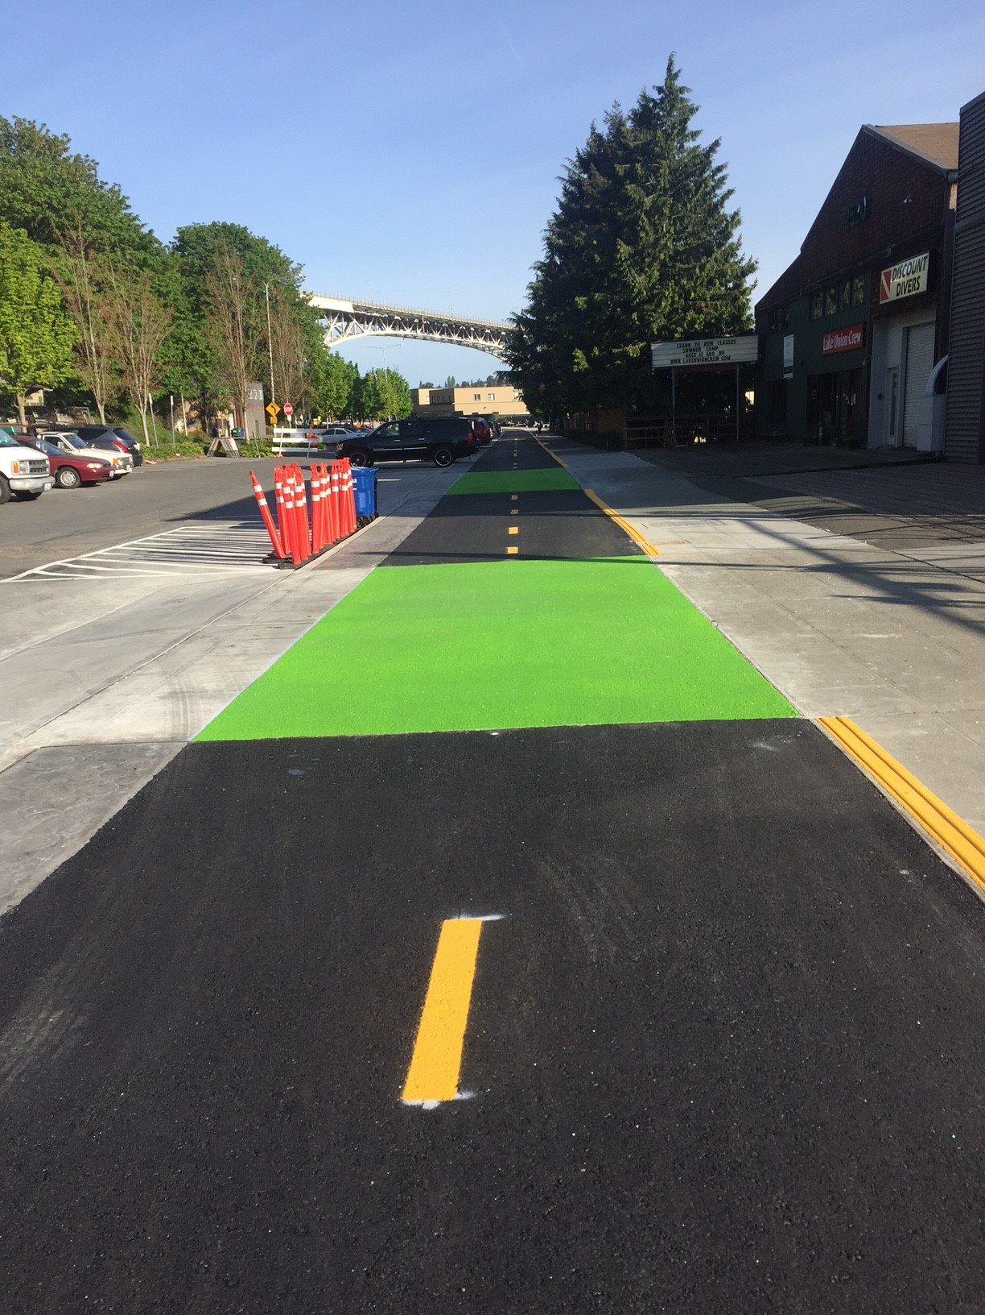
Westlake Cycle Track opening
On schedule for opening in late July
Notes:
Tentative, but baseline schedule on track to be complete by end of July

Slide 7
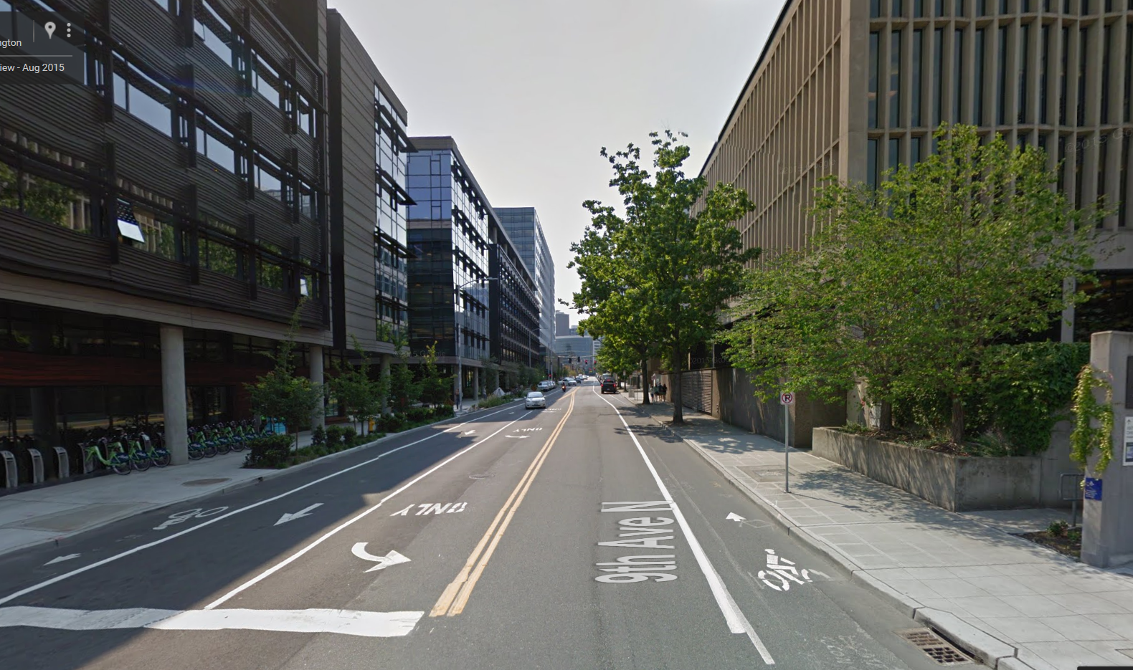
9th Ave N Mobility Improvements

Slide 8
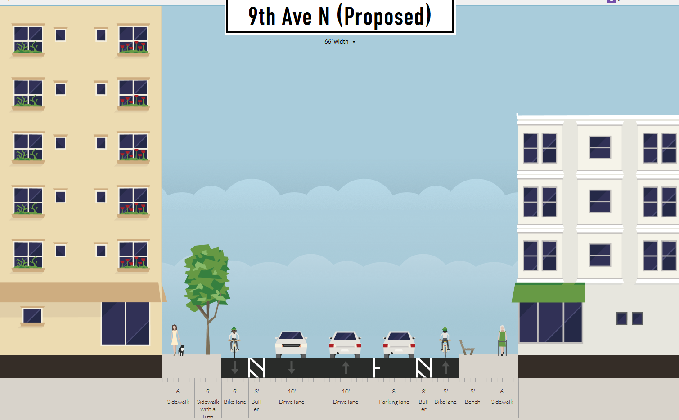
Project description
5’ 3’ 10’ 10’ 8’ 3’ 5’
8

Slide 9
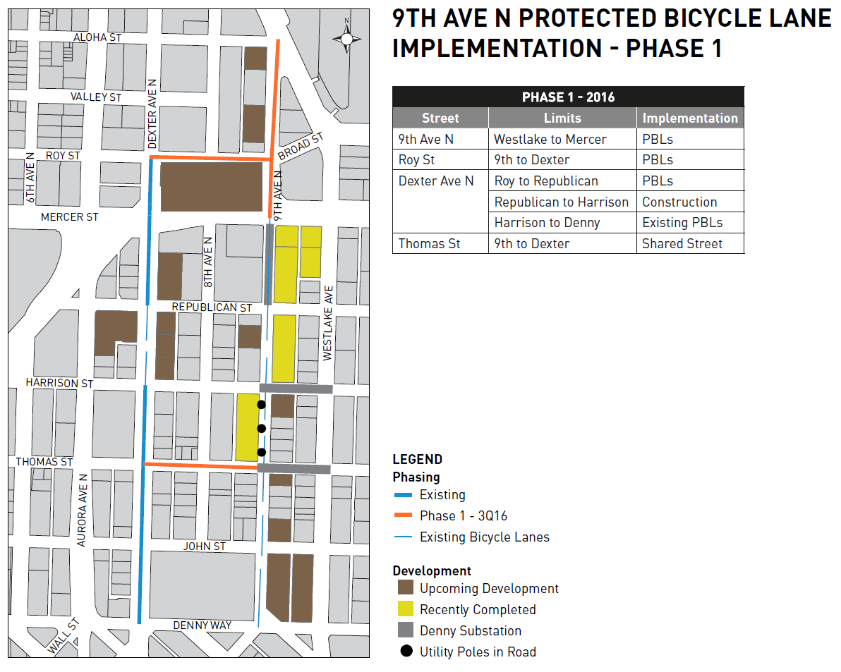
9

Slide 10
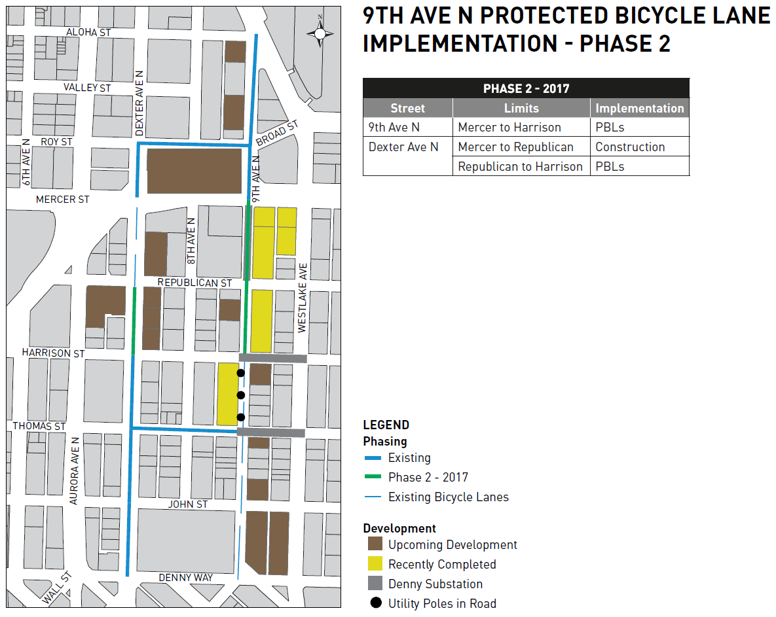
10

Slide 11
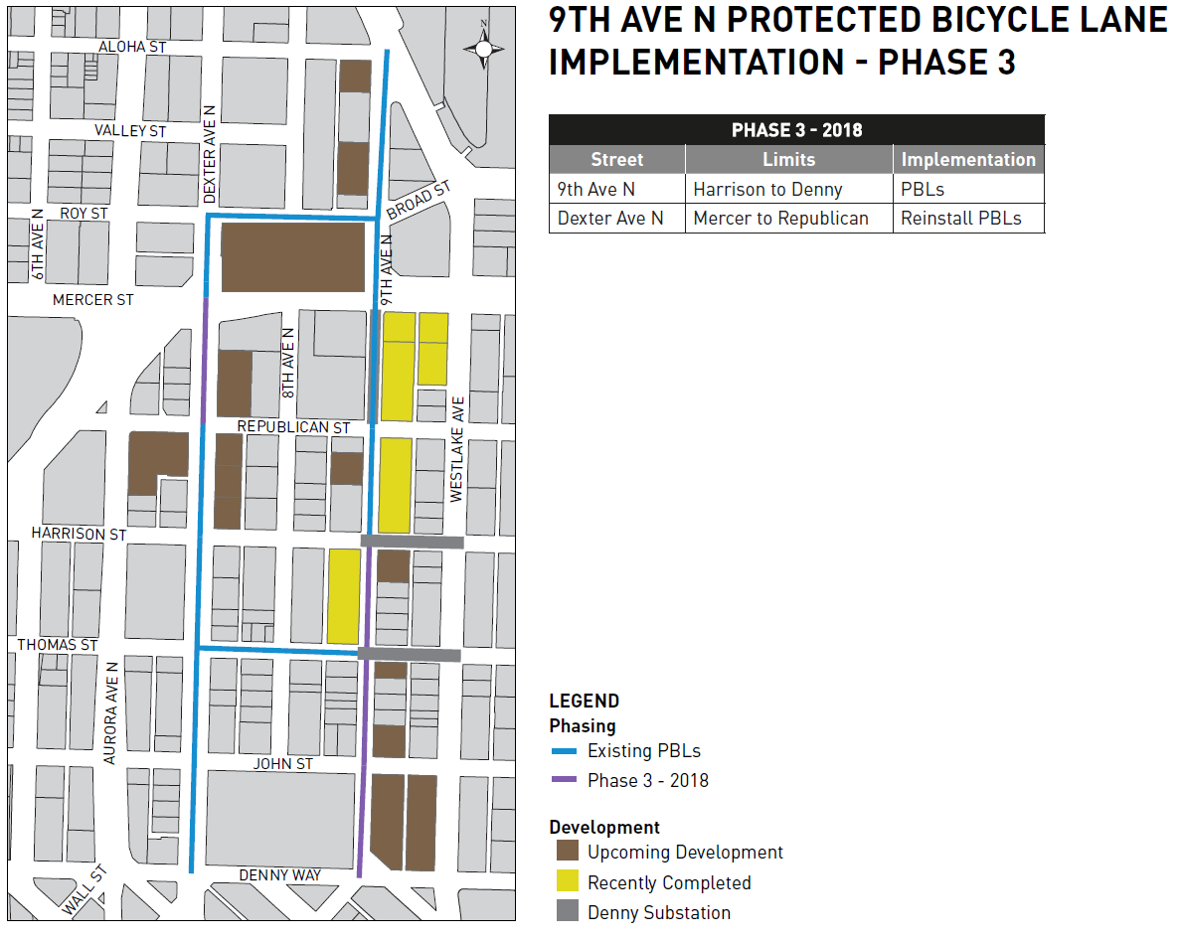
11

Slide 12
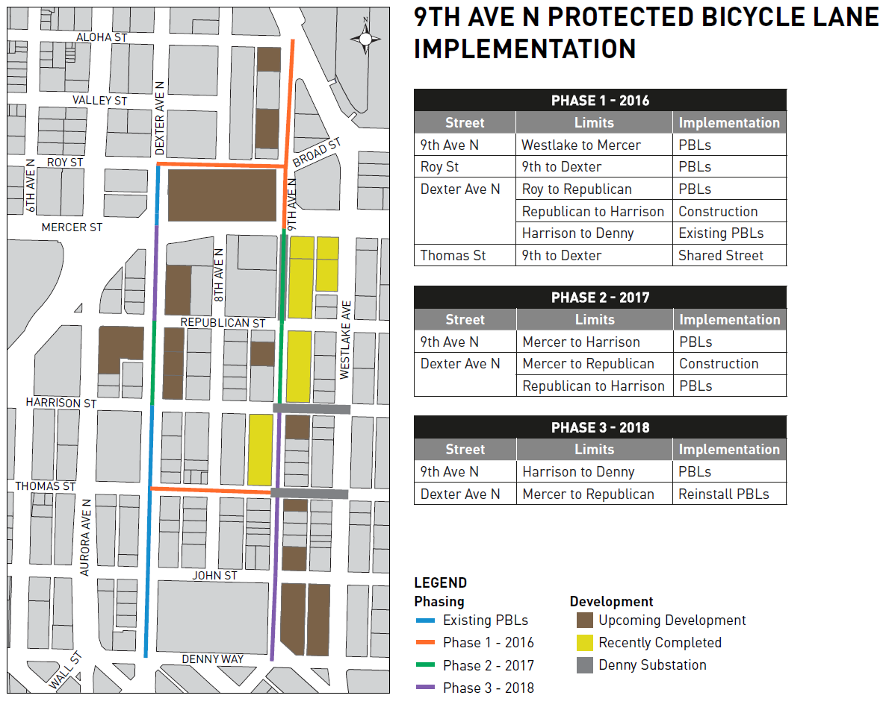
12

Slide 13

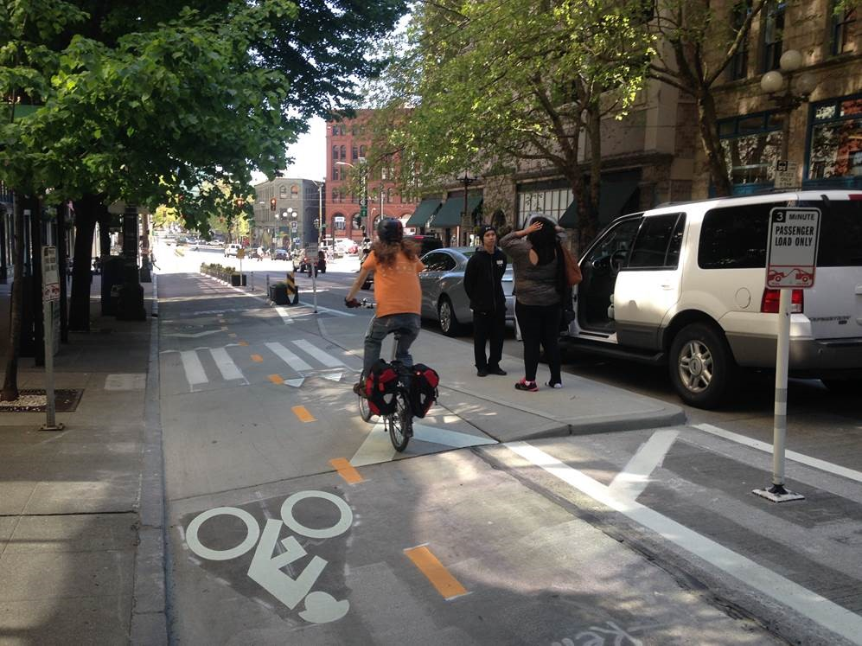
2nd Ave upgrades
2 raised passenger load zones and 2 raised driveways

Slide 14
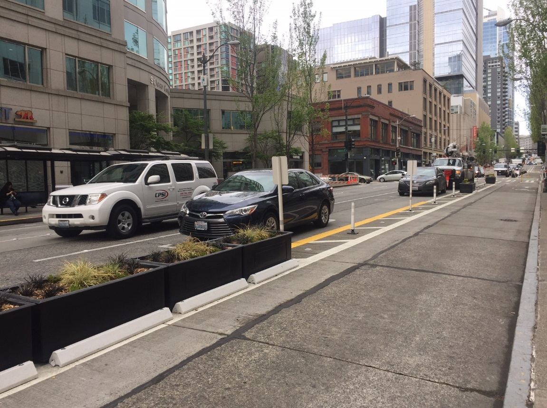
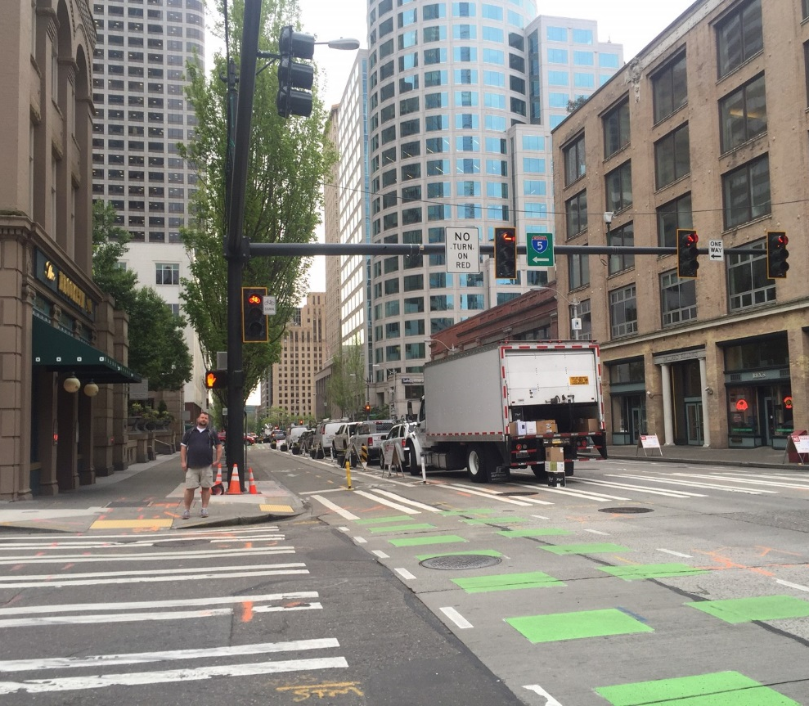
2nd Ave upgrades
Planter boxes
Signal upgrades

Slide 15
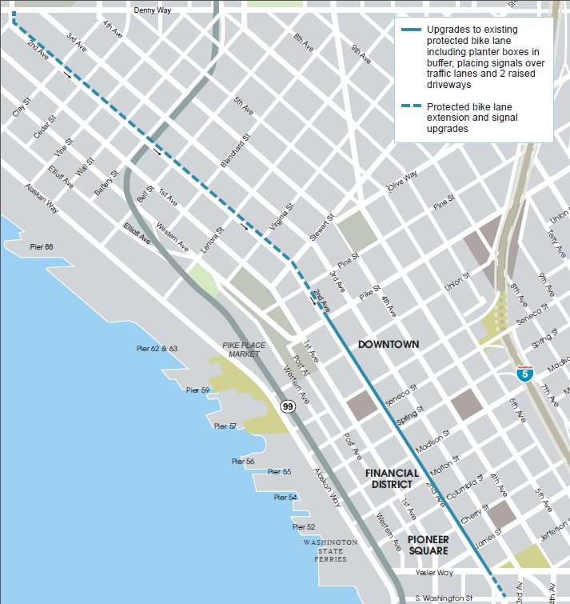
2nd Ave Safety Project
Outreach has included:
Stakeholder briefings
One-on-one meetings
Project area mailer
Door-to-door flyering and surveys
Notes:
As you know from a couple meetings ago, we’re extending the protect bike lane on 2nd up to Denny Way.
Generally the response has been positive or neutral. The main concerns we hear are about congestion, however, signal analysis actually shows an increase in efficiency for vehicles.

Slide 16
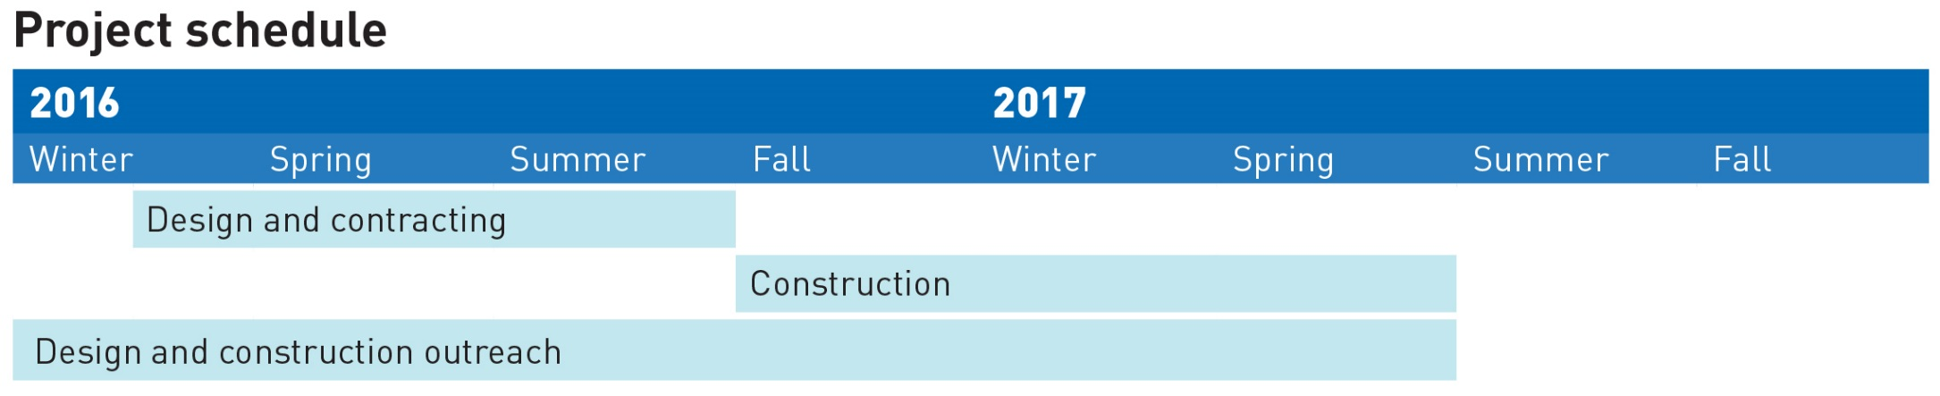
2nd Ave Safety Project timeline
Construction is planned to begin this fall
Construction complete in spring 2017

Slide 17




Questions?
CCBike@seattle.gov | (206) 615-1485 www.seattle.gov/transportation/2ndavepbl.htm
www.seattle.gov/transportation

