Slide 1



Bicycle Master Plan 2016-2020 Implementation Plan
Seattle Bicycle Advisory Board
February 3, 2016

Slide 2
Our mission, vision, and core values
Mission: deliver a high-quality
transportation system for Seattle
Vision: connected people, places, and products
Committed to 5 core values to create a city that is:
Safe
Interconnected
Affordable
Vibrant
Innovative
For all
2
Notes:
Our core values for transportation anchor to the core values that Mayor Murray has laid out in his vision (Move Seattle) for Seattle:
Safe
Interconnected
Affordable
Vibrant
Innovative

Slide 3
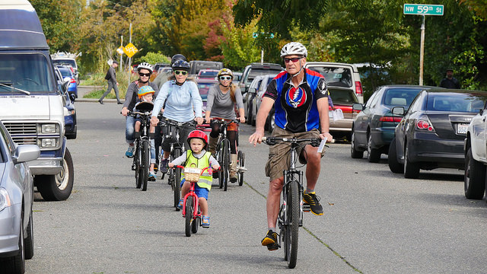
Presentation Overview
Deadlines and Deliverables
2016 – 2020 BMP Implementation Plan
Input from SBAB
Next Steps
3

Slide 4
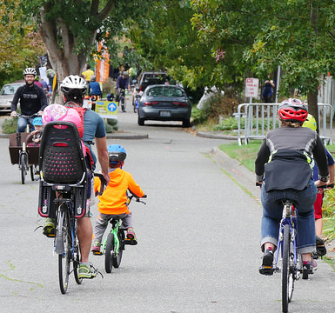
Deadlines and Deliverables
February 3 SBAB meeting
Portions of draft 2016-2020 BMP Implementation Plan
Draft project list
Draft project maps
Draft strategies and programs
February 24 (email to SBAB for review)
Draft 2016-2020 BMP Implementation plan
Draft 2015 Annual Progress Report
March 2 SBAB meeting
Discuss comments/questions
March 9
Final SBAB comments due
March 16
SBAB endorsement of documents
March 31 (submit to City Council)
Final 2016-2020 BMP Implementation Plan
Final 2015 Annual Progress Report
4

Slide 5
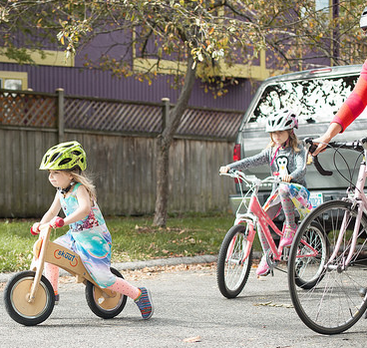
2016-2020 BMP Implementation Plan
Table of Contents:
Introduction
Move Seattle deliverables
50 miles of protected bicycle lanes
60 miles of neighborhood greenways
Purpose
Updates and Reporting
Prioritization
5
Notes:
Five-year implementation plan is intended to:
Serve as an accountability and reporting tool
Provide predictability for stakeholders by including a multi-year project list
Guide future budget requests
Includes strategies and actions identified in the plan as well as project lists
Annual progress updates (March of each year) for review by SBAB and City Council
Six-month interim update reports to SBAB and City Council on status of projects, programs and actions

Slide 6
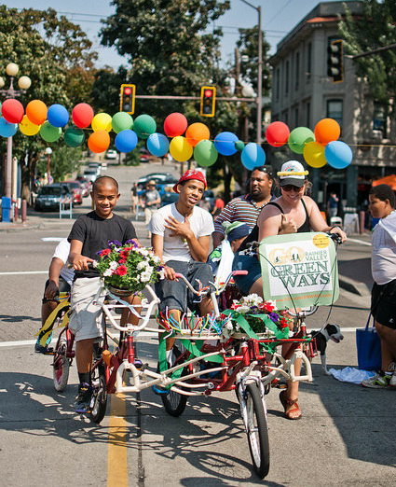
2016-2020 BMP Implementation Plan
Table of Contents:
Project Delivery, Program Delivery and Public Engagement
Funding
Move Seattle = $65M/9 years
Performance Measures
Design Initiatives (NEW)
Major Projects Update (NEW)
6
Notes:
Design initiatives: protected intersections, srts greenway spurs, gateway greenways
Major projects: BGT missing link, SR-520, CCMP/CCBN, Waterfront, Northgate ped/bike bridge

Slide 7
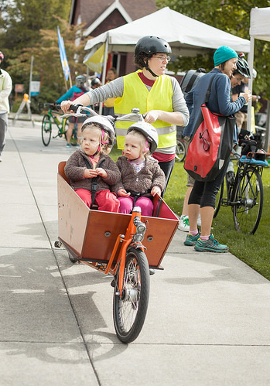
2016-2020 BMP Implementation Plan
Table of Contents:
Appendix 1: Costs and Funding Summary
Appendix 2: Project and Program Delivery Summary
Appendix 3: Implementation Maps
Appendix 4: Project Lists
Appendix 5: Strategies and Programs
Appendix 6: Project Changes in this Update
7

Slide 8
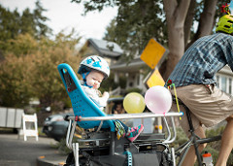
2016-2020 BMP Implementation Plan
Project list process:
Account for built projects
Re-run prioritization framework
Review other work plans to identify leveraging
Review 2015-2019 project status
Qualitative evaluation criteria
Update project list
8
Notes:
Other work plans - (Vision Zero, Safe Routes to School, Transit and multimodal corridors, Paving)

Slide 9
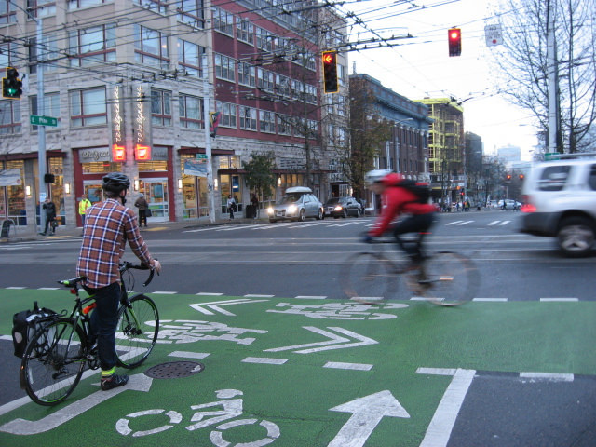
2016-2020 BMP Implementation Plan
Project list update:
Protected Bicycle Lanes
Neighborhood Greenways
Trails
In street, minor separation
9
Notes:
See handout (list and maps)

Slide 10
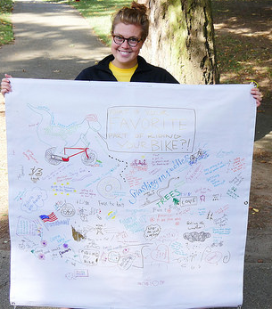
2016-2020 BMP Implementation Plan
Strategies and Programs:
Carried over activities
New activities
Status updates in the 2015 annual progress report
10
Notes:
See handout
- met expectations of many the strategies within the BMP, due to the importance of many of these, continue to evaluate and build on new existing strategies as well as tie into various programs at SDOT.

Slide 11
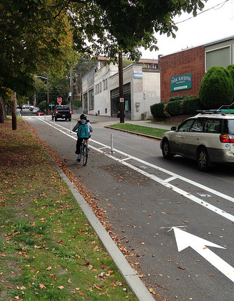
2016-2020 BMP Implementation Plan
Performance Measures:
Targets and Trends established in 2014 Bicycle Master Plan
Introducing and documenting baseline numbers in BMP IMP Plan
To be tracked via annual progress reports
11

Slide 12
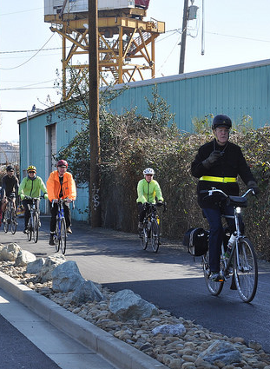
Input from SBAB
Other major projects to provide an update about?
Highest priority strategies and actions?
Strategies and actions SBAB could champion?
Top BMP priorities? Or design initiatives?
Additional qualitative criteria to consider?
12

Slide 13
Next steps
Date | Activity/action
Thursday, February 11 | SBAB to meet with SDOT (if needed)
March 2 | Draft 2016-2020 BMP Imp Plan and 2015 Annual Progress Report to SBAB (will email prior to meeting)
March ?? | SBAB to meet with SDOT (if needed)
March 31 | Final 2016-2020 BMP Imp Plan and 2015 Annual Progress Report to City Council
13
Notes:
Insert a project timeline. Clarify the process and opportunities for engagement/feedback.

Slide 14





Questions?
kyle.rowe@seattle.gov | (206) 684-7639
www.seattle.gov/transportation/bikemaster.htm
www.seattle.gov/transportation

Slide 15
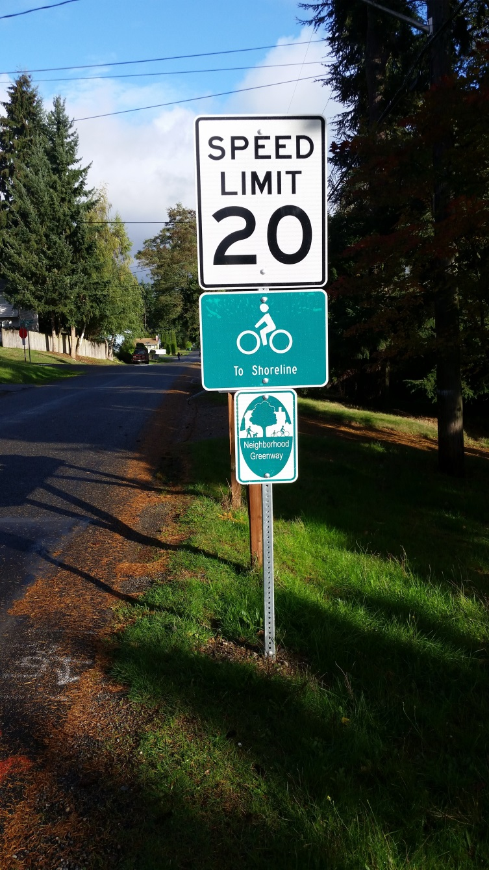
2015 annual progress report
Bridging the Gap Summary
Ridership Data
15

Slide 16
2015 Bridging the Gap
Deliverable | 2014 Goal | 2014 Actual
Neighborhood greenways | 4 miles | 4 miles
Bike lanes and sharrows | 6 miles | 6.3 miles
Bike parking | 500 spaces | 523 spaces
Bike route signs | 25 miles | 25.2 miles
Bike facility maintenance | 60 miles | 60.5 miles
Trail improvements | 10 locations | 10 locations
Trail inspection | 40 miles | 40 miles
Notes:
Why greenway miles are low
How many PBLs in the 6.3 miles
Racks v. corrals for parking

Slide 17
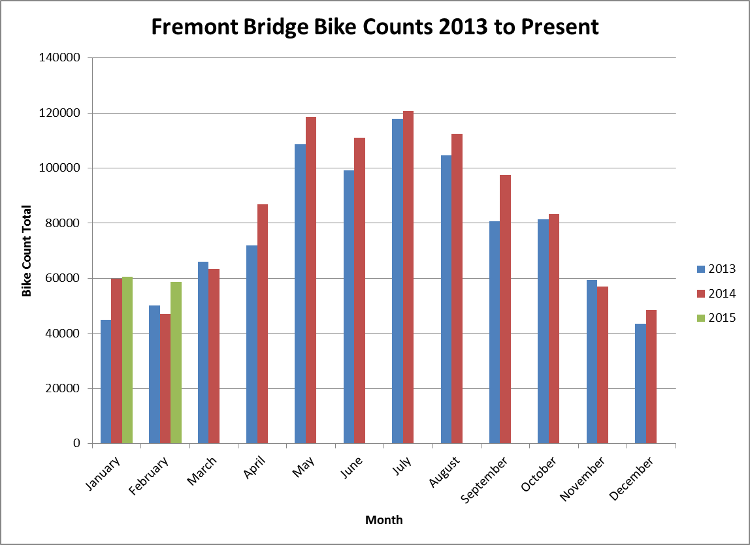
2015 data - Fremont counts

Slide 18
2015 data – Spokane Bridge counts

Slide 19
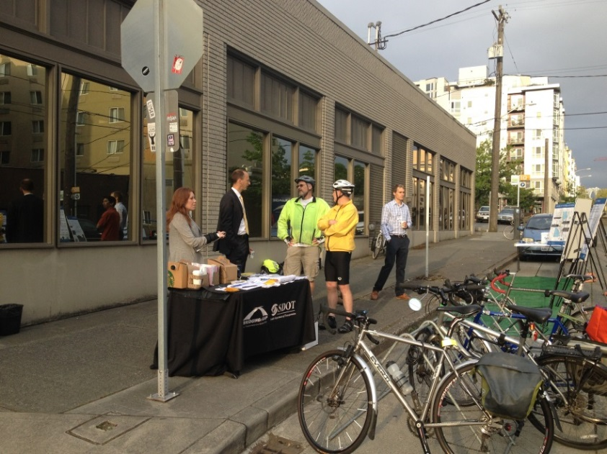
2016 – 2020 Implementation Plan
Changes from 2015 Plan include:
Several new projects added
New funding source
Performance Measures
Major project updates

Slide 20
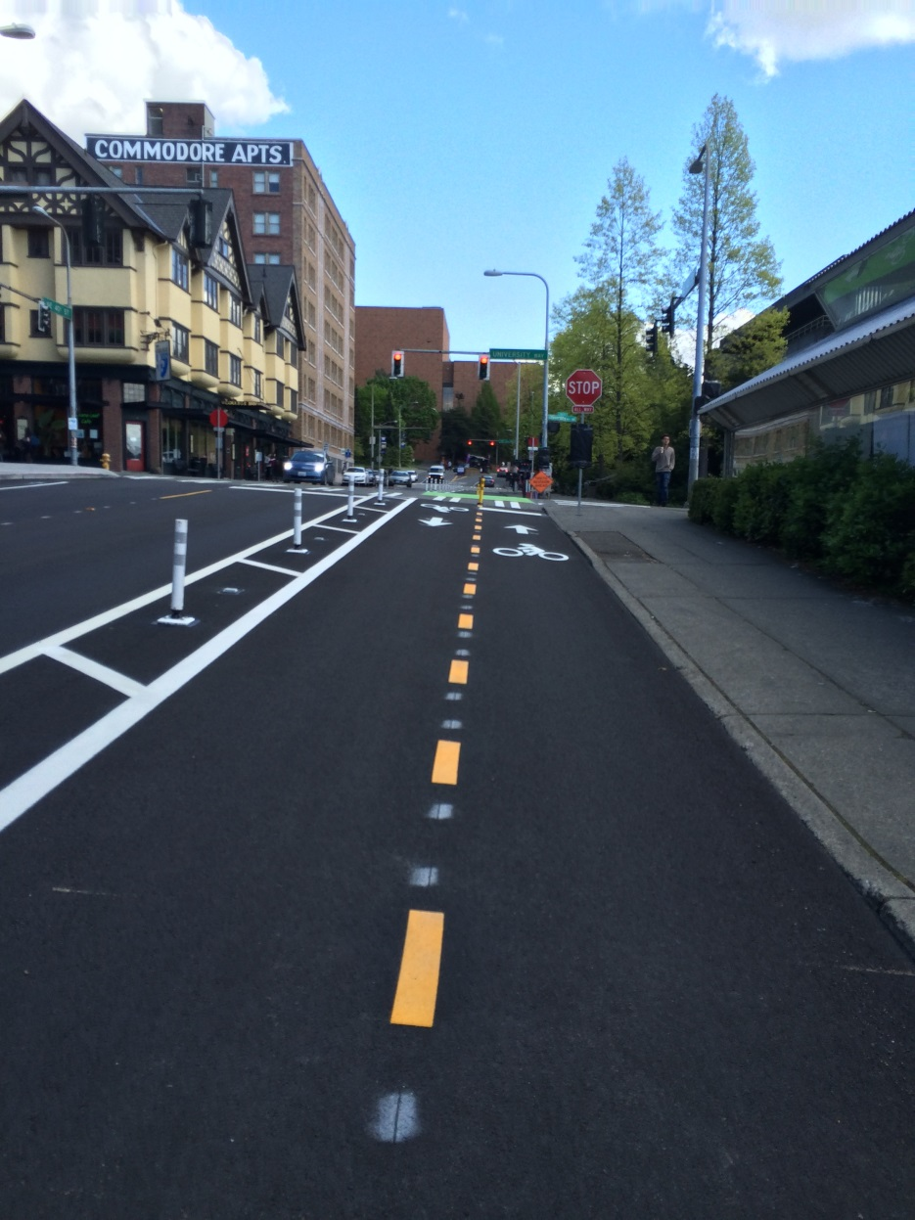
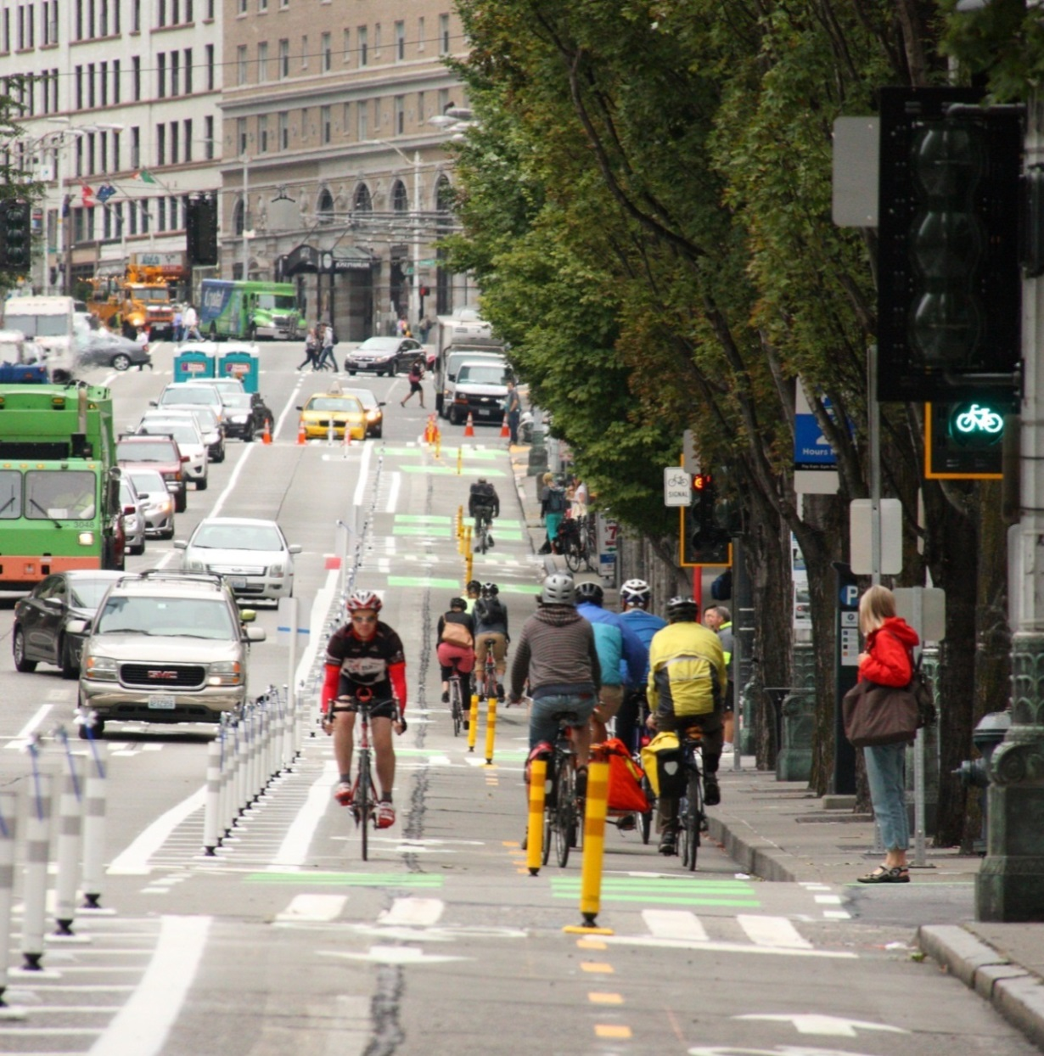
2014 projects – protected bike lanes
NE 40th Street
Second Avenue
Notes:
NE 40th St
2nd Av

Slide 21
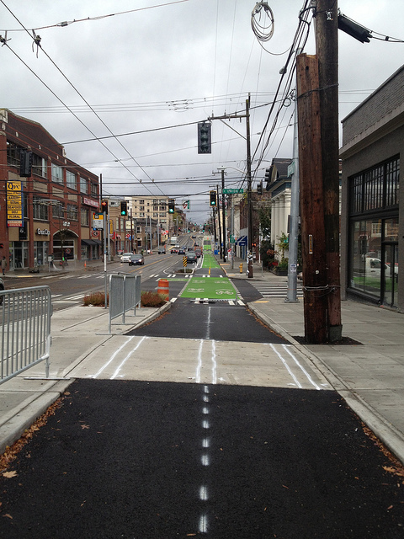
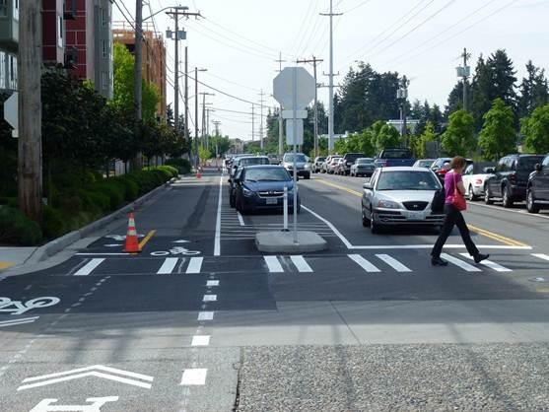
2014 projects – protected bike lanes
Broadway
Linden Avenue North

Slide 22
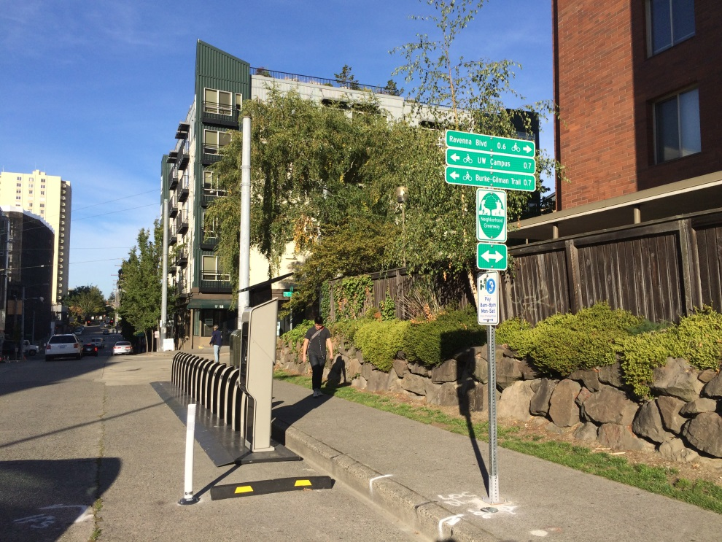
2014 projects – greenways
Four miles of new Greenways including:
Olympic Hills
Wedgwood
U-District
Madison Park
Jackson Place
Notes:
University district – pronto station near neighborhood greenway on 12th.

Slide 23
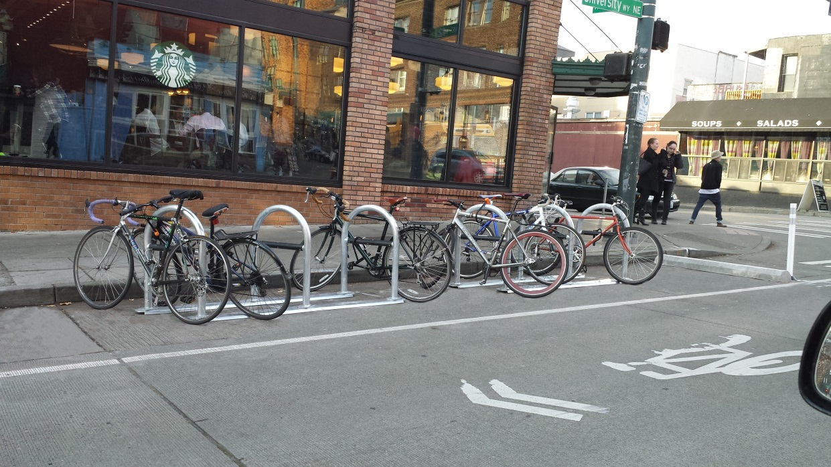
2014 bike parking and maps
Total of 523 new parking spaces
18 corrals = 152 spaces
Balance in standard racks
Updated bike maps
Add image of map

Slide 24

2014 education and encouragement

Slide 25
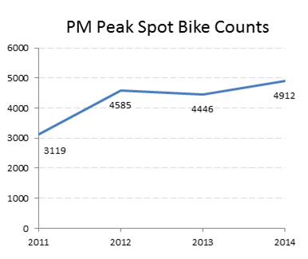
2014 data - citywide bike counts
Notes:
The trend is up with a 57% increase since 2011.
Average total of PM peak (5-7pm) volumes for Jan, May, and Sept for all 50 locations.

