Slide 1
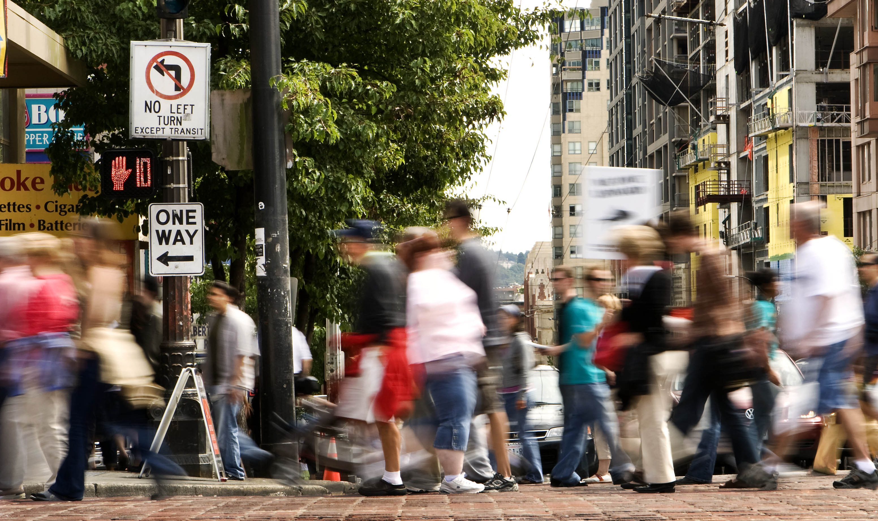

Comprehensive Plan Update
Kevin O’Neill
Seattle Bicycle Advisory Board
September 2, 2015

Slide 2
Comprehensive Plan framework
State Growth Management Act requires us to plan for growth
Purpose
Elements
City vision and core values
20-year blueprint to guide future growth and investments
High-level goals and policies
Growth Forecasts (2015-2035)
+70,000 HH; 120,000 people
+115,000 jobs
Growth Strategy
Land Use
Transportation
Housing
Capital Facilities
Utilities
Economic Development
Environment
Parks and Open Space
Arts and Culture
Community Well-Being
Container Port
Shoreline Management

Slide 3
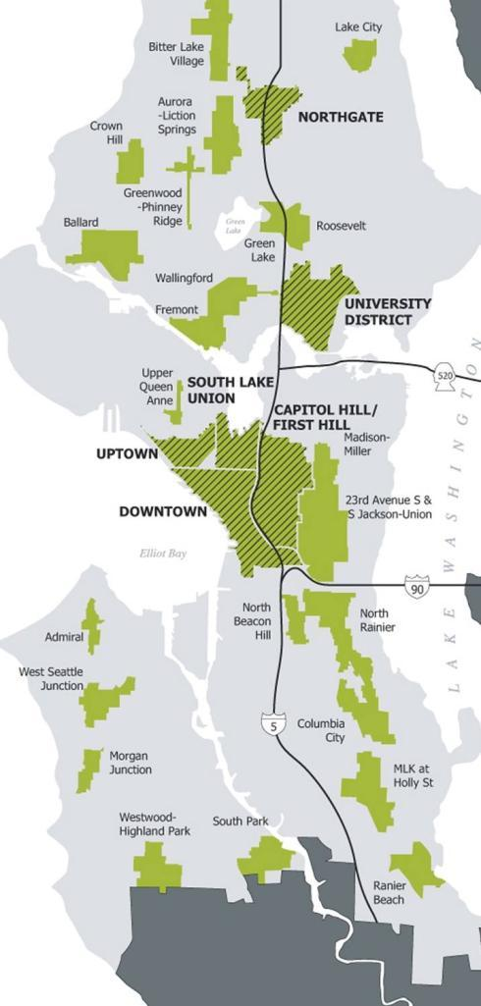
Seattle’s Growth Strategy
Comp Plan establishes the City’s growth strategy (urban centers, MICs, urban villages)
Obligates City to provide infrastructure to accommodate growth targets
Provides key policy framework for other SDOT and City plans
Comp Plan adopted by ordinance, so helps direct implementation activities
Plan must be certified by PSRC after adoption to be eligible for grant funding

Slide 4
Planning Framework
Seattle Comprehensive Plan
(20-year plan)
Climate Action Plan
Citywide Plans
Bicycle Master Plan
Transit Master Plan
Pedestrian Master Plan
Freight Master Plan
Area Plans
Subarea Community
-Southeast -Mt. Baker
-Northgate -Ballard
-U District -Uptown
-SLU -Rainier Beach
Operational Plans
Vision Zero Action Plan
ITS Next Generation
Urban Forestry
Performance-Based Parking
Move Seattle
(10-year strategic plan)
Projects
Examples:
Seawall Replacement
NGate ped/bike bridge
Center City Connector
23rd Avenue
E Marginal Way
Third Avenue
Center City bike network
Market/45th Corridor
Programs
Examples:
Safe Routes to School
Pavement Management
Complete Streets
Travel Options
Parking Management
Traffic Calming
Asset Management
Public Space Management

Slide 5
Public Review Draft of Comprehensive Plan
Released in July: http://www.seattle.gov/dpd/cityplanning/completeprojectslist/comprehensiveplan/documents/default.htm
Outline of Transportation Element
Integrating Land Use and Transportation
Make the Best Use of the Streets We Have
Transportation Options
Environment
Support a Vibrant Economy
Safety
Connecting to the Region
Operations and Maintenance
Measuring Level of Service
Funding

Slide 6
Example of Goals/Policies Relating to Bicycles
T1.6 Improve connections to urban centers and villages from all Seattle neighborhoods, particularly by providing a variety of affordable travel options (bicycle, transit, and pedestrian facilities)
T2.1 Designate space in the public right-of-way to accommodate multiple travel modes.
T3.1 Develop and maintain high-quality, affordable and connected bicycle, pedestrian, and transit facilities.
T3.9 Develop and maintain pedestrian and bicycle facilities that enhance the predictability and safety of all users.
T3.10 Prioritize bicycle and pedestrian investments on the basis of increasing use, safety, connectivity, equity, health, livability, and opportunities to leverage funding.
TG6 Provide and maintain a safe transportation system that protects all travelers, particularly the most vulnerable users.
T6.3 Invest in education measures that increase mutual awareness among motorists, pedestrians, and bicyclists.

Slide 7
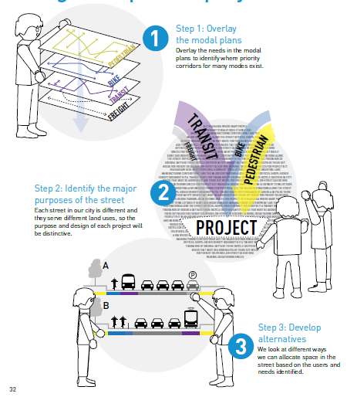
Make the Best Use of the Streets We Have
Identifies policies and a framework for ROW allocation decisions
Supports Move Seattle
Describes ROW allocation process to internal and external audiences
Guides modal plan integration
Notes:
SDOT needed policies to:
For the comp plan about how we allocate the right-of-way
We developed policies to:
Support Move Seattle
Help us explain our decision to the public and contribute to a consistent internal decision making process
Give us guidance on how we integrate the modal plans – but not prescribe a set answer

Slide 8
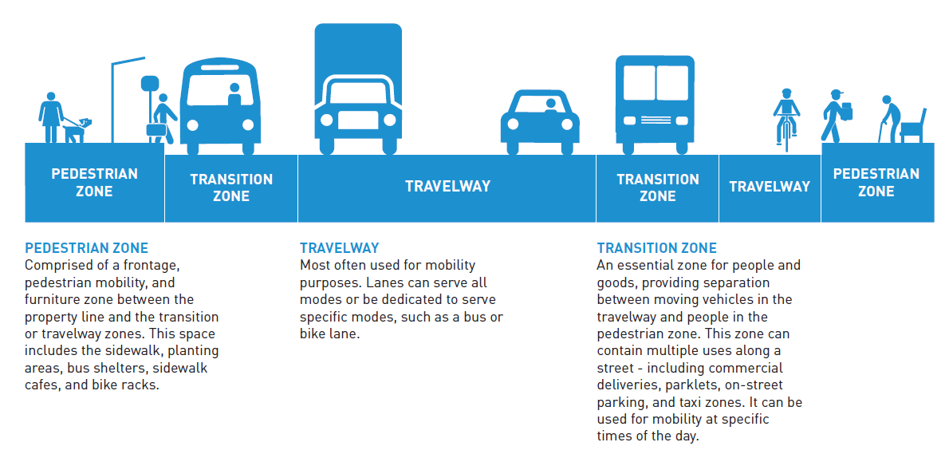
Right-of-Way Zones
Notes:
The first way we approached ROW allocation was thinking of each of its parts.
These are the three zones and what typically happens in each.

Slide 9
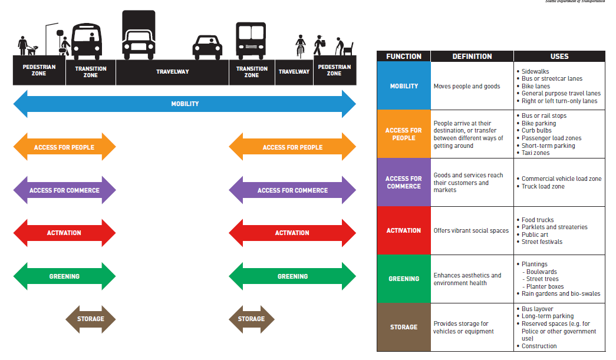
Right-of-Way Functions
Notes:
We considered what goes on in the ROW and identified six essential right-of-way functions.
Name six functions. Give examples of uses
Identify how the transition zone is the pinch-point.

Slide 10
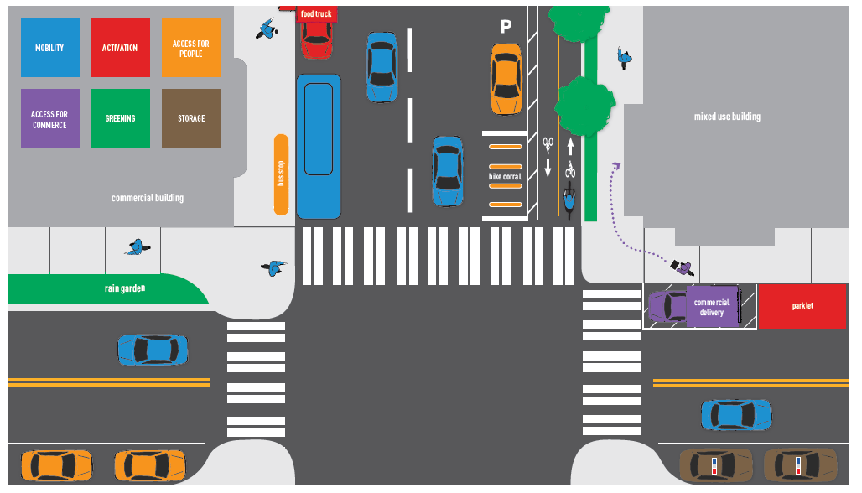
Outcome: multi-functional streets
Notes:
And we saw that what we wanted were streets and corridors that were able to serve all of those functions. Not all of them right outside your door –but at least nearby.

Slide 11
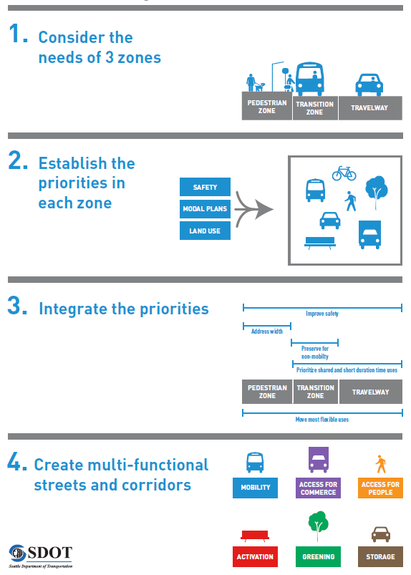
ROW Allocation Decision Process
Allocate space on Seattle’s streets to safely and efficiently connect people and good to their destinations while creating inviting spaces within the ROW (Goal TG2)
See policies T2.1-2.8
Notes:
Our ROW allocation goal in the Comp Plan is about making the best use of the streets we have. (read policy).
In short, we would achieve multi-functional streets by:
Looking at the needs of three ROW zones
Establish the top priority for each zone – driven by safety, modal plan projects and land use
Integrate the top priorities though 5 considerations:
Improve safety
Address sidewalk width before allocating space to other ROW zones
Preserve the transition zone for non-mobility purposes where possible
Prioritize shared and shorter duration uses
Relocate the most flexible uses to other streets or private property

Slide 12
Level of Service (LOS)
LOS is a quantitative or qualitative measure of the performance of transportation systems and facilities
Traditionally, LOS has focused on vehicle congestion (traffic volumes/road capacity)
The Growth Management Act (GMA) requires LOS standards for all locally owned arterials and transit routes
Puget Sound Regional Council is seeking LOS standard that focus on all modes of transportation
12
Notes:
Let the audience know the purpose of your presentation (is it purely informational, are you seeking feedback, etc). Then walk them through what you’ll be covering.

Slide 13
Current LOS Standard
Insert image
Screenlines to assess ratio of traffic volume to capacity
Generally allow for a high level of congestion (v/c of 1.0 to 1.2)
Used for arterials and transit
Standard designed to be difficult to exceed
13

Slide 14
New Approach to LOS
Comp Plan Goals
Enhanced Multimodal Screenlines (Consider Person Trip Capacity)
Performance-Based Measures (VMT, Mode Share)
Tests the merits of individual projects and system performance
Evaluates impacts on the system (corridors), not the merits of individual projects

Slide 15
Potential LOS Mitigations Under New Approach
Bicycle parking & facilities
Paid and/or reduced vehicle parking for residents and employees
Transit passes & subsidies
Pedestrian & bicycle access improvements
Mix of uses
Vanpool accommodation
15
Notes:
Let the audience know the purpose of your presentation (is it purely informational, are you seeking feedback, etc). Then walk them through what you’ll be covering.

Slide 16
Comprehensive Plan Schedule and Next Steps
May 2015 | Release of Comp Plan DEIS and equity analysis
July 2015 | Release of public review draft of Comp Plan update
Summer/Fall 2015 | SDOT advisory board, Planning Commission, and public review and comment on public review draft
Early 2016 | Release of FEIS and Mayor’s recommended Comp Plan
Mid 2016 | City Council approval of Plan

