Slide 1
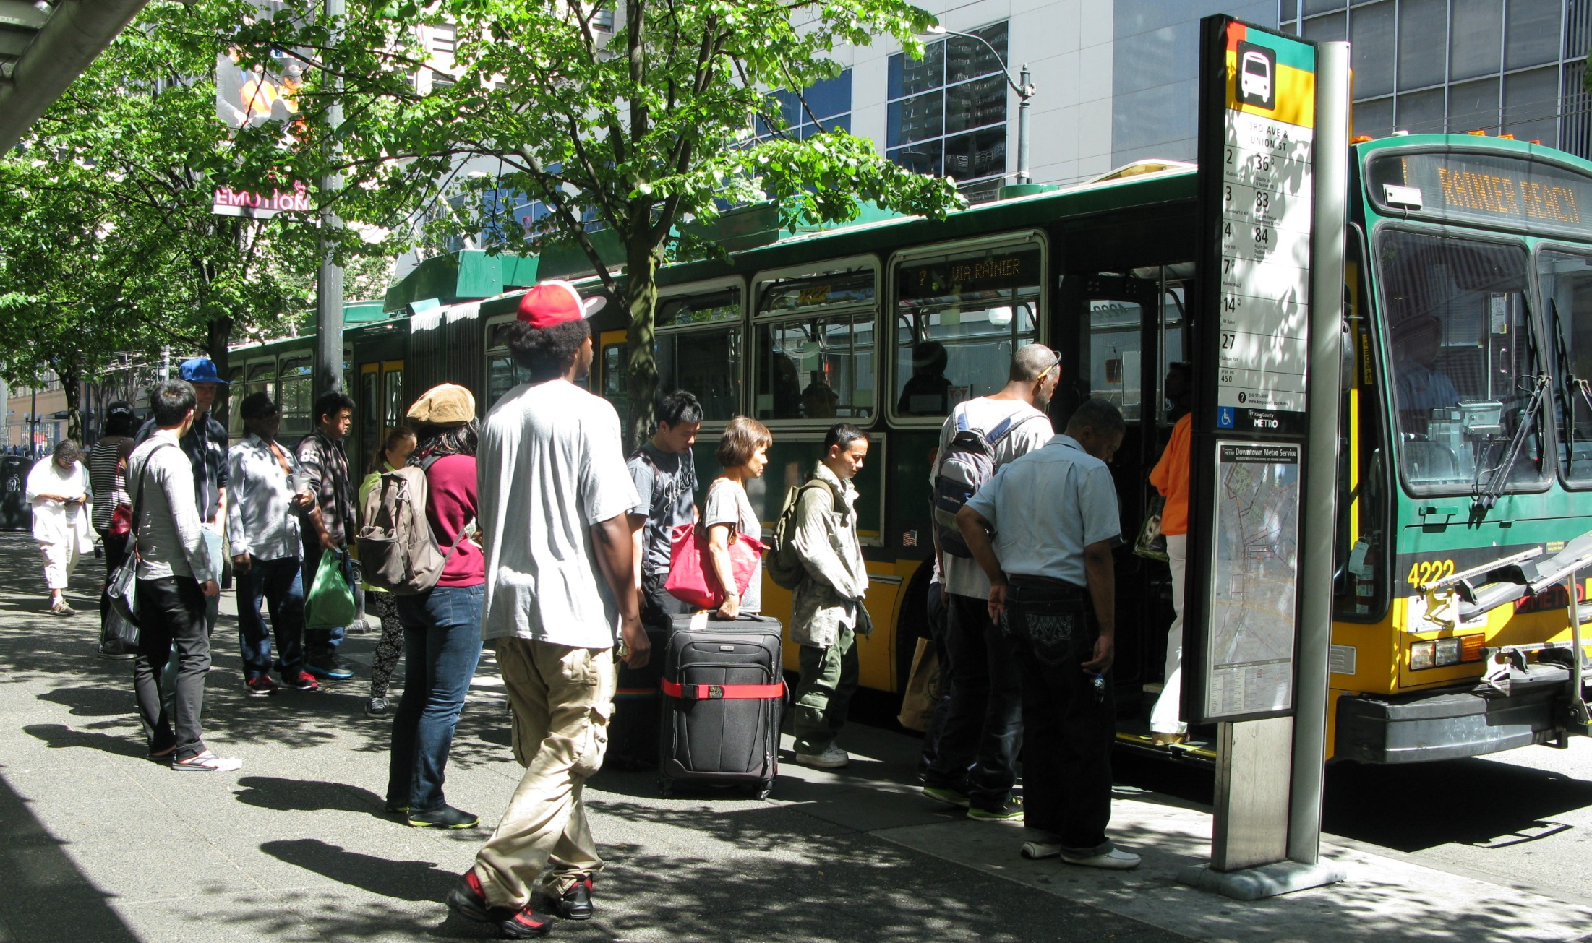

SBAB- Implementation Plan
July 6th 2016

Slide 2
Our mission, vision, and core values
Mission: deliver a high-quality
transportation system for Seattle
Vision: connected people, places, and products
Committed to 5 core values to create a city that is:
Safe
Interconnected
Affordable
Vibrant
Innovative
For all
2
Notes:
Our core values for transportation anchor to the core values that Mayor Murray has laid out in his vision (Move Seattle) for Seattle:
Safe
Interconnected
Affordable
Vibrant
Innovative

Slide 3
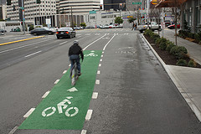
Presentation overview
What we heard from you.
Discuss Implementation plan process: A phased approach
Next steps, schedule.
3
Notes:
Let the audience know the purpose of your presentation (is it purely informational, are you seeking feedback, etc). Then walk them through what you’ll be covering.

Slide 4
What we heard about the prioritization process:
More Transparency
Emphasis on Safety
Add Downtown projects
Better Connectivity
Emphasis on Equity
More quick fix projects
4

Slide 5
Phase I: Create Teams & Assumptions
Create Team:
SDOT Staff and 2-3 SBAB members
Meet a couple times a month (daytime or evenings)
Agree on assumptions
The 2017 work plan stays the same
Quantitative analysis was established in the 2014 BMP and stays the same until the next update in 2018
The SBAB remains our primary stakeholder.
Imp Plan
SDOT
SBAB
Council
5

Slide 6

Phase II Quantitative & qualitative Analysis.
Re-run quantitative Analysis based on:
Safety: 40 points
Connectivity: 25 points
Equity: 20 points
Ridership: 10 points
Livability: 5 points
Dive deep into qualitative
Gaps/Connectivity
Geographic distribution
Partner Projects/Leveraging opportunities
Policy directives
Community Interest

Slide 7
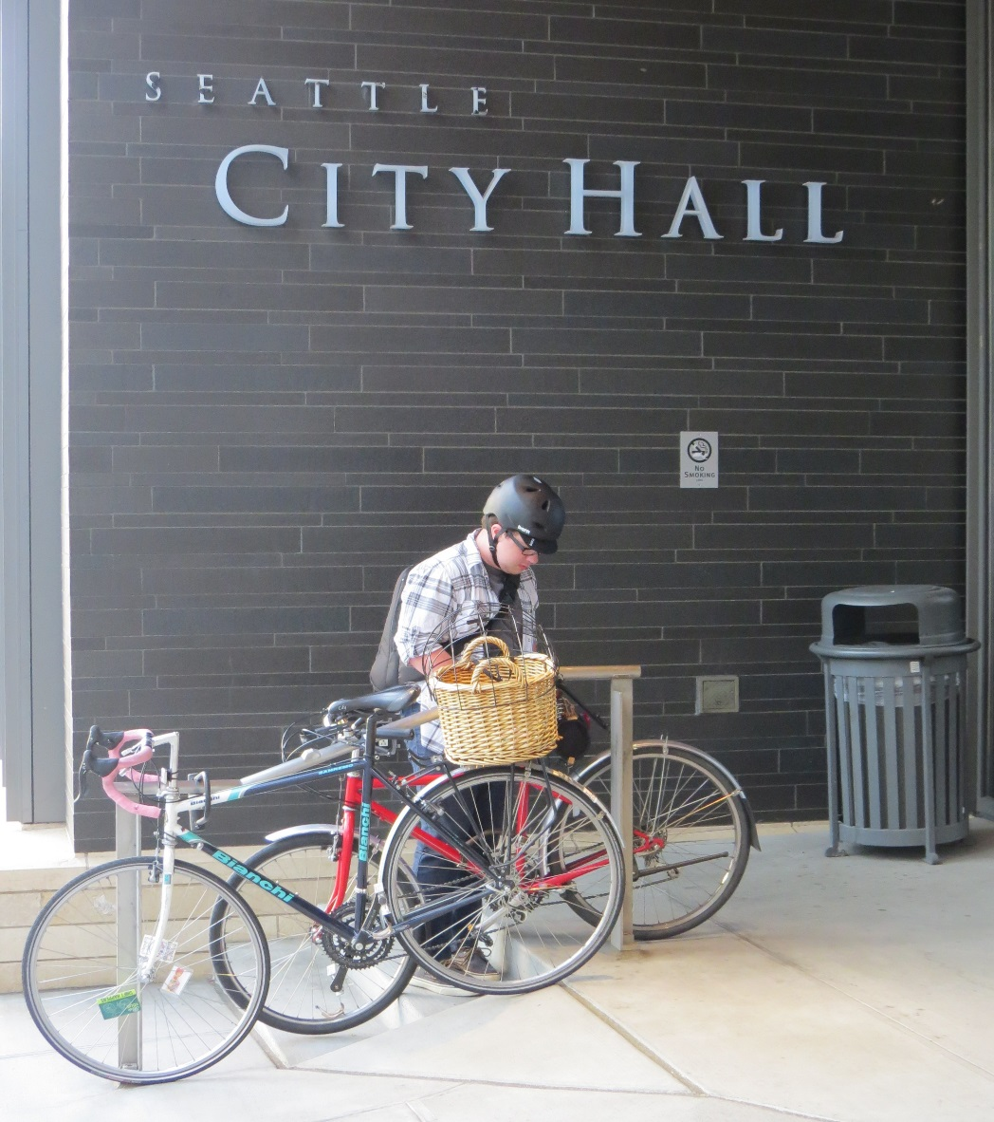
Phase III Finalize for Council.
Discuss Draft project list & confirm projects.
Document all decisions
Review with SBAB, confirm funding.
Internal review.
Present final doc to Council

Slide 8
Schedule
Month | Task
August | Walk through the 2016 prioritization to gain an understanding of the quantitative and qualitative approach. Select SBAB team members. Receive CCMP input
September | Start the prioritization process. Evaluate all the qualitative factors with team. Create lists of projects with costs to present & discuss at next SBAB Meeting.
October | Present list and discuss issues. (budget will limit # and length of projects to be selected) Select preferred projects for draft list
November | Final selection process of projects for the plan.
December | Happy Holidays! (no update)
January | Present & discuss final project list.
February | Prepare final document for Council.

Slide 9




Questions?
Monica.Dewald@seattle.gov | (206) 684-5374
www.seattle.gov/transportation/bike.htm
www.seattle.gov/transportation

