Slide 1
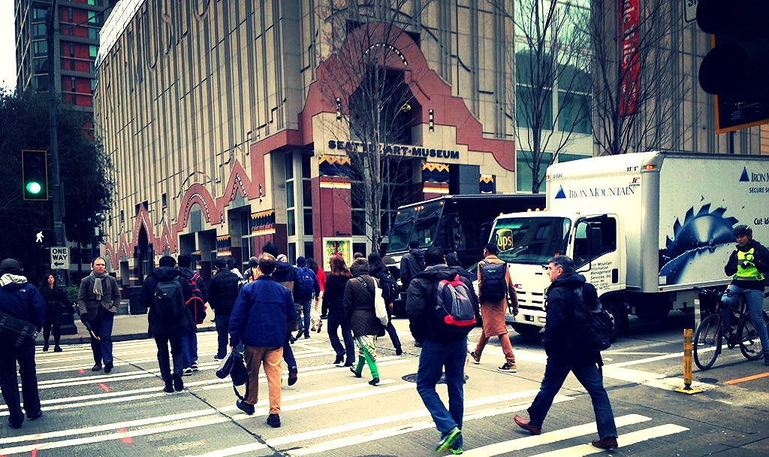
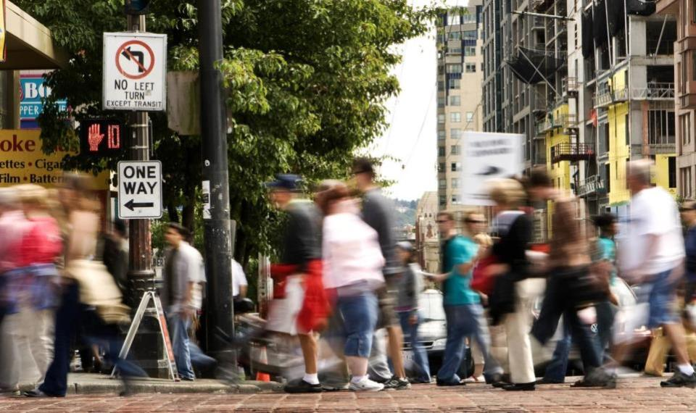

Pedestrian Master Plan Update
Seattle Bicycle Advisory Board
Ian Macek
June 1, 2016

Slide 2
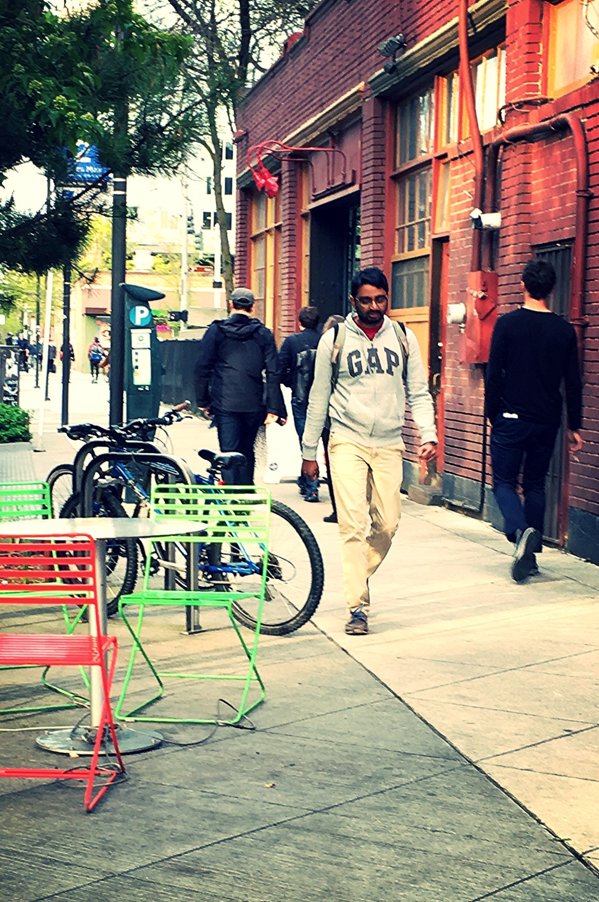
Presentation overview
What is the PMP?
PMP policy framework
What we’ve heard
Prioritizing pedestrian improvements
Plan implementation
Next steps
2

Slide 3
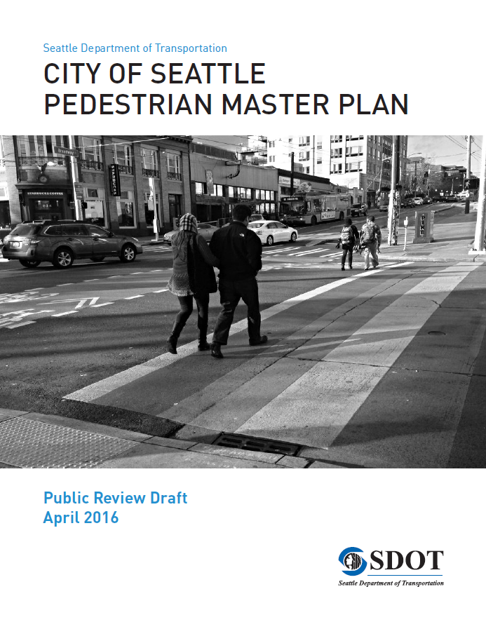
PMP is a resource allocation plan
20-year blueprint to provide walking improvements
Data-driven prioritization of funding
Designed to focus resources where:
  There is high existing and potential pedestrian demand
  There are safety concerns
  There are populations with the greatest need

Slide 4
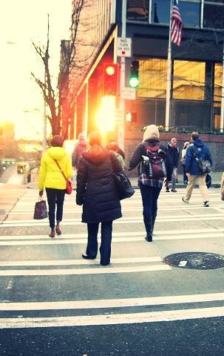
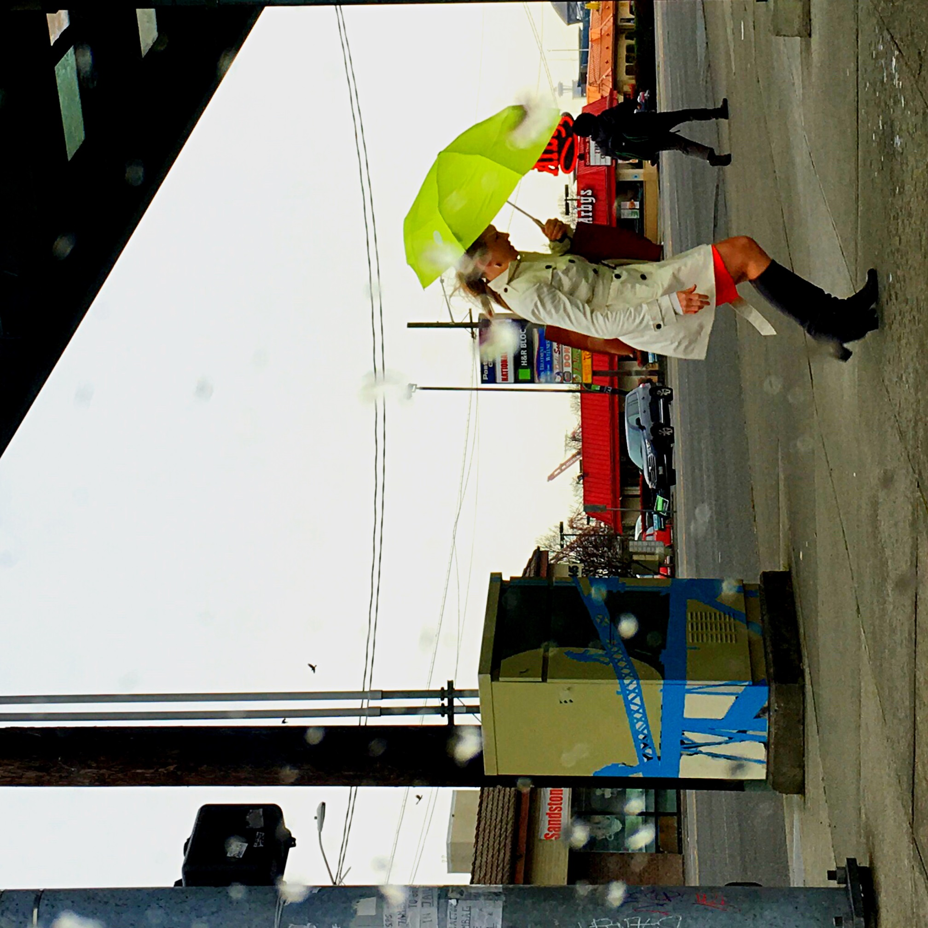
PMP Policy Framework
Vision: Seattle is the most walkable city in the Nation
Goals:
Safety: Reduce the number and severity of crashes involving pedestrians.
Equity: Make Seattle a more walkable city for all through equity in public engagement, service delivery, accessibility, and capital investments.
Vibrancy: Develop a connected pedestrian environment that sustains healthy communities and supports a vibrant economy.
Health: Get more people walking to improve mobility, health, and prevent disease.

Slide 5
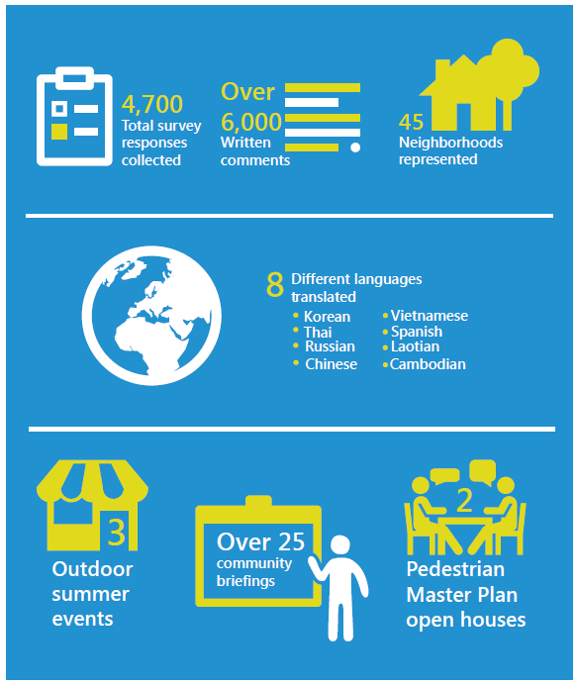
What we’ve heard
PMP Public Outreach in Numbers
Focus investments on:
Streets connecting families and children to schools
Streets connecting people to transit stops
Sidewalks and crossings on busy arterial streets
Residential streets where sidewalks are missing
Locations where pedestrians are injured
Notes:
The public survey asked three key questions about walking conditions in Seattle:
What makes it difficult or unpleasant for you to walk?
Where should the City prioritize walking improvements first?
What types of pedestrian improvements should we build first?

Slide 6
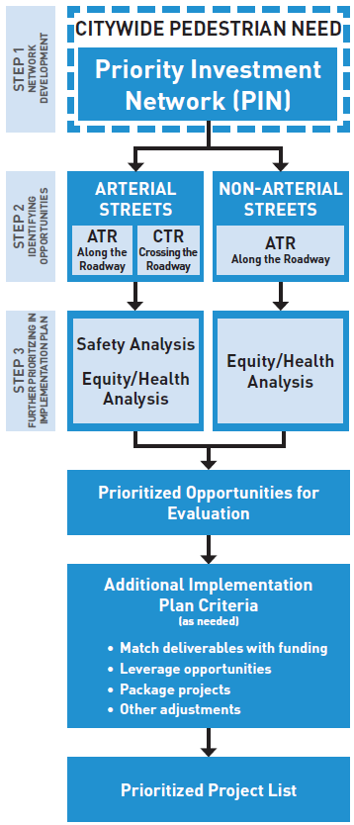
Prioritizing pedestrian improvements
Step 1
Develop a citywide “Priority Investment Network” (PIN) using demand (vibrancy) factors
Step 2
Identify opportunities to improve walking conditions along and crossing the streets in the PIN
Step 3
Further prioritization as the Plan is implemented, using safety and equity/health analyses to identify areas within the network to evaluate first

Slide 7
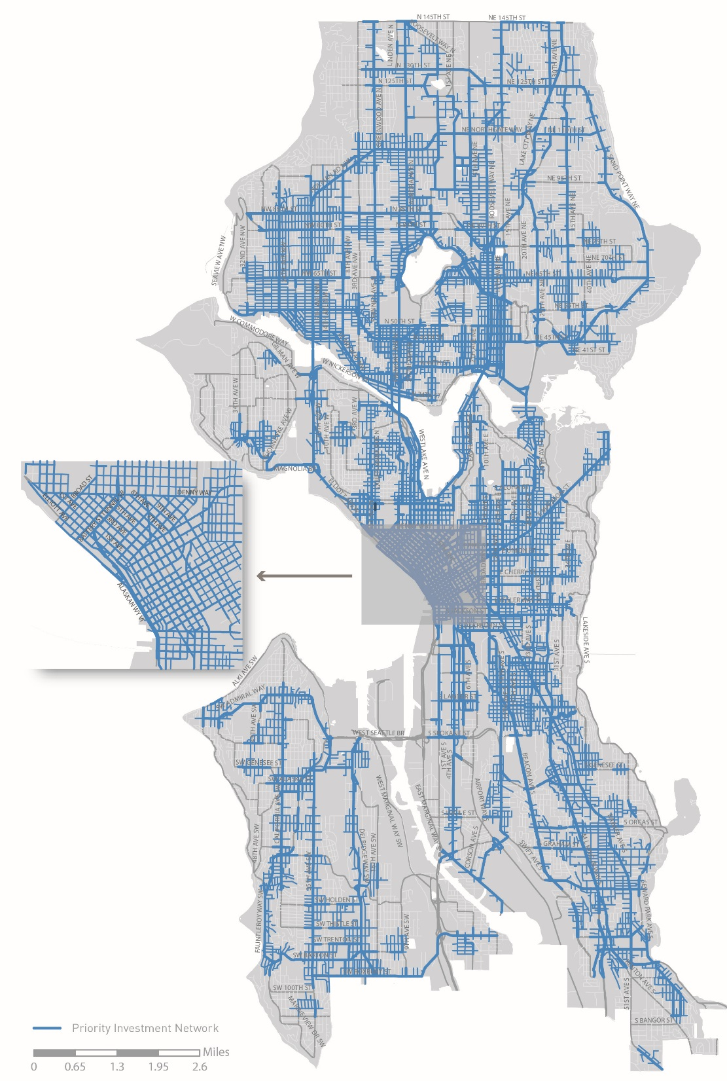
Step 1:
Priority Investment Network
Updated Factors
Walksheds to Frequent Transit Network (FTN) stops (walkshed distance based on transit type)
FTN arterials
Walksheds to public schools (1/4 mile)
Investments are directed to this network (further prioritization is required)
Responds to community priorities
Helps address desire for system connectivity
Distributes investment priorities across the city
Notes:
Based on public survey feedback we’ve narrowed that focus to two key pedestrian generators
Developed a connected network where investments will be directed
See detailed maps
Next step: To identify potential needs within this network…
Crossings improvements (particularly increasing controlled crossings) could also help people who bike.
Greenway improvements could help close some of the arterial crossing gaps we identify.

Slide 8
Step 2: Identify opportunities for further evaluation
Along the roadway
Crossing the roadway
Evaluates arterial and non-arterial streets
  Sidewalk presence
Definition of sidewalk on arterials = includes curb
Does not assess sidewalk condition
Evaluates arterial streets
  Controlled stop spacing
  Crossing width
  Curb ramp status
Notes:
Evaluates arterials only
Identifies opportunities for further evaluation (not specific project recommendations)
Other types of crossing improvements (signals, lighting, etc.) driven by other analyses/programs

Slide 9
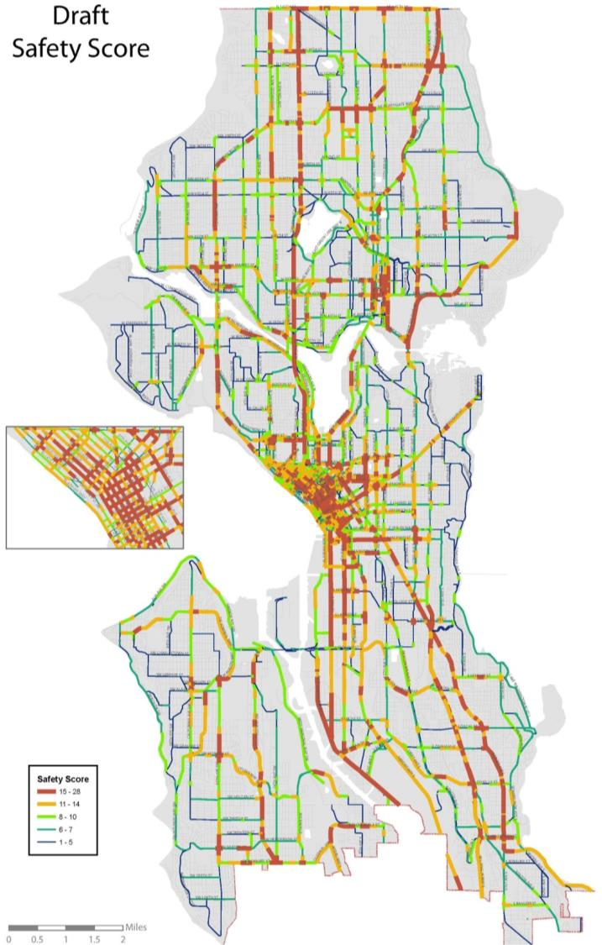
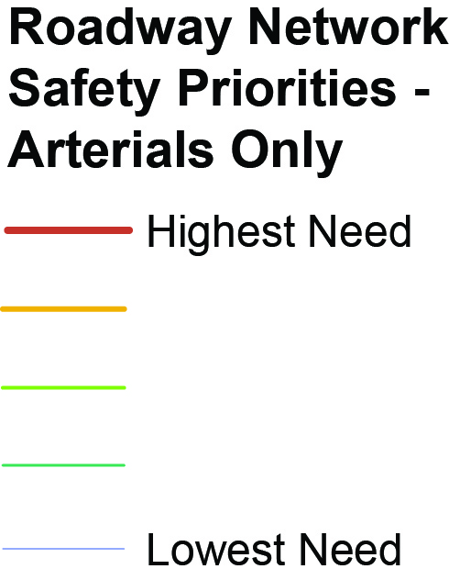
Step 3: Further prioritizing (arterials)
Safety Factors (based on SDOT Pedestrian Safety Analysis and Vision Zero objectives)
Pedestrian collisions | Serious injuries and fatalities more highly weighted. Data from the last 5 years.
Arterial classifications | Proxy for volume; Majority of severe injuries occur on principal and major arterials
Roadway width | Curb to curb width
Speed | 85th percentile speeds where available, and posted speed limit where actual speed is not available.
Controlled crossing spacing | On principal and major arterials

Slide 10
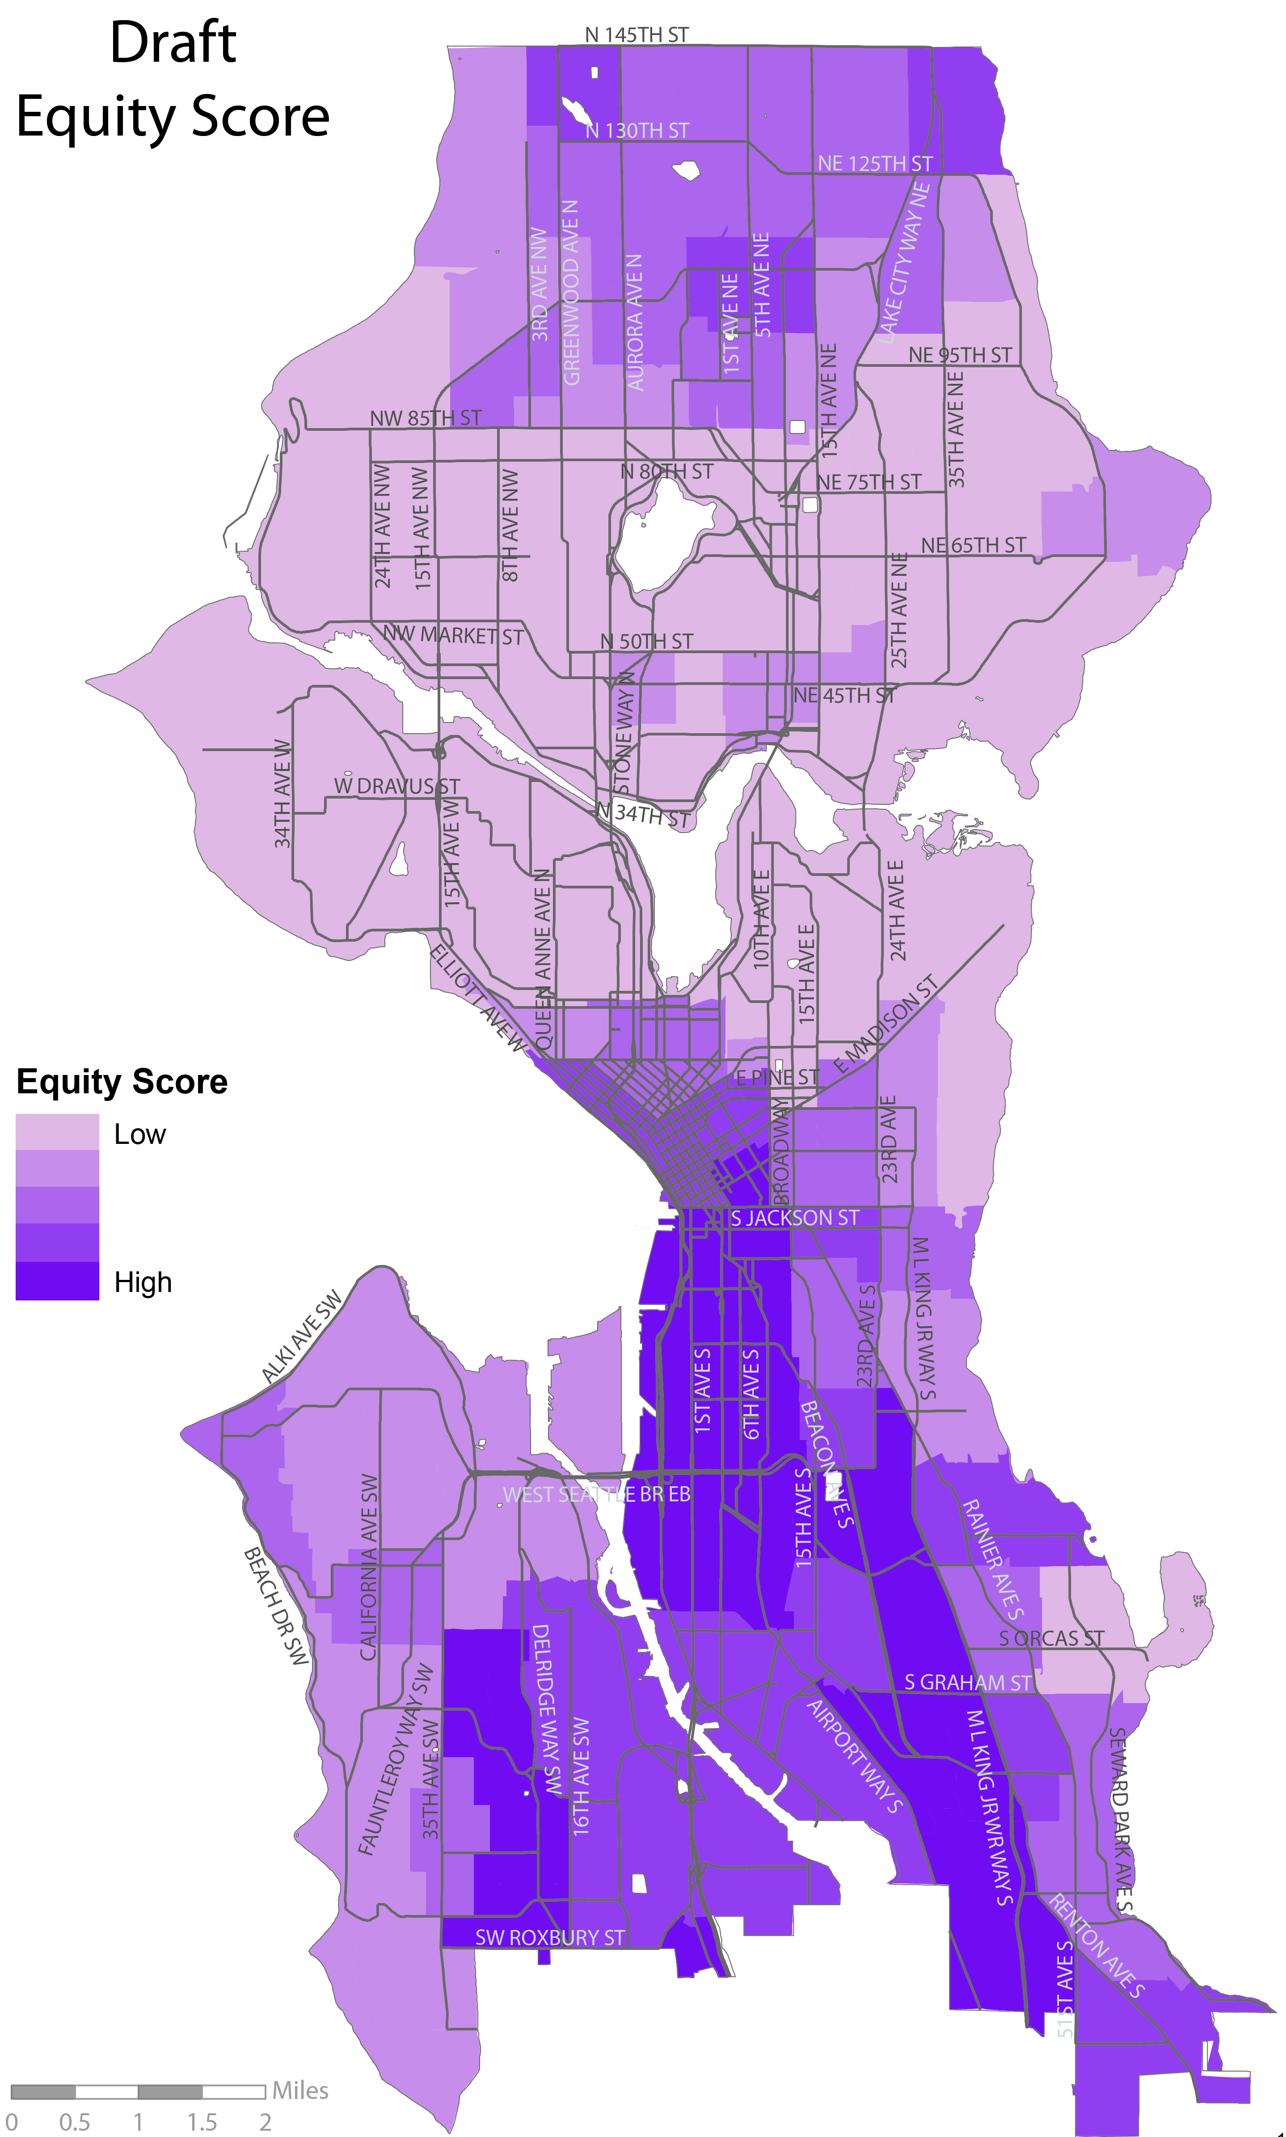
Step 3: Further prioritizing (arterials and non-arterials)
Health and Equity Factors
Communities of color (new)
Low income population
Disability population
Diabetes rates
Physical activity rates
Obesity rates

Slide 11
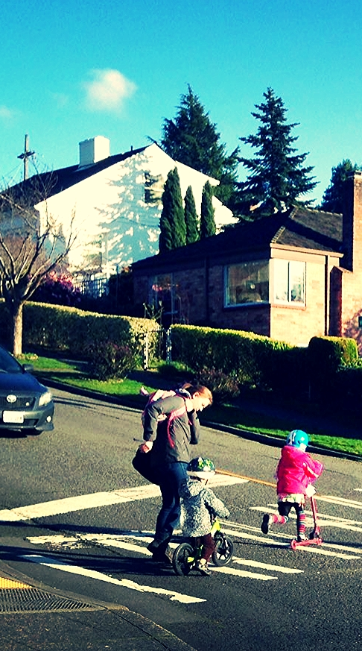
PMP Implementation Plan
Will be developed after Plan adoption
Identify locations within the PIN for near-term improvements based on:
  Safety/Equity/Health analyses
  Annual funding streams, grant opportunities, and other resources.
  Program/project leveraging opportunities
  Other balancing factors
Implementation Plan will be updated regularly
Notes:
Implementation Plan will be updated regularly
Reflects changing funding and leveraging opportunities
Allows safety/equity/health data to be updated regularly

Slide 12
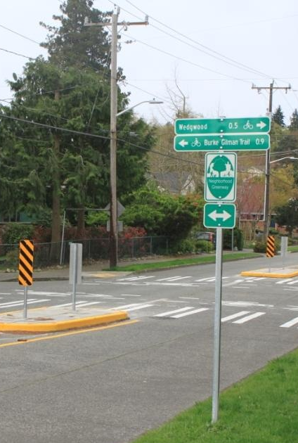
Bicycle considerations
Consolidate driveways and curb cuts
Improve pedestrian visibility at crossings
Increase opportunities for controlled crossings on arterials
Provide neighborhood and arterial traffic calming measures
Provide low-cost walking improvements on non-arterial streets, including Neighborhood Greenways
Expand multimodal traveler safety education and encouragement programs
Notes:
Implementing strategies and actions
Stem from Plan goals/objectives
Outline how we will improve walking conditions within the PIN.
19 implementing strategies
64 implementing actions

Slide 13
Plan performance measures
Measure | Desired trend | Performance target
Number of pedestrian fatalities and serious injury collisions | Decreasing rate | Pedestrian fatalities and serious injury collisions reach zero by 2030
Rate of crashes involving pedestrians | Decreasing rate of pedestrian crashes per 100,000 residents | (None recommended)
Percent of sidewalks within the PIN completed | Increasing percentage of Priority Investment Network arterial sidewalks completed | 100% of PIN arterial sidewalks complete by 2035
Mode share | Increasing percentage of walking trips | (None recommended)
Pedestrian activity | Increasing number of pedestrians at count locations over time | (None recommended)
Children walking or biking to or from school | Increasing number of trips by children | (None recommended)

Slide 14

PMP Public review draft
Public comment period
  45 days
Hard copy of the plan distributed to
  Seattle libraries
  City Council
  Mayor’s office
Available online
Work with Department of Neighborhoods (DON) to spread the word
Notes:
Review the Freight Master Plan
Submit comments to SDOT
Provide a letter of support for the FMP

Slide 15
Status and next steps
 | April | May |  | June | July | August
Develop draft plan
Release draft plan for public review
Public review and outreach
Address comments
Anticipated Mayor’s recommended plan*
*Implementation Plan will be developed after Plan adoption
Notes:
Working with DON on public outreach during the public review period

Slide 16





Questions?
michelle.marx@seattle.gov | (206) 684-0633
ian.macek@seattle.gov | (206) 684-7576
www.seattle.gov/transportation/pedMasterPlan.htm
www.seattle.gov/transportation

Slide 17
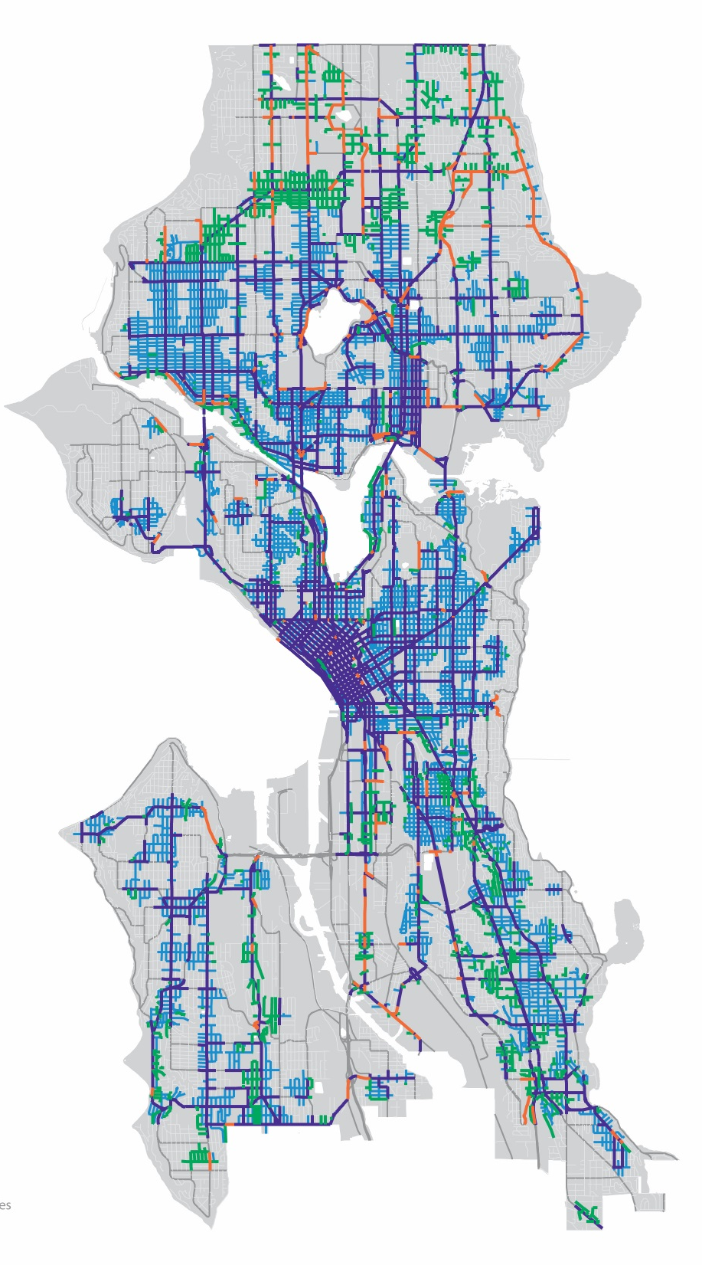

Identifying needs within the PIN:
Missing sidewalks
Arterial missing sidewalk (traditional sidewalks)
Non-arterial missing sidewalk (low-cost sidewalks)
Arterial streets (crossing improvements, maintenance)
Non-arterial streets (maintenance)
 | All arterials city-wide | All arterials within PIN
Total # blockfaces | 12,791 | 9,158
Total blockfaces (or partial blockfaces) missing sidewalks | 1,400 | 669*
 | All non-arterials city-wide | All non-arterials within PIN
Total # blockfaces | 32,511 | 14,770
Total blockfaces (or partial blockfaces) missing sidewalks | 10,001 | 3,136*
* Based on SDOT Asset Management database. Not all locations shown as missing sidewalks are necessarily feasible or desirable locations for new sidewalks.

Slide 18
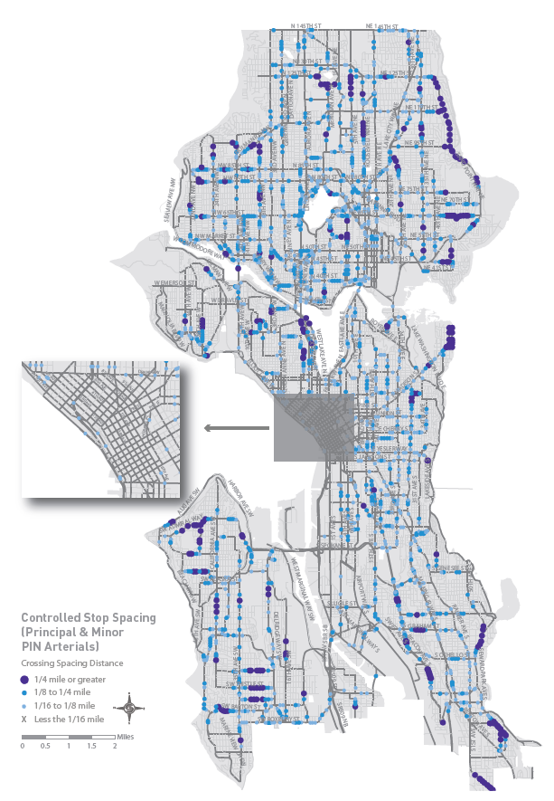
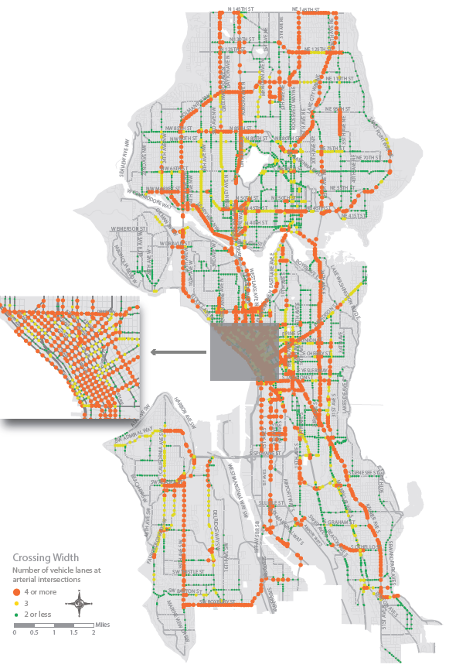
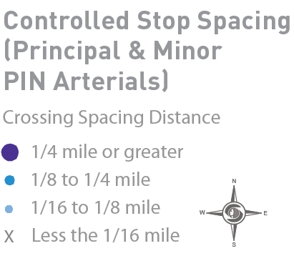
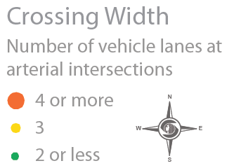
Identifying needs within the PIN: crossings
Crossing width
Controlled crossing spacing
Notes:
Evaluates arterials only
Identifies opportunities for further evaluation (not specific project recommendations)
Other types of crossing improvements (signals, lighting, etc.) driven by other analyses/programs

