Slide 1
12th Ave S PBL
Seattle Bicycle Advisory Board
  Megan Hoyt
  Christiana Farrell
  Serena Lehman

Slide 2
Meeting Goals
Introductions
  Megan Hoyt – Project Manager
  Christiana Farrell – Project Developer
  Serena Lehman – BMP Implementation Plan Program Manager
Provide update on implementation of 12th Ave S PBL
  Yesler to King
  King to Charles
Timeline and Challenges

Slide 3
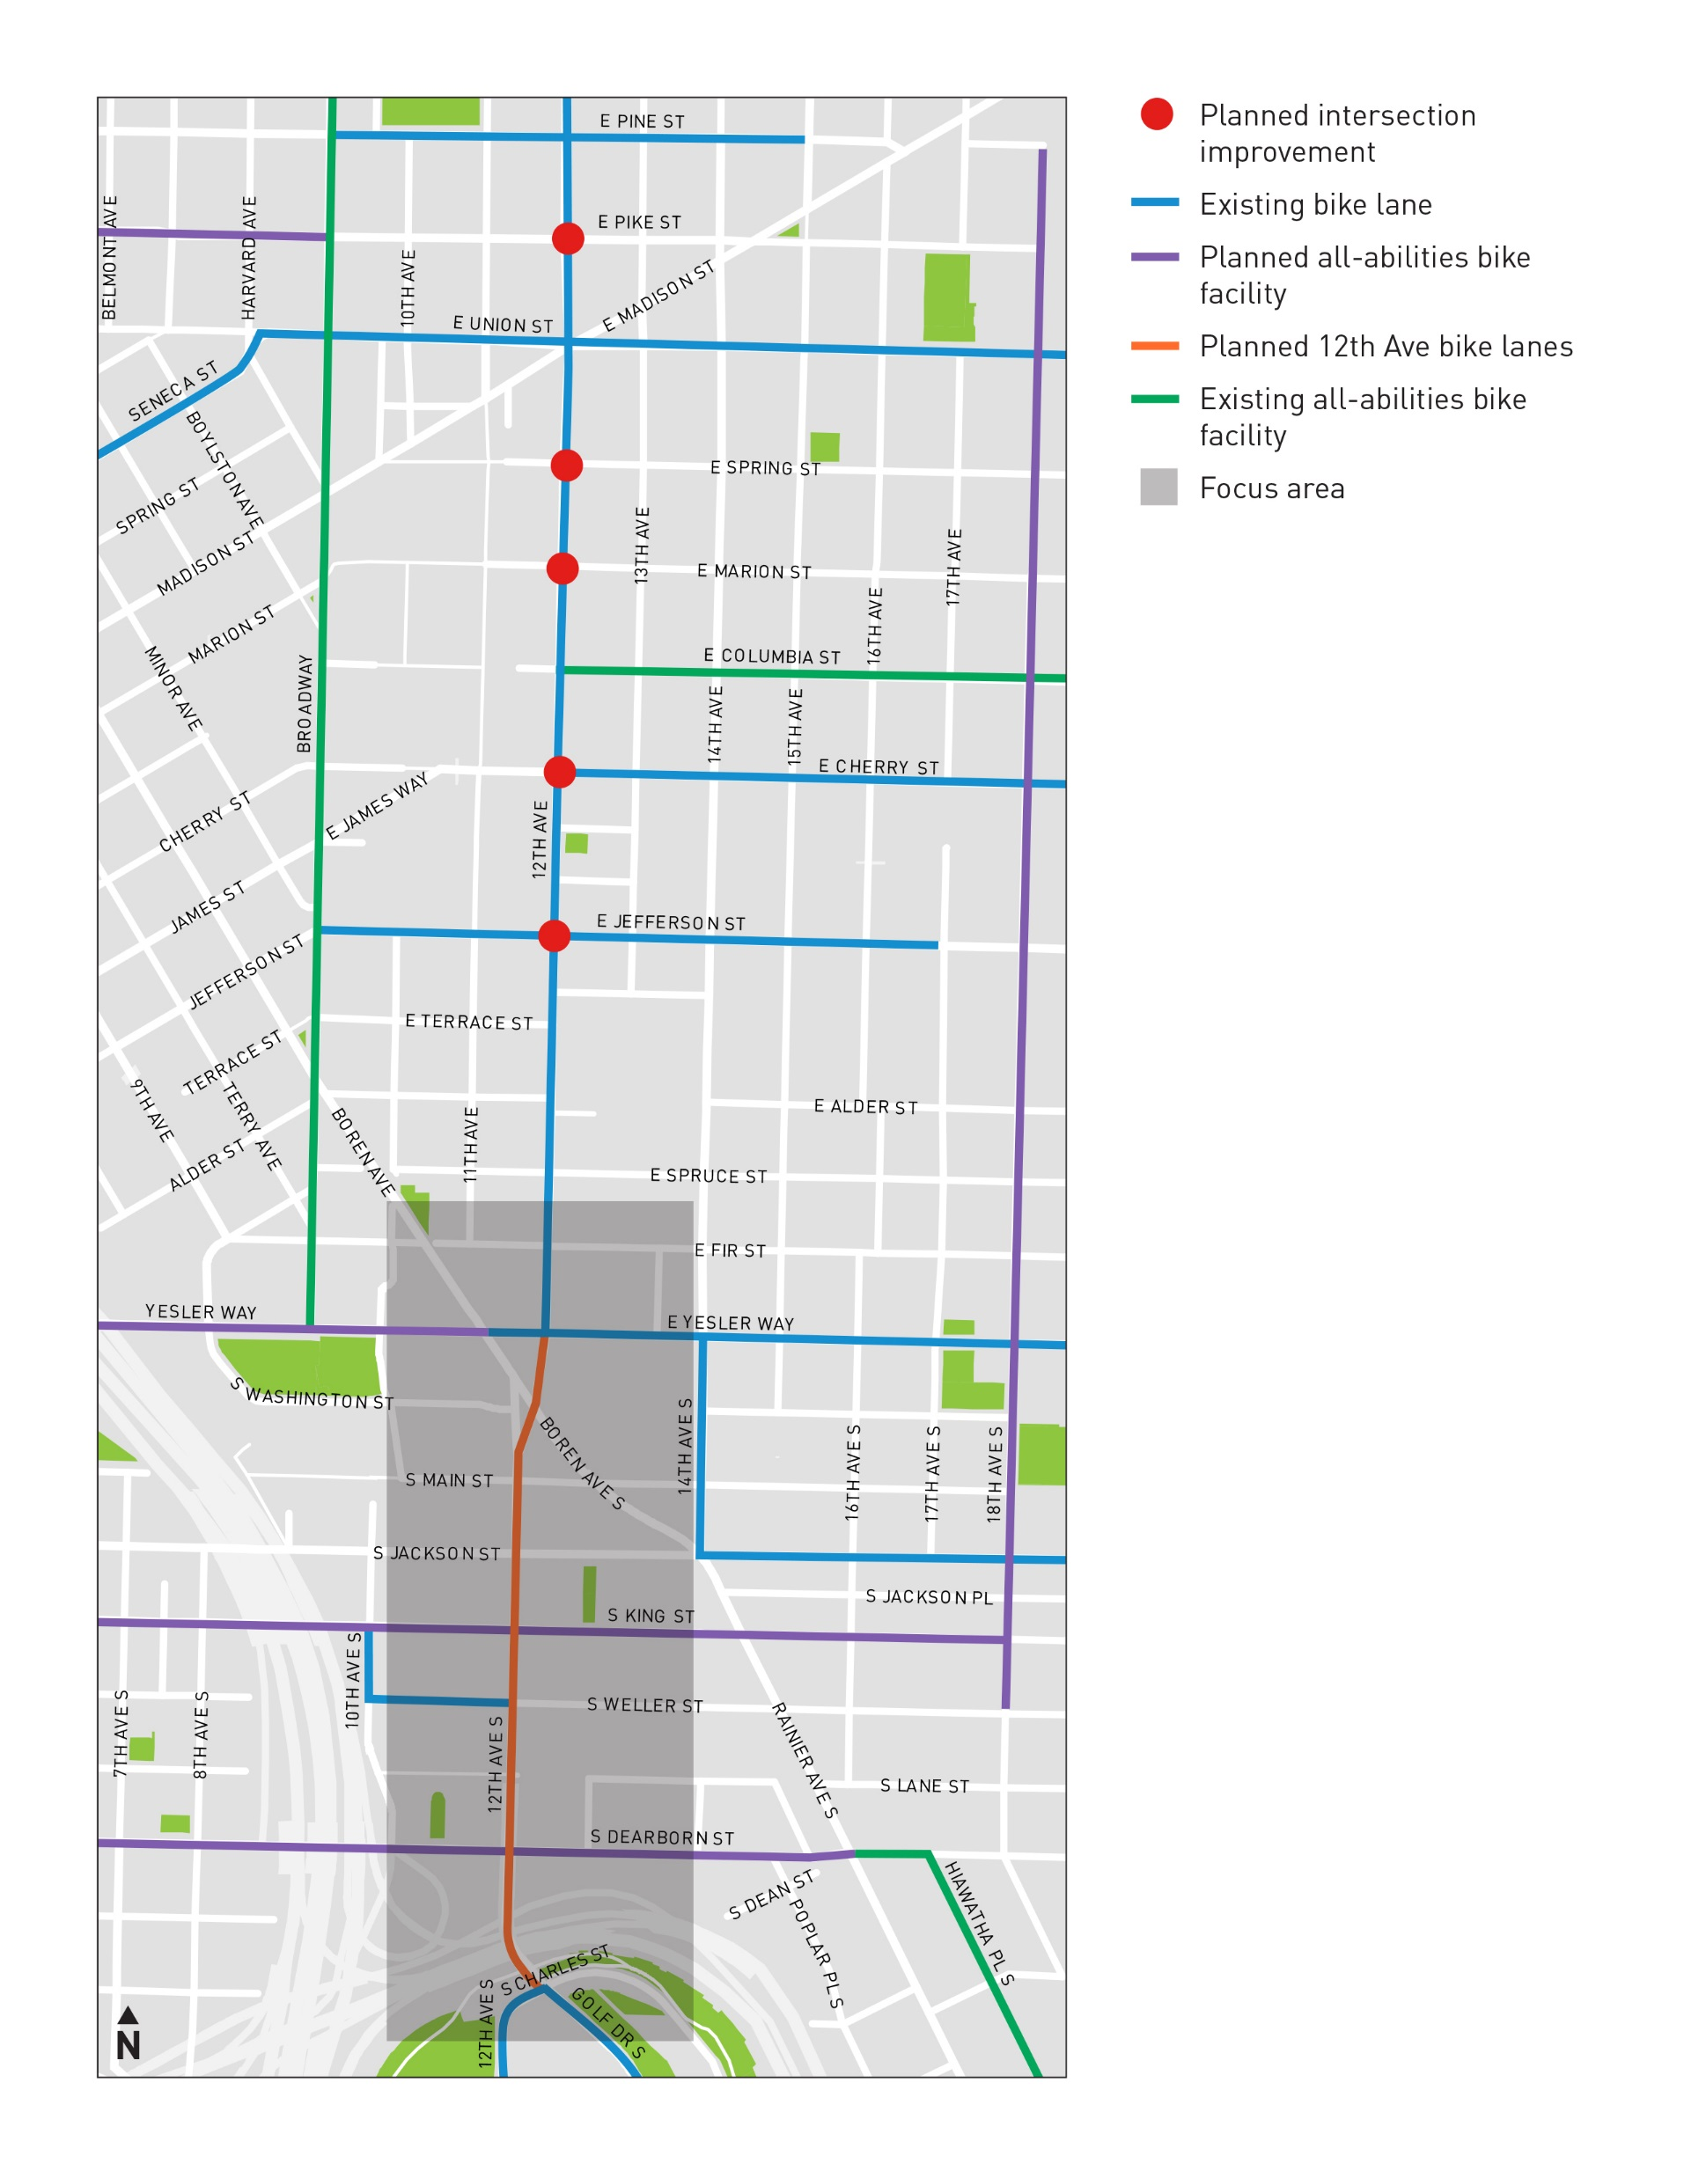
Bicycle Master Plan (BMP) Recommendations
BMP Implementation Plan recommends a Protected Bike Lane on 12th Ave S between Yesler Way and Charles St

Slide 4
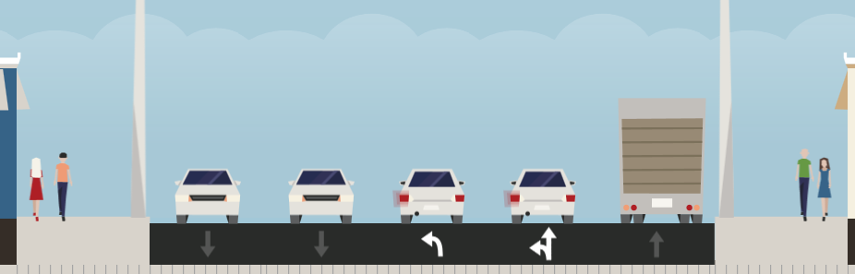
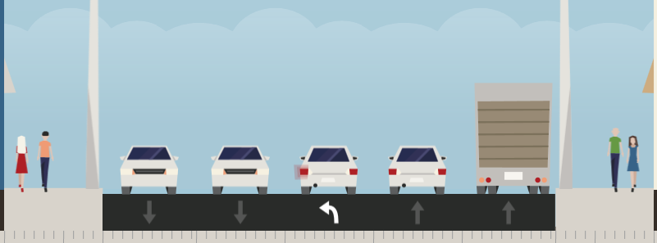
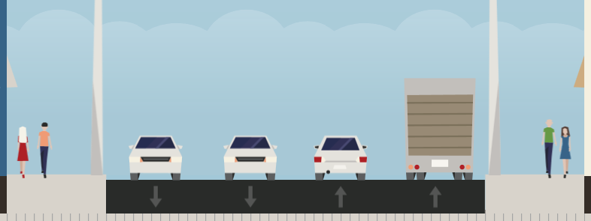
Typical Existing Cross-Section
1. Yesler to Jackson
1
2. Jackson to Weller
2
3
3. Weller to Charles

Slide 5
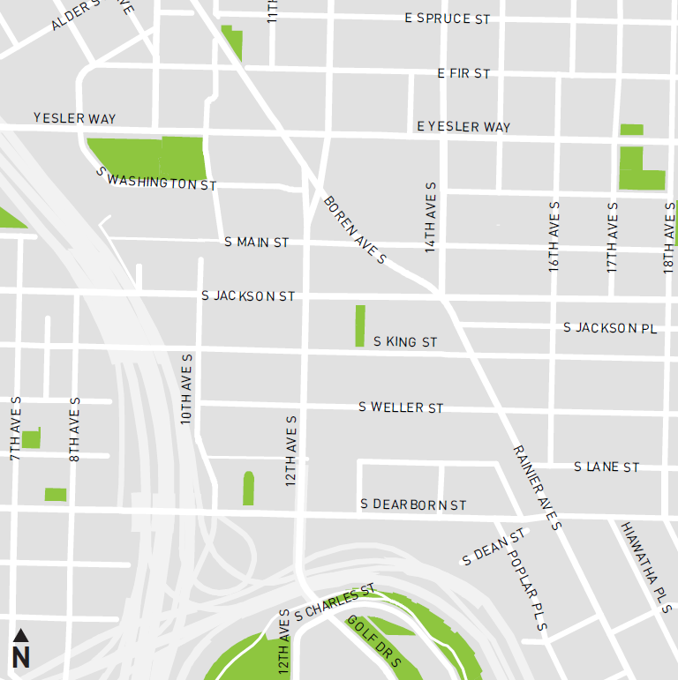
12th Ave / Boren Modal Constraints/Overlaps
1. Streetcar
2. Boren Cars & Transit
Safety Hot Spot

Slide 6
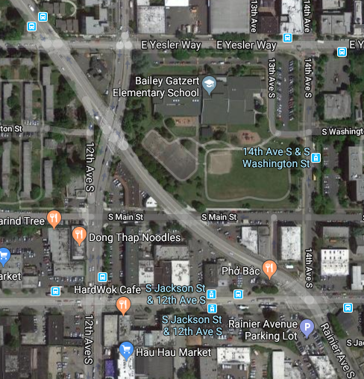
Modal Priorities
Significant investment in Streetcar speed and reliability at Yesler and Jackson
Transit needs on S Jackson St and on Boren Ave
Bicycle safety/mobility on 12th

Slide 7
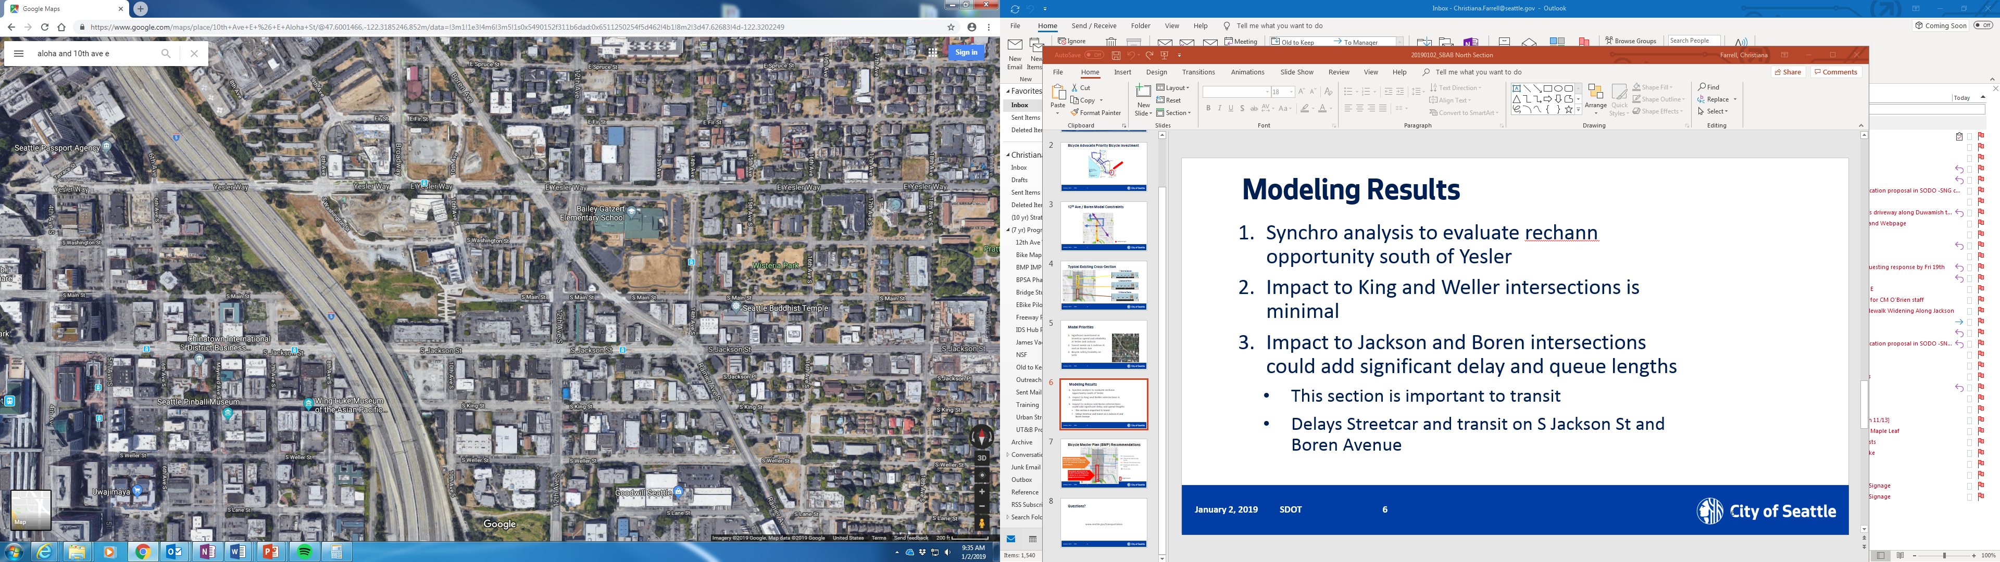
Modeling Results
Traffic model developed Yesler to Charles
  One travel lane removed each direction for PBL
Impacts to Yesler, Boren, and Jackson intersections add significant delay and queue lengths
    Especially delays streetcar and transit
  Impact to King and Weller intersections is minimal
7

Slide 8
Vision Zero 12th Ave S Project
This project will only focus on
12 Ave S between S King St and
S Charles St, to connect trail to Neighborhood Greenway
Project Extents

Slide 9
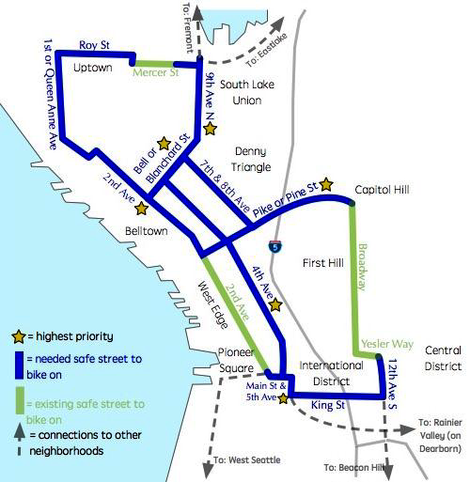
Bicycle Advocate Priority Bicycle Investment

Slide 10
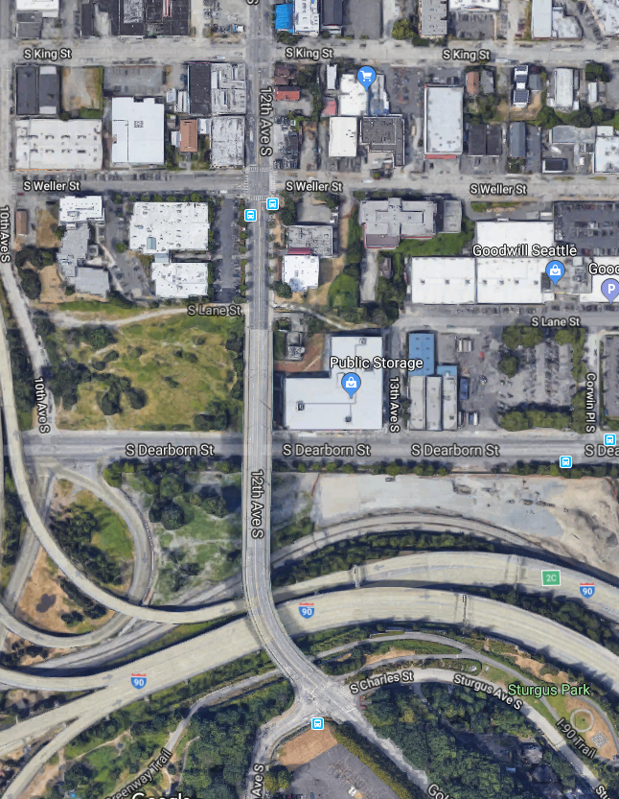
Proposed Scope
Safety projects:
  S Weller St
  S Charles St/Golf Dr S
  Protected Bike Lane: S King St to S Charles St to connect trail and Neighborhood Greenway
  Construct portions of S King St Neighborhood Greenway at King St intersection

Slide 11
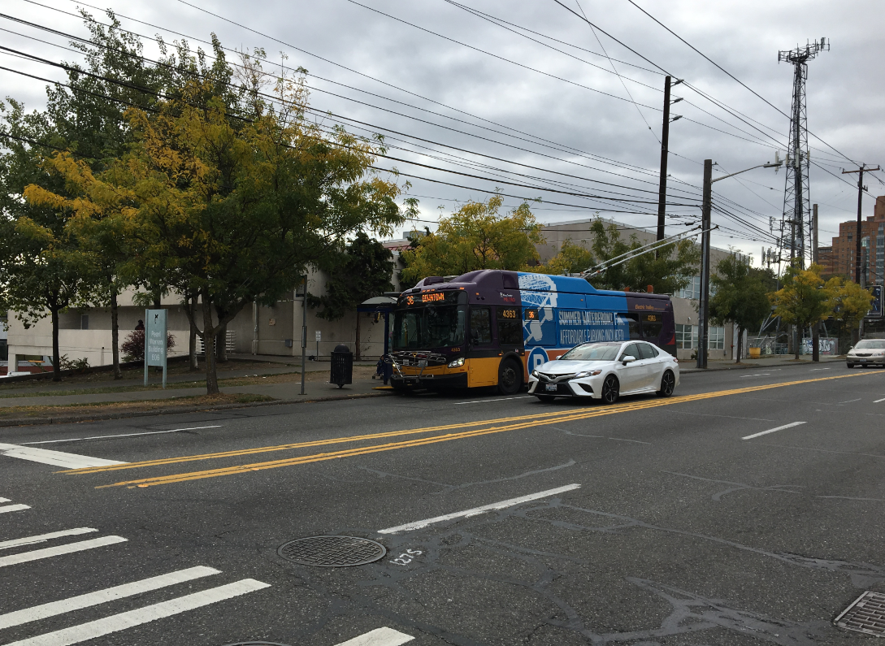
Transit Facilities
High ridership
  Need for in-lane stops and efficient bus routes with minimal delay
Transit dependent populations
  SIHB, Navigation Center
  Longer dwell times
  Not able to add SB in-lane stop
High number of transfers to S Jackson St

Slide 12
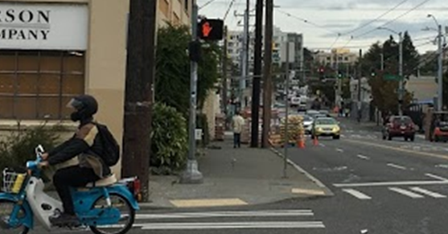
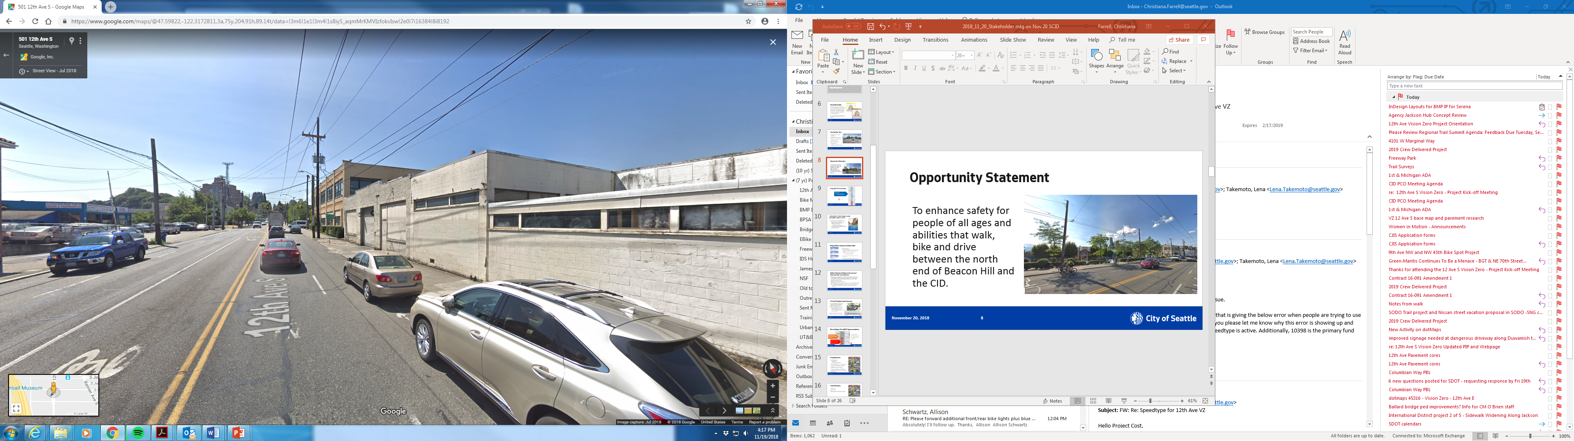
Parking / Loading Needs
Consistent business needs for freight loading with limited possibilities
Concerns about reducing parking in Little Saigon Neighborhood
  Park development
  New residential and business construction

Slide 13
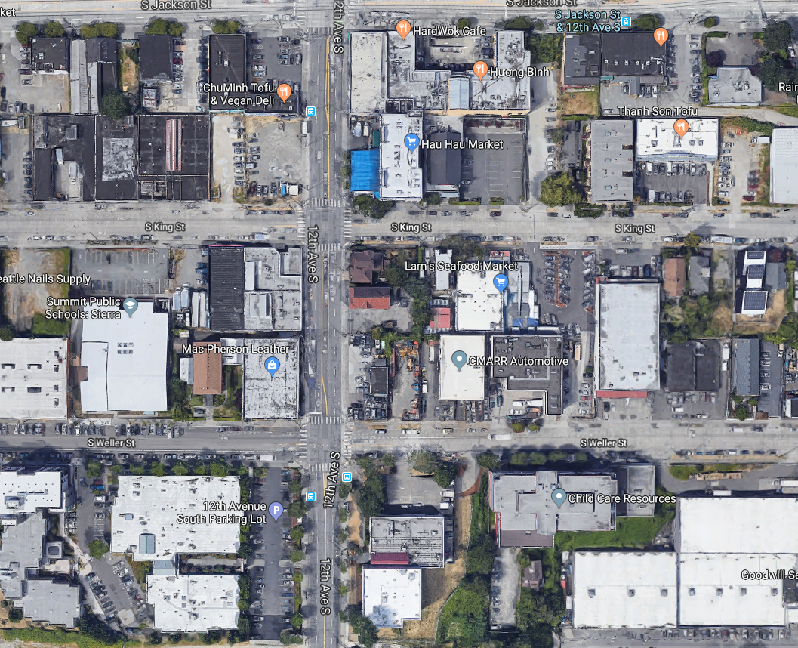
Land Use Development
Land use changes nearby
Impact on traffic volumes and turning movements
Adjacent properties
  New Park
  S King St developments & 10th/Jackson development
  SIHB Building
  Navigation Center
Yesler Terrace

Slide 14
Timeline
February/March 2019 – Return to SBAB with Scope Details
Q1 2019 – Finalize Scope
2019 – Design
2020 – Implementation (Late Summer)

Slide 15
Questions?

