Slide 1
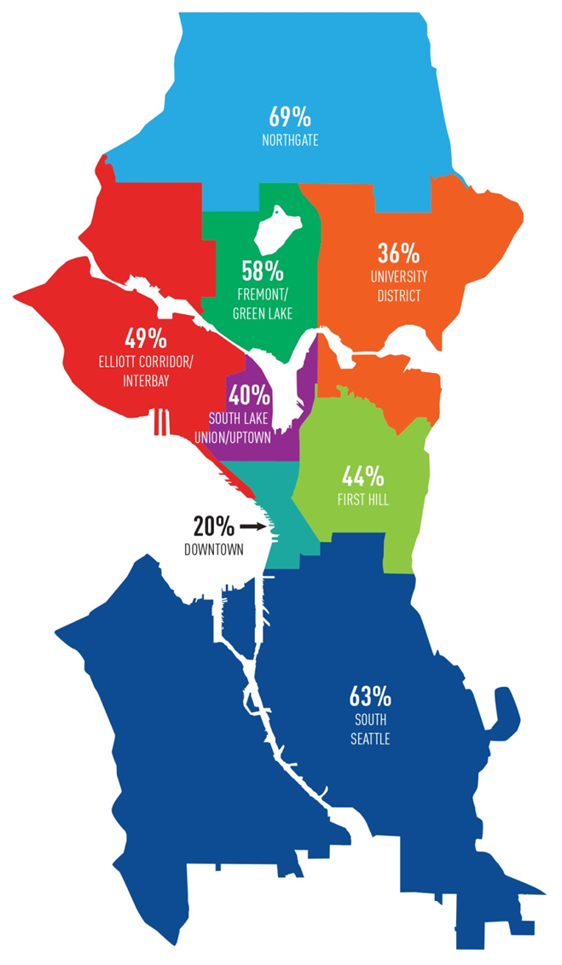
Seattle’s Commute Trip Reduction (CTR) Program
Image
SDOT works with Commute Seattle to reduce drive-alone trips made in the City and to increase commute trips made by bicycles
Support for Employers (Peer to Peer Focus)
CTR Champions program
Employer Bike Summit with Regence
Trainings and Consultations
Enhanced Promotions
Network Leagues for Bike Month
Ride in the Rain, Bagels and Bikes, Light Up Your Ride, Pronto
Targeted Commuter Education
Bicycle workshops at worksites (12 in 2015)
25,000 Bike Maps & 10,000 Bike Guides
Trip Planning Assistance
Leveraging existing programs
Bike racks next to CTR sites & buildings with Transportation Management Program (TMP) requirements (50 racks in downtown in 2015)
CTR Networks &
2017 SOV Goals
1

