Slide 1
Advancing Equity and Accessibility Through Improved Sidewalk Repair
University of Washington Evans School of Public Policy & Governance
April 2020

Slide 2

Who We Are
Mitch Brown, Nina Forbes, Andrew Golden, Andrew Reeves
2nd Year Masters of Public Administration students
Evans School of Public Policy at the University of Washington
Hired by SDOT Sidewalk Repair Team

Slide 3
Project Purpose
Sidewalks provide invaluable access to resources, transit, etc.
In Seattle, sidewalks have a $5 Billion replacement value and only $3-5 million in annual maintenance budget
Council Resolution 31908
Asks SDOT to develop policy options for the maintenance of existing sidewalks
Named options include cost sharing, do-it yourself maintenance, point of sale and lien options and others.
Property owners currently responsible for most repairs
Inequitable to low/fixed-income communities and sidewalk users

Slide 4
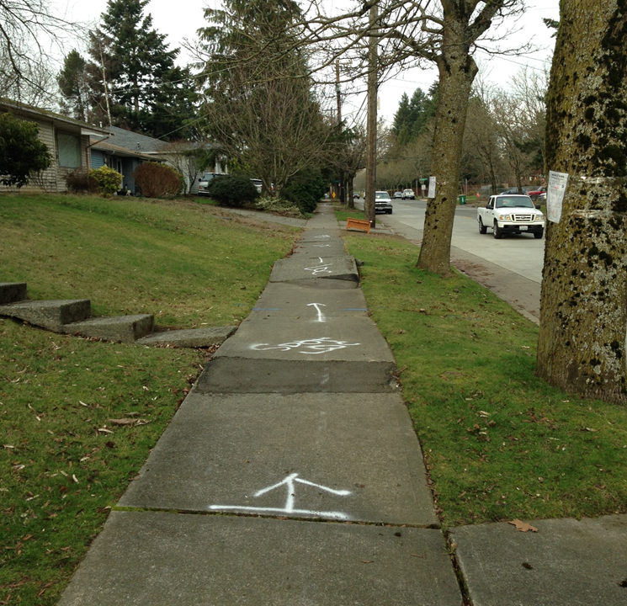
Project Outline
Interview Peer Cities to learn best practices and innovative ideas
Review internal procedures, local and state law for possible changes
Work with community groups to learn what barriers they face and how to spread information

Slide 5
Initial Local Findings
Lack of Awareness
Adjacent property owner responsibility comes as a surprise
Administrative Burden
Difficult to navigate the permitting and repair process
Time-consuming to review each complaint for damage, trees, etc.
Complex internal SDOT process
High Cost
City policy only allows property owners to perform full sidewalk panel replacement, rather than temporary fixes such as bevels, grinding or asphalt shims. Contractors may not be willing to come out for small fixes
Notes:
Explain what the SDOT process is, and how they have to talk to 5 different divisions within SDOT if there is a tree involved

Slide 6
Peer City Case Studies

Slide 7
Boston Findings
Denver Findings
Almost all sidewalks owned and maintained by the City of Boston
$6 million budget for maintenance for all sidewalk, curb ramp and curb repair; mostly from state gas tax
Takes 18-24 months to follow-up on a non-safety hazard report
Sidewalk repair prioritization model includes additional demographic and equity factors
Cost-sharing and low-income discount options are available
Trouble with implementation due to low staff and funding

Slide 8
Vancouver Findings
Portland Findings
82% of sidewalks in good or fair condition
Cost-sharing mechanism of 65% City responsibility, 35% Property Owner responsibility
Only applies in Public Improvement Districts
$1.75 million (CAD) for maintenance
Prioritization mainly incorporates usage
Allows for homeowners to repair their own sidewalk without hiring a contractor
City of Portland can complete the work for the private property owner and bill them through the Office of the City Auditor
Provide long-term financing options for repayment

Slide 9
Next Steps

Slide 10
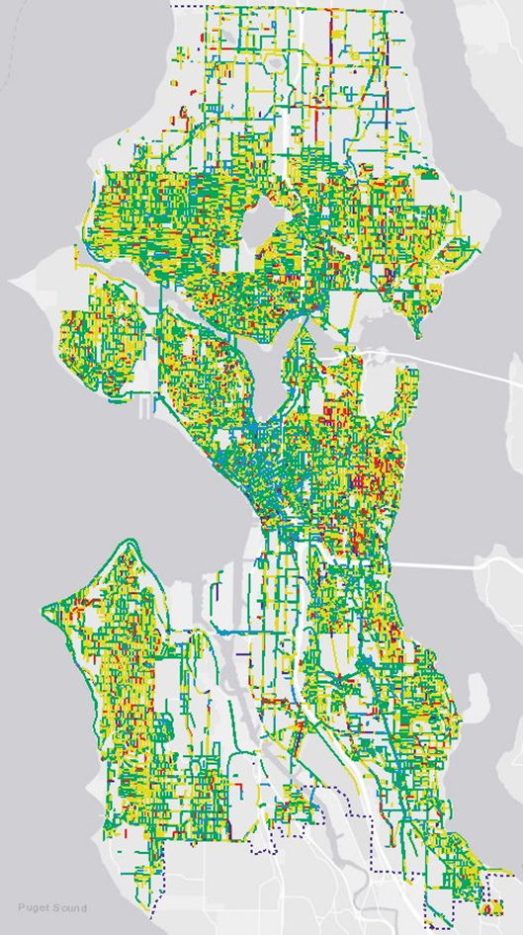
Possible Recommendations
Focus enforcement efforts in higher-density neighborhoods
Streamline private contractor process
Collaborate between work groups/departments
Government - Property Owner Cost Sharing
Split the cost between the city and the property owner
Low-income discount program

Slide 11
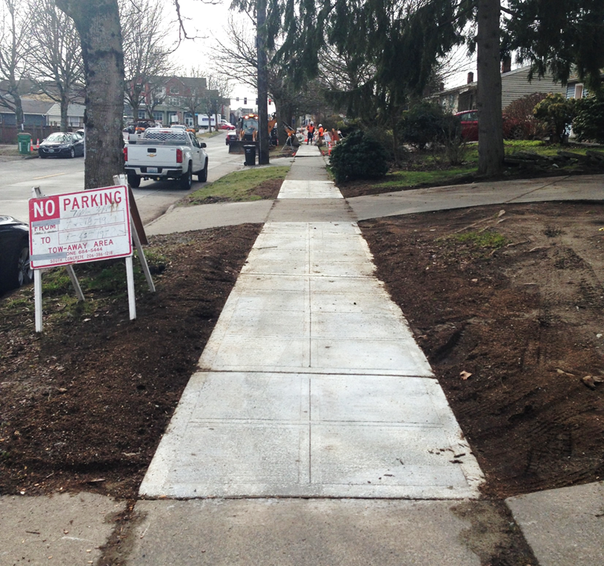
Next Steps
Get community input on our research direction
Continue interviewing peer cities
Complete analysis
Provide actionable recommendations

Slide 12
Community Feedback
Have any of you reported a sidewalk issue? What was your experience?
Has anyone gone through the process of repairing a sidewalk adjacent to their property? What was your experience?
Do you have suggestions on other people or groups we should reach out to?

