Slide 1
Wilson Ave S Transportation Improvements Project
Public meeting presentation

Slide 2
Mission and Vision
Mission: to deliver a high-quality transportation system for Seattle
Vision: a vibrant Seattle with connected people, places, and products
1

Slide 3
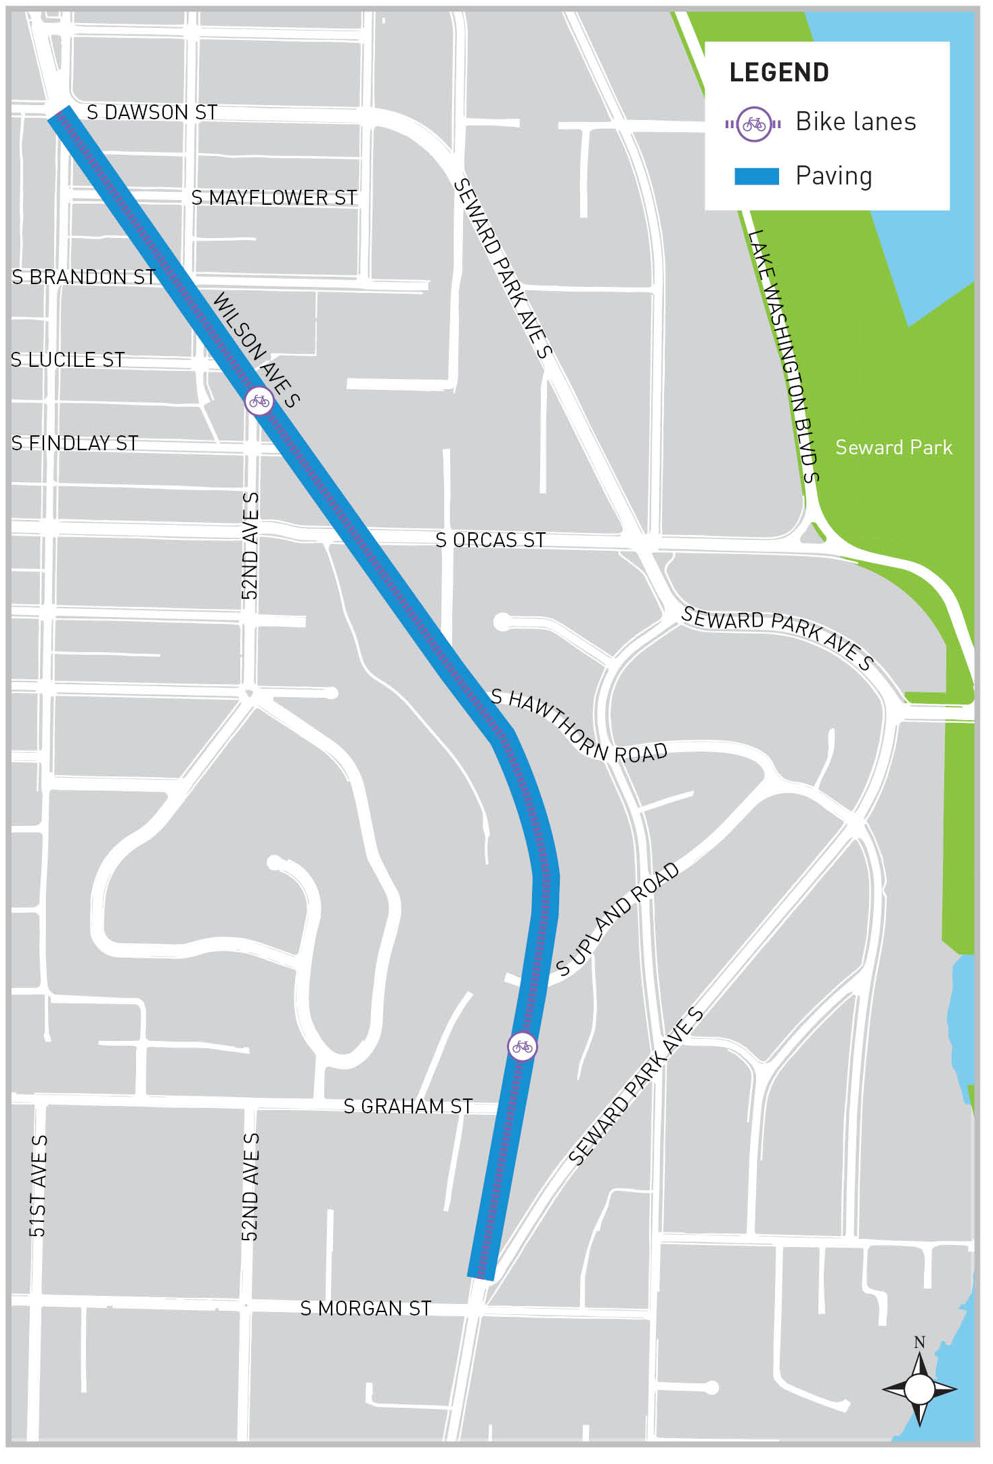
Project Overview
Goal: Improve the safety, accessibility, and comfort for all users
To meet this goal, the project will
Repave
Install new protected bike lanes
Build new curb ramps
Repair or replace sections of sidewalk
Install new rapid flashing beacons at S Graham St
Consolidate parking
2

Slide 4
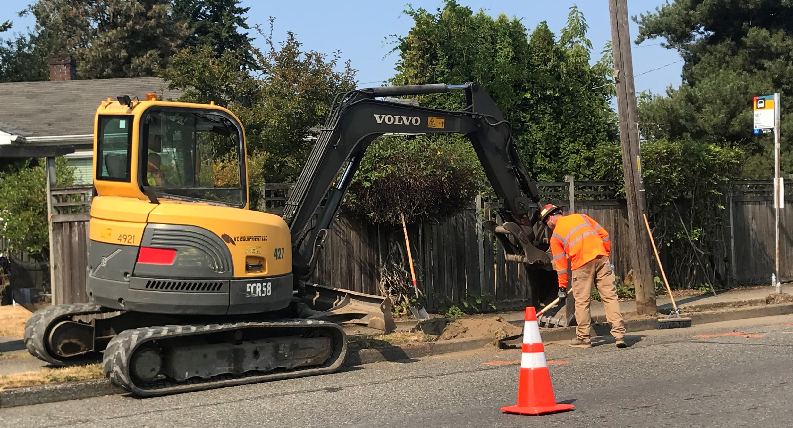
Construction update
July 2018: Curb ramps and sidewalks
August 2018: Public meeting
Fall 2018: Complete curb ramps,
sidewalks, drainage work
Late Fall/Early Winter 2018: Grind and pave
Spring 2019: Final striping based on design
*paving and striping are weather dependent
3

Slide 5
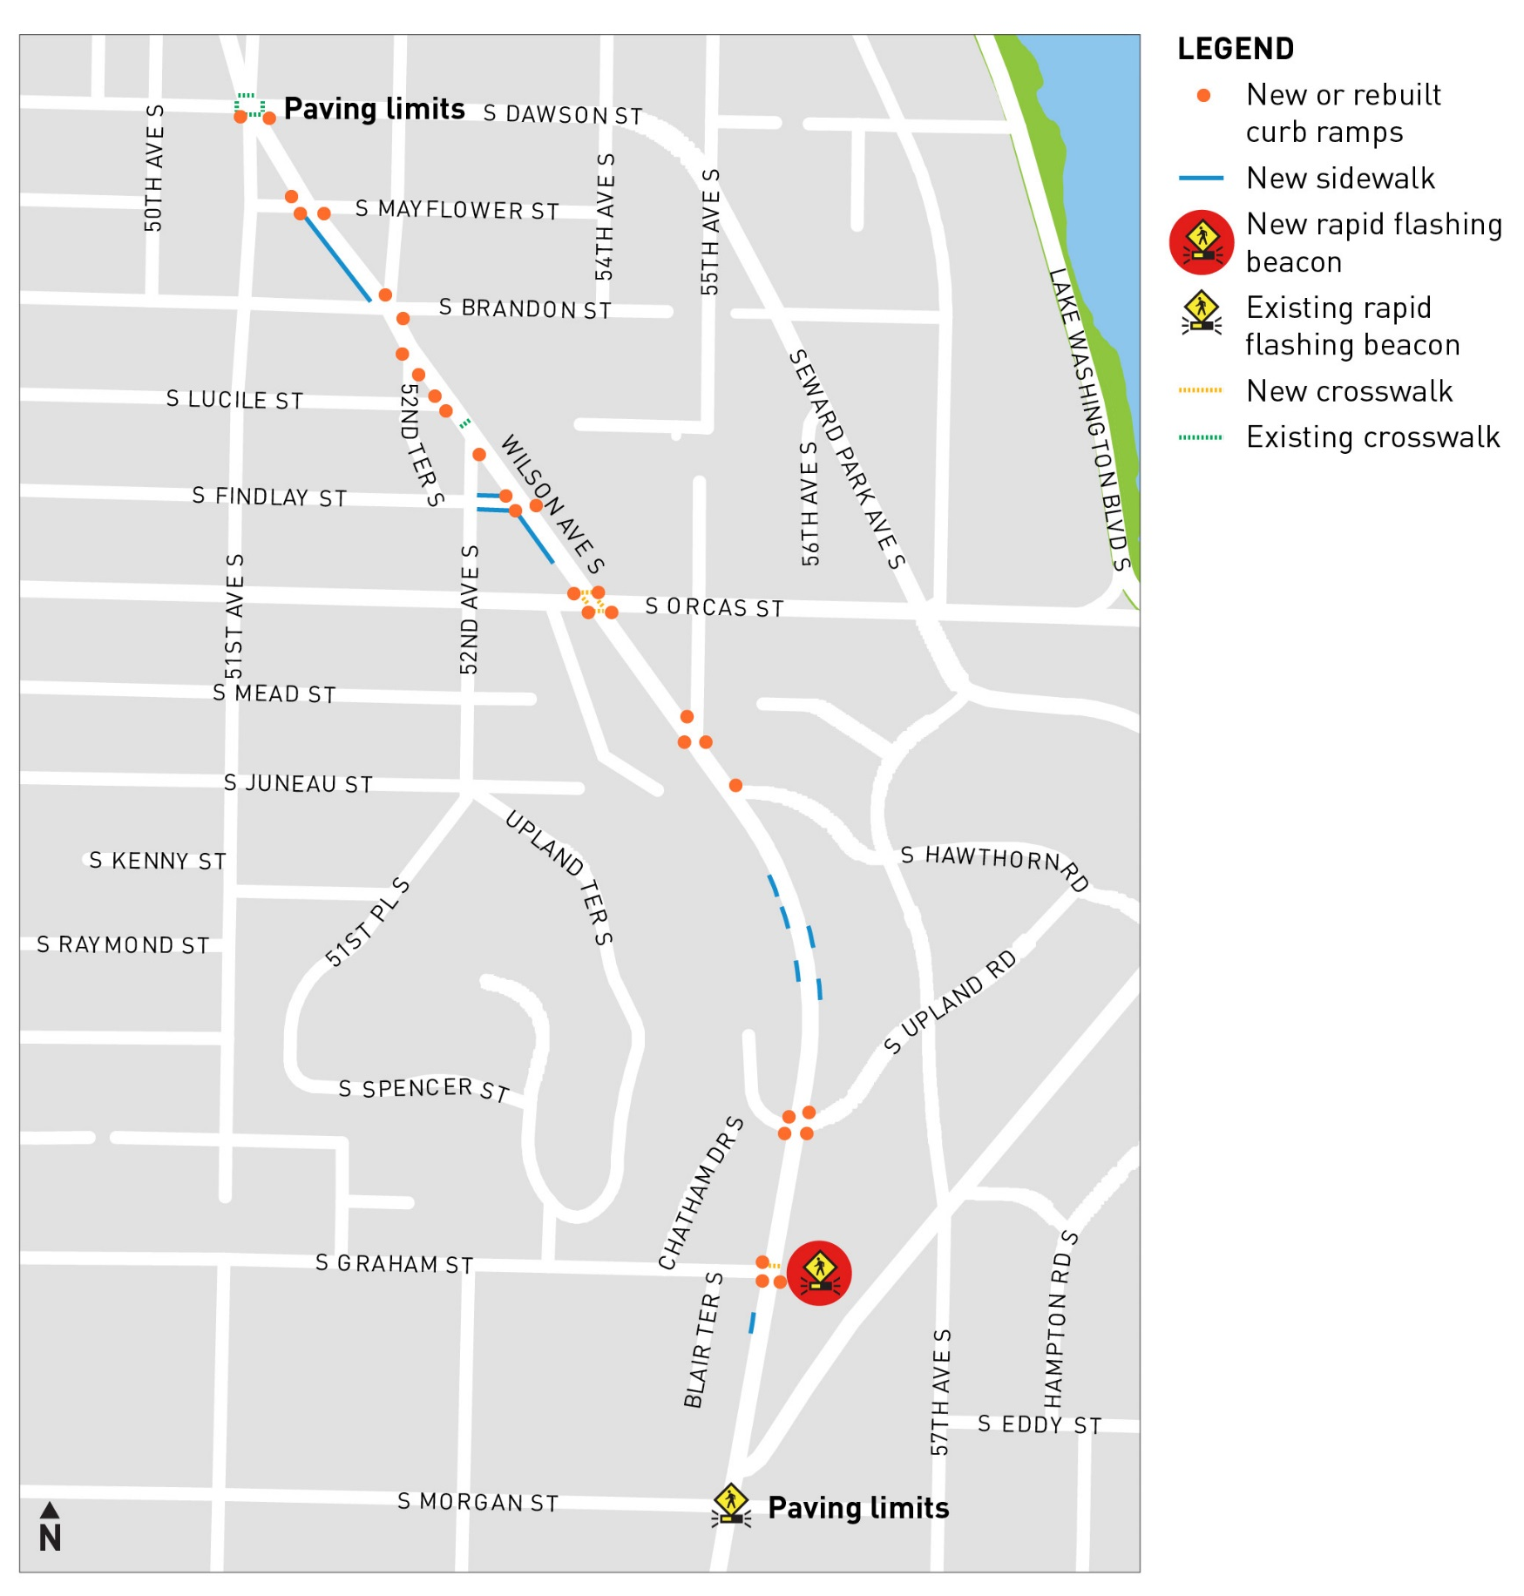
What we’ve heard
Wilson needs to be repaved
  1.6 lane miles
Repair sidewalks and curb ramps
  39 curb ramps (30 new and 9 rebuilt)
  609 feet of new sidewalk
Make it easier for people walking
  New rapid flashing beacon and crosswalk at S Graham St
4

Slide 6
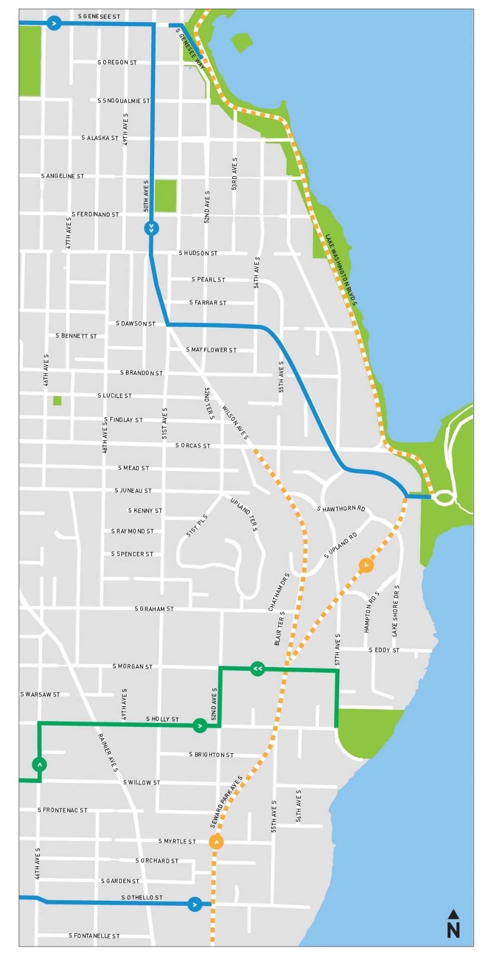
What we’ve heard
Why does Wilson Ave S need a bike lane?
  South end destinations such as restaurants, cafes, and shops
  Most direct route from Rainier Beach to Columbia City
  The Bike Master Plan was adopted in 2014 by the City Council and signed by the Mayor
  City goal of quadrupling bike ridership
  More people biking gets us closer to our traffic safety, congestion, economic, personal health, and sustainability goals
5

Slide 7
What we’ve heard
Parking consolidation
Access concerns
Property damage
Steep driveways
New pedestrian crossings
What we’re doing
Redistributing parking
Offering short-term parking to encourage turn-over
Took pedestrian counts and will take counts again within 3 months of project completion
6

Slide 8
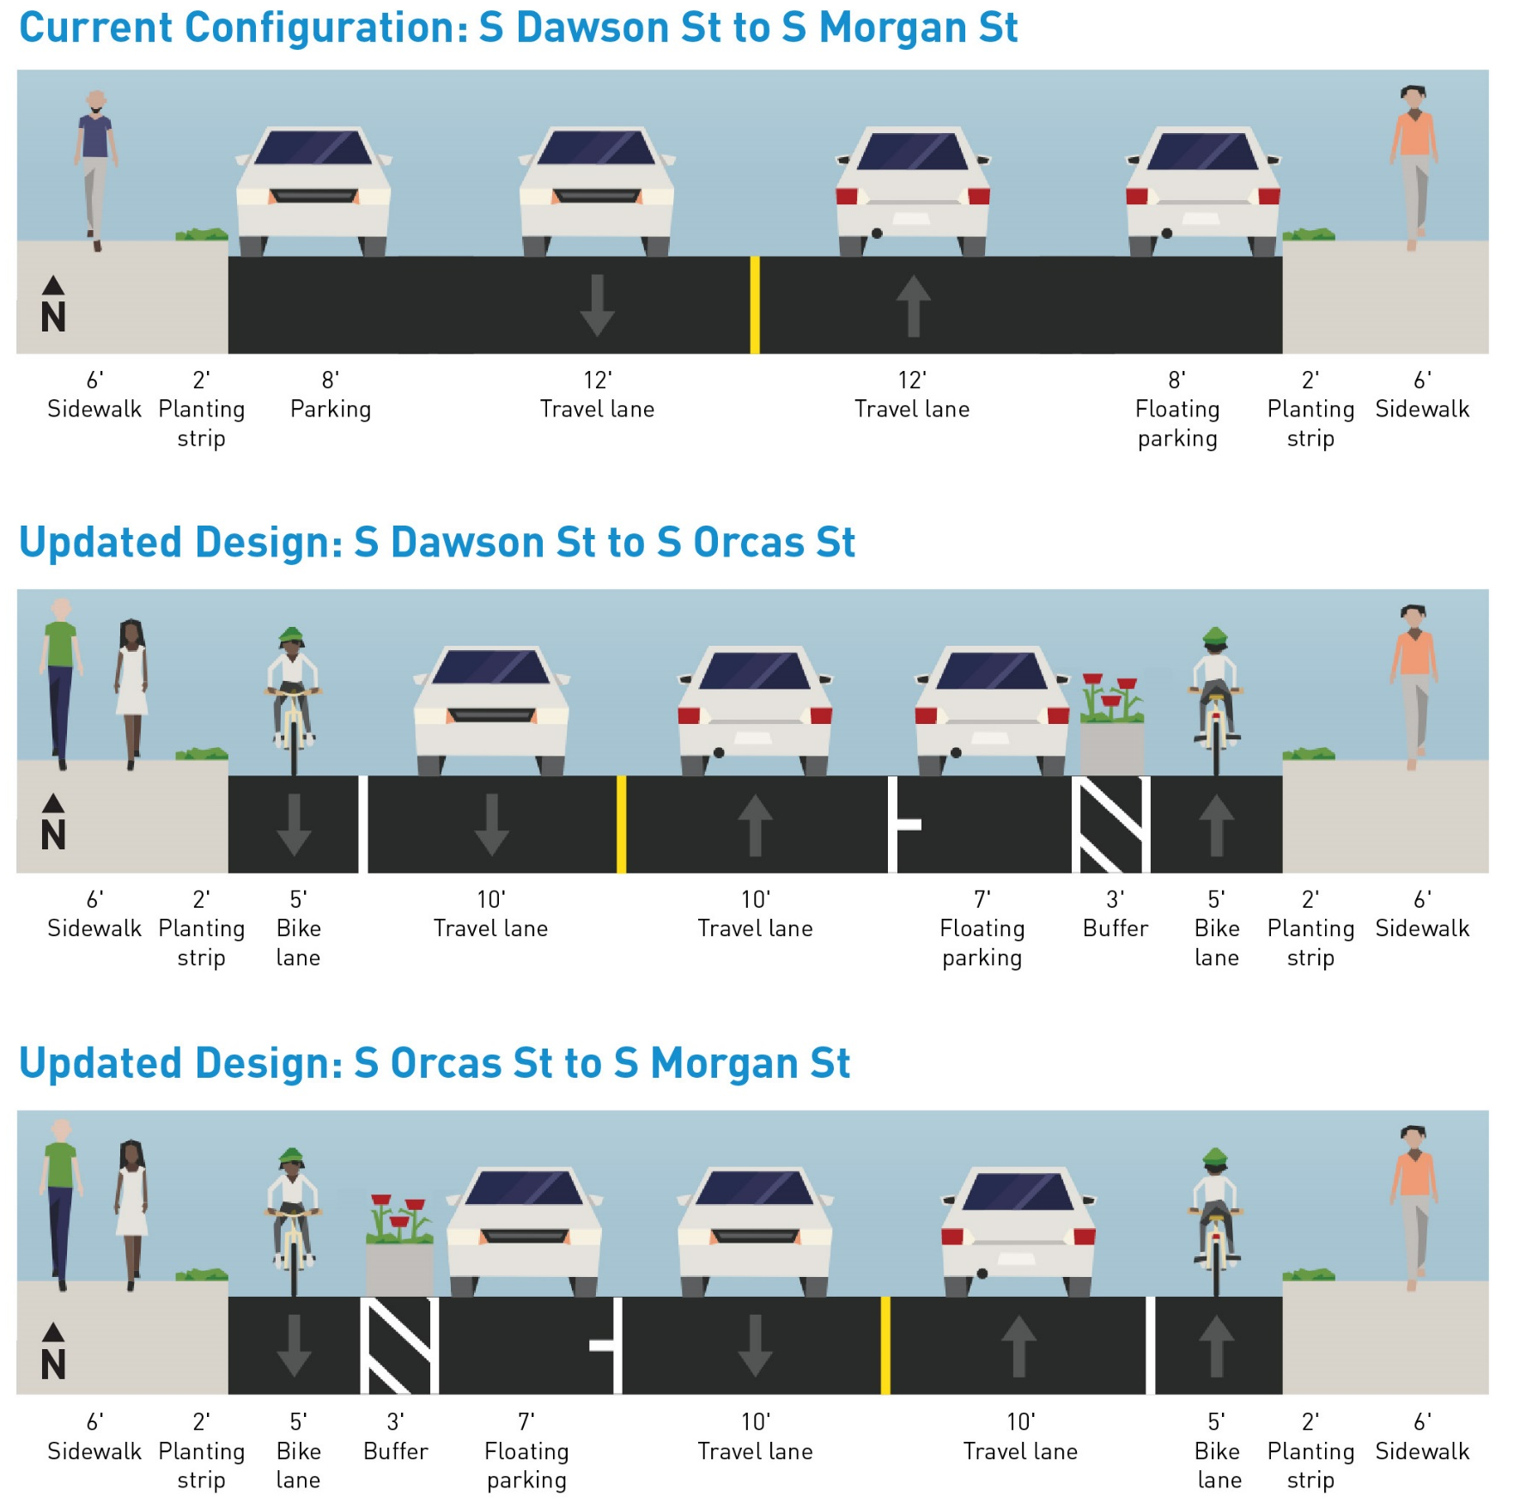
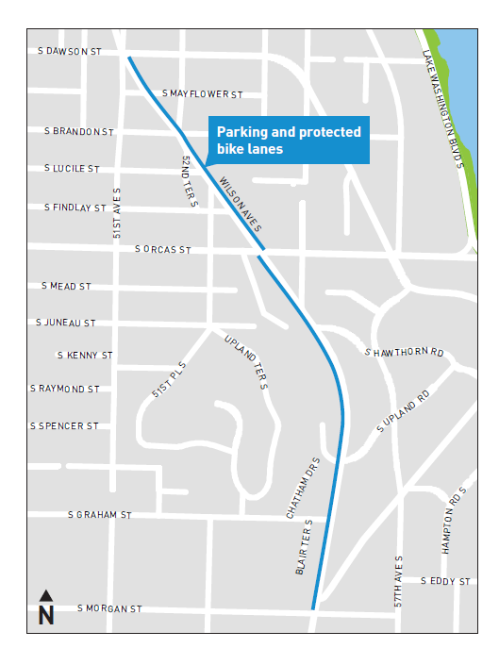
7

Slide 9
Questions and Answers
Thank you!

Slide 11
Contact us!
Voicemail: 206-256-5232
Email: DOT_WilsonAve@Seattle.gov
Web: www.seattle.gov/transportation/pave_WilsonAve.htm

