Slide 2
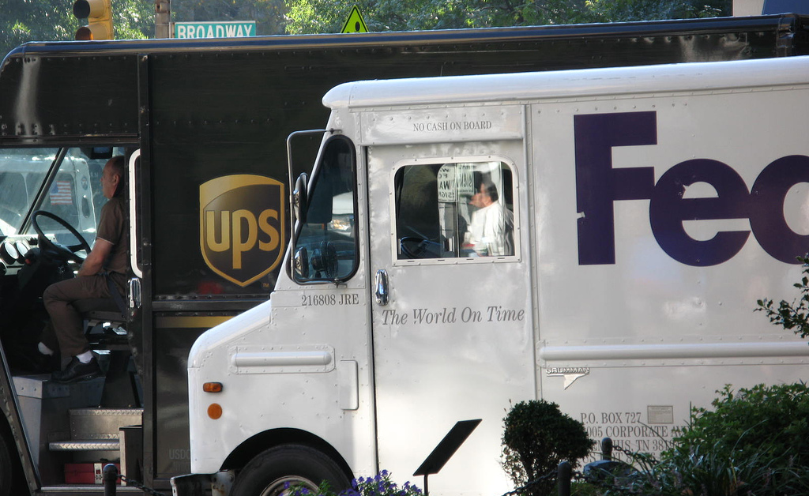

Freight Master Plan
Advisory Committee Meeting
January 29, 2015

Slide 3
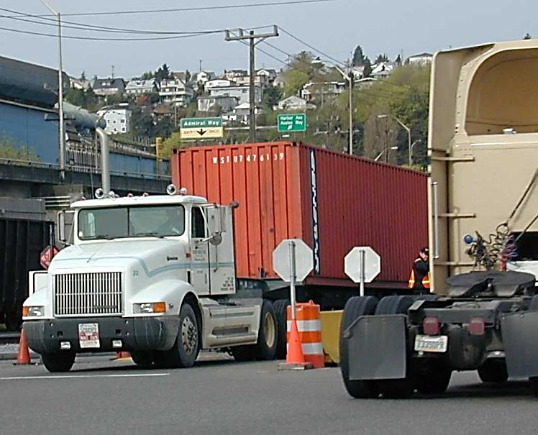
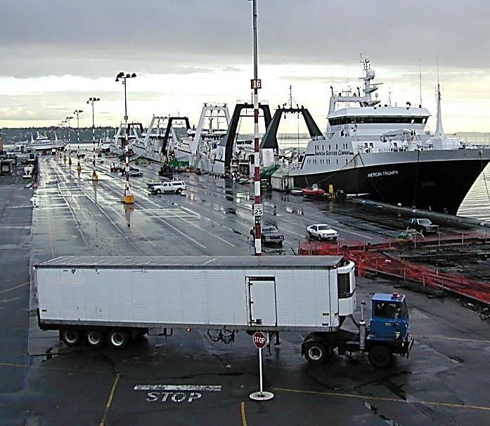
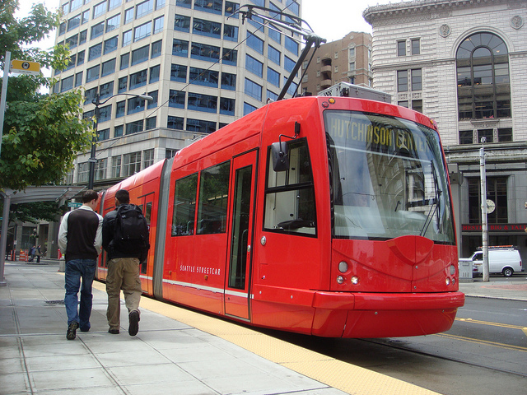
SDOT’s mission & vision
Mission: delivering a first-rate transportation system for Seattle.
Vision: a vibrant Seattle with connected people, places, and products.
3

Slide 4
SDOT’s core principles
Keep it safe
Focus on the basics
Build healthy communities
Support a thriving economy
Provide great service
4

Slide 5
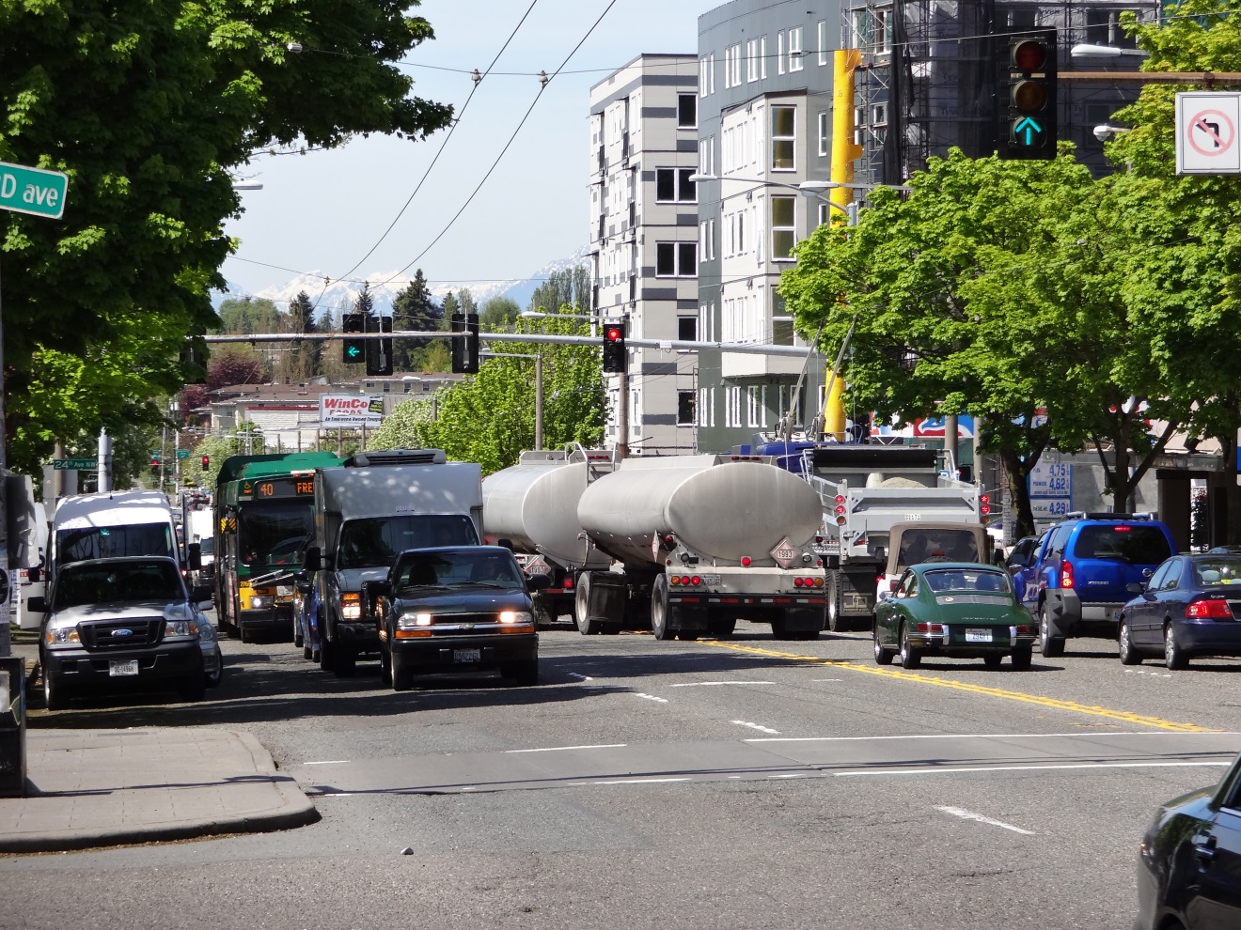
Policy Framework
Freight Master Plan (FMP)
Vision
Goals
Performance
Measures

Slide 6
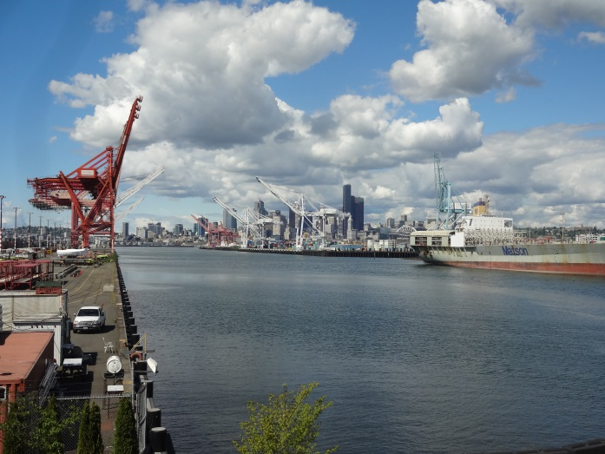
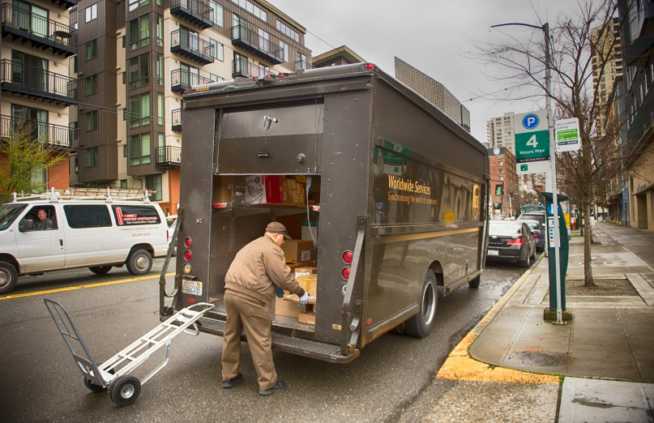
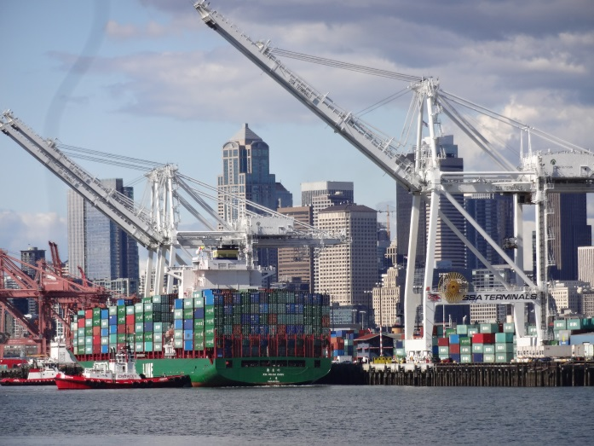
Behind the FMP Vision
Committee feedback from the November 2014 meeting
Existing SDOT plans and policies
Mayor Murray’s vision for Seattle
SDOT project team

Slide 7
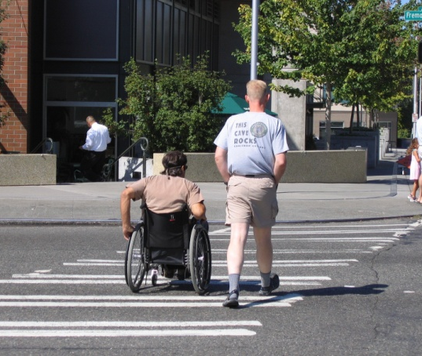
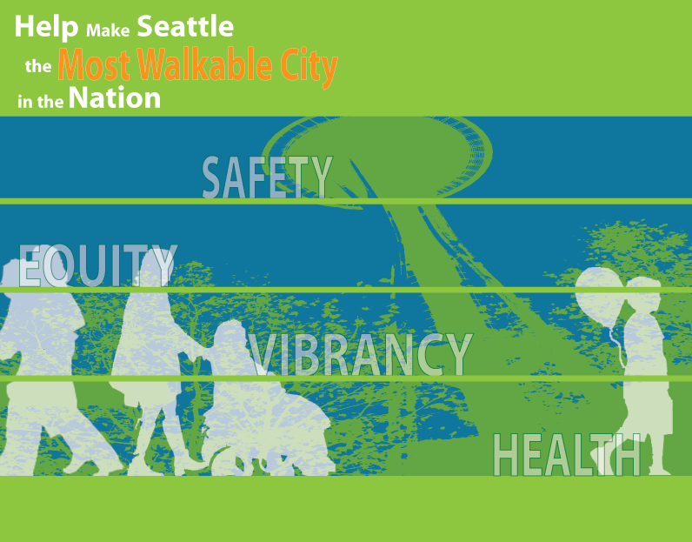
Seattle Pedestrian Master Plan
Vision: Make Seattle the Most Walkable City in the Nation
Goals:
Safety Reduce the number and severity of crashes involving pedestrians
Equity Make Seattle a more walkable city through equity in public engagement, service delivery, accessibility, and capital investment
Vibrancy Develop a pedestrian environment that sustains communities and supports a vibrant economy
Health Raise awareness of the importance of walking in promoting health and preventing disease

Slide 8
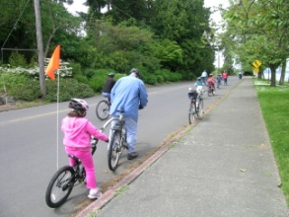
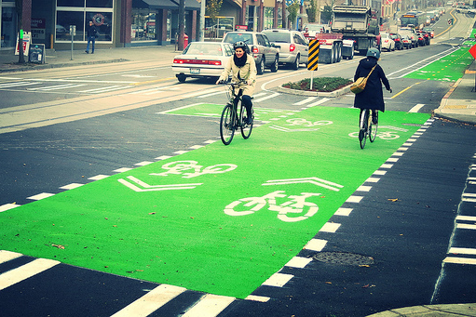
Bicycle Master Plan
Vision: Riding a bicycle is a comfortable and integral part of daily life in Seattle for people of all ages and abilities.
Goals:
Ridership Increase the amount and mode share of bicycle riding in Seattle for all trip purposes.
Safety Improve safety for bicycle riders in Seattle.
Connectivity Create a high-quality bicycle network that connects to places people want to go and provides a time-competitive travel option.
Equity Improve bicycle riding for all through equity in public engagement, program delivery, and capital investments.
Livability Build vibrant communities by creating a welcoming environment for bicycle riding.
Notes:
Reasons for the update:
The plan assumed an update after 5 years (Action 4.11)
Changes in design standards
Interest in building a more dense network to serve intra-neighborhood trips
Current plan, while having many strengths, does not offer much direction on project prioritization; interest in strengthening this in the plan update

Slide 9
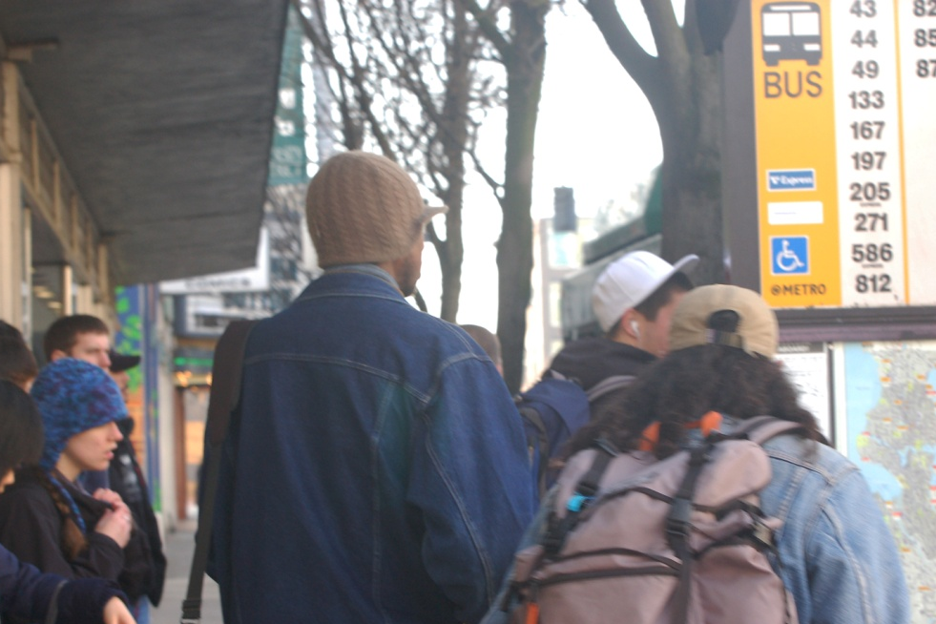
Transit Master Plan
Vision: Supports the mobility needs of Seattle residents and businesses.
Goals:
Make it easier and more desirable for people to take transit
Respond to the needs of vulnerable populations
Use transit to meet sustainability, growth management, and economic goals
Create great places where modes connect
Balance implementation with fiscal, operational, and policy constraints
9

Slide 10
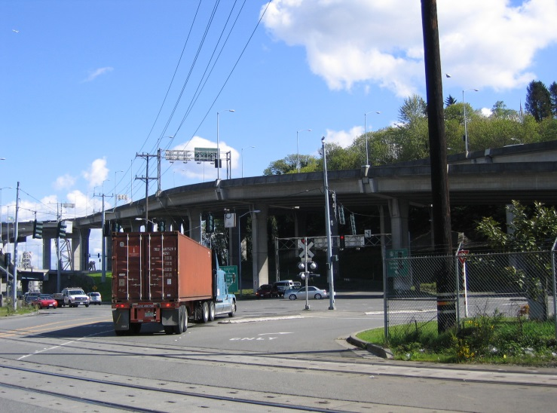
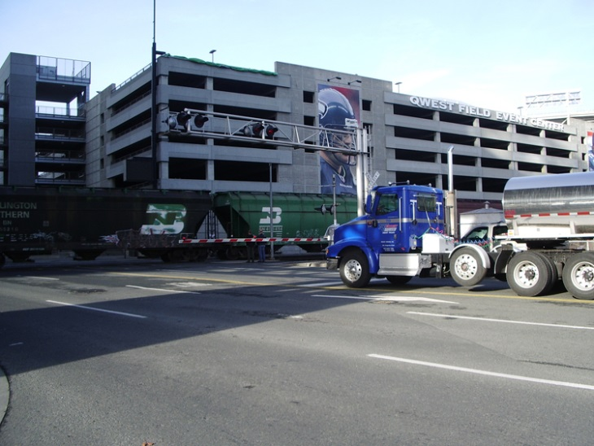
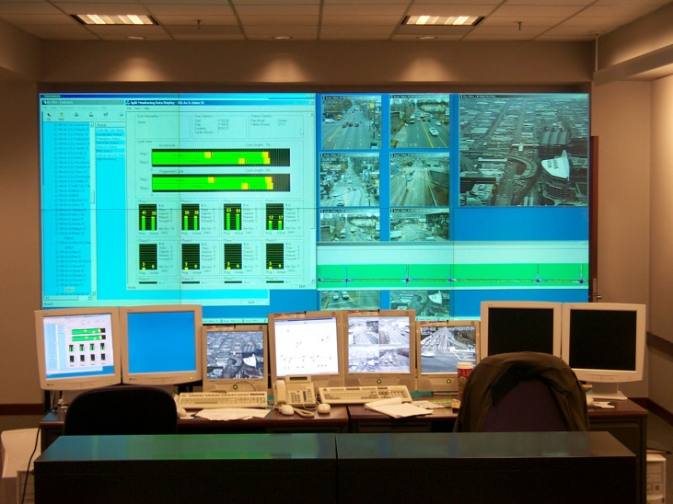
Draft FMP Vision Statement
A high-quality and aspiring statement that will help articulate the desired end state of the FMP.
“A vibrant city and thriving economy connecting people and goods”

Slide 11
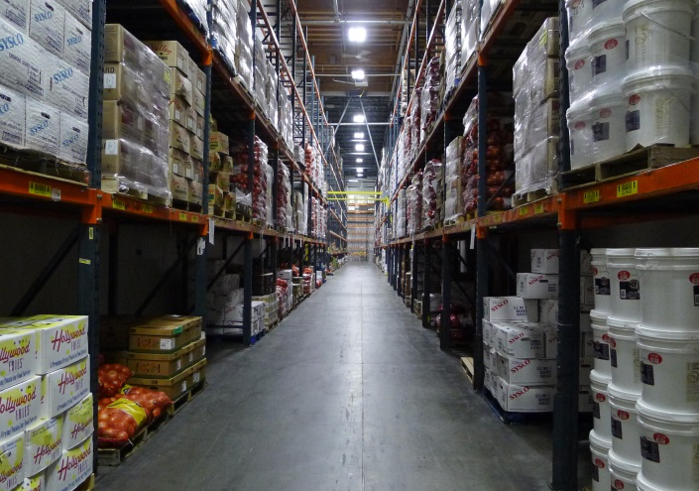
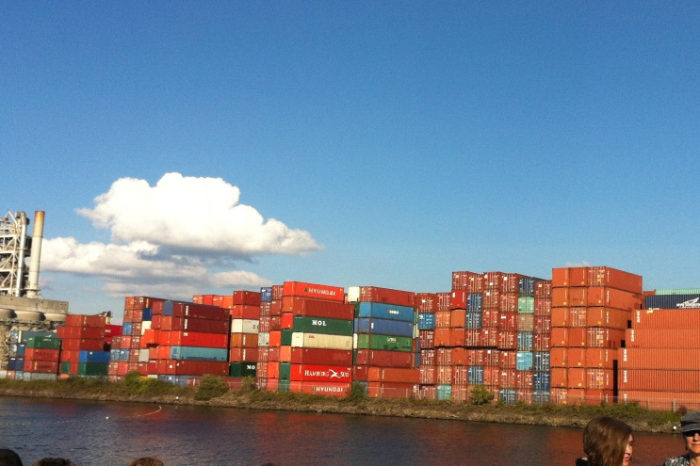
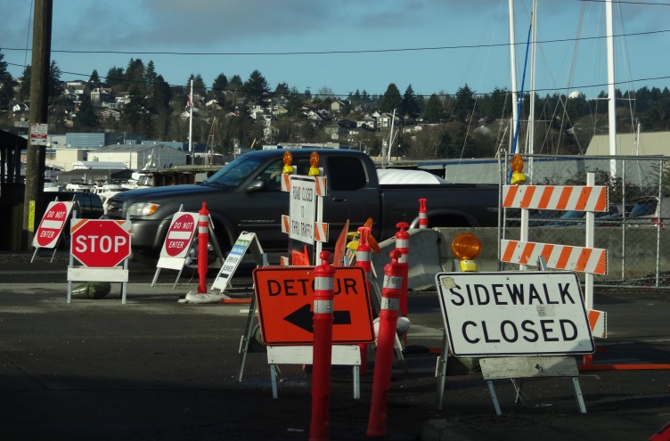
Draft FMP Goals
Project goals should articulate desired outcomes of the FMP
Safety - Improve safety and the predictable movement of goods and people
Mobility - Reliably connect manufacturing/industrial centers and business districts with the local, state, and international freight networks

Slide 12
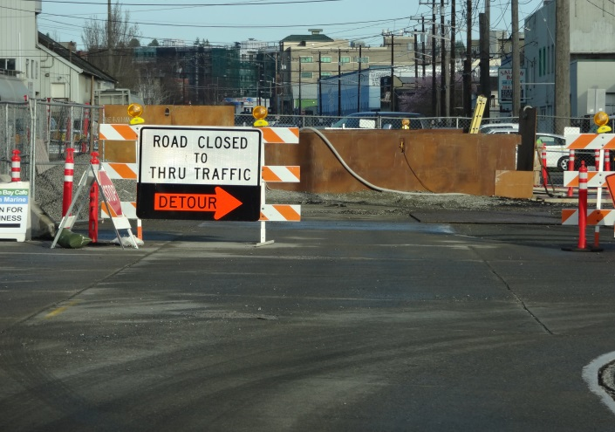
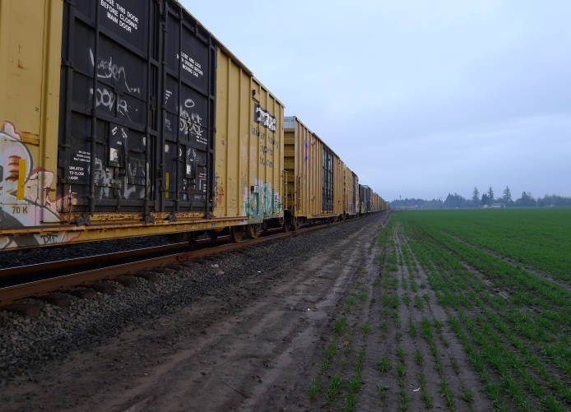
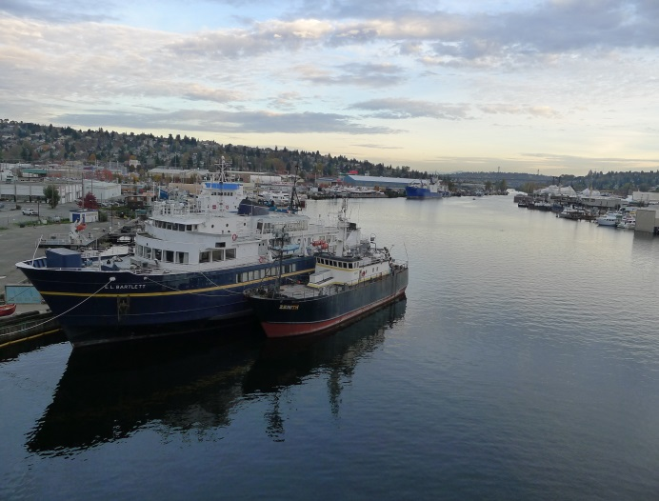
FMP Goals (continued)
Preservation - Improve the state of good repair of the freight transportation network
Environment - Improve the environment through a resilient freight system
Equity – Benefit residents and businesses of Seattle through equity in investments and public engagement relating to freight mobility

Slide 13
Questions and Discussion

Slide 14
Freight Master Plan (FMP)
Existing Conditions Report

Slide 15
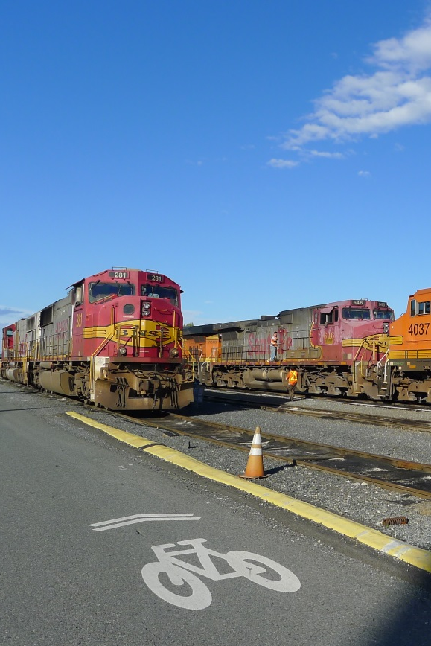
Existing Conditions
Establish a baseline of Seattle’s freight system
Every product purchased or exported uses at least one of the freight modes:
    Maritime
    Rail
    Airport
    Pipeline
    Roadways

Slide 16
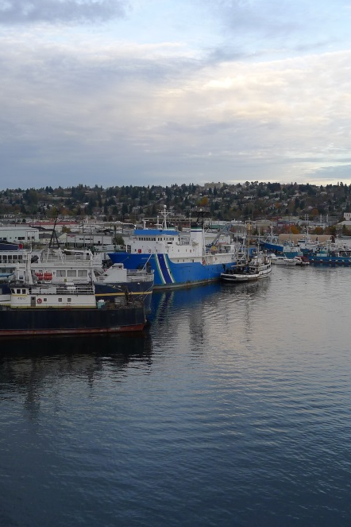
Existing Conditions
Why is freight important?
Washington is the most trade
dependent state in the nation
Seattle is at the center of the
trade economy
Strong freight sector = Stronger Seattle economy
Enhancing quality of life of residents through jobs and revenue

Slide 17
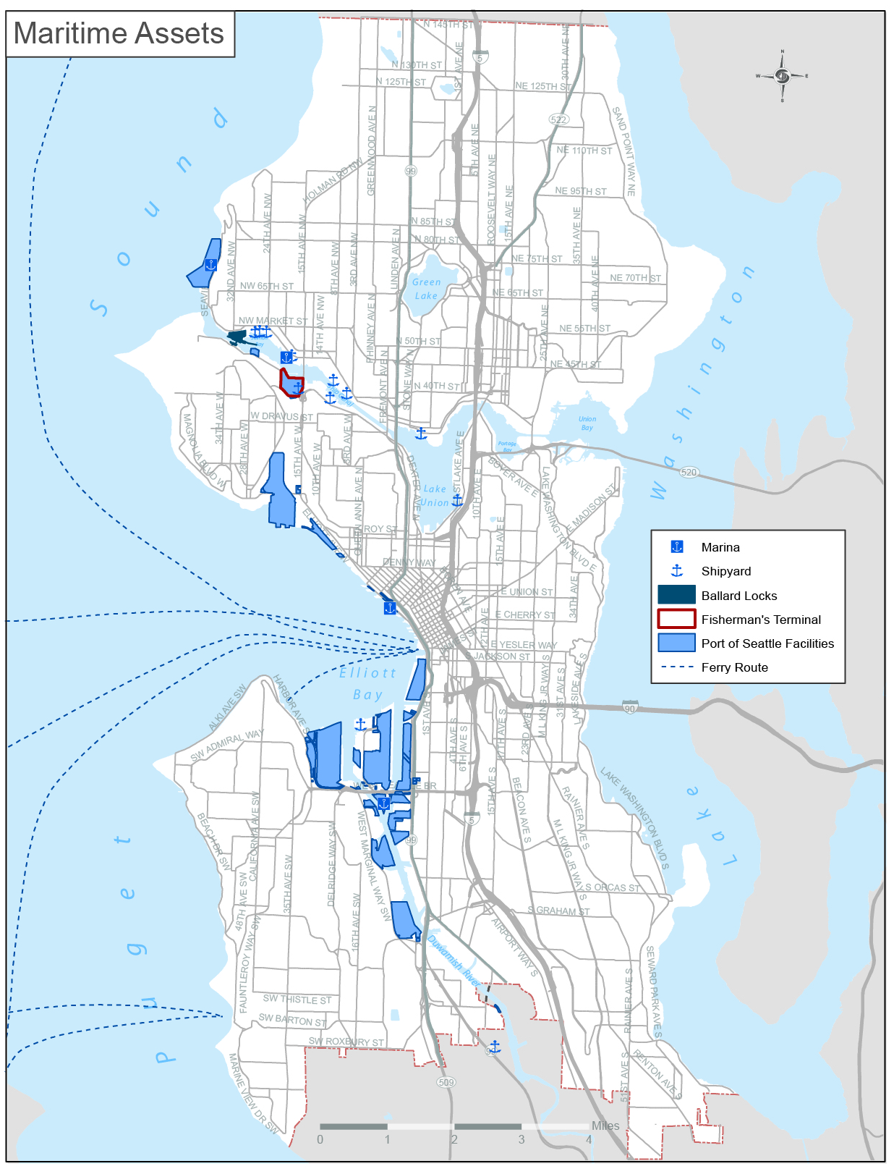
Maritime
Marinas
Shipyards
Ballard Locks
Fisherman’s Terminal
Port of Seattle facilities

Slide 18
Maritime
Advantages of shipping transport
  All materials can be shipped via water
  Different type of vessel per commodity type
  Containerization
  Easy access to Western Alaska
Disadvantages:
  Not time sensitive
  Not cost effective for small trips

Slide 19
Maritime
Economic facts:
  57,700 maritime cluster jobs in WA
  Average annual salary $70,800
  Alaska’s distant water commercial fleet is home-ported in Puget Sound
  Cruise business is responsible for 4,000 jobs
  Each vessel call generates $2.2 million for local economy
Notes:
In 2012 maritime cluster employed 57,700 jobs in the state of Washington
Average annual salary $70,800 (2012)
Alaska’s distant water commercial fleet is home-ported in Puget Sound
Cruise business is responsible for 4,000 jobs
Each vessel call generates 2.2 million dollars for local economy

Slide 20
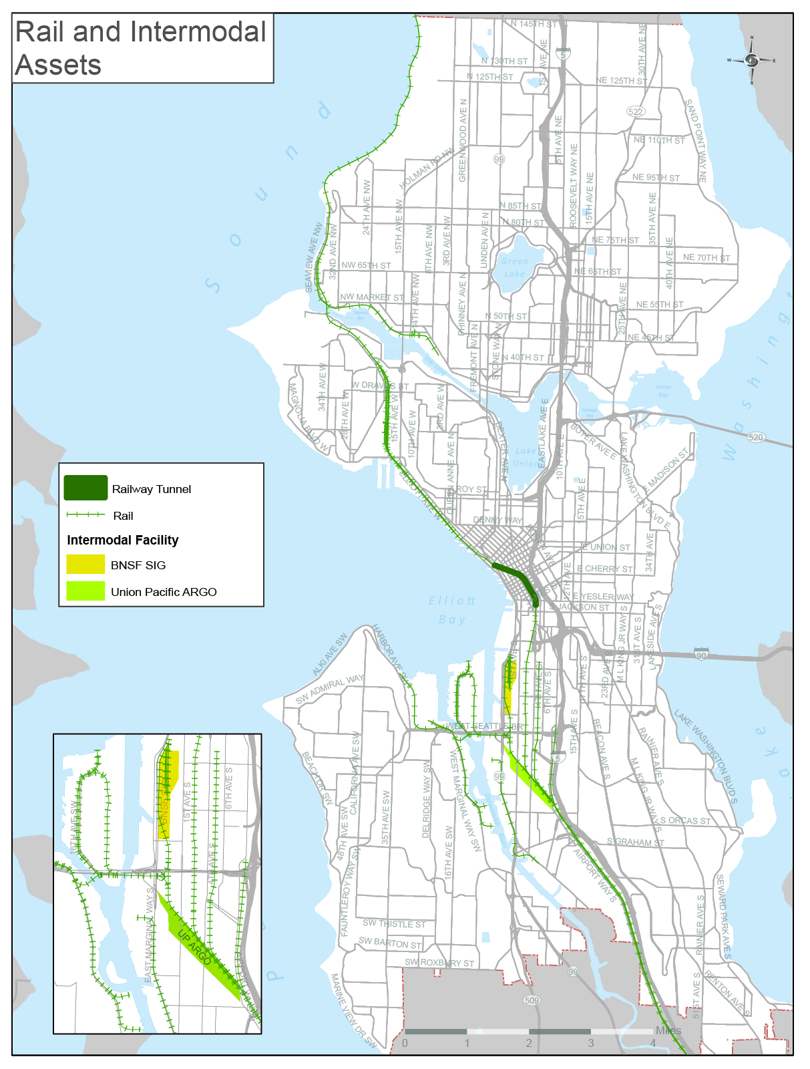
Rail
Railway tunnel
Rail lines (Amtrak, BNSF, Union Pacific)
Intermodal facilities (SIG and Argo Yards)

Slide 21
Rail
Advantages of rail transport:
  Hauls variety of commodities
  More efficient than other freight modes (long dist.)
  Generates less pollution than trucking
  Moves people and goods
Disadvantages:
  Limited flexibility
  Service and access limitations

Slide 22
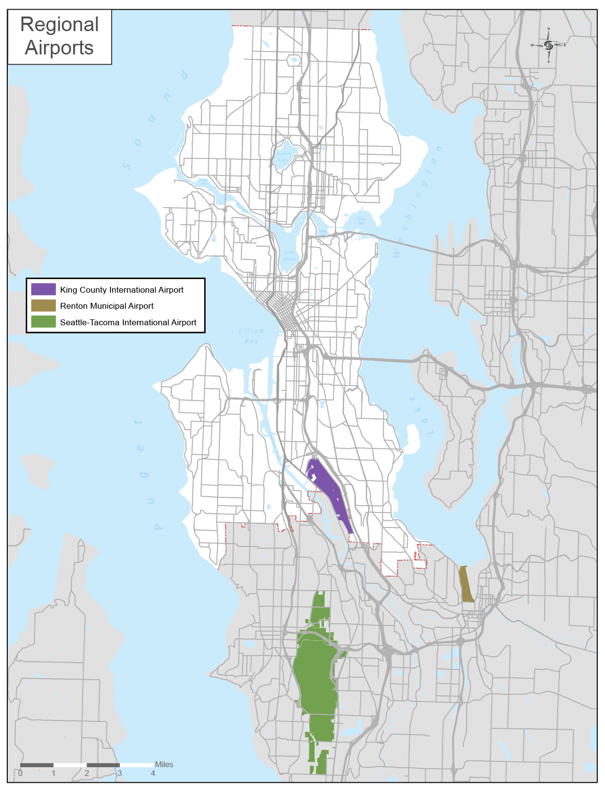
Air
KC International Airport
Seattle-Tacoma International Airport
Renton Municipal Airport

Slide 23
Air
Advantages of air transport:
  Critical for longer distance goods transport
  Shorter goods transit times
  Time-sensitive goods delivery
Disadvantages of air transport:
  High cost
  Smaller and lighter shipments only
  Fuel costs have large variations

Slide 24
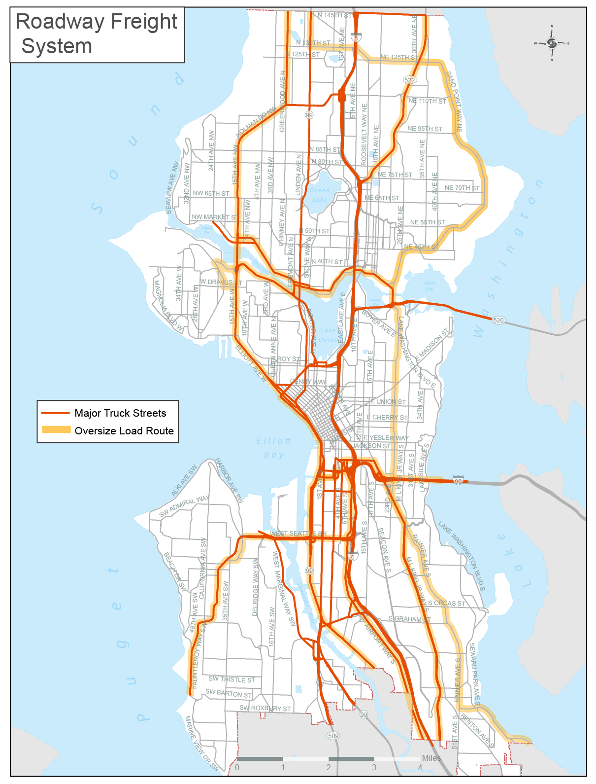
Roadway
Major Truck Streets
Oversize load routes

Slide 25
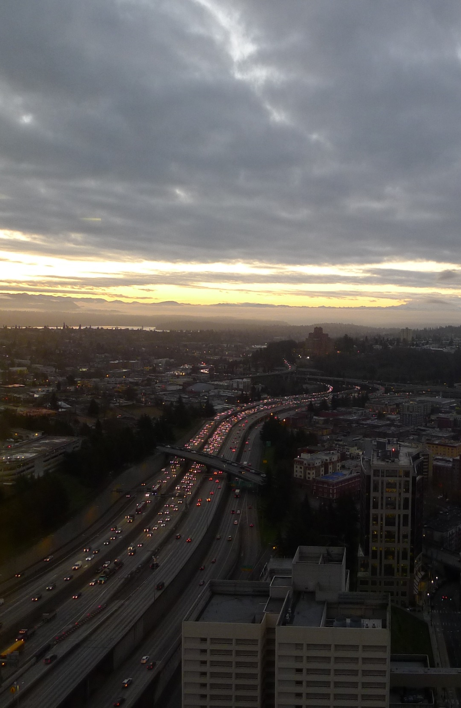
Roadway
Major Truck Streets network – 142 miles
Truck freight expected to grow at 2% annual rate regionally through 2040
Trucks carried $37 million in goods on WA roads per hour every single day (2013).

Slide 26
Roadway
Advantages of truck transport:
  Frequently only mode available for short trips
  Efficient for short trips (first/last mile)
  Flexible
Disadvantages of truck transport
  Truck routes in urban areas are also needed for other uses
  Contributes to congestion

Slide 27
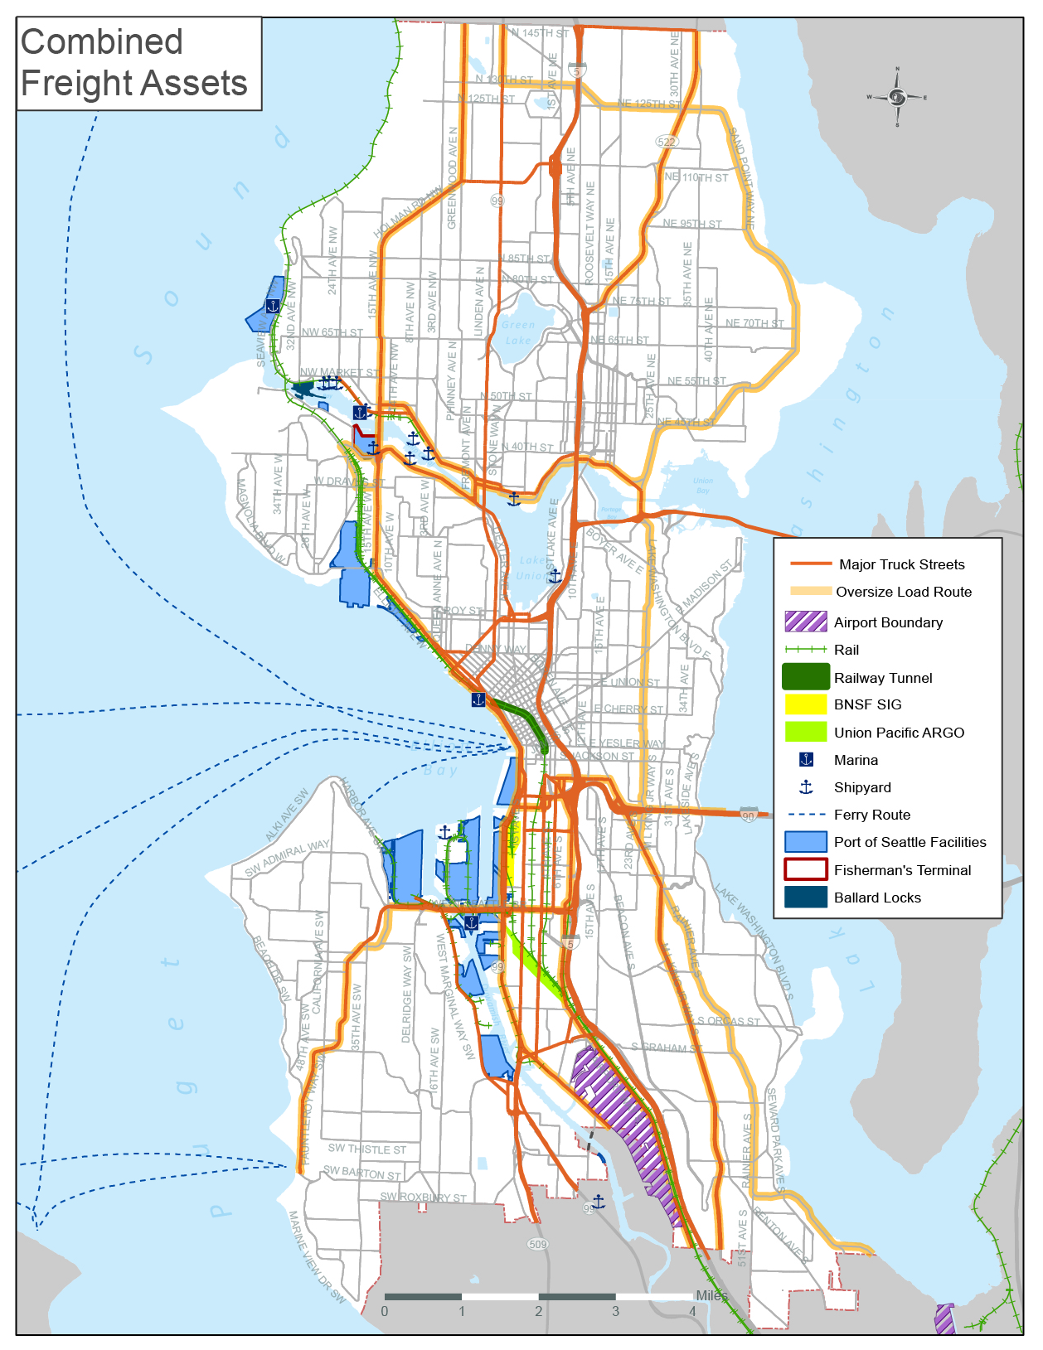
All assets
Impacts of Freight
  Environmental
  Social
  Health

Slide 28
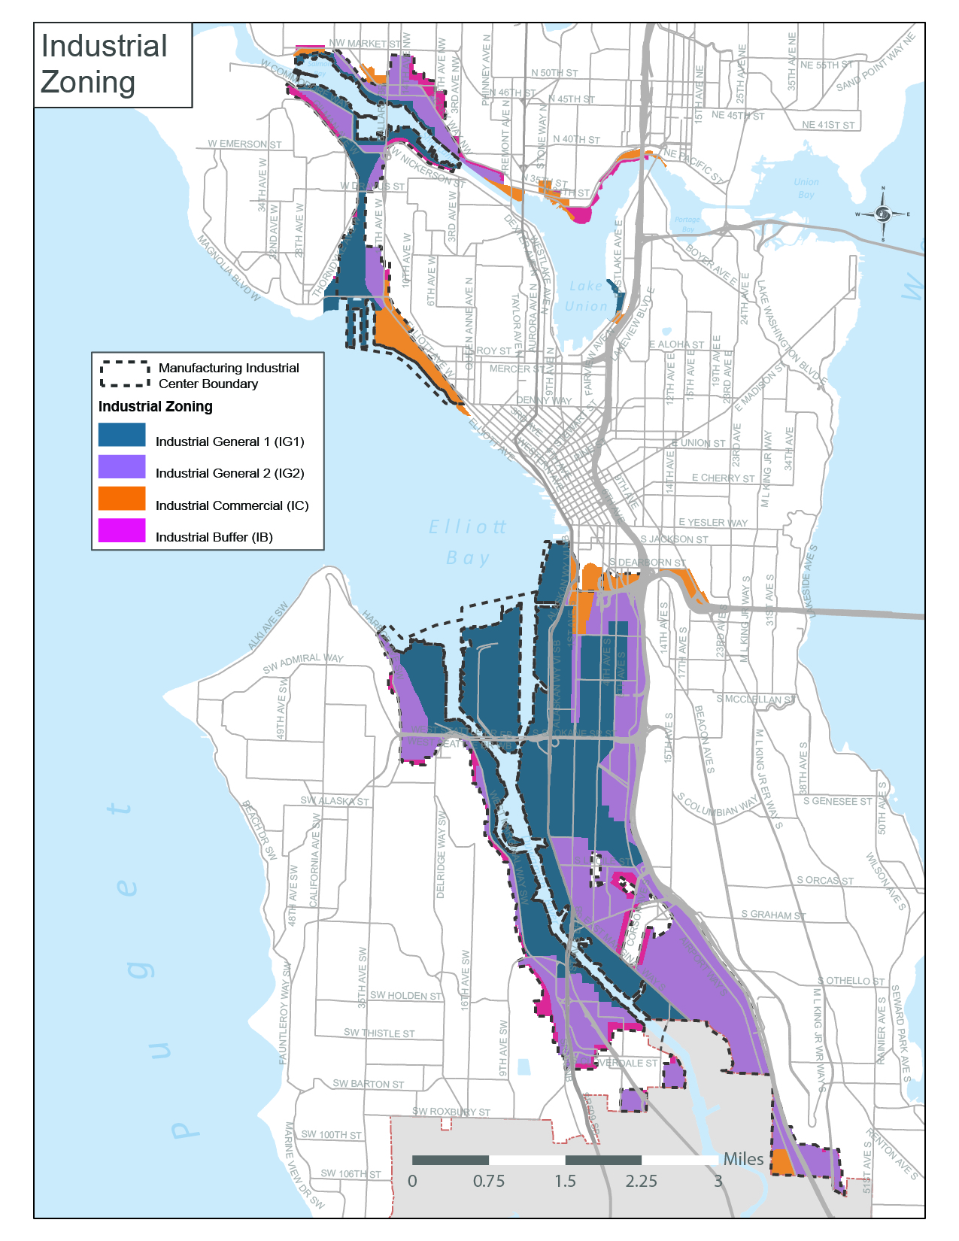
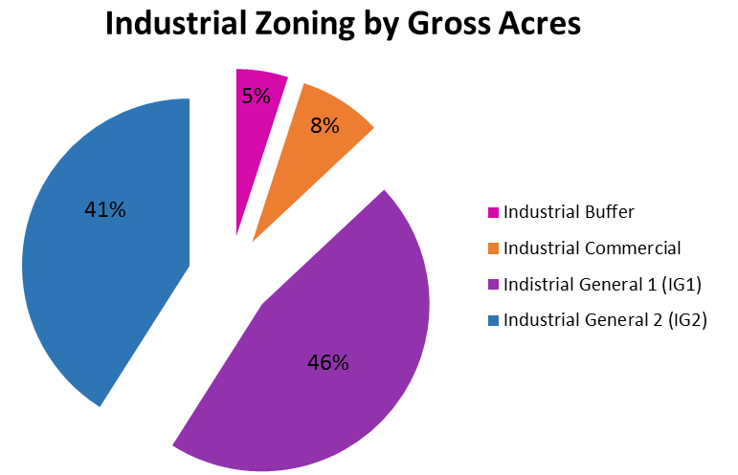
Industrial Zones

Slide 29
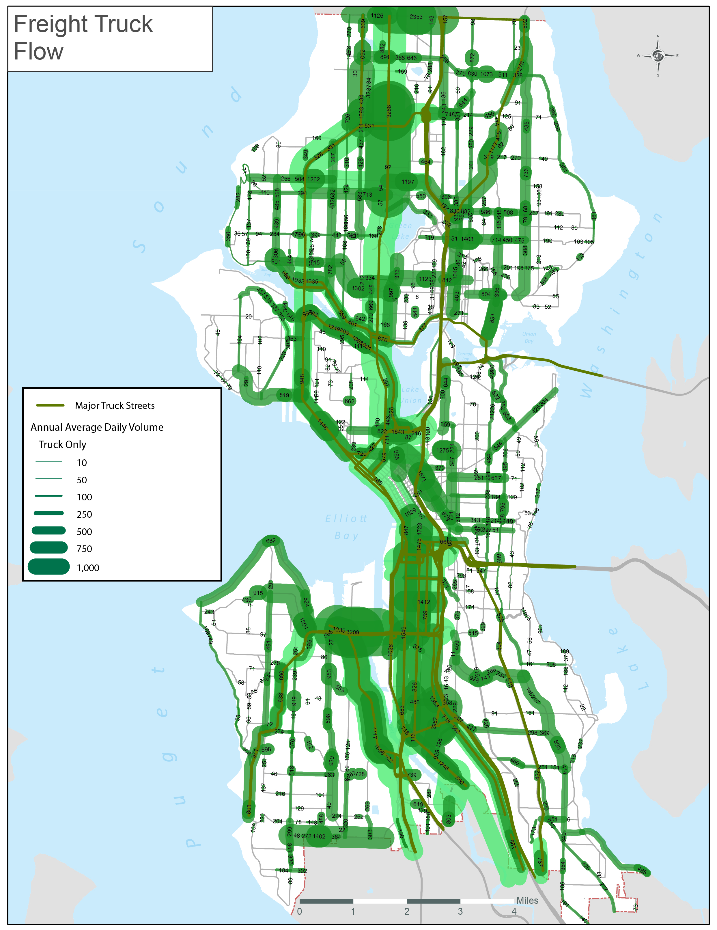
Truck Volumes
City of Seattle: 780 count locations
Washington State DOT facilities
Freight Access Project
King Country Metro

Slide 30
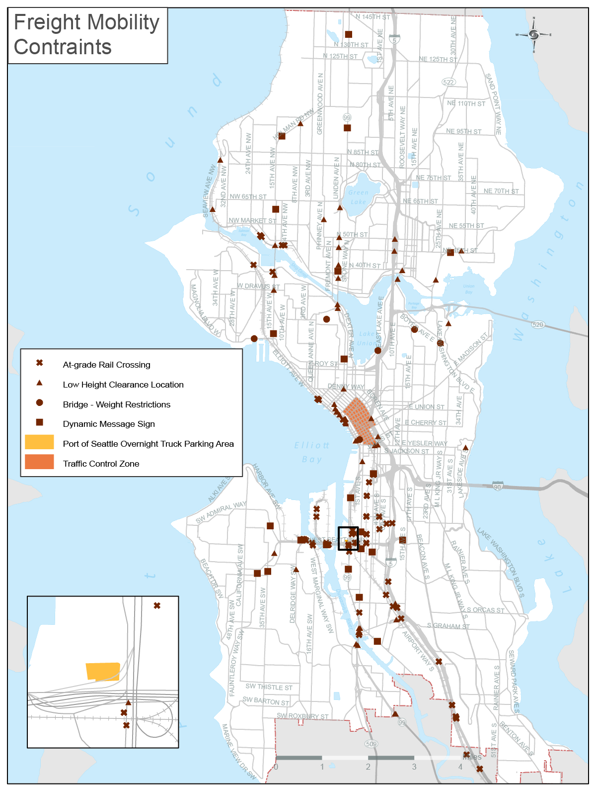
Mobility Constraints
At-grade rail crossings
Low height clearances
Weight restrictions
Dynamic messaging signs
Traffic Control Zone

Slide 31
Mobility Constraints
Total - 943

Slide 32
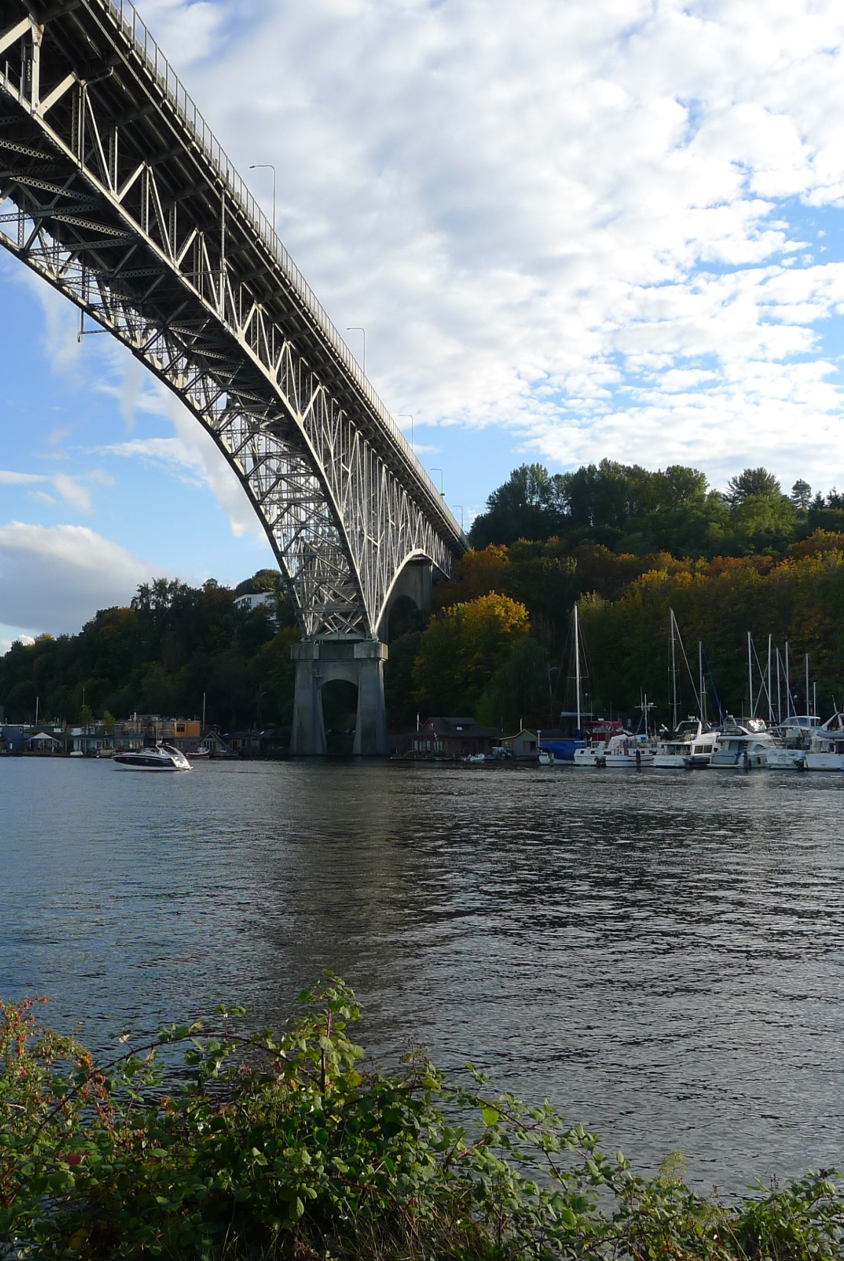
Role of the
Public Sector
Infrastructure management
Policy framework
Accomplishments
Climate adaptation and emergency preparedness

Slide 33
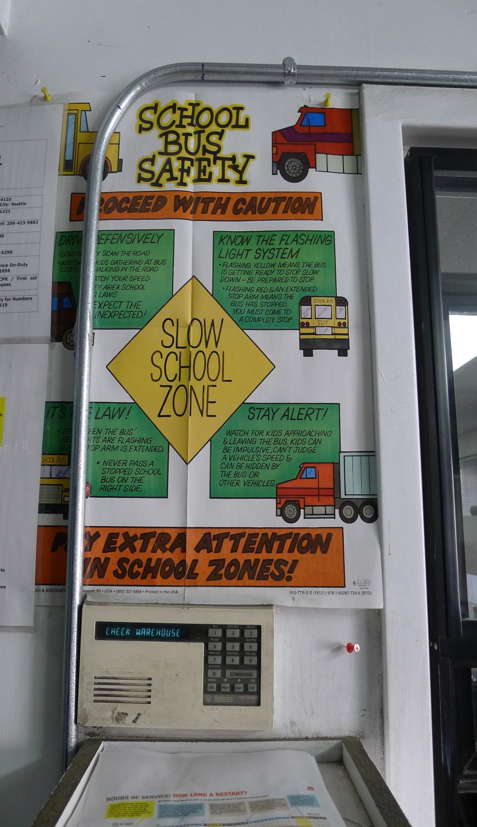
Accomplishments
Pages 56-57
Airport over Argo Bridge
rehabilitation
East Marginal bridge replacement
at S Horton St.
Ballard Bridge seismic retrofit
14th Ave S street improvements

Slide 34
Next steps
February 12 | Comments due from FMP Advisory Committee Members
February | Final draft Policy Framework
34

Slide 35





Questions?
Gabriela.Vega@seattle.gov | (206) 733-9029
Ian.Macek@seattle.gov | (206) 684-7576
http://www.seattle.gov/transportation/freight_fmp.htm
http://www.seattle.gov/transportation

