Slide 1
Understanding Multiyear Estimates from the American Community Survey
Notes:
1
The purpose of this presentation is to provide some background about the ACS multiyear estimates, in particular, when they should be used and how to interpret them.

Slide 2
Overview
What are multiyear estimates?
When should you use multiyear estimates?
What should you be aware of when using multiyear estimates?
How can you use multiyear estimates to make comparisons?
Example of using multiyear estimates
Notes:
This presentation will attempt to address the following basic questions:
What are the multiyear estimates?
When should you use them?
What do you need to be aware of when using them?
How can you use the multiyear estimates when making comparisons?
We’ll finish with an example that applies some of what we’ll learn from answering these questions.

Slide 3
What are multiyear estimates?

Slide 4
What is a Period Estimate?
Definition
An estimate that describes the average characteristics of an area over a specific time period
Period for ACS 1-year estimates is the calendar year
Different from a point-in-time estimate
Notes:
4
Before we talk about multiyear estimates, it’s important to understand the concept of a period estimate because all ACS estimates are period estimates.
The ACS produces period estimates of socioeconomic and housing characteristics. It is designed to provide estimates that describe the average characteristics of an area over a specific time period. In the case of ACS one-year estimates, the period is the calendar year. For example, the 2007 ACS data describe the population and housing characteristics of an area for the period January 1, 2007 through December 31, 2007, not for any specific day or month within the year.
A period estimate is different from a point-in-time estimate. A point-in-time estimate is designed to measure characteristics as of a certain date or narrow time period. For example, the purpose of the decennial census is to count the population living in the United States on a specific date, which is traditionally April 1. Although decennial census data are actually collected over several months, they are designed to provide a snapshot of the U.S. population as of April 1.

Slide 5
What is a Multiyear Estimate?
Definition
A period estimate that encompasses more than one calendar year
Period for ACS multiyear estimates is either 3 or 5 calendar years
Notes:
5
A multiyear estimate is simply a period estimate that encompasses more than one calendar year. In the case of ACS multiyear estimates, the period is either three or five calendar years.
While a one-year estimate includes information collected from independent monthly samples over a 12-month period, a three-year estimate represents data collected from independent samples over a 36-month period, and a five-year estimate includes data collected over a 60-month period. For example, the 2005-2007 ACS three-year estimates describe the population and housing characteristics of an area for the period January 1, 2005 through December 31, 2007. They do not describe any specific day, month, or year within that time period.

Slide 6
Population Thresholds for ACS Estimates
 | 1-year estimates | 3-year estimates | 5-year estimates
65,000 + people | X | X | X
20,000+ people |  | X | X
Less than 20,000 people |  |  | X
Notes:
The types of ACS estimates published for a particular area are based on established population thresholds.
Geographic areas with at least 65,000 people will receive one-year, three-year, and five-year ACS estimates.
Areas with 20,000 or more people will receive three-year and five-year estimates. There are a few exceptions to this rule, however. Zip code tabulation areas, census tracts, and block groups, regardless of their population size, will only receive five-year estimates.
Areas with less than 20,000 people, down to the block group level, will only receive five-year estimates.
6

Slide 7
How to Label Multiyear Estimates
ACS estimates based on data collected from 2005-2007 should not be labeled “2006” or “2007” estimates
Multiyear estimates do not represent any one year or the midpoint of a period
Correct labeling for multiyear estimate: “The child poverty rate for the 2005-2007 period was X percent.”
Notes:
7
Because multiyear estimates are period estimates, they must be labeled to indicate the full period of time that they reflect.
ACS estimates based on data collected from 2005 through 2007 should not be referred to as “2006” or “2007” estimates. Some might also be tempted to refer to a 2005-2007 estimate as a “2006 average.” However, ACS three-year estimates are not produced by averaging each of the three one-year estimates included in the time period, so that could be misleading.
Multiyear estimates do not represent any one year or the midpoint of a period; they represent the entire period over which the data were collected.
Therefore, multiyear estimates should be labeled to indicate the full period of time. For example, “The child poverty rate for the 2005-2007 period was X percent.”

Slide 8
Constructing Multiyear Estimates
Data are pooled across 36 or 60 months
Data are weighted to produce estimates
Estimates are controlled for age, sex, race, and Hispanic origin
Multiyear estimates are not an average of 1-year estimates
Notes:
Next we’ll discuss how multiyear estimates are constructed.
The methods used by the Census Bureau to produce multiyear estimates are generally the same as the methods for producing one-year estimates.
First, the ACS survey data are pooled together across 36 or 60 months.
After the data are pooled together, they are updated with the geographic boundaries of the last year of the period and then assigned the appropriate weights to produce population and housing estimates. Weights are adjusted using the population and housing totals derived from the Census Bureau’s Population Estimates Program.
Income and dollar valued data are then adjusted for inflation. We will discuss this more in a few minutes.
It is important to remember that the estimates are not calculated as a simple average of monthly or annual estimates.
Now that we’ve discussed what multiyear estimates are and how they are created, the next important topic is how data users should decide between using one-year or multiyear estimates.
8

Slide 9
When should I use multiyear estimates?
Notes:
Now that we have a better understanding of what multiyear estimates are, let’s discuss when multiyear estimates should be used.

Slide 10
Use Multiyear Estimates When …
No 1-year estimate is available
Margins of error for 1-year estimates are larger than required
Analyzing data for small population groups
Notes:
First, perhaps it is obvious, but multiyear estimates must be used when no one-year estimate is available. Unless a geographic area has a population greater than or equal to 65,000, that geography will rely on multiyear estimates.
Second, generally, use multiyear estimates when the margins of error for one-year estimates are larger than desired for your particular application.
Lastly, multiyear estimates should also be used when analyzing data for small population groups due to the higher margins of error associated with them. An example of a small population group could be “Families with Female Householder with own Children under 18”.
For some applications, however, the margin of error of the estimate is only one part of what to consider when choosing between one-year and multiyear estimates. We’ll see this on the next slide.
10

Slide 11
Currency vs. Reliability
Currency | Reliability
1-year estimates provide information based on the last year | Larger sample sizes produce estimates that are more statistically reliable
3-year estimates provide information based on the last year and the 2 years before that | 3-year estimates are based on 3 times as many sample cases as 1-year estimates
5-year estimates provide information based on the last year and the 4 years before that | 5-year estimates are based on 5 times as many sample cases as 1-year estimates
Notes:
Another important consideration when deciding between estimates is the trade-off between currency and reliability.
First I’ll mention that the decision is more complicated than just choosing between using the one-year or the multiyear estimates, because for many areas there will also be the choice of which multiyear estimate to use, three- or five-year.
For larger areas, each annual release will provide one-year, three-year, and five-year estimates. For example, in 2010, there will be three sets of commuting data for San Diego County – one-year estimates for 2009, three-year estimates reflecting 2007-2009, and five-year estimates for the period of 2005-2009. Users need to decide which is the most appropriate for their needs.
In making this choice, you need to consider the tradeoff between currency and reliability. The one-year estimates for an area reflect the most current data but they tend to have higher margins of error than the three- and five-year estimates because they are based on a smaller sample.
The three-year and five-year estimates for an area have larger samples and smaller margins of error than the one-year estimates. However, they are less current because the larger samples include data which were collected in earlier years. The main advantage of using multiyear estimates is the increased statistical reliability for smaller geographic areas and small population groups.
There are no hard-and-fast rules on choosing between one-, three-, and five-year data, but the margins of error provided with ACS data can help data users decide on the tradeoff between currency and reliability.
11

Slide 12
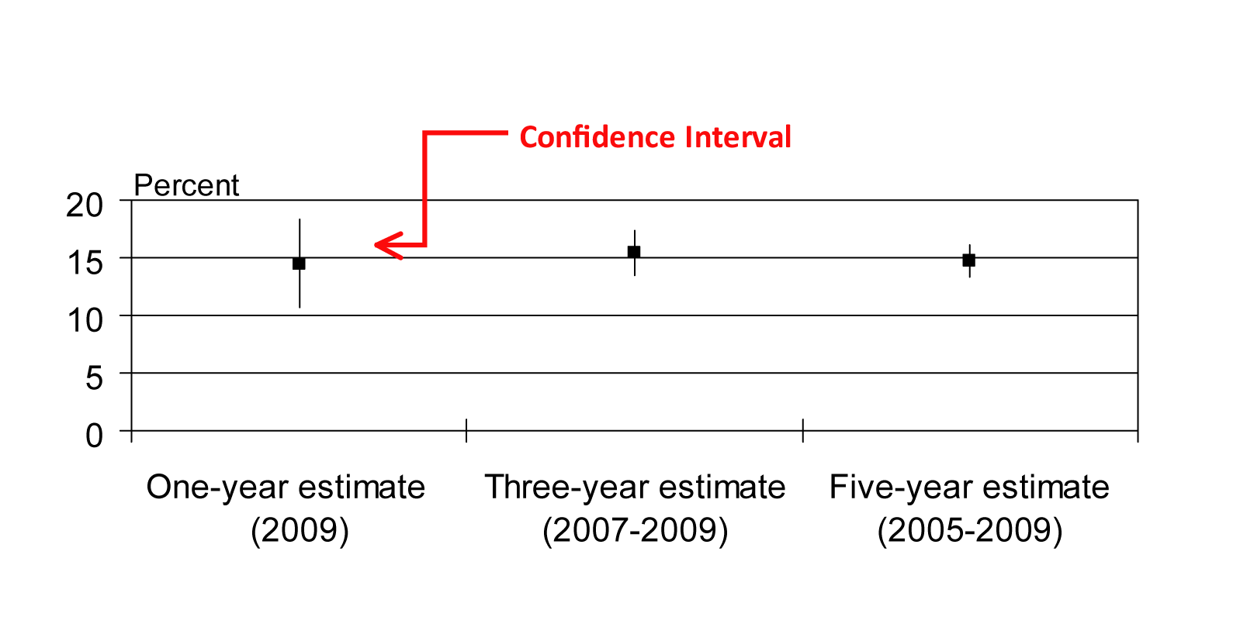
Reliability
Note: Fictional data
Notes:
12
With this slide we illustrate the relative reliability of one-, three-, and five-year estimates.
It presents a scenario where a data user is faced with making a choice between estimates published in the same year. The graph shows the greater reliability of multiyear estimates compared to the single-year estimate. The lines above and below the point estimates represent the confidence intervals around each estimate.
In this graph, the confidence interval for the one-year estimate ranges from 10.7 to 18.3 percent.
The level of reliability improves dramatically with the three-year and five-year estimates as shown by the shorter lines around those estimates.

Slide 13
What should I be aware of when using multiyear estimates?
Notes:
Before we go any further, it is important to discuss some issues that affect ACS estimates in general.

Slide 14
Inflation Adjustment
Dollar-valued data items are inflation adjusted to the most recent year for the period
Income, rent, home value, and energy costs
Adjusted using inflation factors based on the Consumer Price Index (CPI)
Adjustment designed to put the data into dollars with equal purchasing power
Notes:
14
We’ll start with the inflation adjustment.
Estimates of income, rent, home values, and energy costs are referred to as “dollar-valued” or “dollar-denominated” and need to be adjusted for inflation.
The Census Bureau adjusts dollar-valued multiyear estimates to the most recent year using inflation factors based on the Consumer Price Index or CPI. A similar adjustment is also done for individual months within a one-year estimate.
The inflation adjustment is designed to put the collected data into dollars of equal value. It does not adjust for trends in any particular variable.
For example, in a situation involving comparing rent values over time, the adjustment does not consider either inflation in the rental market or trends in rents that might arise from increases in the size and quality of rental units or other factors. It simply uses the overall inflation adjustment to create estimates where dollar values collected in earlier years have the same purchasing power as dollar values collected in the last year of the period.

Slide 15
Geographic Boundaries
Multiyear estimates are based on geographic boundaries as of January 1 of the last year in the multiyear period
Boundary Annexation Survey collects boundary changes
Boundaries of other statistical areas will be updated every decade in conjunction with the decennial census
Notes:
15
Another important consideration when using multiyear estimates are geographic boundaries.
The Census Bureau needs to account for geographic boundary changes that may occur for areas published in the multiyear estimates.
The Census Bureau uses the boundaries as of January 1 of the last year of the period to produce the multiyear estimates. These boundary changes are collected through the Boundary and Annexation Survey, a voluntary survey conducted by the Census Bureau.
Boundaries of other statistical areas, including urbanized areas, Public Use Microdata Areas, census tracts, and block groups will be updated every decade in conjunction with the decennial census.
More information on geographic boundaries can be found in the ACS Compass Products presentation entitled “Geographic Areas and Concepts for the American Community Survey.”

Slide 16
Geographic Boundaries Amarillo city, Texas
Notes:
Let’s look at an example of how boundary changes are handled for multiyear estimates.
In 2008, the Census Bureau tabulated one-year estimates for 2007 and three-year estimates based on data from 2005, 2006, and 2007. These estimates were tabulated using the boundaries that were in effect on January 1, 2007.
Looking at this slide, the area outlined in blue shows the boundaries for Amarillo City, Texas that were in effect on January 1, 2007. The estimates published in 2008 will reflect these 2007 boundaries.
However, Amarillo City annexed some territory in both 2005 and 2006, as shown by the orange and red portions of the map. The 2005 and 2006 one-year estimates were published using the 2005 and 2006 boundaries. The 2007 and the 2005-2007 three-year estimates will both be published using the 2007 boundaries.
We also note that the ACS will not update the 2005 and 2006 one-year estimates with the January 1, 2007 boundaries.

Slide 17
Population Controls
Estimates of housing units and people are controlled to the population estimates derived from the Population Estimates Program
Multiyear estimates are controlled to the average of the individual year’s estimates for the period
Notes:
17
Another factor to consider are population controls.
As discussed in the presentation entitled “An Overview of the American Community Survey,” the Census Bureau uses population controls because the ACS is designed to measure the characteristics of the population, not counts of the population. The official estimates of the population still come from the previous census and from the Census Bureau’s Population Estimates Program.
For one-year ACS estimates, population and total housing unit estimates are controlled to equal population and housing counts as of July 1 of the tabulated year.
Since multiyear estimates represent estimates for more than one year, they are controlled to equal an average of the individual years’ estimates over the period. Data users should not expect the ACS demographic estimates to match any individual year’s population estimate within the time period.

Slide 18
How can I use multiyear estimates to make comparisons?
Notes:
Next I’ll talk about how to use multiyear estimates to make comparisons.

Slide 19
Comparing Across Geographies
Only compare the same type of estimate
1-year estimates to other 1-year estimates
3-year estimates to other 3-year estimates
5-year estimates to other 5-year estimates
Same time period
Notes:
19
We’ll start with making comparisons across geographies.
A challenge for data users is how to compare geographic areas with different population sizes.
Comparisons across different geographies should be made with estimates of comparable period length and of the same time period. For example, to make comparisons of educational attainment across several geographies use the same period for each geography, such as 2005-2007.
Users shouldn’t compare one-year estimates with multiyear estimates. Likewise, they shouldn’t compare three-year estimates to five-year estimates. For example, you should not compare the 2005-2007 estimate of educational attainment for an area to the 2007 estimate of educational attainment for another area.

Slide 20
Counties in Kentucky, by Population Size
Source: U.S. Census Bureau, American Community Survey Handbook for General Audiences.
Notes:
20
Let’s use Kentucky as an example. This map shows the population sizes for the counties in Kentucky based on the Census Bureau’s 2007 population estimates. As discussed in the presentation titled “An Overview of the American Community Survey,” population sizes such as these are used to determine which ACS estimate is published for each type of estimate.
There are 12 large counties, shaded in dark blue, that are receiving one year ACS data every year, starting in 2005. These 12 counties also receive three-year estimates starting in December 2008 and five-year estimates starting in 2010. There are also 43 counties that receive three-year estimates starting in December 2008, which are shaded in a lighter blue, and five-year estimates starting in 2010. Lastly, there are 65 counties that receive five-year estimates starting in 2010, which are lightly shaded.
Suppose a user in Kentucky wants to compare three counties: Fulton County, which is a small county in the southwest corner of the state; Franklin County, home to the state capital; and Fayette County, home to the city of Lexington. These counties vary widely in their population sizes.

Slide 21
Comparing Data in 2010
 | 2009 | 2007-2009 | 2005-2009
Fayette County | X | X | X
Franklin County |  | X | X
Fulton County |  |  | X
Notes:
21
This slide shows which estimates are published for each of the three counties of interest.
The ACS publishes annual estimates for Fayette County and three-year estimates for Franklin County. However, only five-year estimates will be available for Fulton County.
Therefore, in 2010, when five-year estimates for smaller geographic areas become available, the data user should compare 2005-2009 estimates for Fulton with 2005-2009 estimates for Fayette and the 2005-2009 estimates for Franklin. This is despite the fact that more recent, one-year data are available for Fayette. In the meantime, this user can compare Franklin County to Fayette County, as both will receive three-year estimates in 2008.
To summarize, when making comparisons across geographic areas do not cross-compare one-year, three-year, and five-year estimates.

Slide 22
Comparing Across Time Periods
Same geographic area
Use caution if geographic boundaries have changed over time
Easier to compare non-overlapping periods
Make comparisons using the same length time period
Notes:
Next we’ll discuss making comparisons across time periods in the same geography.
Data users should be cautious when looking at changes for a geographic area over time. They should be aware that boundary changes may have occurred, as we’ve just discussed with the Amarillo, Texas example.
An important point: it is easier to compare non-overlapping time periods. They are easier to interpret and it’s easier to perform statistical testing on them. Now we’ll discuss the comparison of non-overlapping time periods in more detail.

Slide 23
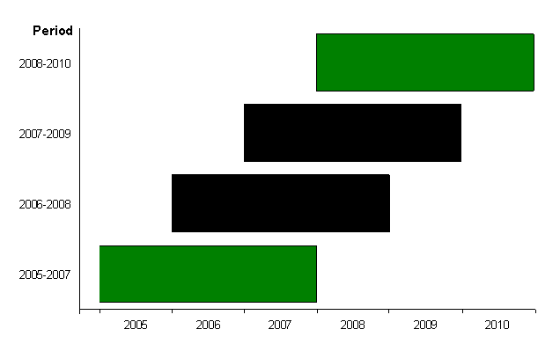
Overlapping Periods
Notes:
This slide shows the overlapping periods for the three-year estimates from 2005 through 2010.
When comparing estimates from two multiyear periods, it is easier to make comparisons between non-overlapping periods. This is because the difference between two estimates of overlapping periods is driven by the non-overlapping years. To illustrate what we mean, consider the 2005-2007 and the 2007-2009 period estimates. Both contain the year 2007. Thus, the difference between the 2005-2007 and 2007-2009 estimates is determined by the difference between the 2005 and 2006 estimates versus the 2008 and 2009 estimates.
In this example, the simplest comparison is between the 2005-2007 estimate and the 2008-2010 estimate, which do not include any overlapping years. Statistical testing is straightforward for nonoverlapping periods. You can use the formulas discussed in the presentation titled “Things that May Affect Estimates from the American Community Survey.”
You can make comparisons using overlapping periods, however it is more difficult and the statistical testing is more complicated.

Slide 24
Comparing ACS Data with Census 2000
Global differences exist between ACS and Census 2000
Comparisons can be made for most population and housing subjects
http://www.census.gov/acs/www/UseData/compACS.htm
Notes:
The last comparisons we’ll talk about are those between ACS data and the Census 2000.
There are global differences that exist between the ACS and Census 2000. These include differences in residence rules, universes, and reference periods. For example, the ACS uses a "two-month" residence rule - defined as anyone living for more than two months in the sample unit when the unit is interviewed. On the other hand, Census 2000 used a "usual residence" rule - defined as the place where a person lives or stays most of the time.
The reference periods for the ACS and Census 2000 also differ. For example, the ACS asks respondents to report their income for the 12 months preceding the interview date, while Census 2000 asked for a respondent’s income in calendar year 1999.
Also, as we discussed earlier, the ACS produces period estimates whereas Census 2000 data are interpreted to be a snapshot of April 1, 2000.
The Census Bureau subject matter specialists have considered these differences and have determined that for most population and housing subjects, comparisons can be made. Further information about comparing measures from the ACS and Census 2000 can be found at the website shown on the slide.

Slide 25
Example of using multiyear estimates
Notes:
Now we’ll give an example of using multiyear estimates.

Slide 26
Tracking Social Change
7 school districts in the county of Centerville, USA
Question to be answered:
Has there been a change in the population with a high school diploma in these school districts?
Notes:
26
This is an example of tracking social change in a hypothetical county called Centerville. It walks you through some of the issues in working with multiyear estimates. The data used in this example come from research data produced by the Census Bureau.
Suppose community leaders in 7 of the 10 school districts that comprise the county of Centerville are interested in measuring change in the population with a high school diploma. They have anecdotal evidence that the number of people with a high school diploma has increased. But they want to use the ACS to see if this is actually the case.

Slide 27
Determining Which Data To Use
Since the data must be “current,” decennial census long form data for 1990 and 2000 are not adequate
A data analyst turns to the ACS data for a look at trends since 2000
Only data available are three-year ACS estimates for 7 school districts
Notes:
27
The question is, which data do they use?
The community leaders want the data to be “current.” Therefore decennial census long form data from 1990 or 2000 are not useful for this analysis.
Instead, the community leaders hire a data analyst to use the ACS to investigate trends since 2000.
Since the population in each of these school districts is over 20,000, the data analyst can choose between three-year and five-year data. However, because currency is very important to them they choose to use the three-year data.

Slide 28
Centerville County, USA
A
B
D
C
E
F
G
Notes:
28
This map shows the collection of school districts that make up the hypothetical county of Centerville. The seven school districts in the study are shaded tan and are labeled A through G.

Slide 29
3-Year Estimates Available for the School Districts, 1999-2005
Notes:
29
This chart shows the periods for the available estimates.
As shown in the chart, the five three-year estimates available for the 7 school districts are: 1999-2001, 2000-2002, 2001-2003, 2002-2004, and 2003-2005.

Slide 30
Choosing the Estimates
These estimates allow for ten comparisons:
1999-2001 vs. 2000-2002
1999-2001 vs. 2001-2003
1999-2001 vs. 2002-2004
1999-2001 vs. 2003-2005
2000-2002 vs. 2001-2003
2000-2002 vs. 2002-2004
2000-2002 vs. 2003-2005
2001-2003 vs. 2002-2004
2001-2003 vs. 2003-2005
2002-2004 vs. 2003-2005
Notes:
30
Next, one must decide which estimates to use in making the comparison.
This slide shows the ten separate comparisons that can be made.
The data analyst has to decide which comparison best establishes whether there has been an increase in residents with a high school diploma.

Slide 31
Determining Which Estimates to Use
Notes:
31
This chart shows the overlapping and non-overlapping years in the five sets of three-year estimates. The best comparisons between three-year estimates are for periods that do not overlap.
For this example, the 1999–2001 and 2002-2004 estimates, both in red, do not overlap. Therefore these estimates would make a good choice to compare.
The 2000-2002 and 2003-2005 estimates, in purple, also do not overlap and make a good choice to compare.
The data analyst chooses to compare estimates from 2000-2002 and 2003-2005 since this will be the most current data available. The analyst will use the formal test of statistical significance covered in the presentation titled “Things that May Affect Estimates from the American Community Survey.”

Slide 32
Summary: What Have We Learned?
Multiyear estimates are period estimates
Multiyear estimates should be interpreted and labeled as period estimates
Data users should consider the tradeoffs of currency versus reliability
Notes:
32
Let’s summarize what we’ve learned.
Multiyear estimates are period estimates and should not be interpreted as estimates for any particular year in the period.
When you refer to multiyear estimates, the labels for multiyear estimates should reflect the entire period that they cover.
Data users must consider the tradeoffs between using the one-year estimates, which are more current, versus multiyear estimates, which are more reliable.

Slide 33
Summary: What Have We Learned?
Comparisons between estimates of different geographies should be based on ACS data from the same time periods
It is easier to compare estimates from non-overlapping periods
Notes:
33
Make comparisons between estimates of different geographies based on ACS data from the same time periods.
It is easier to compare estimates from non-overlapping time periods because they are more straightforward to interpret and it’s easier to perform statistical testing on them.

Slide 34
For more information
Subscribe to “ACS Alert”
http://www.census.gov/acs/www/Special/Alerts.htm
Visit the ACS/PRCS website:
http://www.census.gov/acs/www
Contact by telephone:
1-800-923-8282
Contact by email:
acso.users.support@census.gov
34
34
Notes:
This presentation gave you information on the definition, use, and interpretation of multiyear estimates from the American Community Survey.
The American Community Survey staff has developed the ACS Alert, which is an e-mail newsletter giving data users the latest news about the survey. You can subscribe to the newsletter by contacting the American Community Survey staff on the Internet at: http://www.census.gov/acs/www/Special/Alerts.htm. You can also read past editions of the “ACS Alert” at this site.
Please feel free to contact the Census Bureau if you have questions or need further information. If you have questions that are not answered by the Web site, please call 1-800-923-8282 or email acso.users.support@census.gov.

