Slide 1
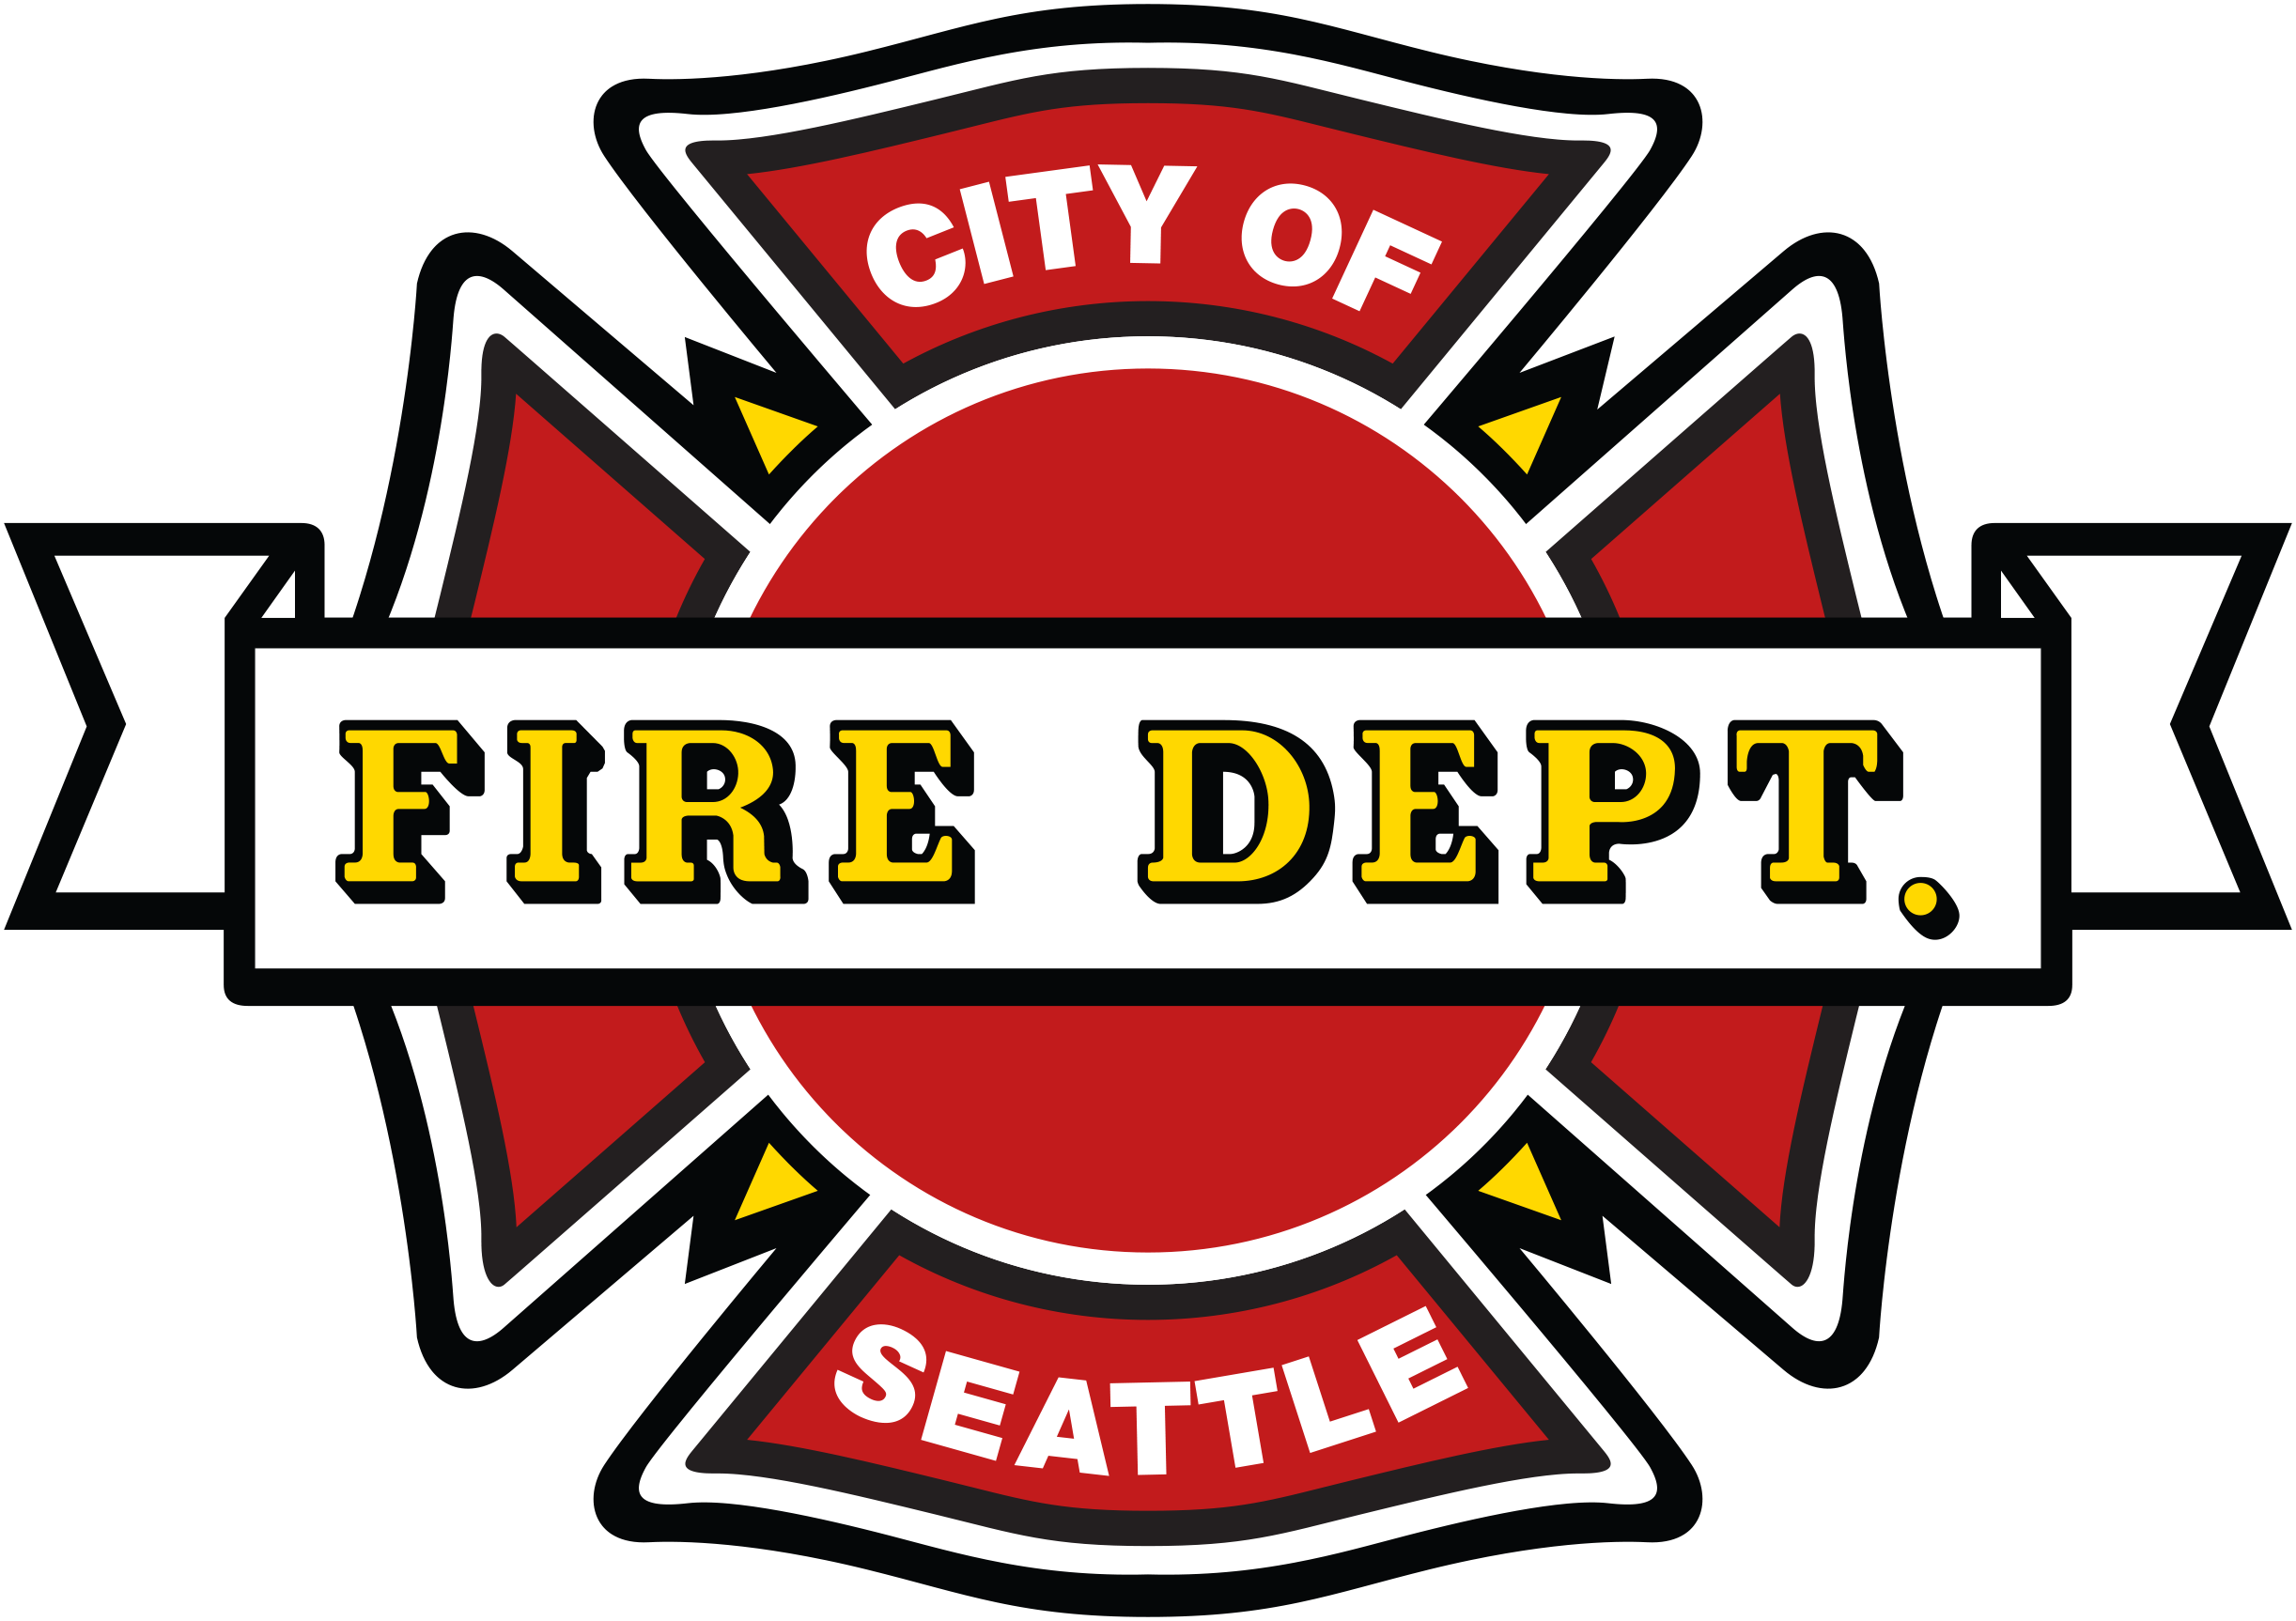
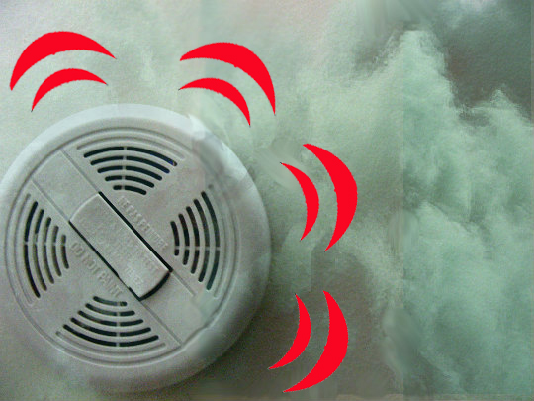
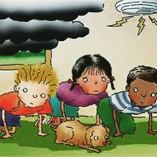
Smoke Alarms: Don’t be without them!
Notes:
Does everyone recognize what is in these pictures? (smoke alarms) Having a smoke alarm that works is one of the most important safety items to have in your home. Why do you think smoke alarms are so important? (Smoke alarms alert you that there is a fire in your home) What is their job? (To recognize there is smoke and make a loud beeping noise to alert you to a fire in your home)
Did you know that a home with smoke alarms reduces your chance of dying in a fire in half?
If the smoke alarms sounded in your home, would you know what to do? Do you see the smoke in this picture? The smoke is high, so we go low under the smoke. Having a family home fire escape plan will help everyone in your family know what to do and where to go if the smoke alarm sounds!

Slide 2
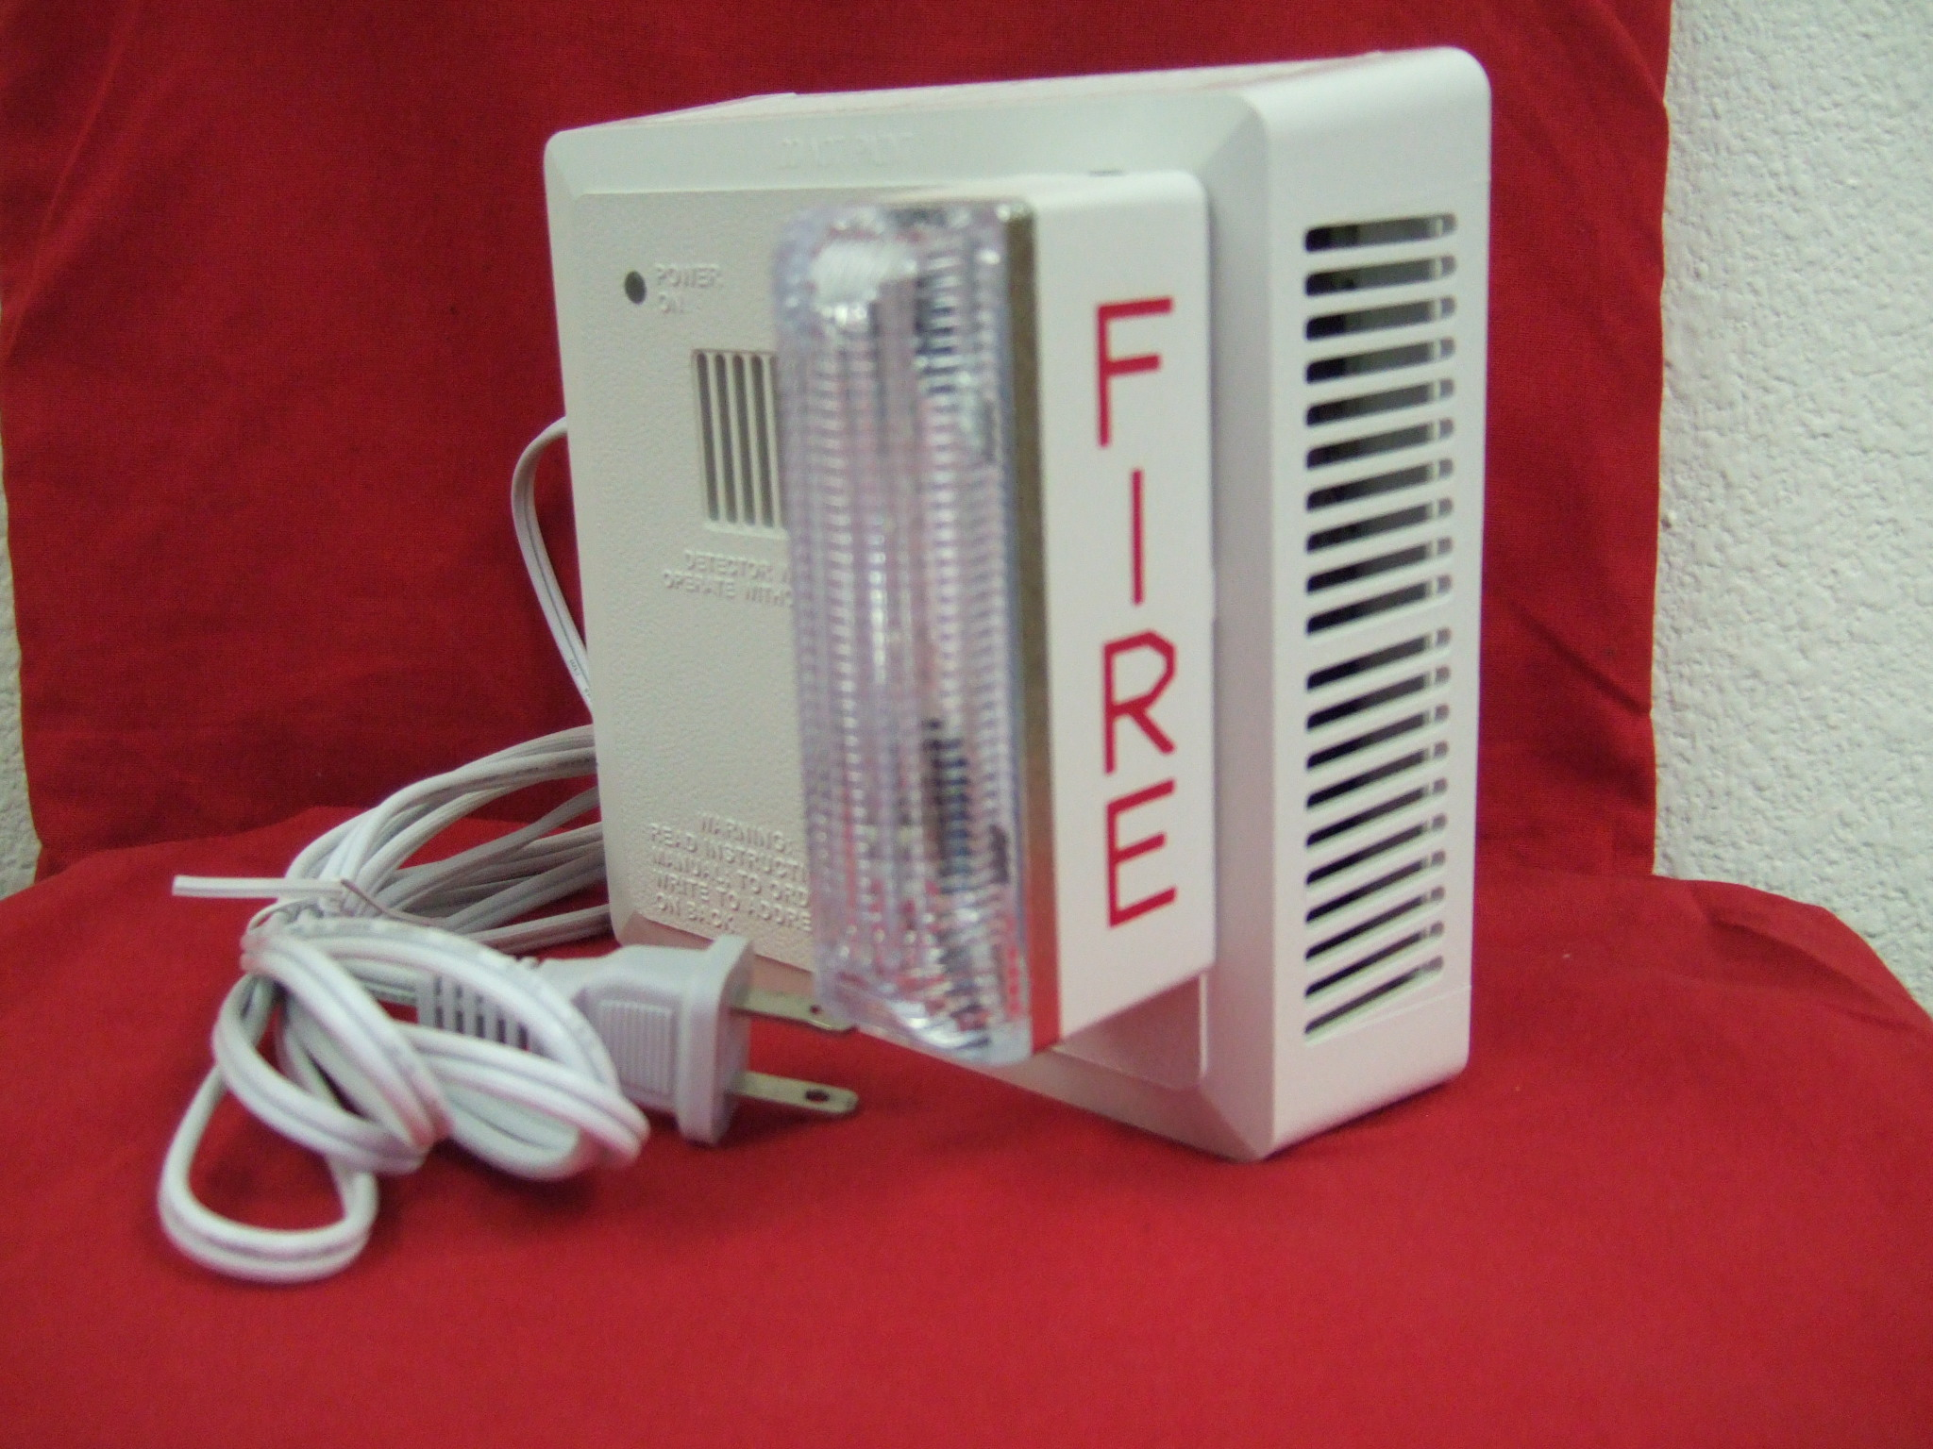
Strobe Smoke Alarm
Notes:
Did you know there are special smoke alarms for people who are deaf or hard-of-hearing? A very bright light flashes to alert someone to a fire in their home.

Slide 3
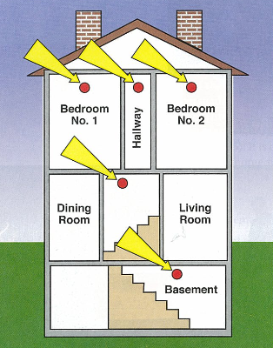
Where to have smoke alarms in your home.
Notes:
Smoke alarms should be placed on every level of your home, outside each sleeping area and inside each bedroom. The kitchen and bathrooms are not good places for smoke alarms. Why? Because steam from a shower can cause the smoke alarm to sound in a bathroom and smoke from a toaster or cooking on top of the stove can set off the smoke alarm.
Do you have a smoke alarm in your bedroom? Why do you think this is one of the most important places to have a smoke alarm. (To wake you up at night when you are sleeping)

Slide 4
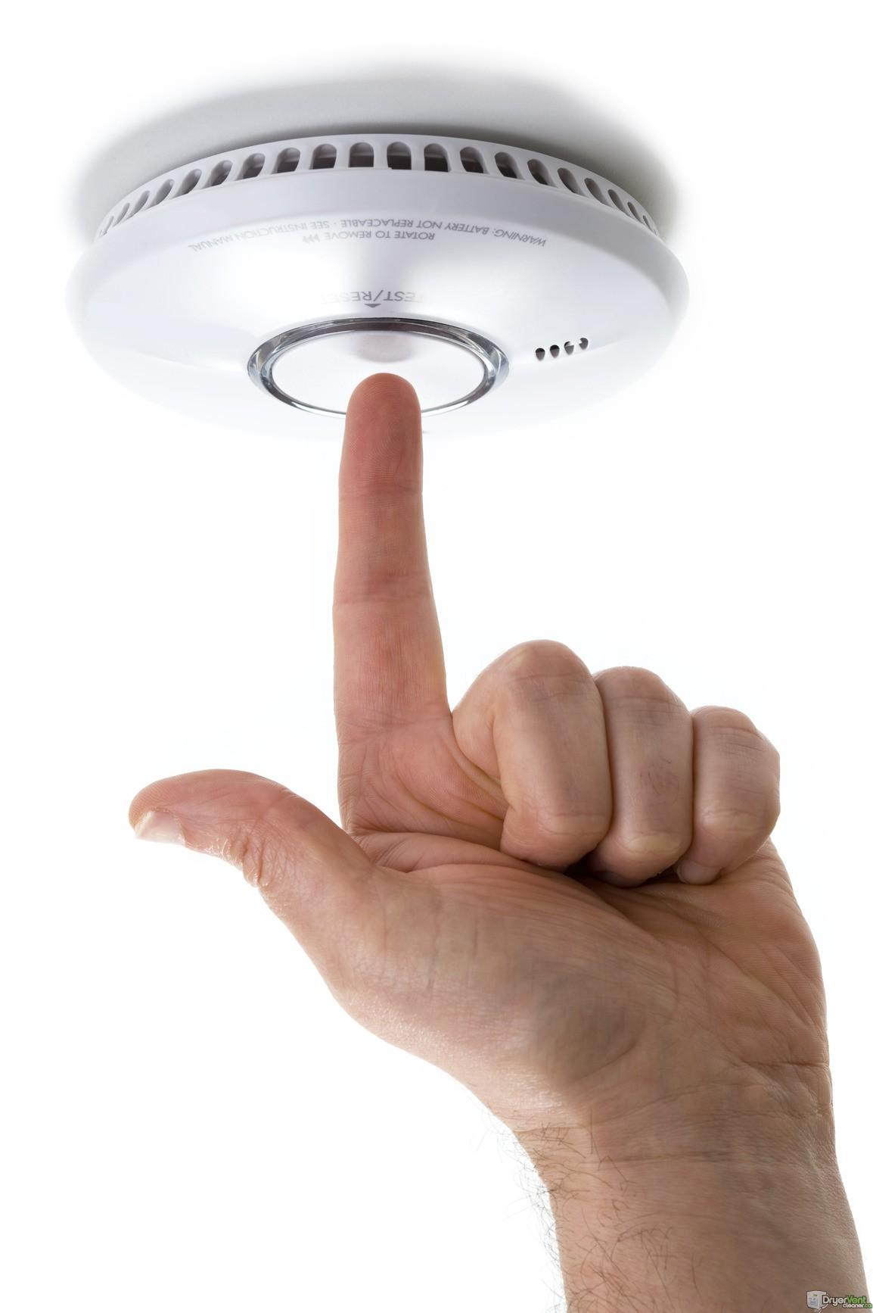
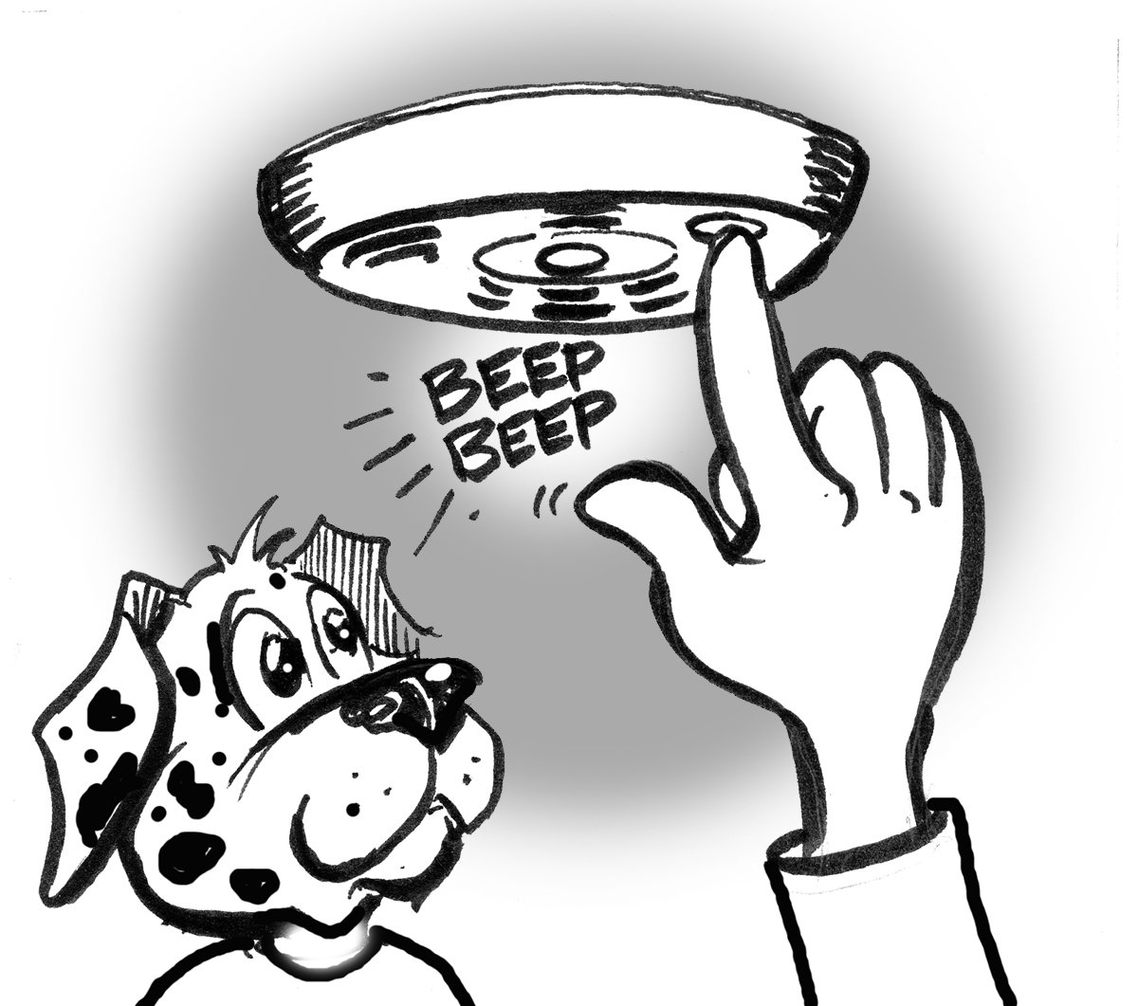
Test your smoke alarm every month!
Notes:
Smoke alarms need batteries that work! Do you know what the pictures are showing? Test your smoke alarms every month by pushing the test button to be sure it is working. Replace batteries once a year or replace the entire smoke alarm every 10 years. Add link to a video.

Slide 5
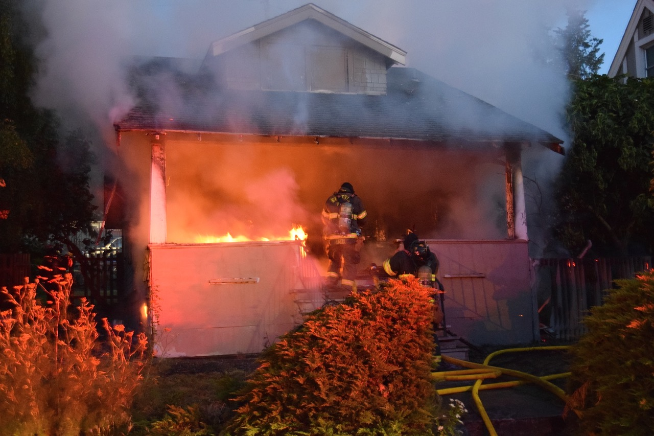
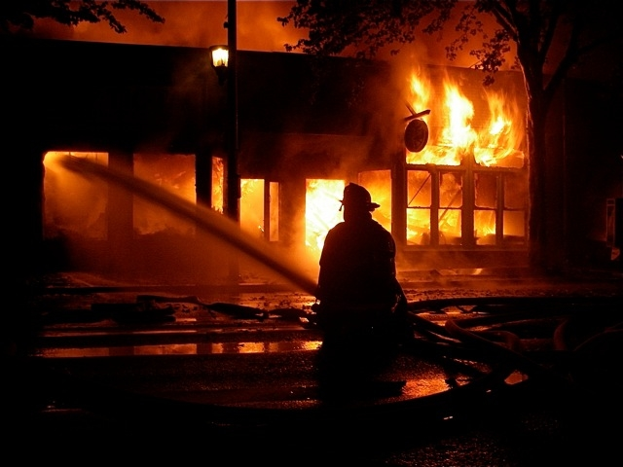
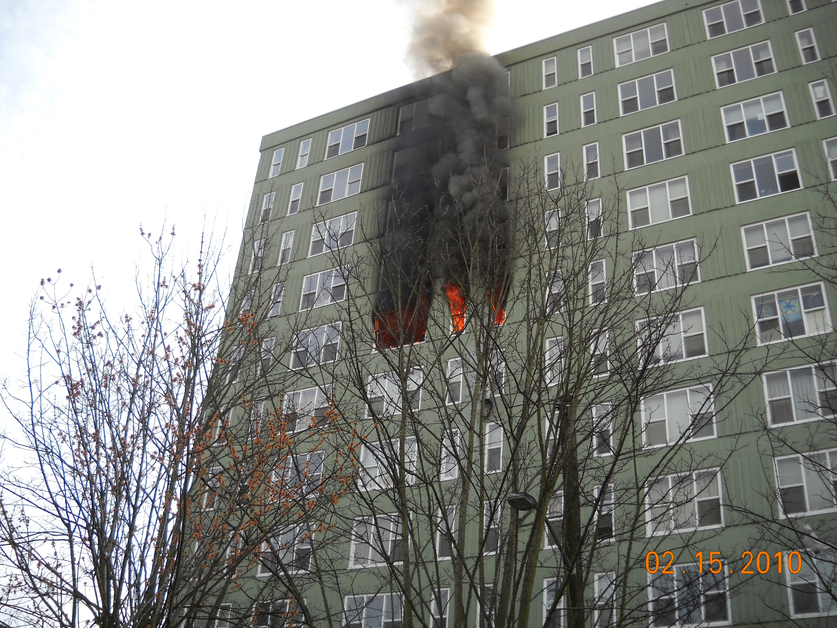
What does a home fire look like?
Notes:
To fully understand why smoke alarms are so important, we first need to understand what fire is really like…. Not how they are often shown in movies and on TV. Here are some photos of fires that happened in Seattle. How would you describe fire when looking at these photos? Fire is HOT, DARK, FAST and SMOKEY.

Slide 6
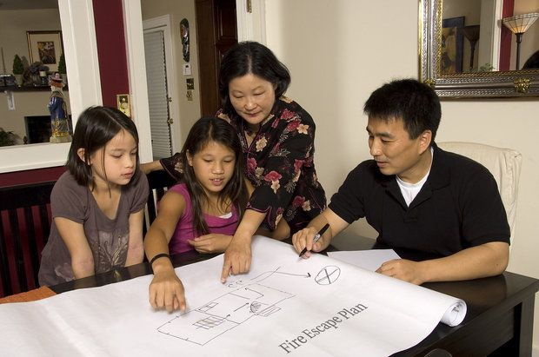
Have a plan and practice it!
Notes:
Just like firefighters practice putting out fires, it is important for us to practice getting out of our homes safely if there is a fire! Many people are very disoriented, even in their own home when there is a fire because of the smoke. You may need to crawl under smoke and you may not be able to see very well, especially at night, so practicing makes sure that you know exactly where to go. Firefighters call this muscle memory… your body knows exactly what to do in an emergency if you practice.
By making a plan, you will know two ways out of your house and two ways out of every room. You might need to go out a window to escape a fire.

Slide 7
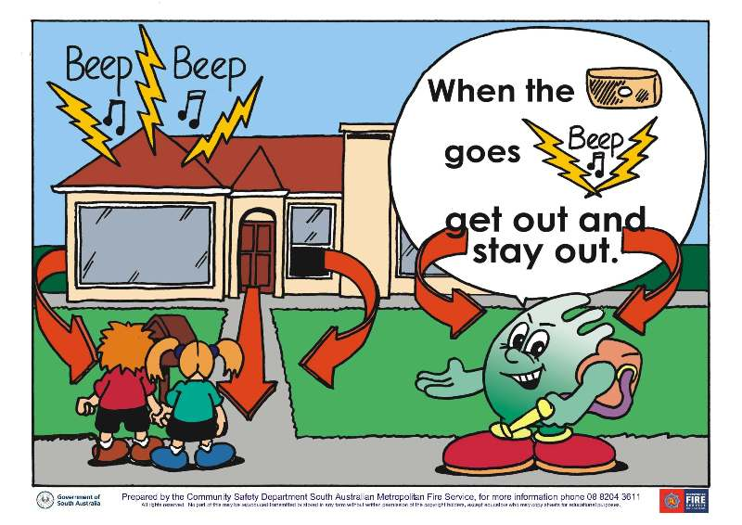
Know two ways out of every room.
Notes:
Making sure you have two ways out is very important. One way may be a window…can you find the window escape route in the picture?
If your bedroom is on the second floor, be sure you have an escape ladder or roof you can jump down from to help you get out.

Slide 8
Practice your home fire safety plan!
Notes:
Let’s say you are sleeping and the smoke alarm sounds. What will you do?
Roll out of bed, get low and crawl under smoke, get outside quickly, go to your outside meeting place and call 911. Do not go back inside once you are out safely. A firefighter will let you know once it is safe.
Be able to tell the 911 dispatcher the nature of your emergency (fire in this case) and give them your home address, so make sure you know your address.

Slide 9
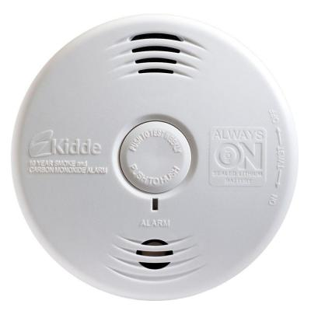
Seattle Fire Department free smoke/Carbon Monoxide (CO) alarms
Smoke Alarm - 3 beeps and a pause
CO Alarm - 4 beeps and a pause
Notes:
What if my family doesn’t have smoke alarms in all the places they should be, particularly in a bedroom? Your parents can ask for a free smoke alarm by calling us! We will give you a free smoke alarm flyer to take home.
The best part of our smoke alarms is that they are actually combination alarms, which means they will beep if there is smoke OR carbon monoxide (CO for short) in your home. Carbon monoxide is a gas that you can’t smell, see or taste that is poisonous. If your furnace or fireplace isn’t working properly, too much of this gas can escape into your home…it doesn’t happen very often, but if it does, you will be alerted! What to do if it beeps? Get out quickly just like you would if the smoke alarm sounded.
Link to video with the difference in the beeps.

